Slide 1
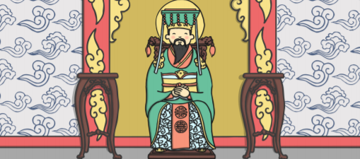
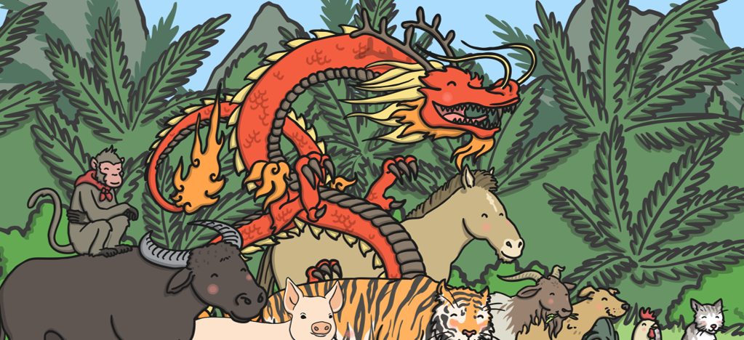
Finish the sentences after the conjunction.
1. The Jade Emperor decided to have a race because
___________________________________________
___________________________________________
___________________________________________
2. The animals lined up at the river but
___________________________________________
___________________________________________
___________________________________________

Slide 2
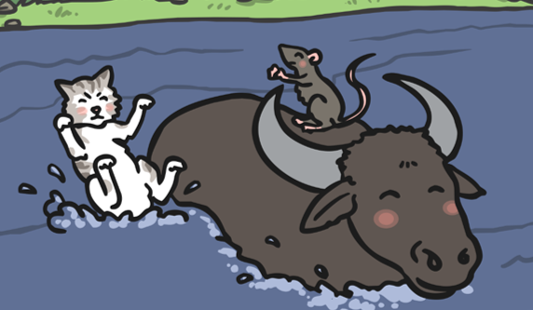
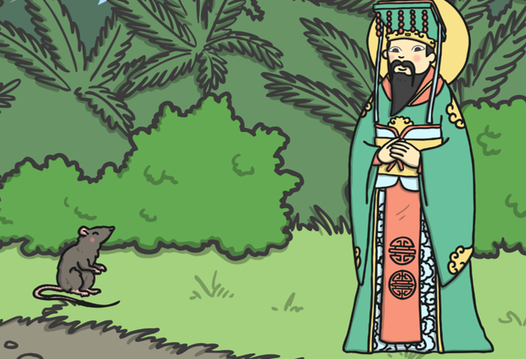
3. The ox was almost at the other side of the river when
___________________________________________
___________________________________________
___________________________________________
4. “Well done Rat” said The Emperor. “You are first so
___________________________________________
___________________________________________
___________________________________________

Slide 3
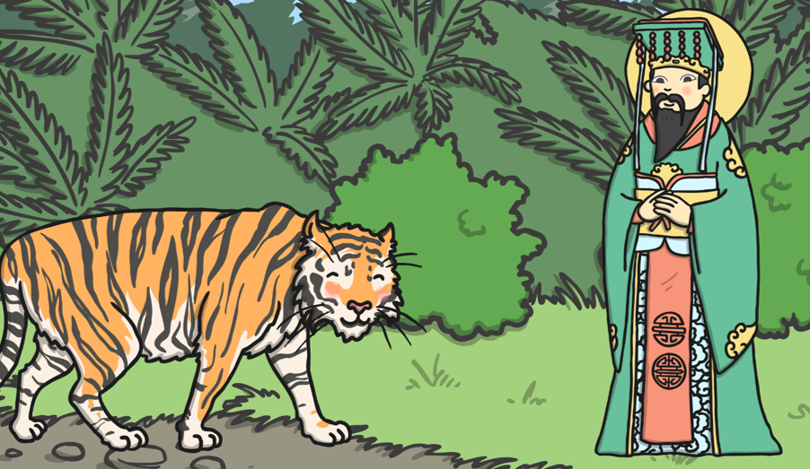
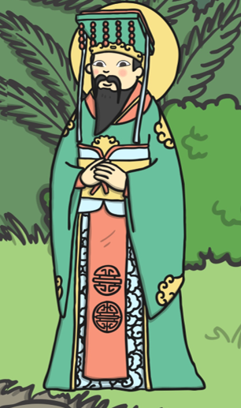
5. The tiger was next then
___________________________________________
___________________________________________
___________________________________________
6. The rest of the animals came onto the river bank so
___________________________________________
___________________________________________
___________________________________________

Slide 4
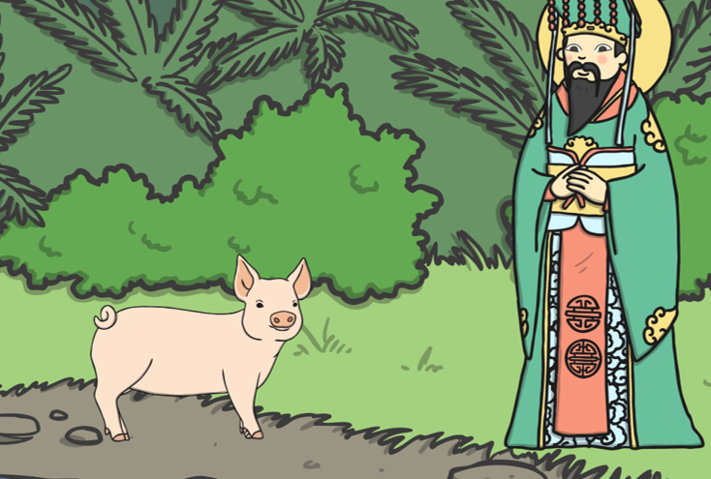
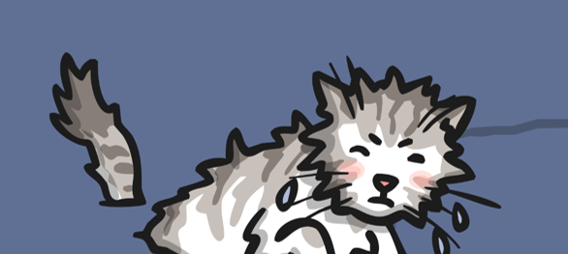
7. The pig said he was late because
___________________________________________
___________________________________________
___________________________________________
8. Later the cat scrambled out the river but
___________________________________________
___________________________________________
___________________________________________

