Slide 1
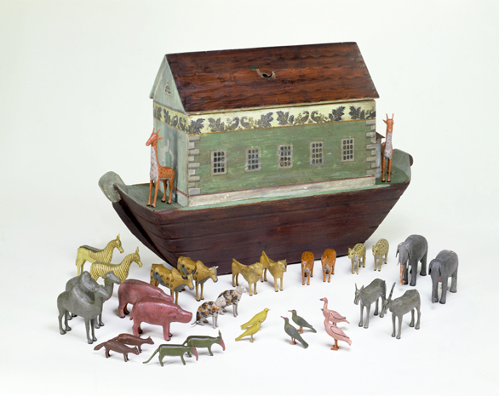
THE VICTORIANS
During the 19th century, factory-made toys, including tin toys and clockwork toys, went on sale. Rich children had more toys to choose from: train sets, toy soldiers, rocking horses, dolls and doll's houses, tea-sets and toy shops with toy fruit, vegetables, meat, hats and medicines. Other popular toys were alphabet bricks, sailing boats, jigsaw puzzles and Noah's Arks. In many homes,
By Thea and Poppy.

Slide 2
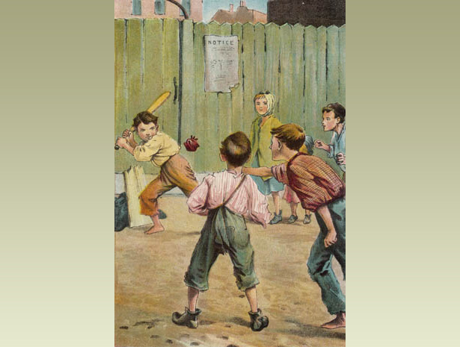
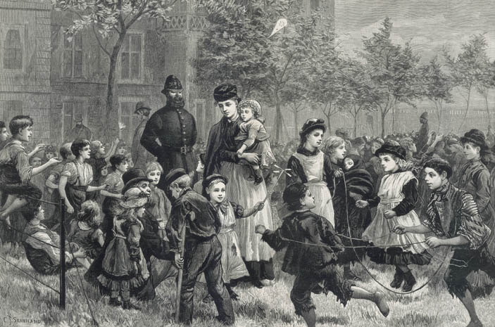
Although many children worked in Victorian times, they still had time to play.
Outdoors, most Victorian children played in the street or in the fields and woods. Not many families had gardens big enough to play in, and there were no children's playgrounds. Rich families had playrooms or nurseries, but poorer children played wherever they could find space. With ten or more children often crammed into one or two rooms, play-space for poor families was a luxury. Playing outside was the usual escape.
Here
Here you can see some rich boys playing, as you can see it was not so easy for the poor. Look at the too photos and see if you can tell which is the poor and which is rich.

Slide 3
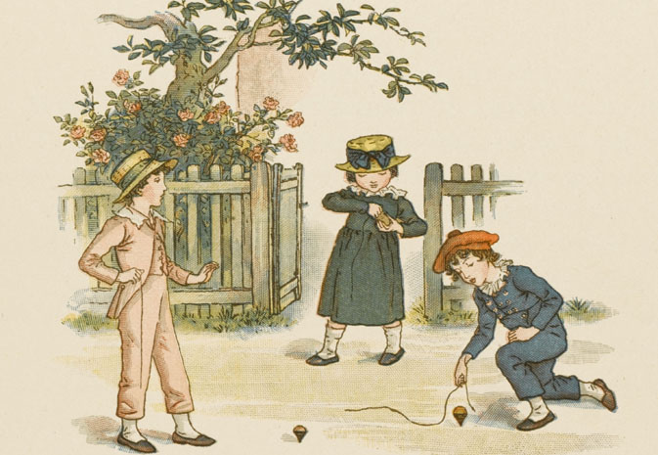
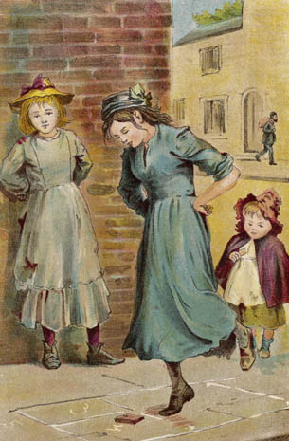
Children girls loved too play with glass dolls if they were rich here is some girls playing outside of their home.
Children also liked spinning toys on strings you can see the girls playing with the spin toys here the girl with the blue dress and red hat is fixing her toy putting the string through the spinning wood toy.

Slide 4
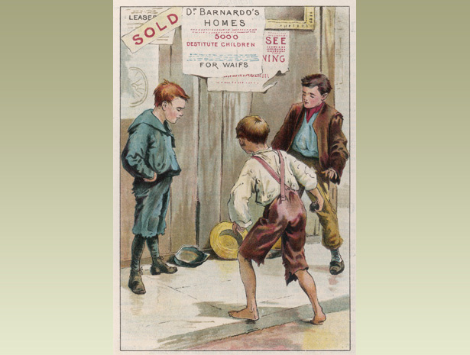
Boys liked to play sporty games. But that was only if they were rich but when they were poor boys they just play on the streets and play games like tag, hide or seek but if they were very lucky which is very rare they would just play with the other boys as you see on this photo.

Slide 5
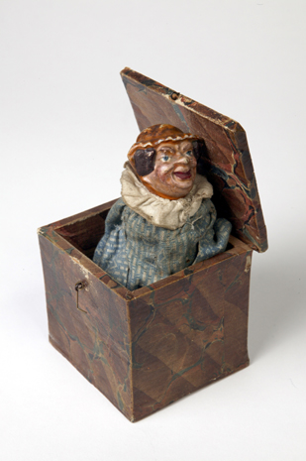
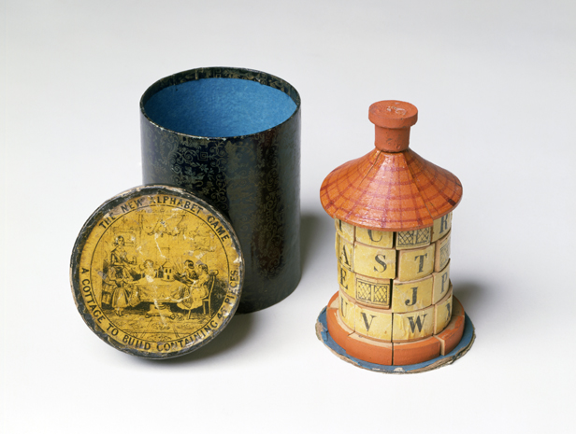
THE END

