Slide 1
James hall fact file

Slide 2
Full name: James Hall
Date of birth: Born in 22/11/1920
Place of birth: Amble
Famous for: Being a tail gunner in a Lancaster bomber ww2.
Who were they: As he was a tail gunner he had the most dangerous job but he was my great grandfather to.
Their life: James Hall also known as my great granddad was a tail gunner in a Lancaster bomber in ww2 and he had been coming back from Germany and two engines were out one working and the other faltering he was so low he could have reached out and touched the steeple of the church at widrington village and the engines that weren't working had been shot out.Time after time he was the only gunner left alive.

Slide 3
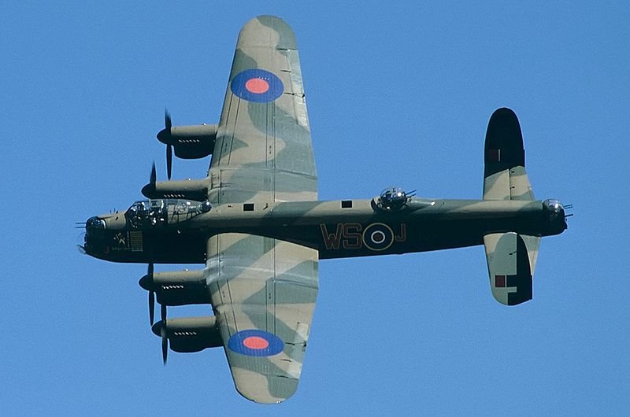
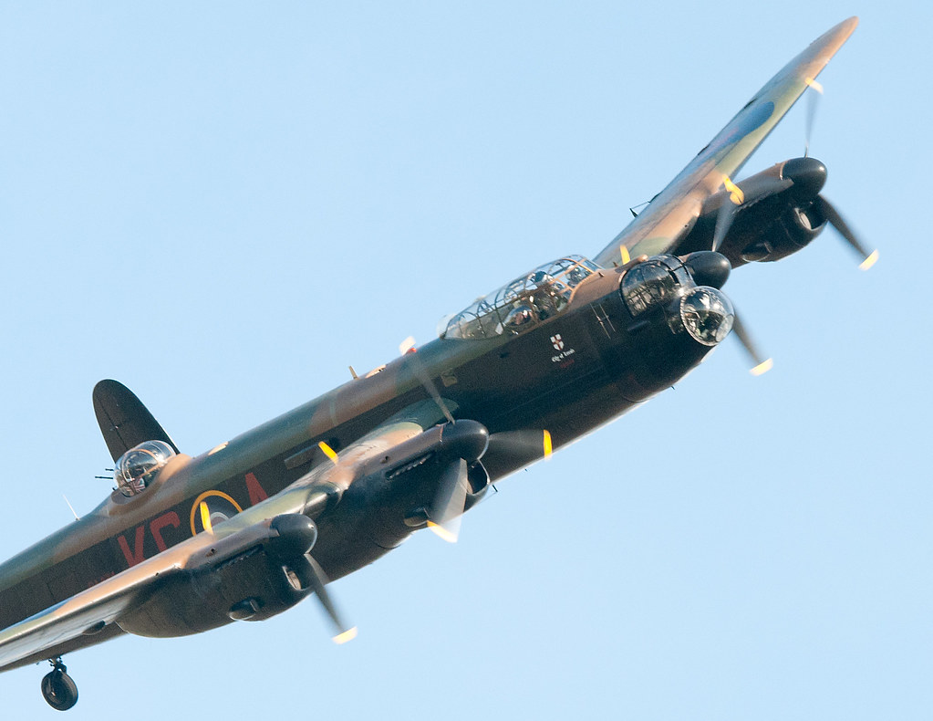
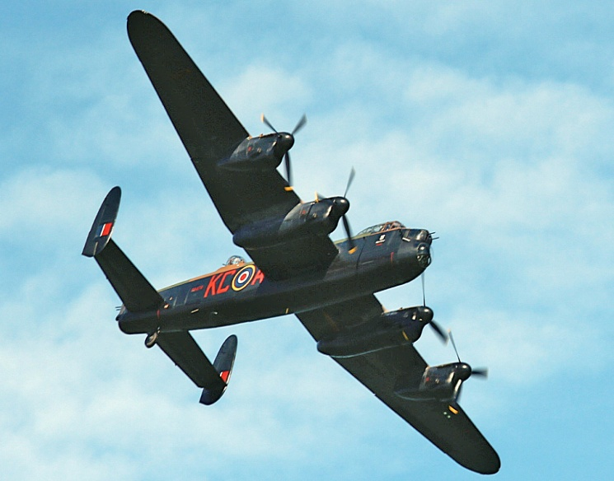
Lancaster bomber
Here are some pictures of a Lancaster bomber.
Here is were he sat.

