Slide 1
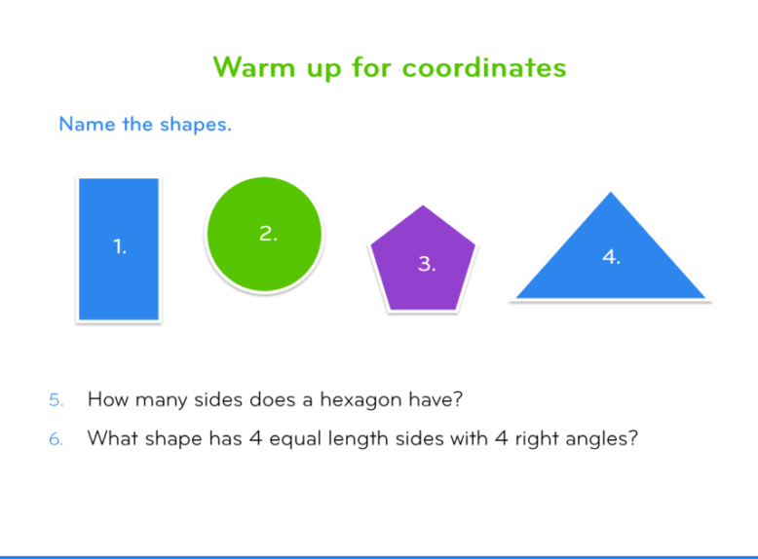
Week 4 – Home Learning
Warm your brains up thinking about the following questions:

Slide 2
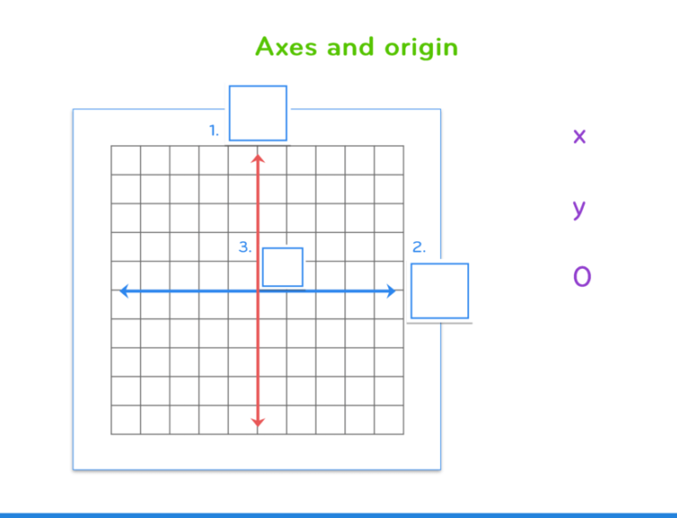
Week 4 – Home Learning
Where would you position the ‘x’, ‘y’ and ‘0’ ?

Slide 3
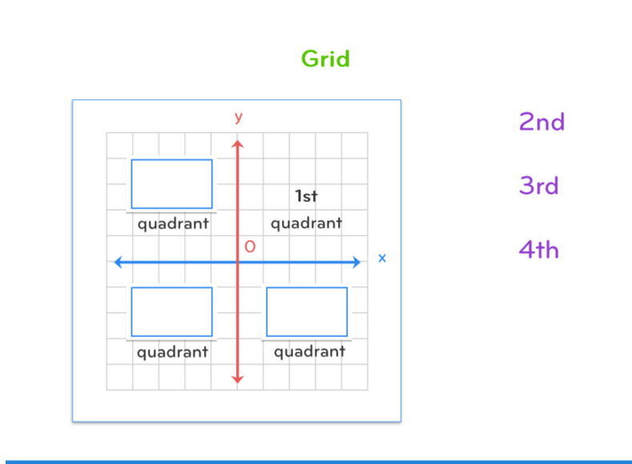
Week 4 – Home Learning
Locate the 2nd, 3rd and 4th quadrant

Slide 4
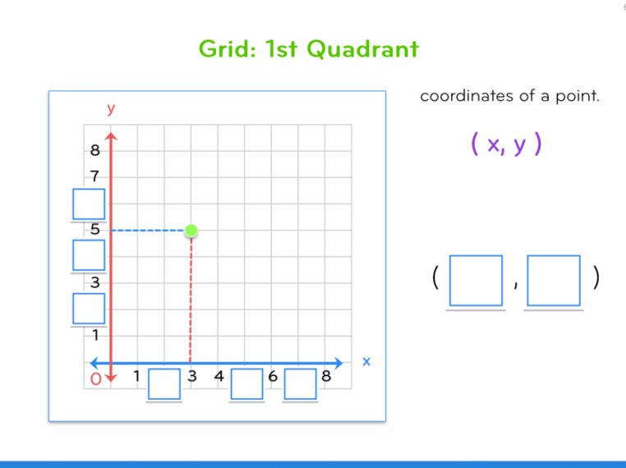
Week 4 – Home Learning
What would you write in the blue boxes?
Along the corridor and up the stairs

Slide 5
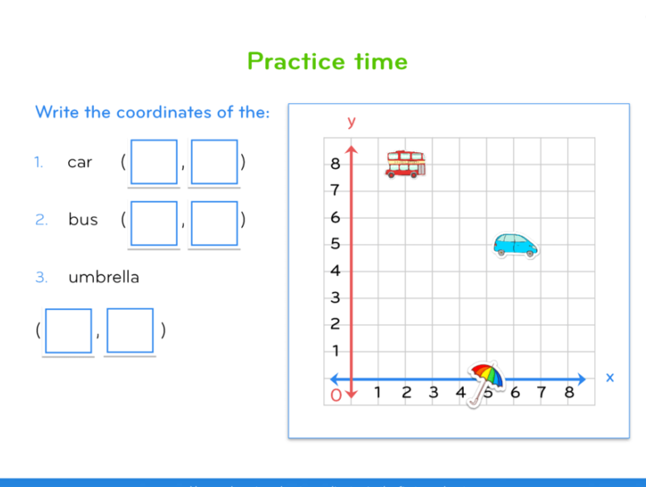
Week 4 – Home Learning
What are the coordinates for the following items?
Along the corridor and up the stairs

Slide 6
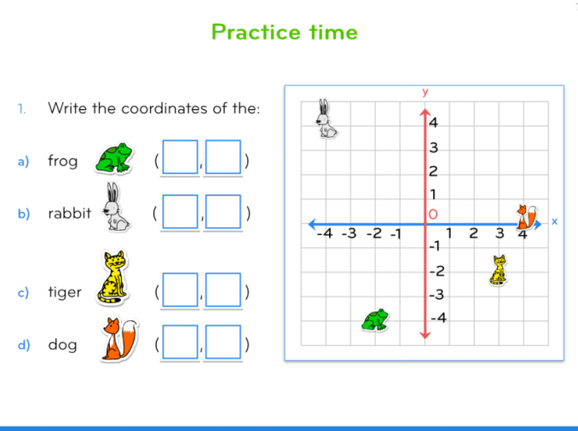
Week 4 – Home Learning
Now what are the coordinates for the following items?
It’s still along the corridor but then up or down the stairs

Slide 7
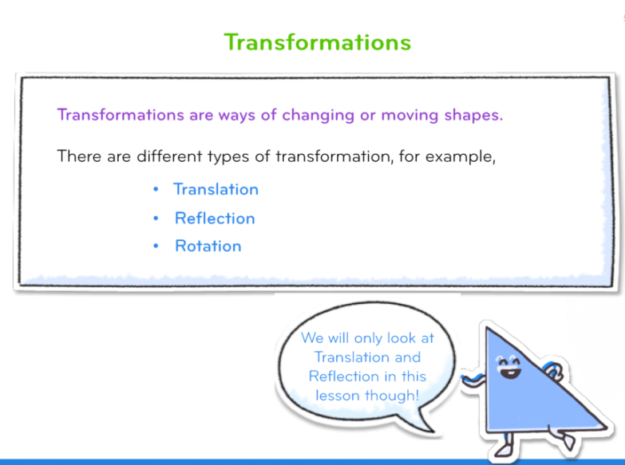
Week 4 – Home Learning

Slide 8
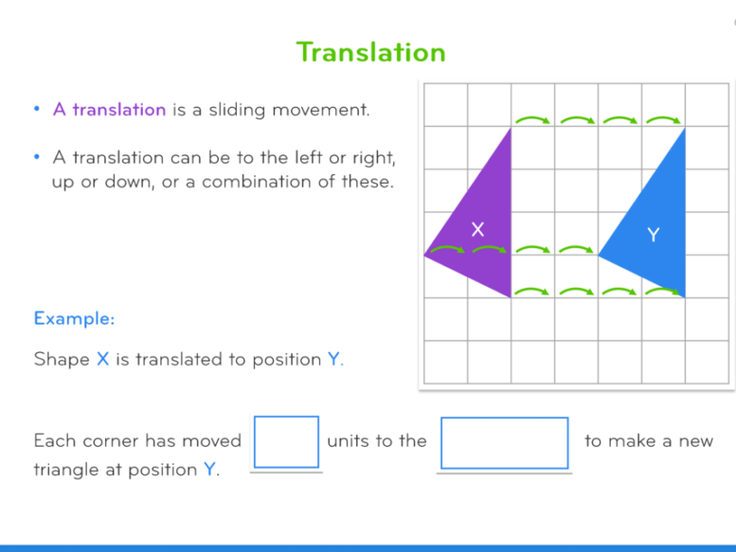
Week 4 – Home Learning
What is missing?

Slide 9
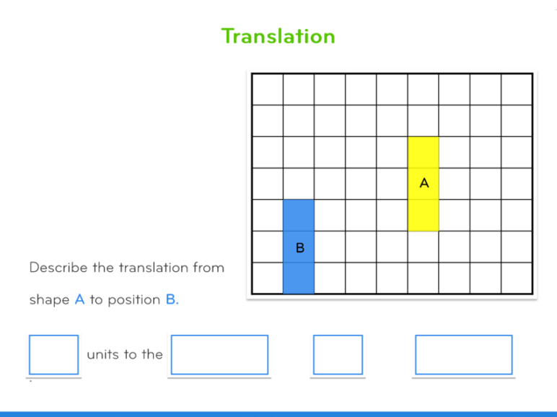
Week 4 – Home Learning
How would you describe the translation?

Slide 10
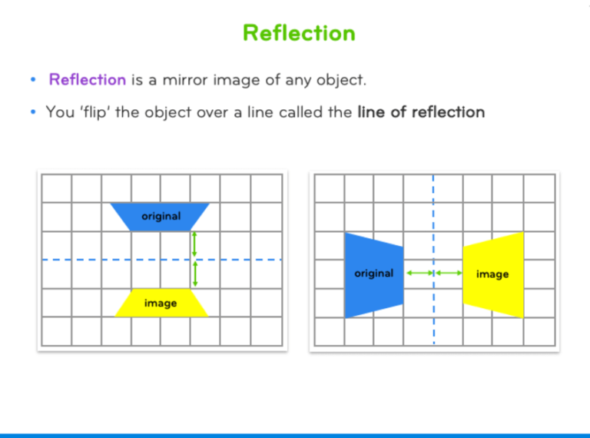
Week 4 – Home Learning

Slide 11
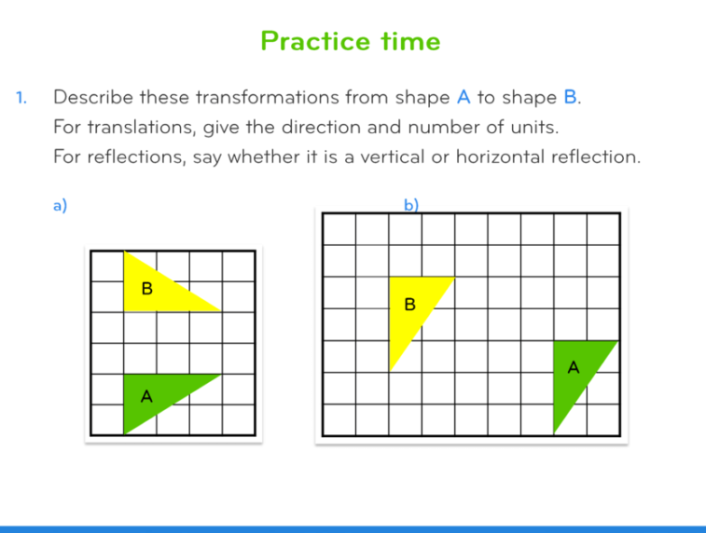
How would you describe the transformations?
Week 4 – Home Learning

Slide 12
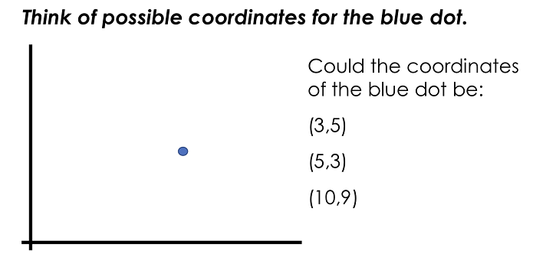
Tickle that brain of yours a little further with the following two mastery questions...
Week 4 – Home Learning

Slide 13
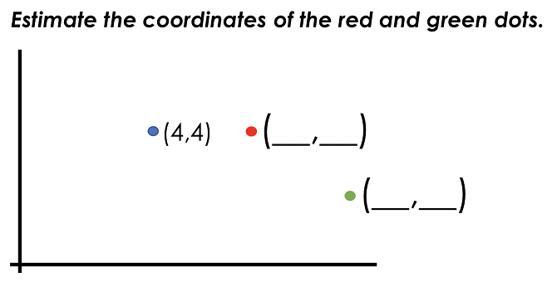
Tickle that brain of yours a little further with the following two mastery questions...
Week 4 – Home Learning

