Slide 1
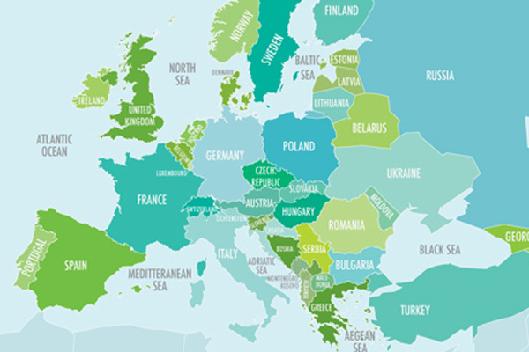
Journey to my Country

Slide 2
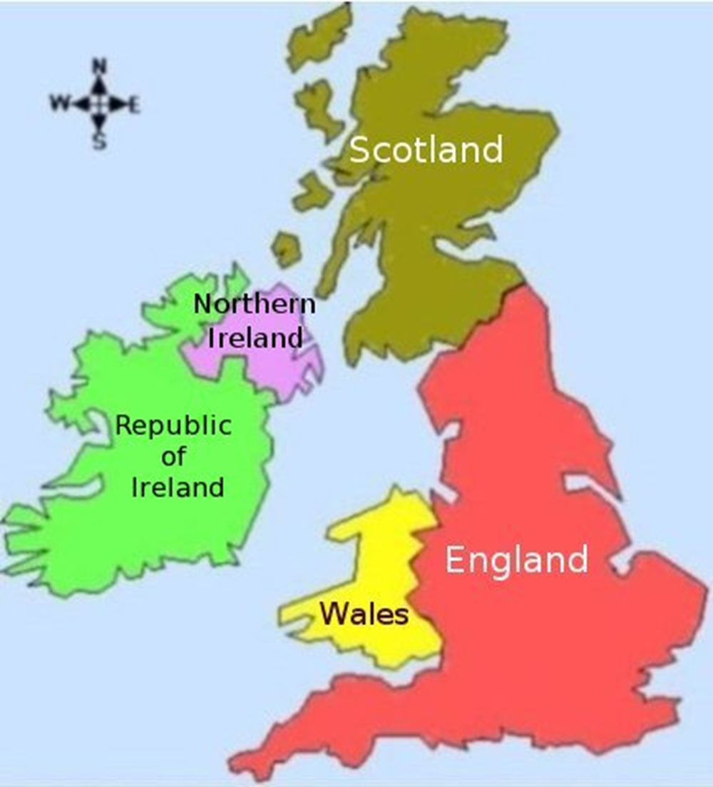
The British isles

Slide 3
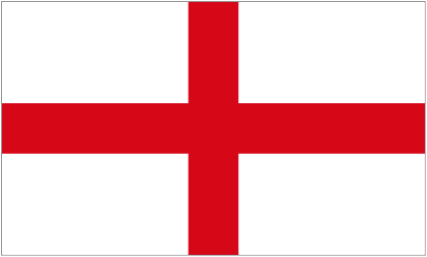
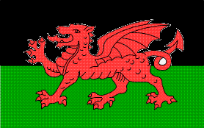
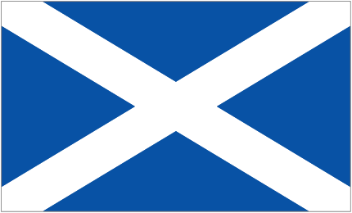
Flags of the British Isles
Which is the English flag?

Slide 4
Flags of the British Isles
Which is the Scottish flag?

Slide 5
Flags of the British Isles
Which is the flag of Northern Ireland?

Slide 6
Flags of the British Isles
Which is the Welsh flag?

Slide 7
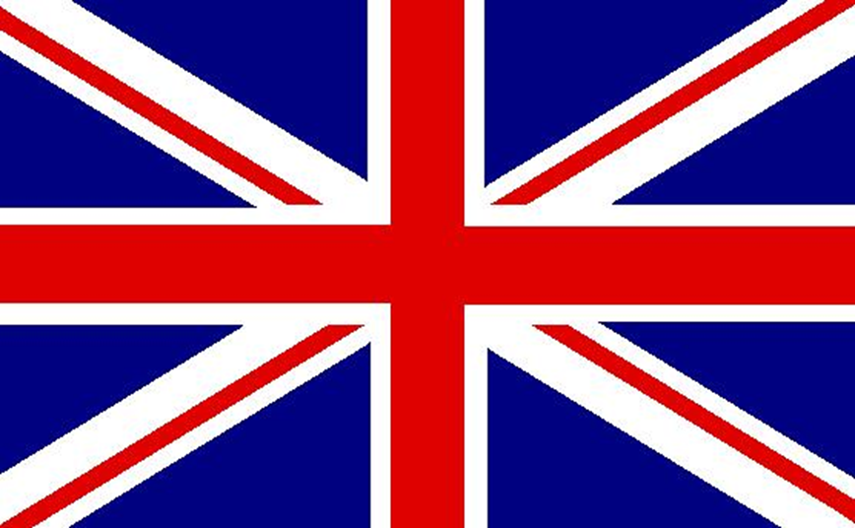
Our flags go together to make the Union Jack Flag

Slide 8
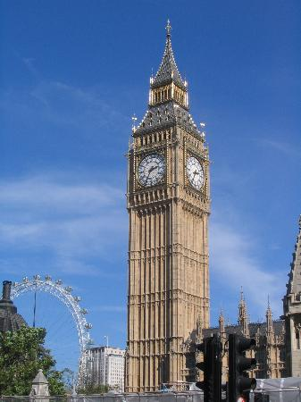
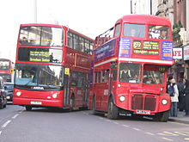
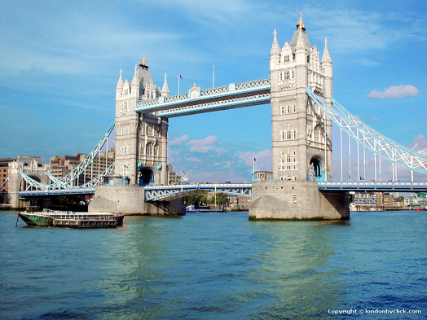
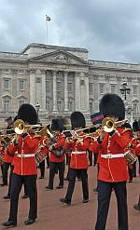
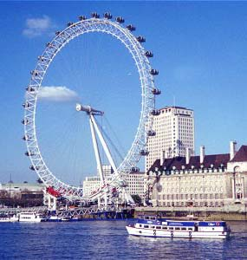
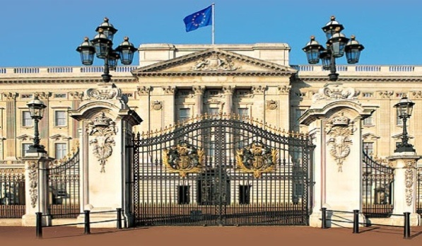
Where are we?

Slide 9
London Bus
Tower Bridge
Big Ben
London
Buckingham Palace
The Queens Guards
The London Eye

Slide 10
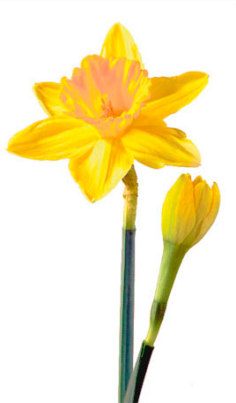
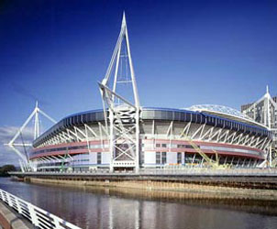
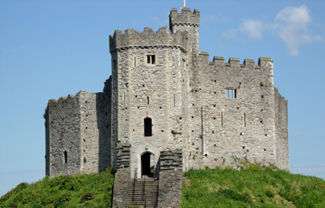
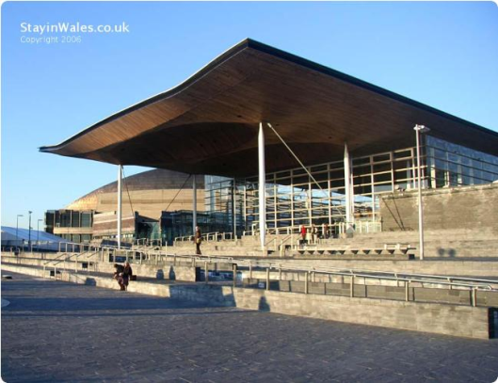
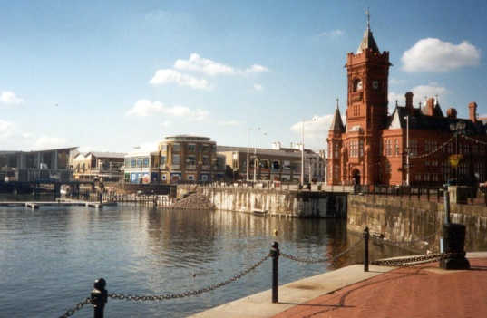
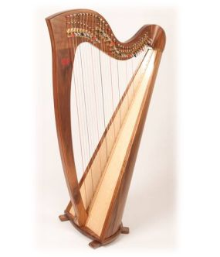
Where are we?

Slide 11
Daffodil - the national flower
Cardiff Castle
Millennium Stadium
Wales
The Welsh harp
The Welsh Assembly
Cardiff Bay

Slide 12
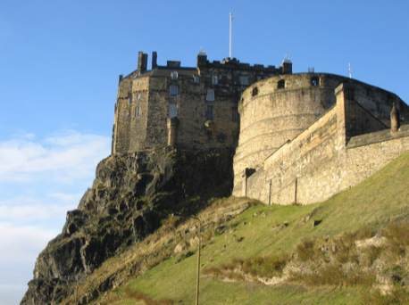
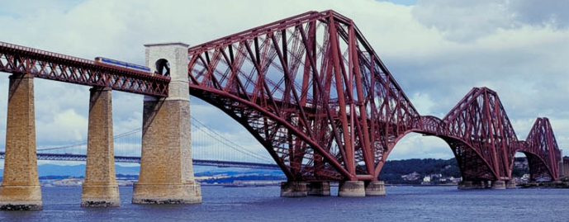
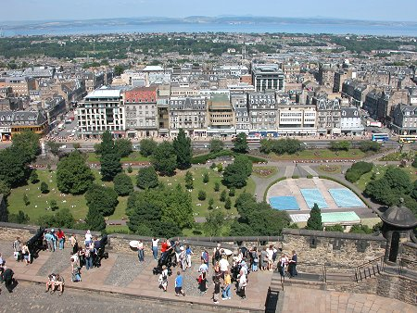
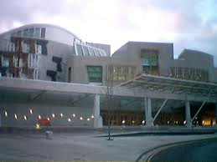
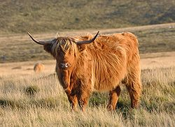
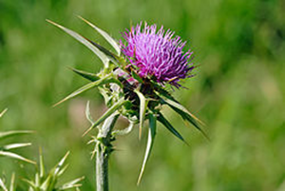
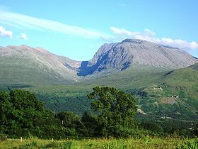
Where are we?

Slide 13
Edinburgh Castle
Forth Bridge - Edinburgh
Scotland
Edinburgh
Scottish Parliament
Scottish Thistle
Highland Cattle
Ben Nevis

Slide 14
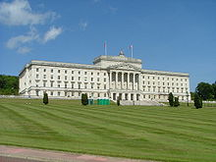
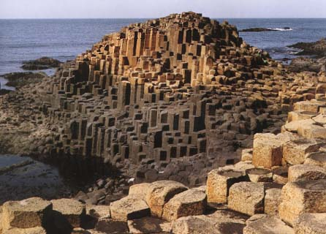
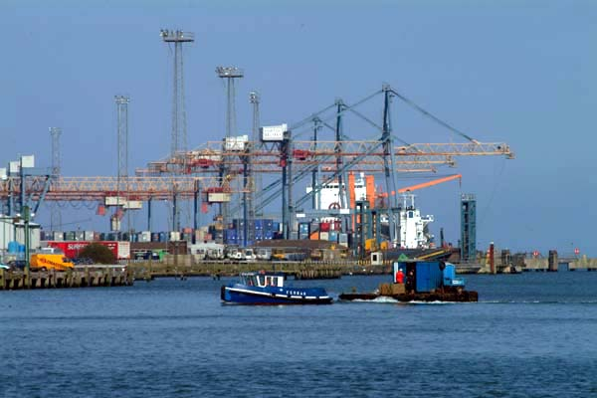
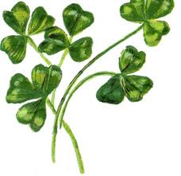
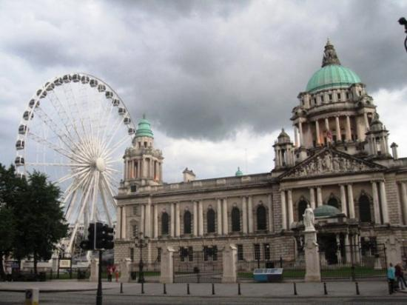
Where are we?

Slide 15
Stormont Parliament
Giants Causeway
Northern Ireland
City Hall Belfast
Belfast Port
Irish Shamrock

Slide 16
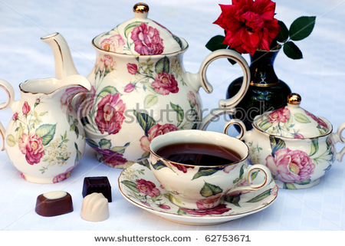
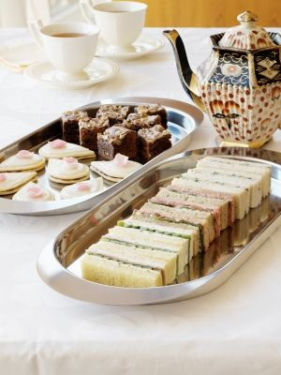
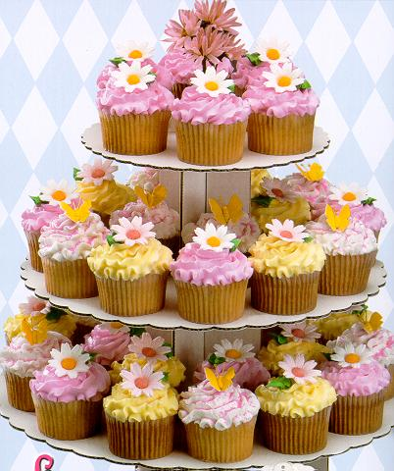
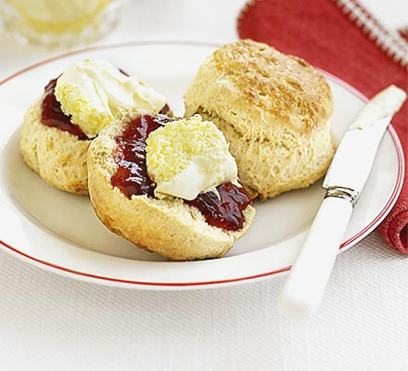
A Traditional English Tea

Slide 17
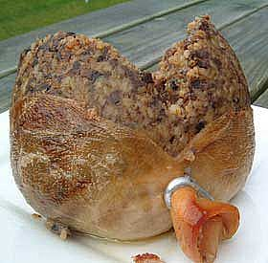
Which Country does this food come from?
Haggis from Scotland

Slide 18
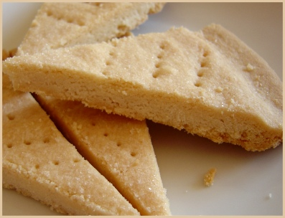
Which Country does this food come from?
Shortbread from Scotland

Slide 19
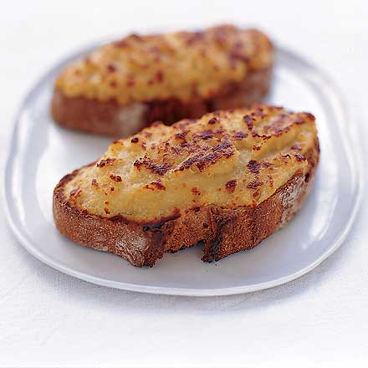
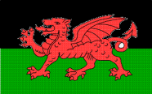
Which Country does this food come from?
Welsh Rarebit from Wales

Slide 20
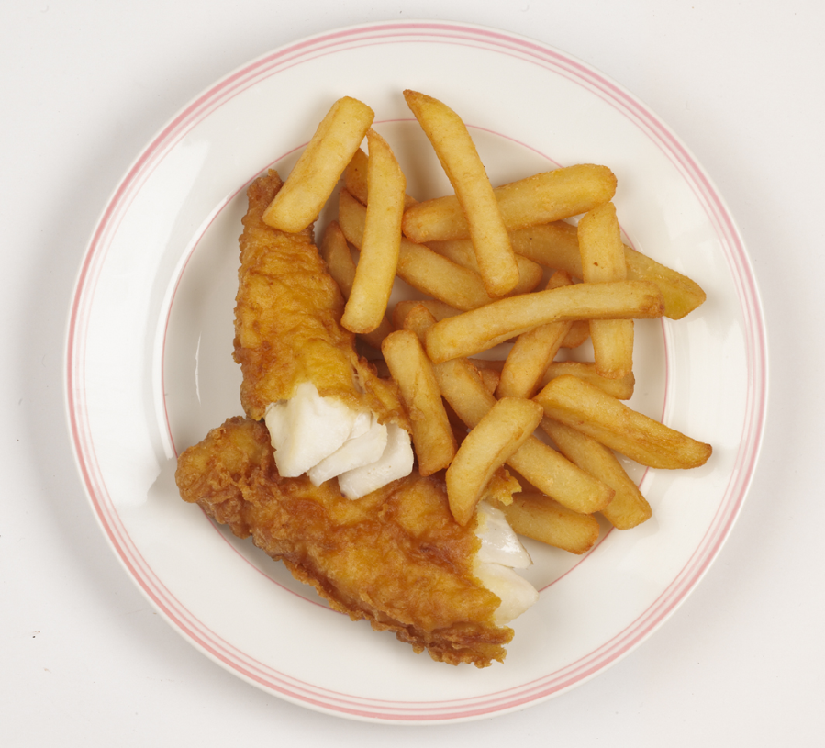
Which Country does this food come from?
Fish and chips from England

Slide 21
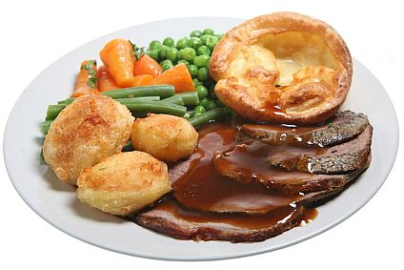
Which Country does this food come from?
Roast beef and Yorkshire pudding from England

