Slide 1
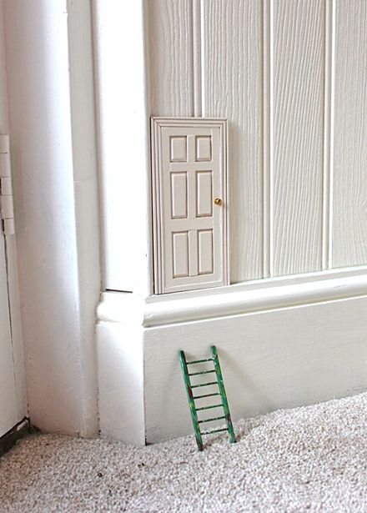
One day, you find this door at the corner of your room. What do you do? Who uses that door? Where does the door take you?

