Slide 1
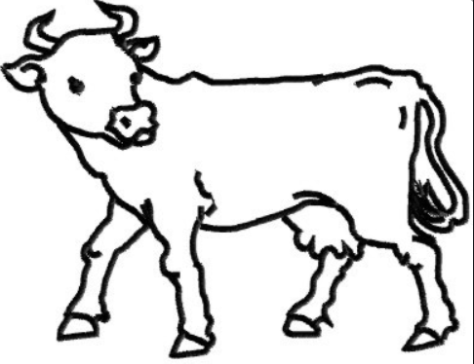
Label the different parts of a cow (use a ruler to draw the lines).
ear hoof tail udder horn eye
muzzle tail nostril forehead leg

Slide 2
Which other mammals live on farms?
How many can you list and draw?
Cows are mammals.
How do we know?
Write 3 clues that tell us that a cow is a mammal:
_________________________________
____________________________________
2. __________________________________
____________________________________
3. __________________________________
____________________________________

Slide 3
Let’s find out about cows.
Find out 3 or more facts about cows:
Find out what the 2 types of farms are that keep cows:
_________________________
_________________________
Tick the correct answer, cows are:
carnivores
herbivores
omnivores
How do you know? What do they eat?
______________________________________
______________________________________
______________________________________

