Slide 2
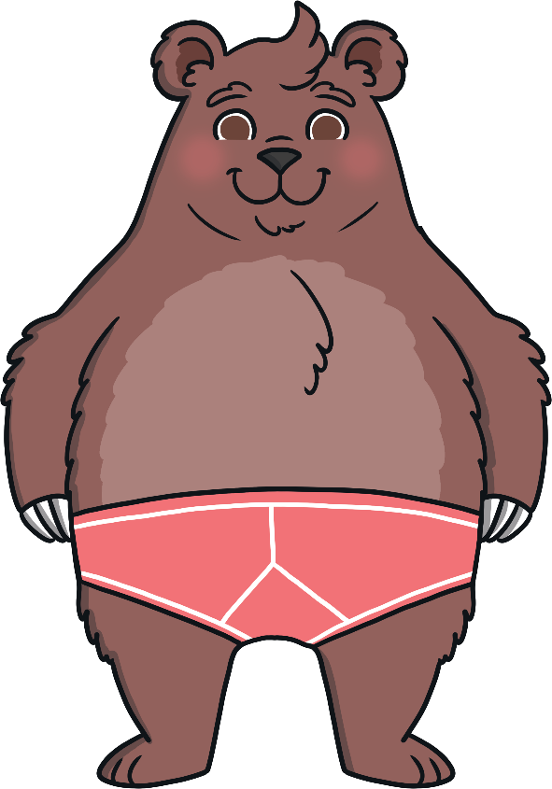
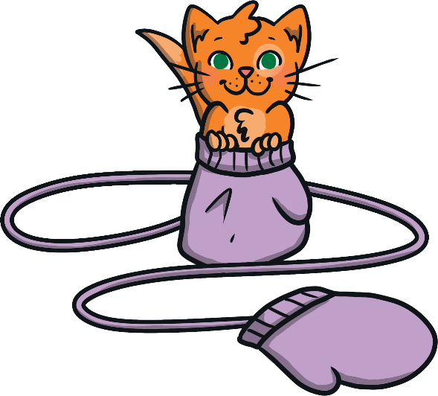
Instructions
Look at the picture on each slide. Try to find the rhyming word from the three choices underneath.
See if you can find all of the rhyming words!

Slide 3
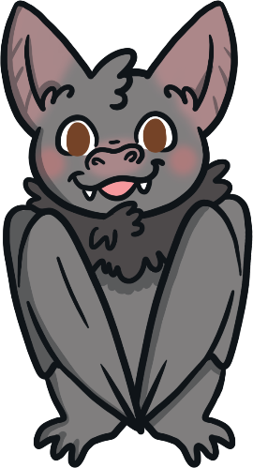
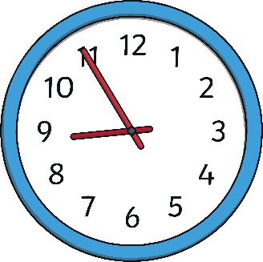
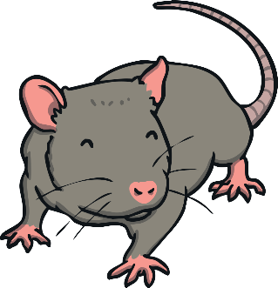
Find the Rhyme!
Back
Next

Slide 4
Correct!
Next

Slide 5
Try again!
Back

Slide 6
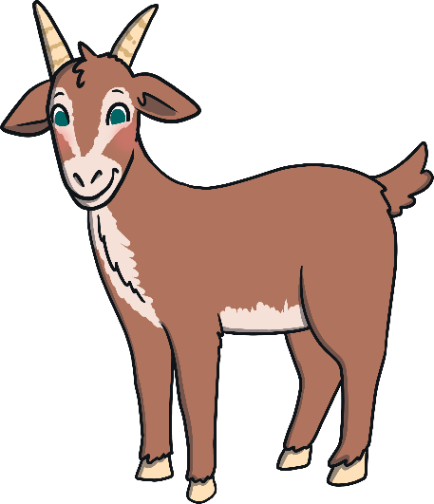
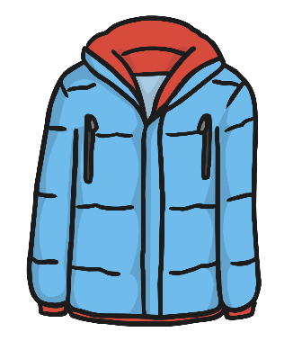
Find the Rhyme!
Back
Next

Slide 7
Correct!
Next

Slide 8
Try again!
Back

Slide 9
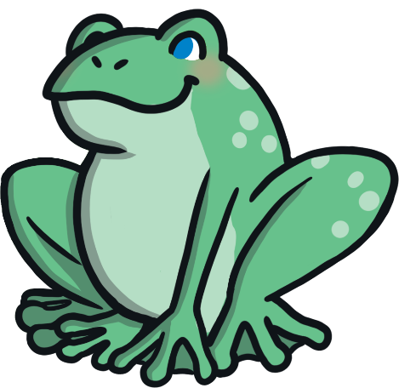
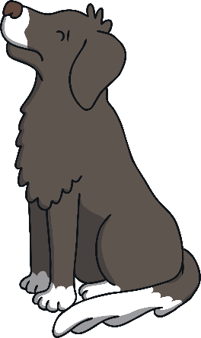
Find the Rhyme!
Back
Next

Slide 10
Correct!
Next

Slide 11
Try again!
Back

Slide 12
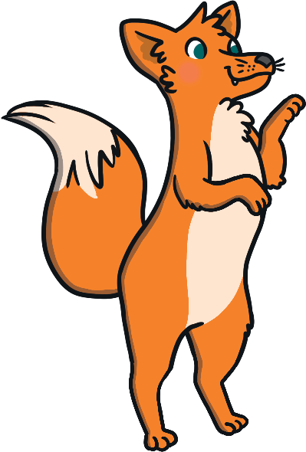
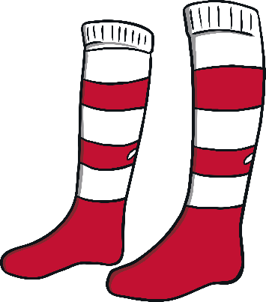
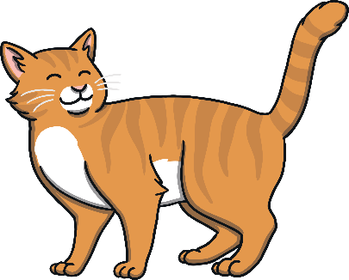
Find the Rhyme!
Back
Next

Slide 13
Correct!
Next

Slide 14
Try again!
Back

Slide 15
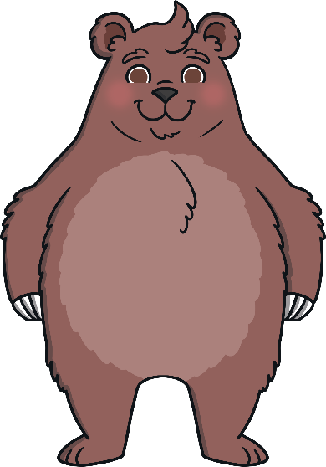
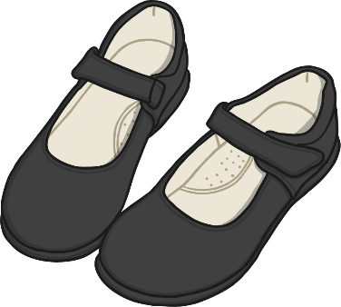
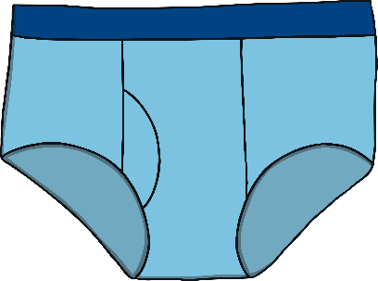
Find the Rhyme!
Back
Next

Slide 16
Correct!
Next

Slide 17
Try again!
Back

Slide 18
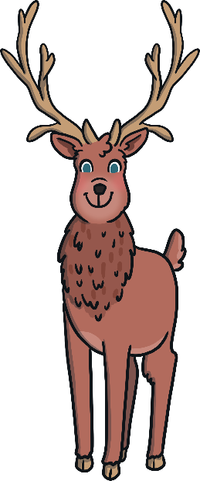
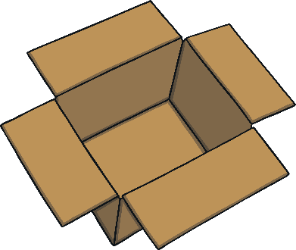
Find the Rhyme!
Back
Next

Slide 19
Correct!
Next

Slide 20
Try again!
Back

Slide 21
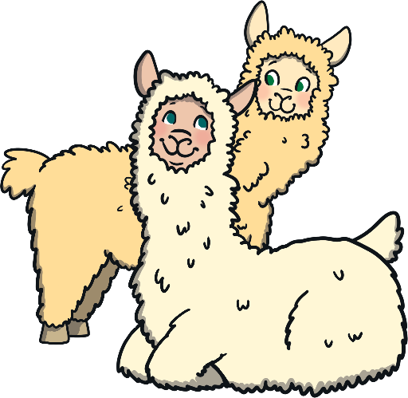
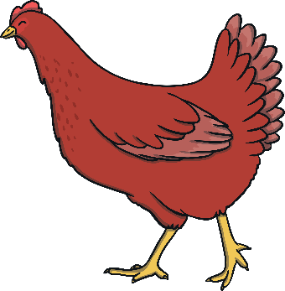
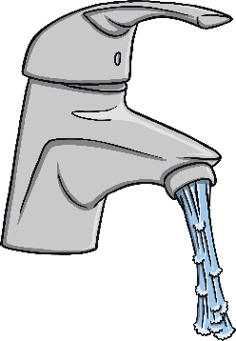
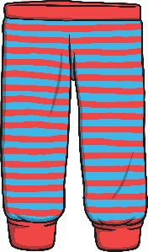
Find the Rhyme!
Back
Next

Slide 22
Correct!
Finish
Play Again

Slide 23
Try again!
Back

