Slide 1
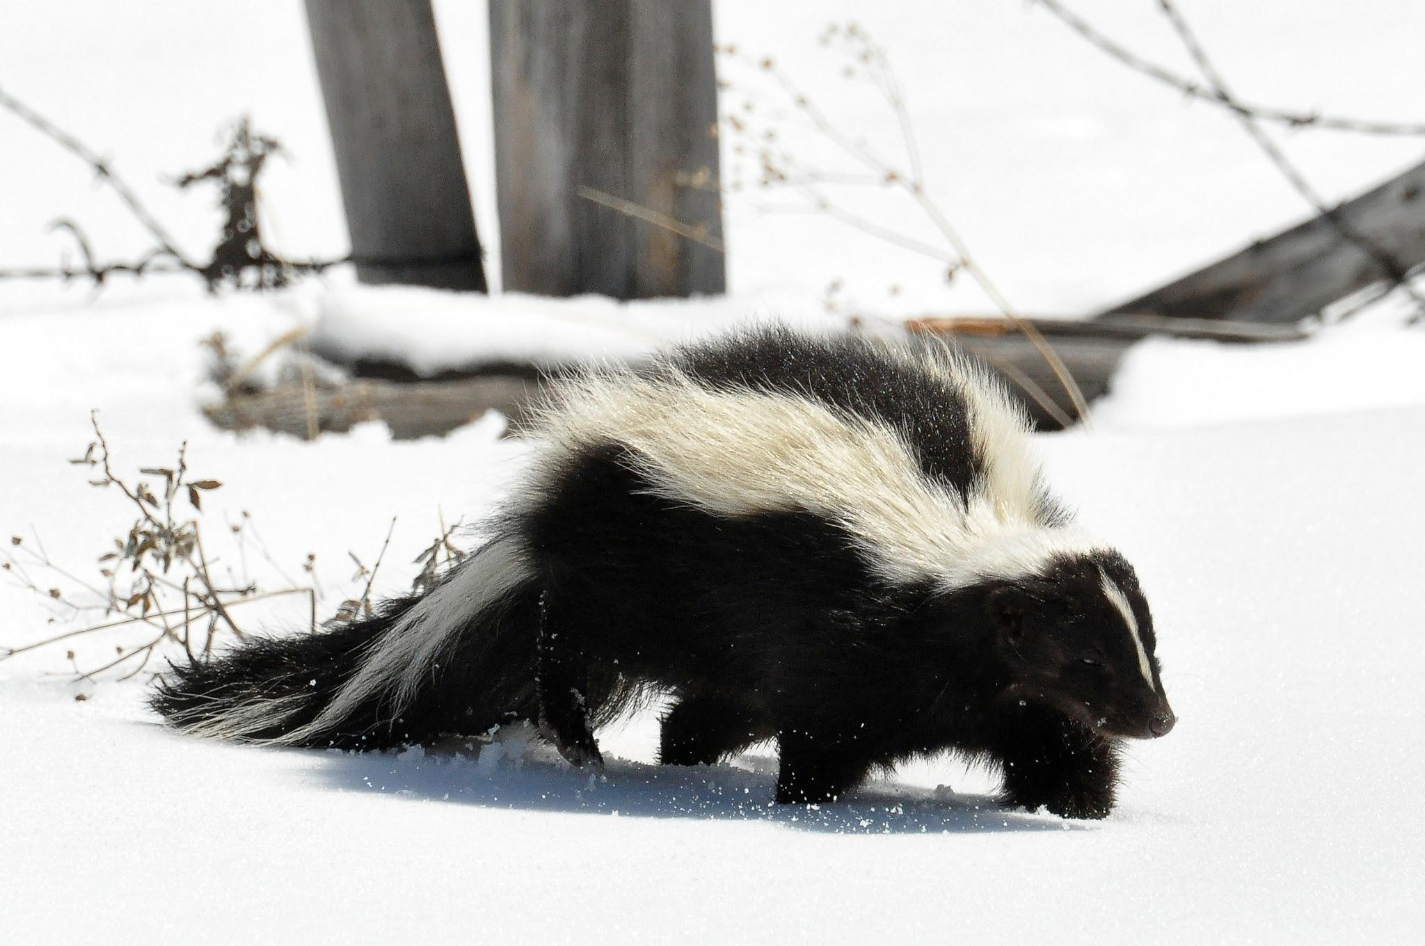
The Spotted Skunk

Slide 2
Fun facts about the Skunk
Habitat
The western spotted skunk can be found west of Continental Divide from southern British Columbia to central America , as well as in some parts of Montana , North Dakota , Wyoming , Colorado and western Texas. Eastward , its range borders that of the eastern spotted skunk.
Next page for more information about the Spotted Skunk.

Slide 3
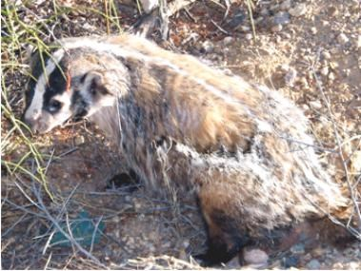
Is the Eastern Spotted Skunk endangered?
Formerly , the plains spotted skunk subspeaces was most common in the western half of the state but is now extreamly rare and is listed as endangered Missouri. The decline is due to “clean” farming , which eliminates cover this species requires.

Slide 4
What they eat and and their predator
Skunks are omnivorous and will eat small rodents , fruits , berries , birds , eggs , insects , larlae , lizards , snakes , and carrion. There diet may vary with the seasons as food availability fluctuates.

Slide 5
The spotted skunk predators
The predators of the eastern spotted skunk are humans , dogs , cats , bobcats , foxes , coyotes and owls. It’s kind of weird people eating skunks.
End of presentation

