Slide 1
Area and Perimeter
40cm
Find the perimeter of this rectilinear shape.
What is the area?
54cm²
8cm
7cm
2cm
Hide Answers
12cm
*not to scale
Show Answers

Slide 2
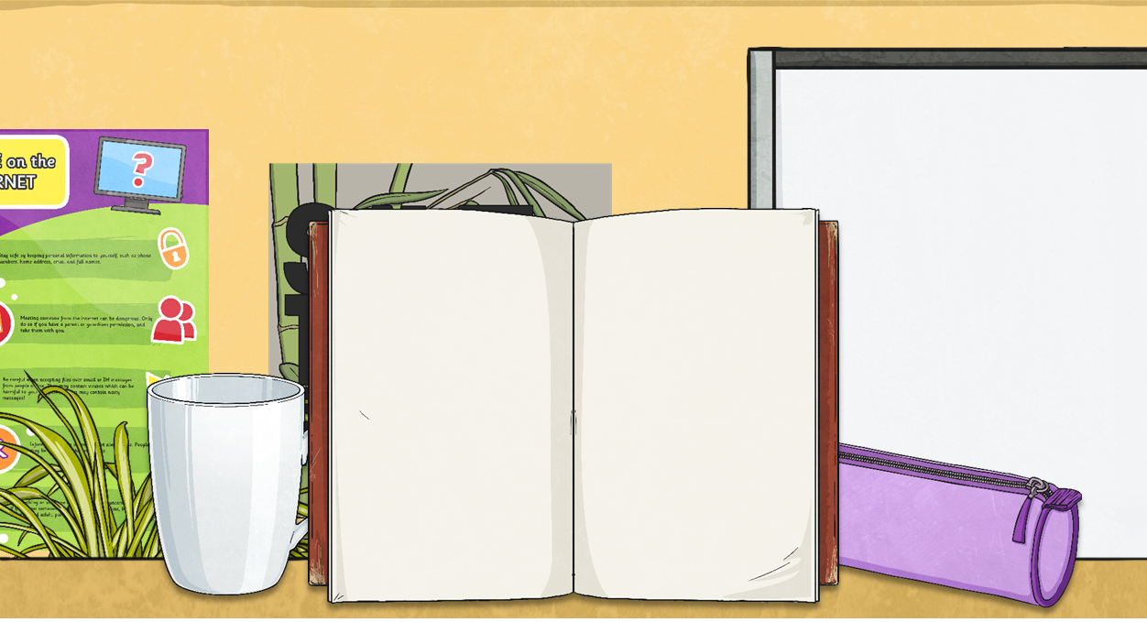
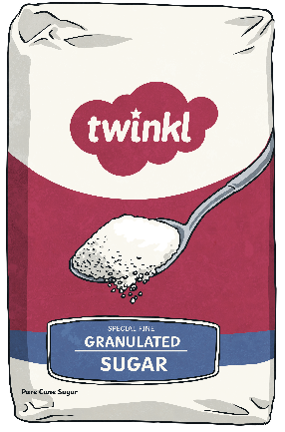
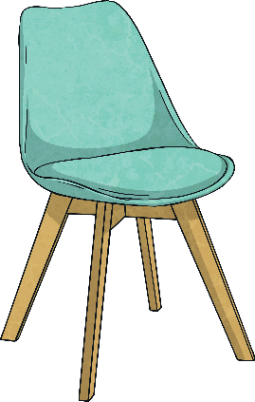
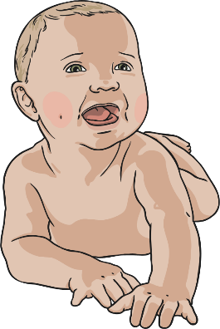
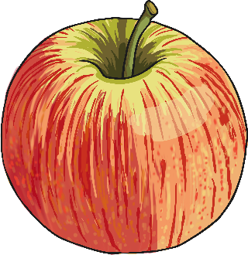
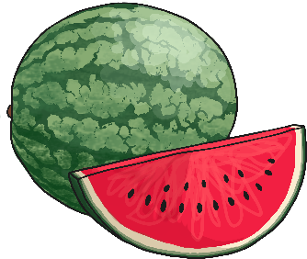
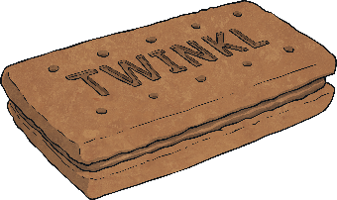
Most Sensible
Which do you think is the most sensible measurement for this object?
100g | 1kg | 10kg
150g | 15kg | 5kg
10g | 1kg | 100g
3000g | 9kg | 300g
1000g | 10kg | 10g
130g | 1.3g | 13g
A bag of sugar
apple
baby
watermelon
biscuit
chair

Slide 3
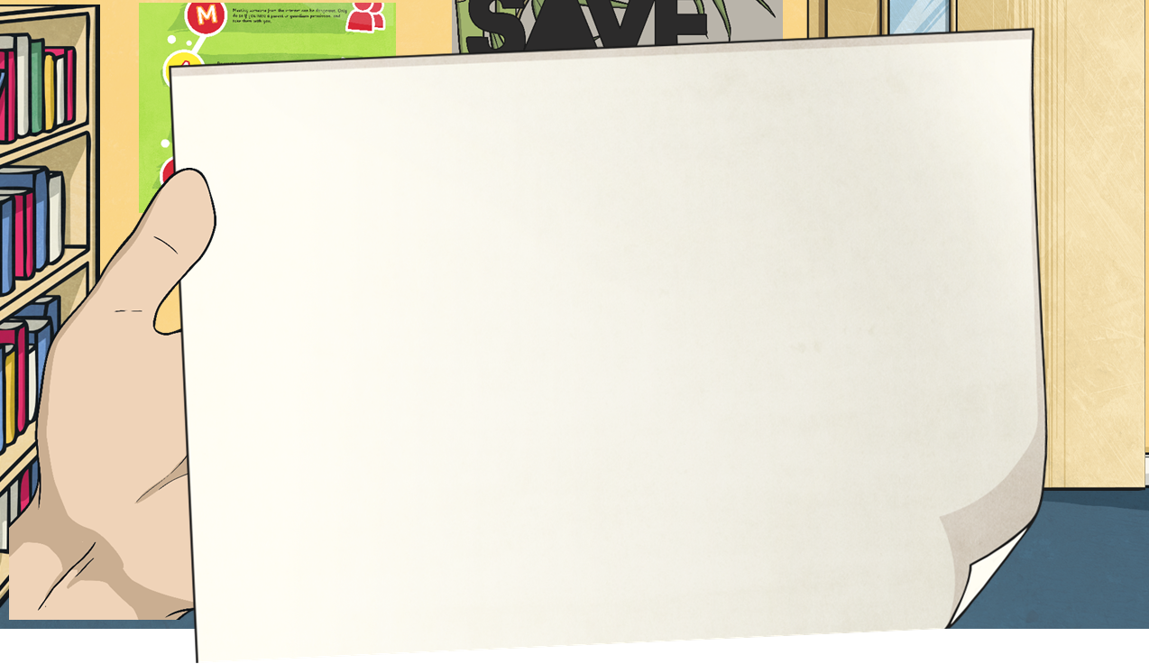
Converting From Kilograms to Grams
7kg = 7000g
What calculation did we do to convert from kilograms to grams?
7 × 1000 = 7000
We multiply by 1000 to convert kilogram measurements with decimal numbers in the same way.
To convert from kilograms to grams, we multiply by 1000 – just like we would multiply by 1000 to convert from kilometres to metres.
To multiply by 1000, each digit moves three places to the left.
8.149kg =
8149g
thousands | hundreds | tens | ones | tenths | hundredths | thousandths
0
0
0
8
7
1
4
9

Slide 4
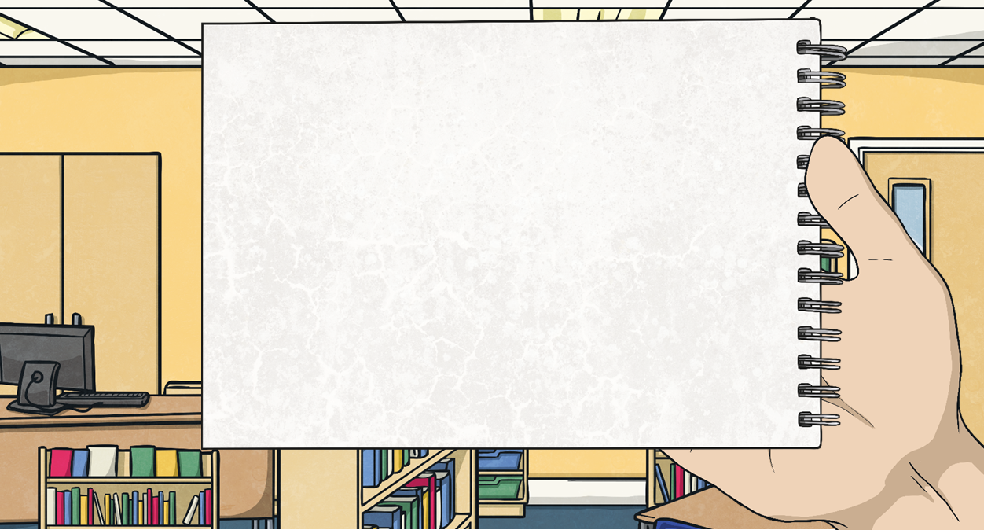
Converting From Kilograms to Grams
When we have moved the digits, if there are no digits in a column before the decimal place then we place a zero in this column as a ‘placeholder’.
4.52kg =
2.7kg =
4250g
2700g
thousands | hundreds | tens | ones | tenths | hundredths | thousandths
0
0
4
2
0
7
5
2

Slide 5
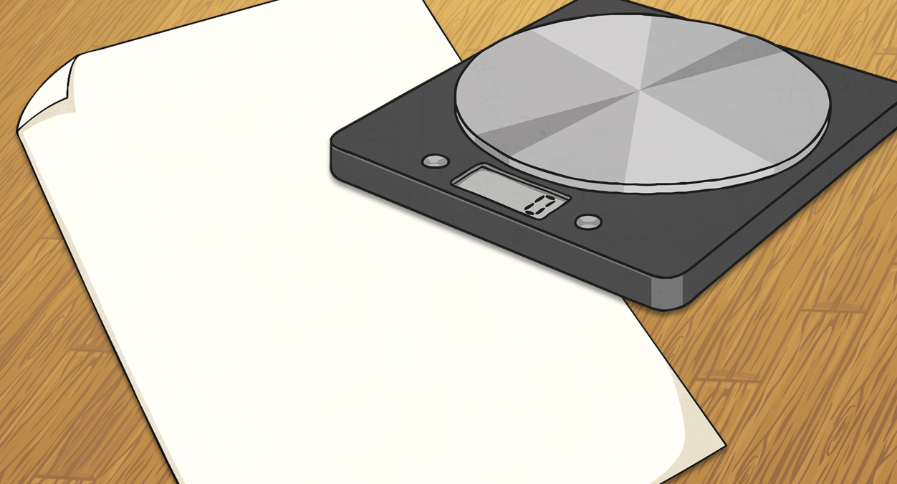
Converting From Kilograms to Grams
Convert these measurements from kilograms to grams.
Kilograms | Grams
4.795kg
6.238kg
15.089kg
3.75kg
12.96kg
14.1kg
4795g
6238g
15 089g
3750g
12 960g
14 100g

Slide 6
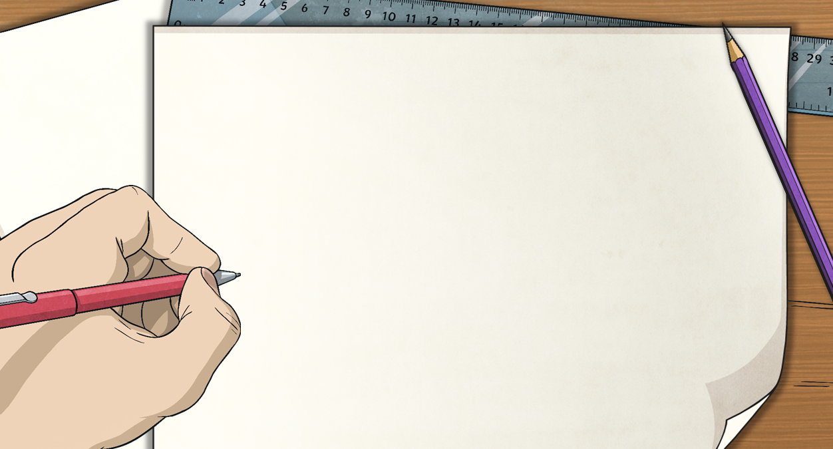
Converting From Grams to Kilograms
2000g = 2kg
What calculation did we do to convert from grams to kilograms?
2000 ÷ 1000 = 2
We divide by 1000 to convert measurements in grams with decimal numbers in the same way.
To convert from kilograms to grams, we divide by 1000 – just like we would divide by 1000 to convert from metres to kilometres.
To divide by 1000, each digit moves three places to the right.
3455g =
3.455kg
thousands | hundreds | tens | ones | tenths | hundredths | thousandths
3
4
5
5
2
0
0
0

Slide 7
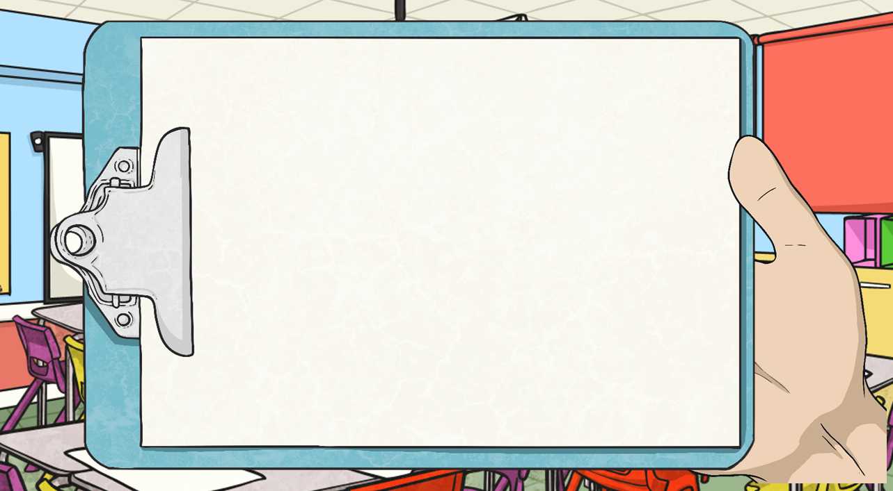
Converting From Kilograms to Grams
When we have moved the digits, there might be zeros at the very end of the number after the decimal place…
… They have no value so we do not need to write them.
2450g =
2405g =
2.45kg
2.405kg
thousands | hundreds | tens | ones | tenths | hundredths | thousandths
2
4
0
0
2
4
5
5
In this measurement, we do include the zero after the decimal place as there is another digit after it.

Slide 8
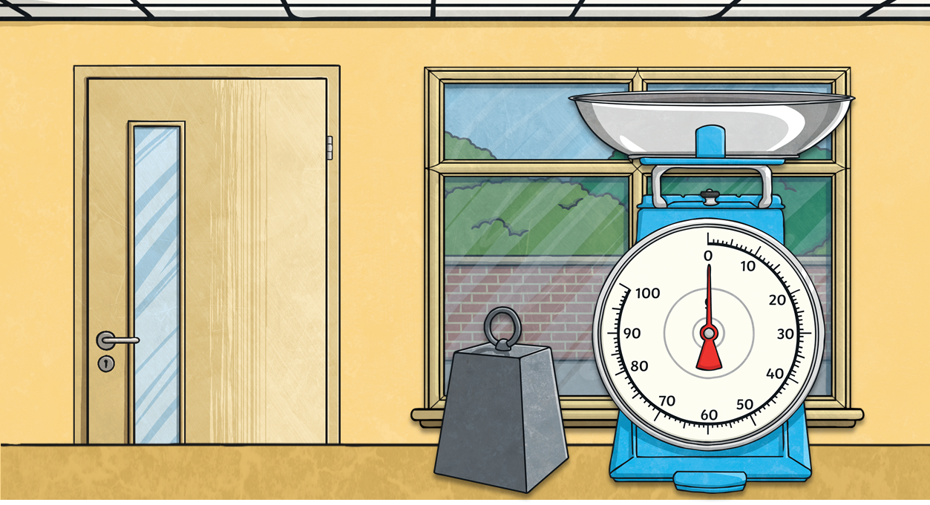
Converting From Grams to Kilograms
Convert these measurements from grams to kilograms.
Grams | Kilograms
3467g
2119g
5008g
1250g
13 880g
12 500g
3.467kg
2.119kg
5.008kg
1.25kg
13.88kg
12.5kg

Slide 9
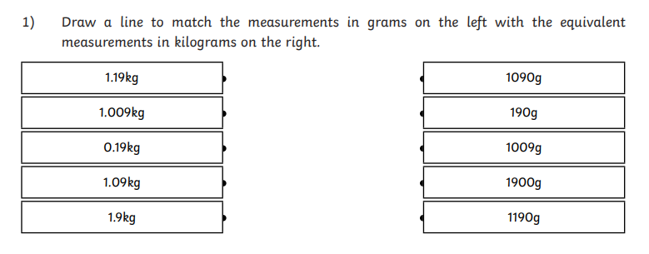
On a piece of paper can you write down the matching measurements.

Slide 10
Were you correct?
1.19kg = 1190g
1.009kg = 1009g
0.19kg = 190g
1.09 = 1090g
1.9kg = 1900g

Slide 11
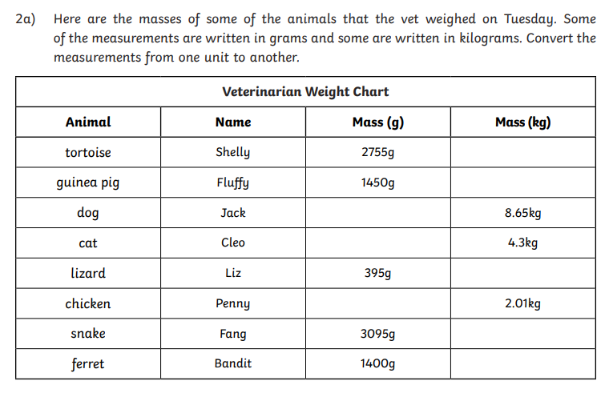
Here are some masses of some animals that the vet weighed on Tuesday. Some of the measurements are written in grams and some in kilograms. Convert the measurements from one unit to another.

Slide 12
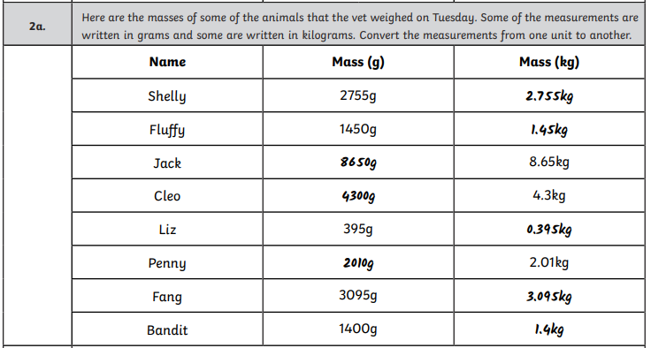
Were you correct?

Slide 13
Challenge one
Using your table can you now write them in order from lightest to heaviest.

Slide 14
How did you do?
Liz
Bandit
Fluffy
Penny
Shelly
Fang
Cleo
Jack

Slide 15
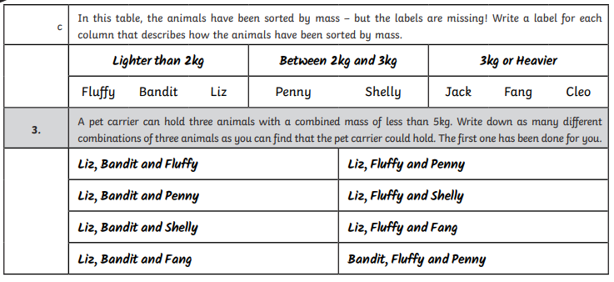

Slide 16
On No!!!!!
In this table, the animals have been sorted by mass- but the labels are missing!
Write a label for each column that describes how the animals have been sorted.
Fluffy Bandit Liz | Penny Shelly | Jack Fang Cleo

Slide 17
How did you do?
Lighter than 2kg | Between 2 and 3 kg | 3kg or heavier
Fluffy Bandit Liz | Penny Shelly | Jack Fang Cleo

Slide 18
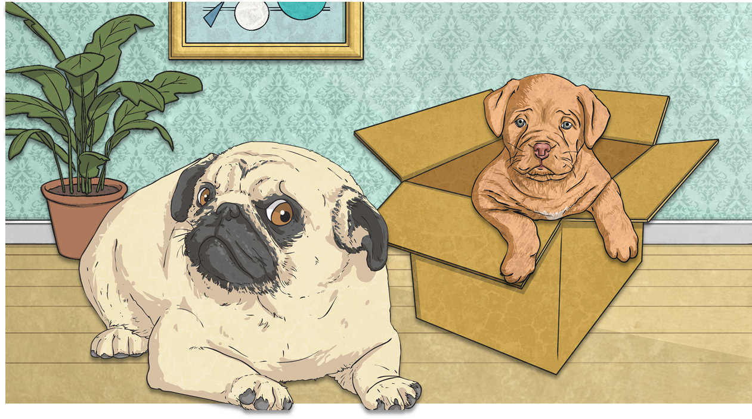
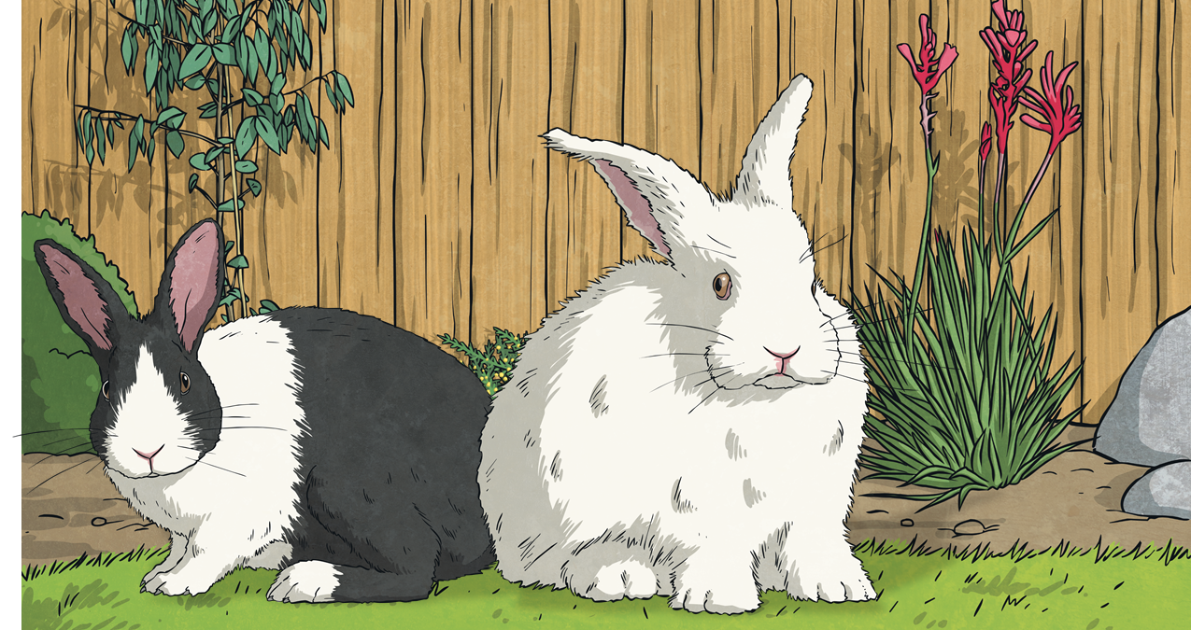
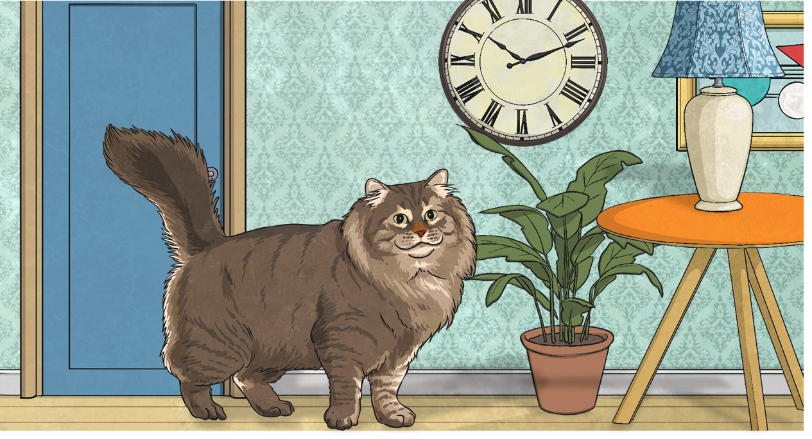
Animal Problems
Molly has a mass of 7.8kg. Her new friend, Biscuit, is 500g lighter. What is Biscuit’s mass? Write your answer in kg.
Hazel’s mass is 2421g. Her brother, Nibbles, is 1.2kg heavier. What is Nibbles’ mass? Write your answer in grams.
Coco has a mass of 6.2kg. However, the vet has recommended that Coco should lose 450g. What would Coco’s mass be after this?
5750g or
5.75kg
7.3kg
3621g

