Slide 2
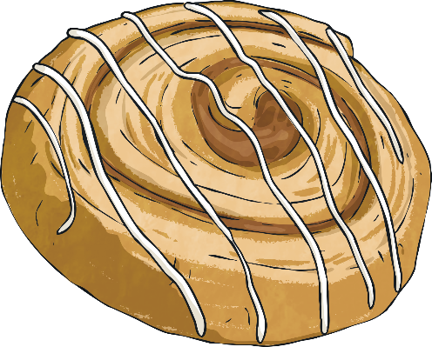
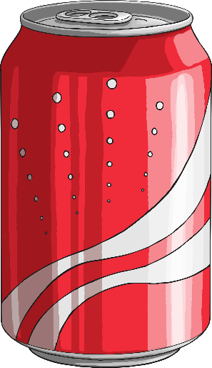
Imperial Units of Volume and Capacity
However, we do use some imperial units of measurement as well. Pints are the most common imperial units we use to measure volume and capacity. Although there are eight pints in a gallon, which is another imperial unit of volume and capacity, we do not normally use gallons as a measurement in the UK.
Can you think of anything that we would measure in litres or millilitres?
Can you think of anything that we would measure in pints?
In the UK, we mainly use metric units of measurement to measure volume and capacity. The most common metric units we use are litres and millilitres.

Slide 3
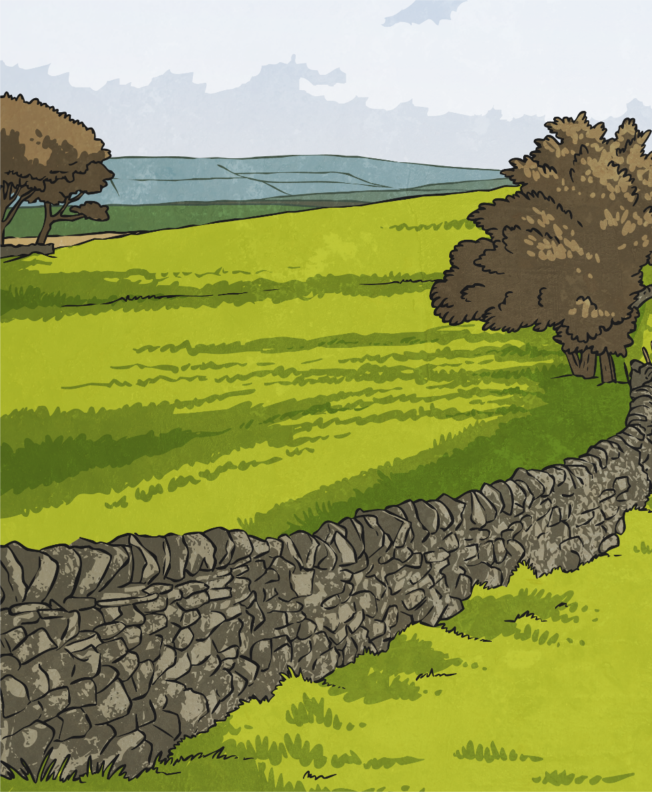
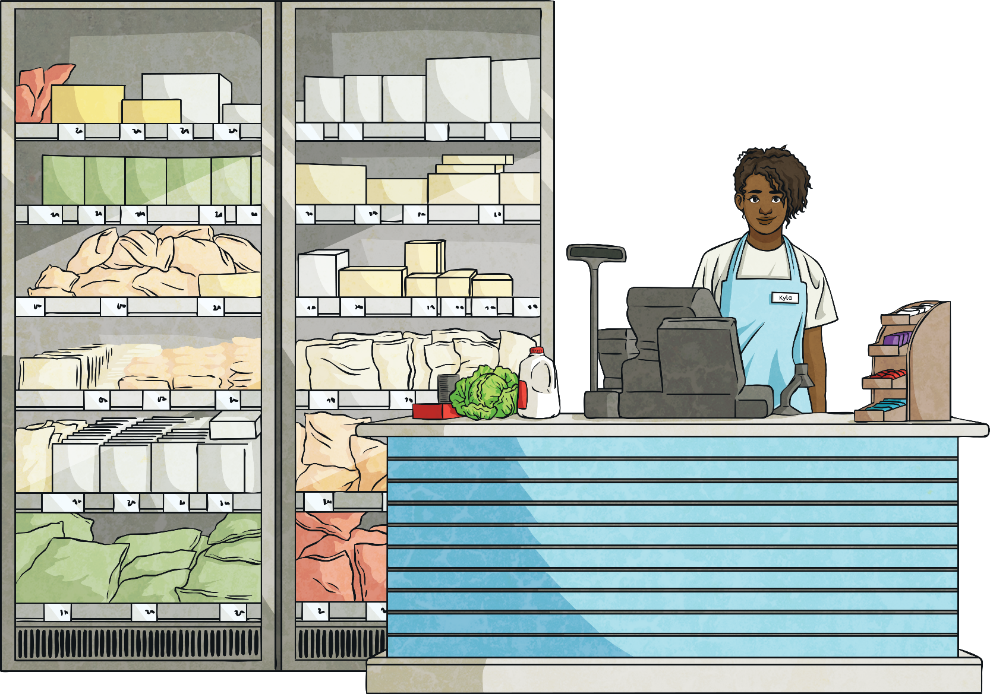
Pints to Litres
The customers of both companies need to convert between the two to work out which company they should order from.
Two different milk delivery companies measure their milk in different ways. Milko uses glass bottles that are measured in pints while Dairy Moo uses cartons that are measured in litres.
1 pint ≈ 0.6l
How did you calculate 5 × 0.6?
How many litres are in 5 pints?
5 pints ≈ 3l
One way of calculating this would be to use the number facts that you already know.
5 × 6 = 30
5 × 0.6 = 3

Slide 4
Pints to Litres
1 pint ≈ 0.6l
number facts
another method?
add
÷ 2
What strategies will you use to convert from pints to litres?
double
halve
1 pint | 2 pints | 3 pints | 4 pints | 5 pints | 6 pints | 7 pints
0.6l
1.2l
1.8l
2.4l
3l
3.6l
4.2l
5 × 6 = 30
5 × 0.6 = 3

Slide 5
Litres to Pints
1l ≈ 1.8 pints
What strategies will you use to convert from litres to pints?
add
halve
number facts
÷ 2
double
another method?
1l | 2l | 3l | 4l | 5l | 10l
1.8 pints
3.6 pints
5.4 pints
7.2 pints
9 pints
18 pints

Slide 6
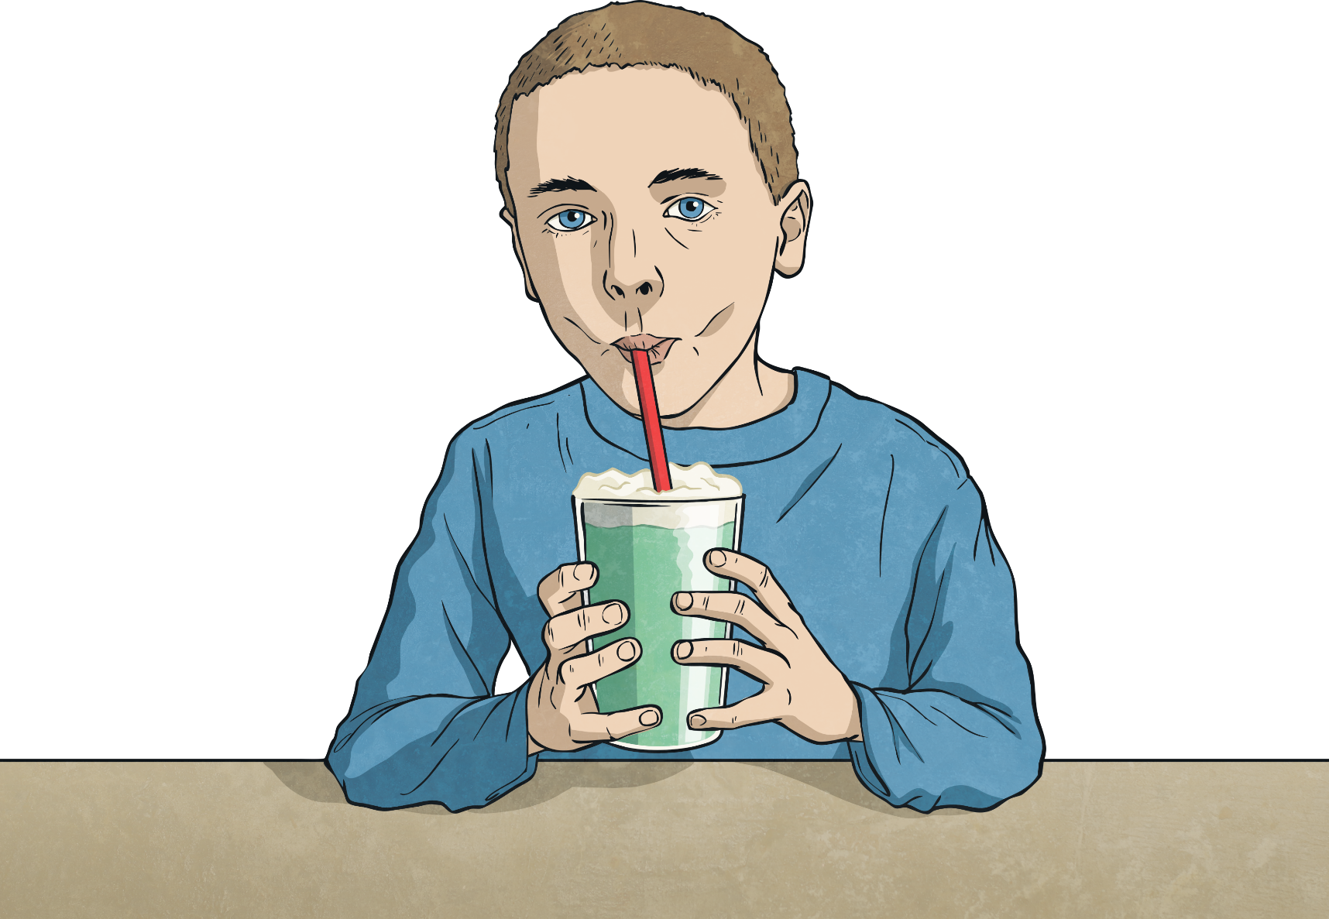
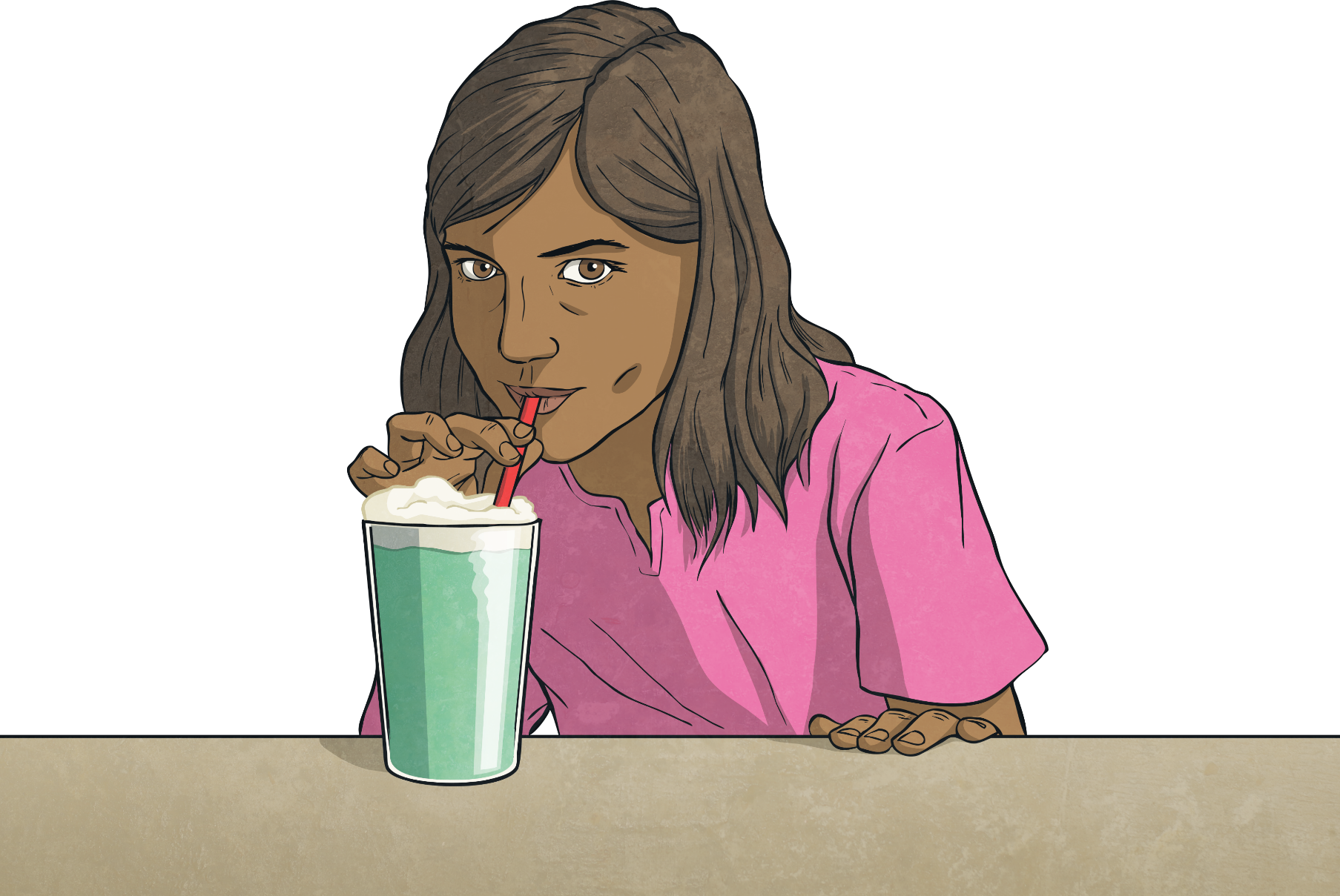
Milk Delivery Problems
Maria and her brother, Karolis, bought 3 pints of milk to make milkshakes. They already had 3 litres of milk at home. How much milk did they have altogether? Give your answer in pints.
They used 4 litres of milk to make the milkshakes. How much milk did they have left over? Give your answer in pints.
3 litres = 5.4 pints
5.4 pints + 3 pints = 8.4 pints
They had 8.4 pints of milk in total.
4 litres = 7.2 pints
8.4 pints - 7.2 pints = 1.2 pints
They had 1.2 pints of milk left over.
1 pint ≈ 0.6l
1l ≈ 1.8 pints

Slide 7
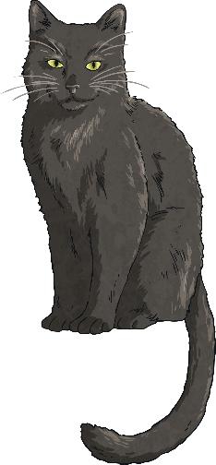
Milk Delivery Problems
Maria says that more than 8 litres was delivered overall. Karolis says that it was less than 8 litres. Who is correct? Explain how you know.
Milko delivered the following amounts of milk to Maria’s family:
Monday | Tuesday | Wednesday | Thursday | Friday
2 pints | 1 pint | 3 pints | 2 pints | 4 pints
How did you calculate the answer?
10 pints = 6l
2 pints = 1.2l
6l + 1.2l = 7.2l
Milko delivered 12 pints altogether. We need to convert this amount to litres. One way of doing this would be to split it into 10 pints and 2 pints.
This is less than 8 litres – Karolis is correct.

Slide 8
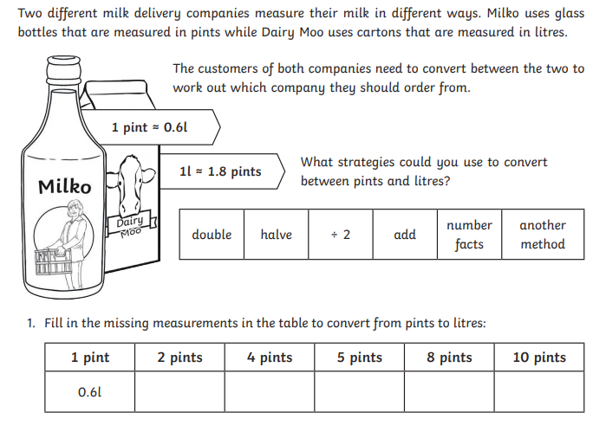
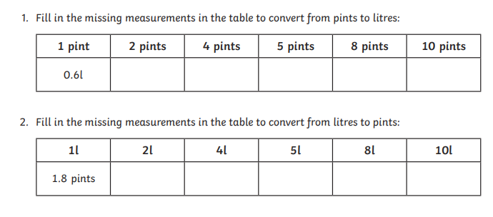
Your turn

Slide 9
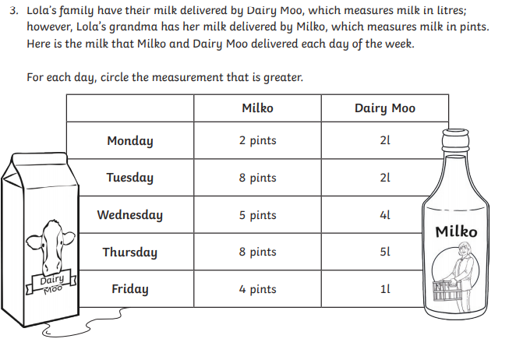
For each day write down the greater measurement.

