Slide 1
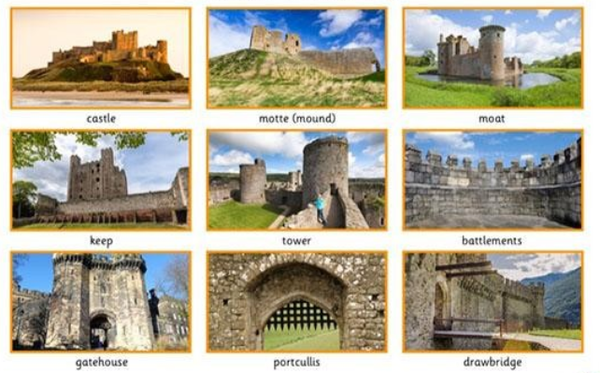
Different Parts of a Castle

