Slide 1
Adding and Subtracting Mixed numbers

Slide 2
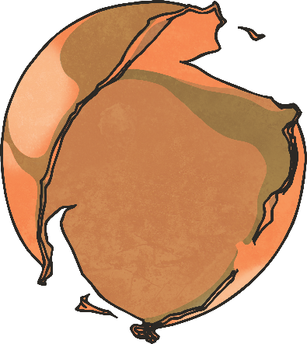
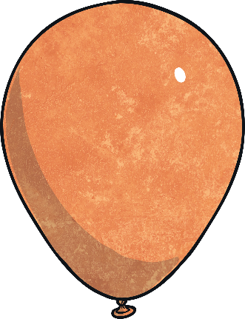
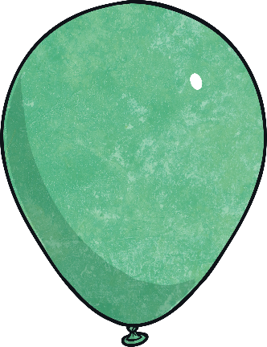
Warm up- Can you remember what a PROPER fraction is?
Pop the balloons which are proper fractions.
1 3
5 3
4 7
5
5 8
3 4
3 4
2
12 8
8 4

Slide 3
Improper Fraction?
Pop the balloons which are improper fractions.
1 3
5 3
4 7
5
5 8
3 4
3 4
2
12 8
8 4

Slide 4
Mixed Number
Pop the balloons which are mixed-number fractions.
1 3
5 3
4 7
5
5 8
3 4
3 4
2
12 8
8 4

Slide 5
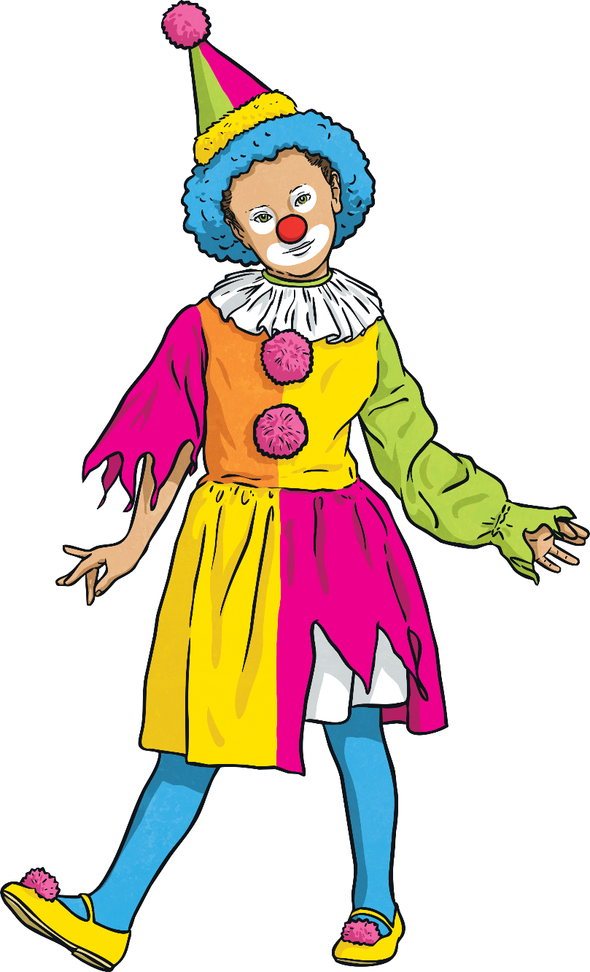
So how do we add mixed
How would you add these mixed numbers together?
We can add the whole numbers and the fractions separately.
1 8
+
3 8
1
1

Slide 6
So how do we add mixed
How would you add these mixed numbers together?
First we add the 2 whole numbers.
1 8
+
3 8
1
1
= 2

Slide 7
So how do we add mixed
How would you add these mixed numbers together?
Now we add the fraction.
1 8
+
3 8
1
1
= 2
=$\frac{1}{8}+\frac{3}{8}$ = $\frac{4}{8}$

Slide 8
So how do we add mixed
How would you add these mixed numbers together?
Now we just add the 2 together.
1 8
+
3 8
1
1
2 +$\frac{4}{8}$= 2$\frac{4}{8}$

Slide 9
What has happened on this one?
How would you add these mixed numbers together?
The answer is 2 $\frac{10}{8}$
7 8
+
3 8
1
1

Slide 10
What has happened on this one?
How would you add these mixed numbers together?
The answer is 2 $\frac{10}{8}$
7 8
+
3 8
1
1
You can’t have a mixed number and an improper fraction. What should we do?

Slide 11
What has happened on this one?
How would you add these mixed numbers together?
The answer is 2 $\frac{10}{8}$
7 8
+
3 8
1
1
We need to convert the improper fraction.
$\frac{10}{8}$ = 1 $\frac{2}{8}$ Now what?

Slide 12
What has happened on this one?
How would you add these mixed numbers together?
The answer is 2 $\frac{10}{8}$
7 8
+
3 8
1
1
Challenge:
Can you simplify it?
Add it to the 2!!!
1 $\frac{1}{8}$ + 2= 3 $\frac{2}{8}$

Slide 13
What has happened on this one?
How would you add these mixed numbers together?
The answer is 2 $\frac{10}{8}$
7 8
+
3 8
1
1
Add it to the 2!!!
1 $\frac{1}{8}$ + 2= 3 $\frac{2}{8}$
3 $\frac{2 }{8}$ = 3 $\frac{1}{4}$

Slide 14
What has happened now ?
Can you spot the extra step?
1 4
+
3 8
1
1

Slide 15
What has happened now ?
Yep!!!
All we need to do is find the common multiple and 4 and 8 to create equivalent fractions.
1 4
+
3 8
1
1

Slide 16
What has happened now ?
Easy, I already know that $\frac{1}{4}$ = $\frac{2}{8}$
So now it becomes
1 $\frac{2}{8 }+1\frac{3}{8}=2\frac{5}{8}$
1 4
+
3 8
1
1
Now you try the questions on P1 of your new Home Learning pack.

Slide 17
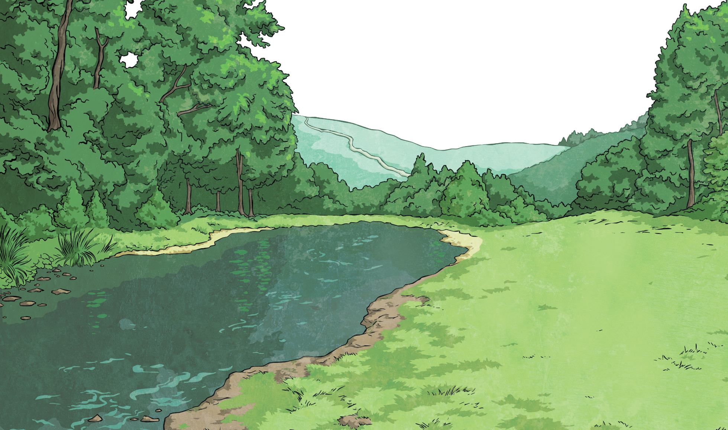
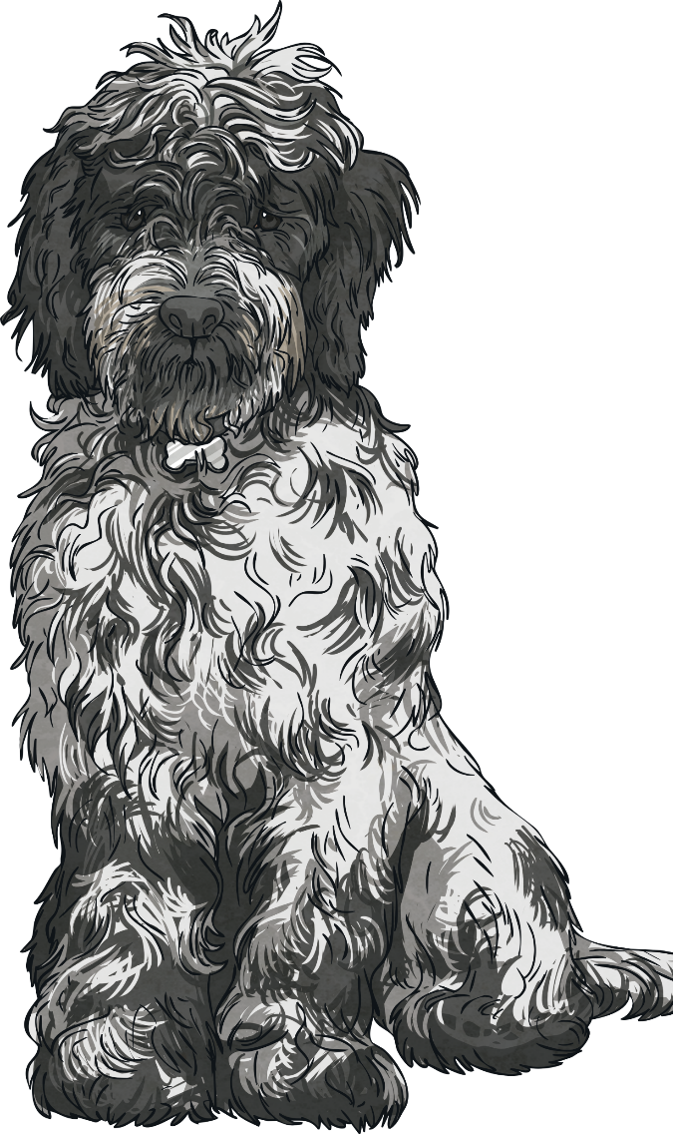
Mixed-Number Fraction Count
Count forwards and backwards along the counting stick in mixed numbers.
1
1
1
3
2
1
2
3
?
?
?
?
5
5
5
5
1
2
3
?
?
?
?
1
2
1
4
2
2
2
4
5
5
5
5

Slide 18
Mixed-Number Fraction Count
Count forwards and backwards along the counting stick in mixed numbers.
1
1
1
3
2
1
2
3
3
1
?
?
?
?
?
4
4
4
4
4
1
2
3
?
?
?
1
1
2
1
3
1
2
2
2

Slide 19
Mixed-Number Fraction Count
Count forwards and backwards along the counting stick in mixed numbers.
1
1
2
1
3
1
4
1
?
?
?
?
3
3
3
3
1
2
3
4
?
?
?
1
2
2
2
3
2
3
3
3

Slide 20
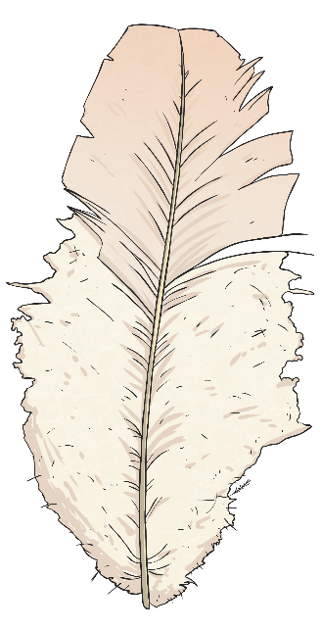
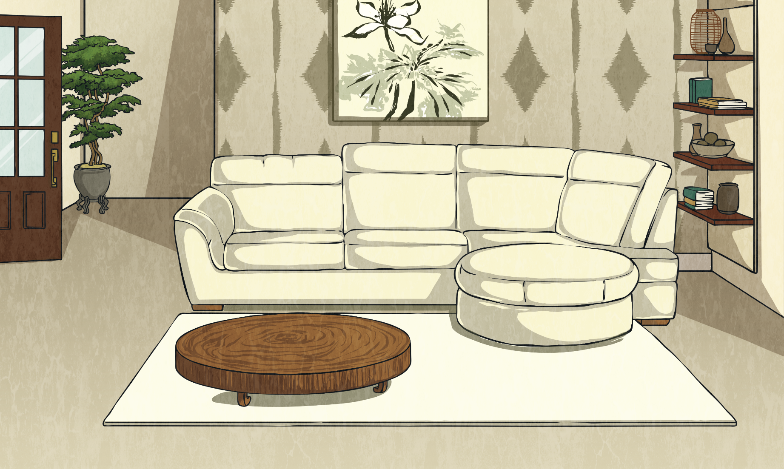
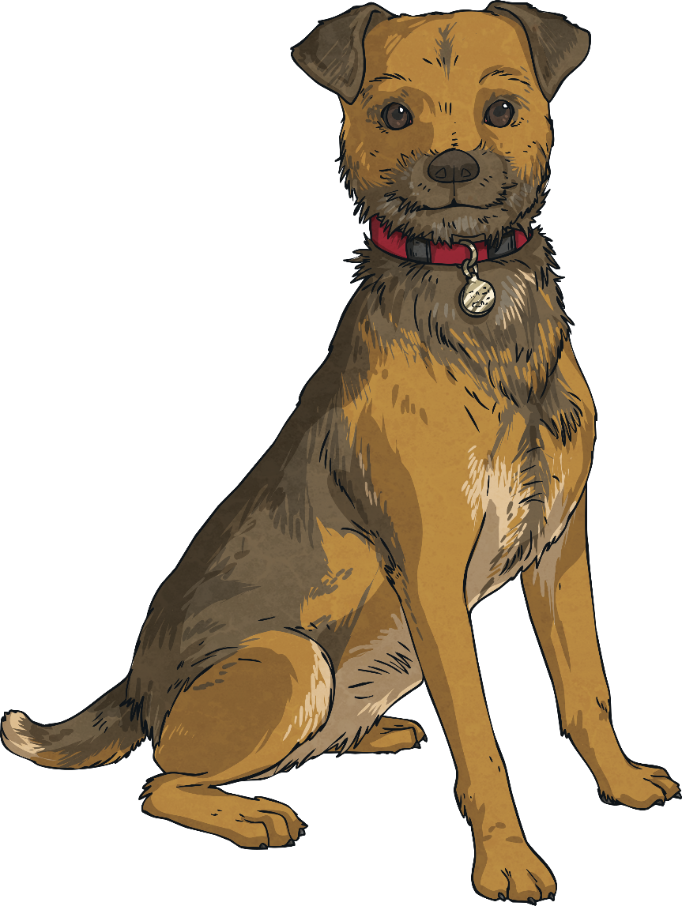
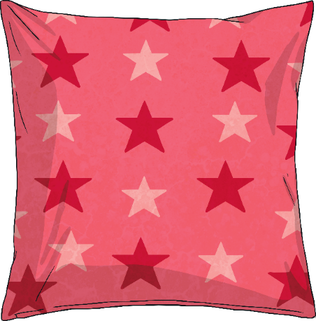
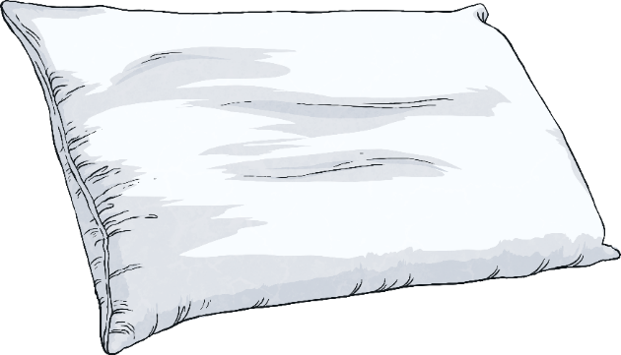
Subtraction with Regrouping
Easy!!!
$\frac{3}{4}$– $\frac{1}{4}$ = $\frac{2}{4}$
and 3-1 =2.
So……
3
3
4
−
1
1
4

Slide 21
Subtraction with Regrouping
Easy!!!
$\frac{3}{4}$– $\frac{1}{4}$ = $\frac{2}{4}$
and 3-1 =2.
So……
3
3
4
−
1
1
4
2 $\frac{2}{4}$

Slide 22
Subtraction with Regrouping
Can you simplify it?
3
3
4
−
1
1
4
2 $\frac{2}{4}$

Slide 23
Subtraction with Regrouping
2$\frac{2}{4 }=\text{2}\frac{1}{2}$
3
3
4
−
1
1
4
2 $\frac{2}{4}$

Slide 24
Subtraction with Regrouping
Have a think.
How would you subtract these mixed numbers?.
3
1
4
−
1
1
8

Slide 25
Subtraction with Regrouping
We need to find the equivalent fraction so they have common denominators.
3
1
4
−
1
1
8

Slide 26
Subtraction with Regrouping
Easy!!! We know that $\frac{1 }{4 }=\frac{2}{8}$
3
1
4
−
1
1
8

Slide 27
Subtraction with Regrouping
So it is 3 $\frac{2}{8 }−1\frac{1}{ 8}=2\frac{1}{8}$
3
1
4
−
1
1
8

Slide 28
Your turn to complete p2 in your new maths booklets.

