Slide 2
Step 1: Click this link to access Reading Plus.
Or Google Reading Plus and click Student log in option.
https://student.readingplus.com/seereader/api/sec/login

Slide 3
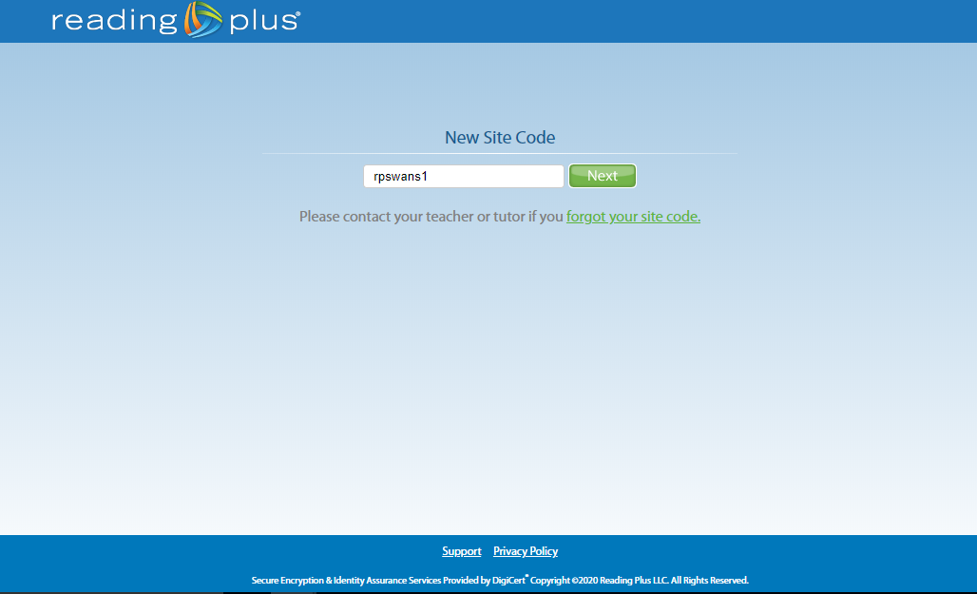
Step 2: You will see this page. Type in our site code is rpswans1

Slide 4
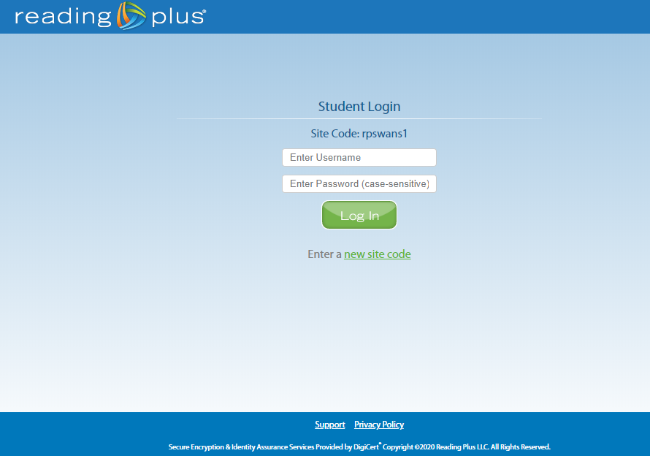
Step 3: This is when you enter your personal log in details. There is a copy in your packs but if you need a copy please drop me an email.

Slide 5
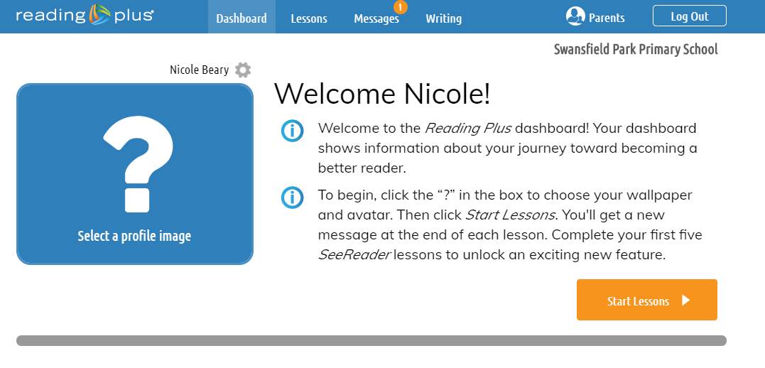
Step 4: You will be taken to this page. When you are ready click Start Lesson.

Slide 6
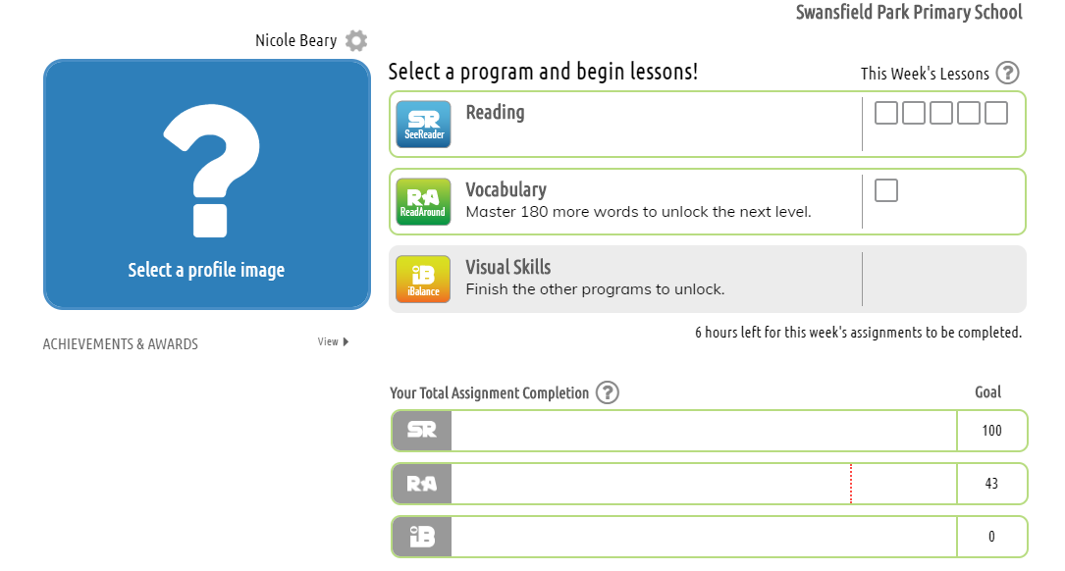
Step 5: On your next page you will see this page. Start by clicking Reading.

Slide 7
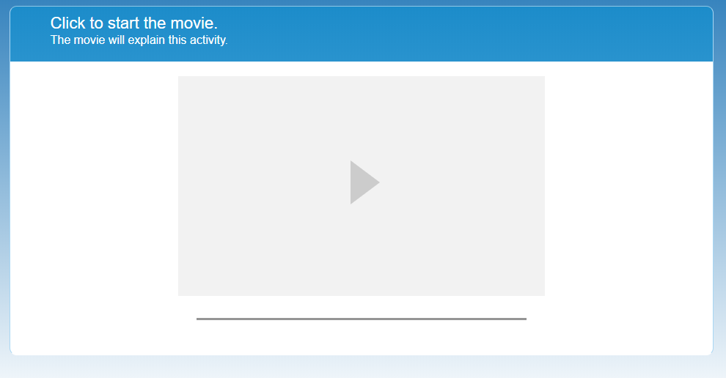
Step 6: The next page will have a movie which explains the activity. Once you have watched it, the programme will take you to your

Slide 8
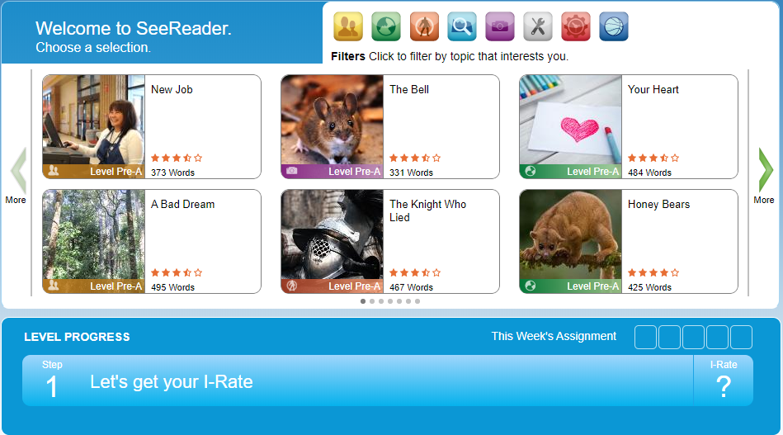
Step 7: On this page you can choose to read a topic that interests you. As you can see at the bottom you have to read 5 each week.

Slide 9
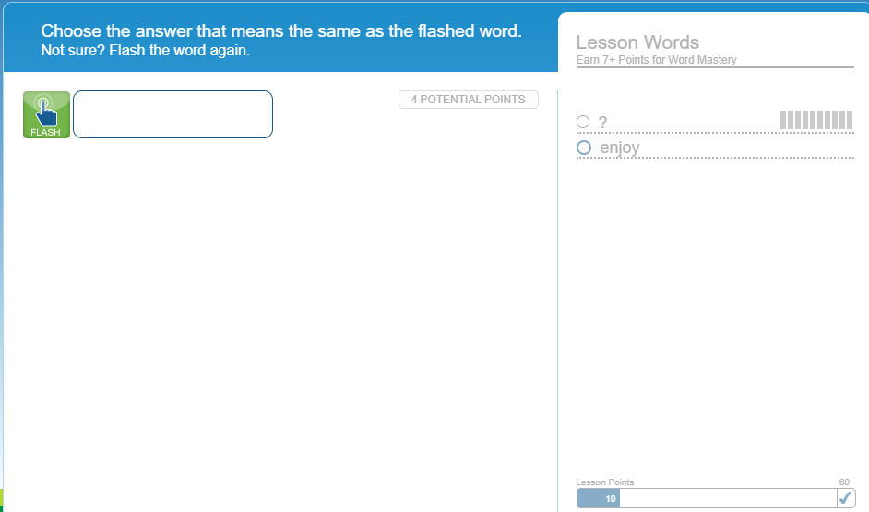
Step 8: Once you have completed the reading it is time to practise your vocabulary. After you have watched the introduction video the programme will take you to this page. Work through the tasks and keep building those points.

