Slide 1
Lesson 1: Decimals as Fractions
© Classroom Secrets Limited 2019

Slide 2
Warm up
Match the statements to the decimals.
7 ones, 4 tenths and 5 hundredths |  | 5.47
5 ones, 7 tenths and 4 hundredths |  | 4.75
4 ones, 7 tenths and 5 hundredths |  | 7.45
5 ones, 4 tenths and 7 hundredths |  | 5.74
© Classroom Secrets Limited 2019

Slide 3
Were you correct?
Match the statements to the decimals.
7 ones, 4 tenths and 5 hundredths |  | 5.47
5 ones, 7 tenths and 4 hundredths |  | 4.75
4 ones, 7 tenths and 5 hundredths |  | 7.45
5 ones, 4 tenths and 7 hundredths |  | 5.74
© Classroom Secrets Limited 2019

Slide 4
Varied Fluency 1
Circle the fraction and decimal which match the picture.
9
100
90
100
0.9
0.09
Lets use our knowledge of fractions to start. We know that the denominator shows us how many parts the shape is broken into. Count the squares.
© Classroom Secrets Limited 2019

Slide 5
Varied Fluency 1
Circle the fraction and decimal which match the picture.
9
100
90
100
0.9
0.09
$$\frac{?}{10}$$
Now we know the denominator is 10. We can work out the numerator by counting the squares shaded in.
© Classroom Secrets Limited 2019

Slide 6
Varied Fluency 1
Circle the fraction and decimal which match the picture.
9
100
90
100
0.9
0.09
$$\frac{9}{10}$$
Great we have the fraction, in its simplest form. Can you spot the equivalent?
© Classroom Secrets Limited 2019

Slide 7
Varied Fluency 1
Circle the fraction and decimal which match the picture.
9
100
90
100
0.9
0.09
$$\frac{9}{10}$$
How can we use this to find the decimal equivalent?
© Classroom Secrets Limited 2019

Slide 8
Varied Fluency 1
Circle the fraction and decimal which match the picture.
$$\frac{9}{10}$$
0.9
9
100
90
100
0.09
© Classroom Secrets Limited 2019

Slide 9
0.9
$$\frac{9}{10}$$
Look at our first fraction . This tells us there is 9 under the tenths column. If we
write it in our place value chart. We now know it is 0.9

Slide 10
Fantastic!!!
Circle the fraction and decimal which match the picture.
9
100
90
100
0.9
0.09
© Classroom Secrets Limited 2019

Slide 11
Now can you use the place value chart to match these fractions and decimals. Match the fractions to their decimal equivalents.
A. | 6 |  | 0.6
 | 100
B. | 6 |  | 0.65
 | 10
C. | 65 |  | 0.06
 | 100
Top tip. If it is 6/100. Write the 6 in the hundredth place value column and use place holders. 0.06.
© Classroom Secrets Limited 2019

Slide 12
Were you correct?
Match the fractions to their decimal equivalents.
A. | 6 |  | 0.6
 | 100
B. | 6 |  | 0.65
 | 10
C. | 65 |  | 0.06
 | 100
© Classroom Secrets Limited 2019

Slide 13
Now can you use these skills to complete this table.
Complete the table below.
#Top tip. Write them in your place value columns
Fractions | Decimals
 | 0.07
25
100
1
2
© Classroom Secrets Limited 2019

Slide 14
Were you correct
Complete the table below.
Fractions | Decimals
 | 0.25
 | 0.07
 | 0.5
25
100
7
100
1
2
© Classroom Secrets Limited 2019

Slide 15
Easy!
Don’t forget to use your place value columns to help.
Match the decimals below to their expanded forms.
0.68 |  | 8 + 0.06
6.08 |  | 6 + 0.8
8.6 |  | 0.6 + 0.08
8.06 |  | 6 + 0.08
6.8 |  | 8 + 0.6
© Classroom Secrets Limited 2019

Slide 16
Introduction
Match the decimals below to their expanded forms.
0.68 |  | 8 + 0.06
6.08 |  | 6 + 0.8
8.6 |  | 0.6 + 0.08
8.06 |  | 6 + 0.08
6.8 |  | 8 + 0.6
© Classroom Secrets Limited 2019

Slide 17
Now complete p6 and 7 from your work pack.

Slide 18
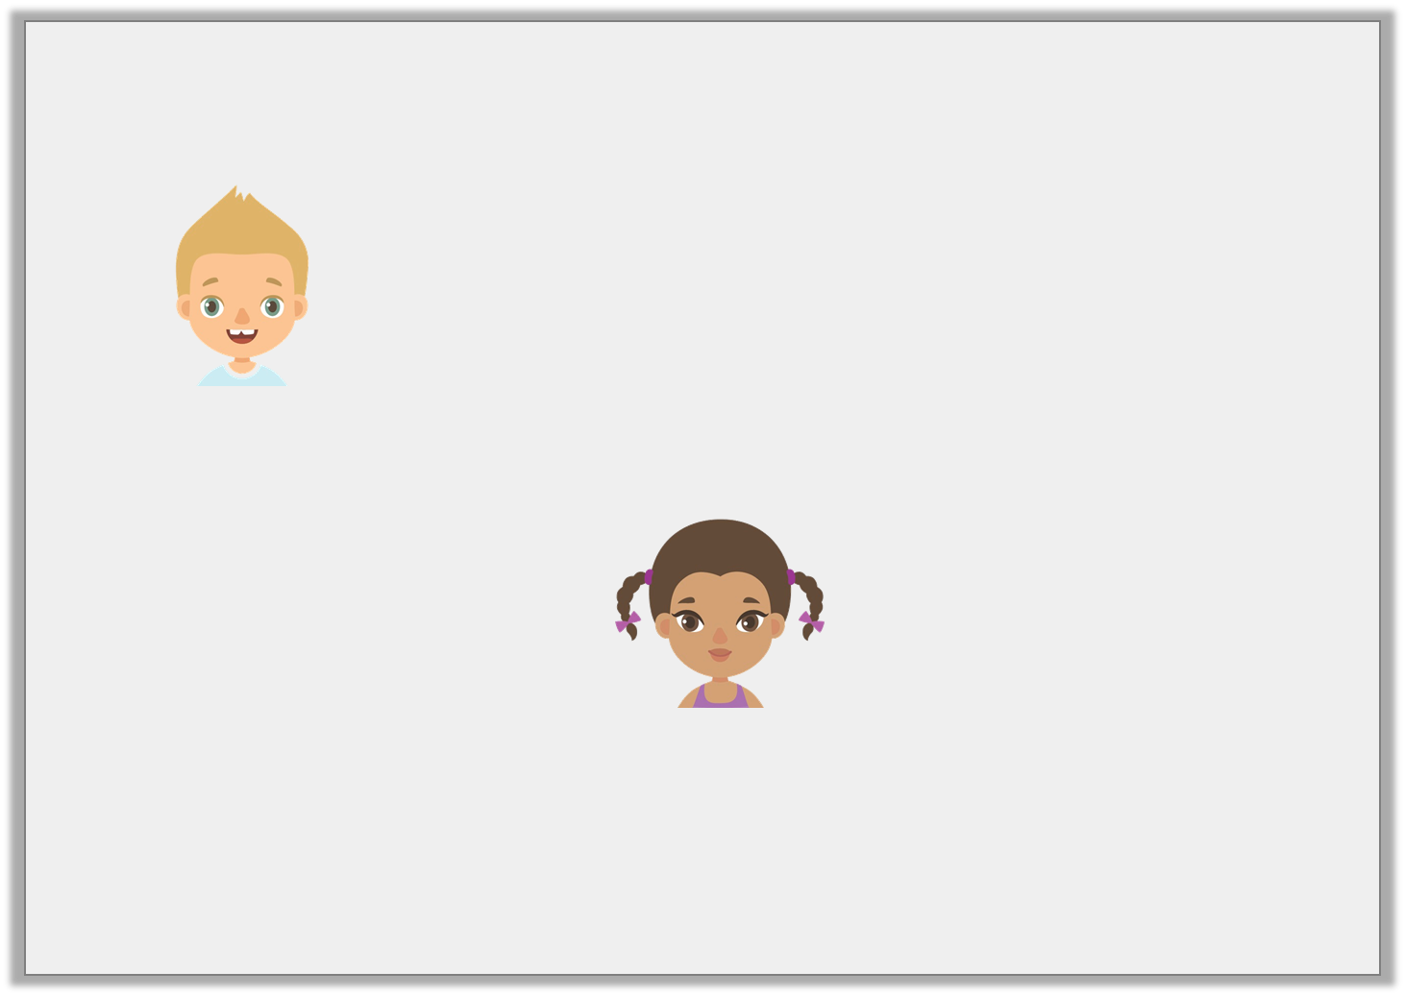
Reasoning 1
Seth says,
Leticia says,
Who is correct? Prove it.
is equal to 0.25
1
4
is equal to 1.4
1
4
© Classroom Secrets Limited 2019

Slide 19
Reasoning 1
Seth says,
Leticia says,
Who is correct? Prove it.
Seth is correct because…
is equal to 0.25
1
4
is equal to 1.4
1
4
© Classroom Secrets Limited 2019

Slide 20
Reasoning 1
Seth says,
Leticia says,
Who is correct? Prove it.
Seth is correct because is equal to which is equal to 0.25.
is equal to 0.25
1
4
is equal to 1.4
1
4
1
4
25
100
© Classroom Secrets Limited 2019

