Slide 1
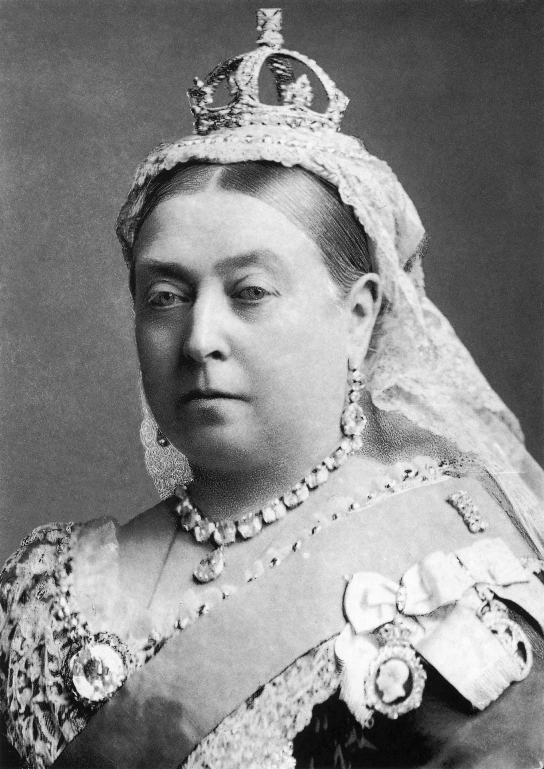
THE VICTORIANS
By Max and Lilly

Slide 2
Queen Victoria
She became queen when she was 18 years old.
She was queen for 63 years
Queen victoria died on the 22nd january 1901.

Slide 3
Victorian schools
The school were made out of stone.
There were 8 games to play in the victorian times.
The color of the uniforms were brown,black and white

Slide 4
The workhouse
All the food in the workhouse is terrible.
The girls in the workhouse have to nit.
The boys have to lift.

Slide 5
Rich VS poor
The rich have big houses. The poor have very bad schools.
The rich have a lot of money. The poor have very small houses.
The rich has good schools. The poor hat to work in the workhouse.

