Slide 1
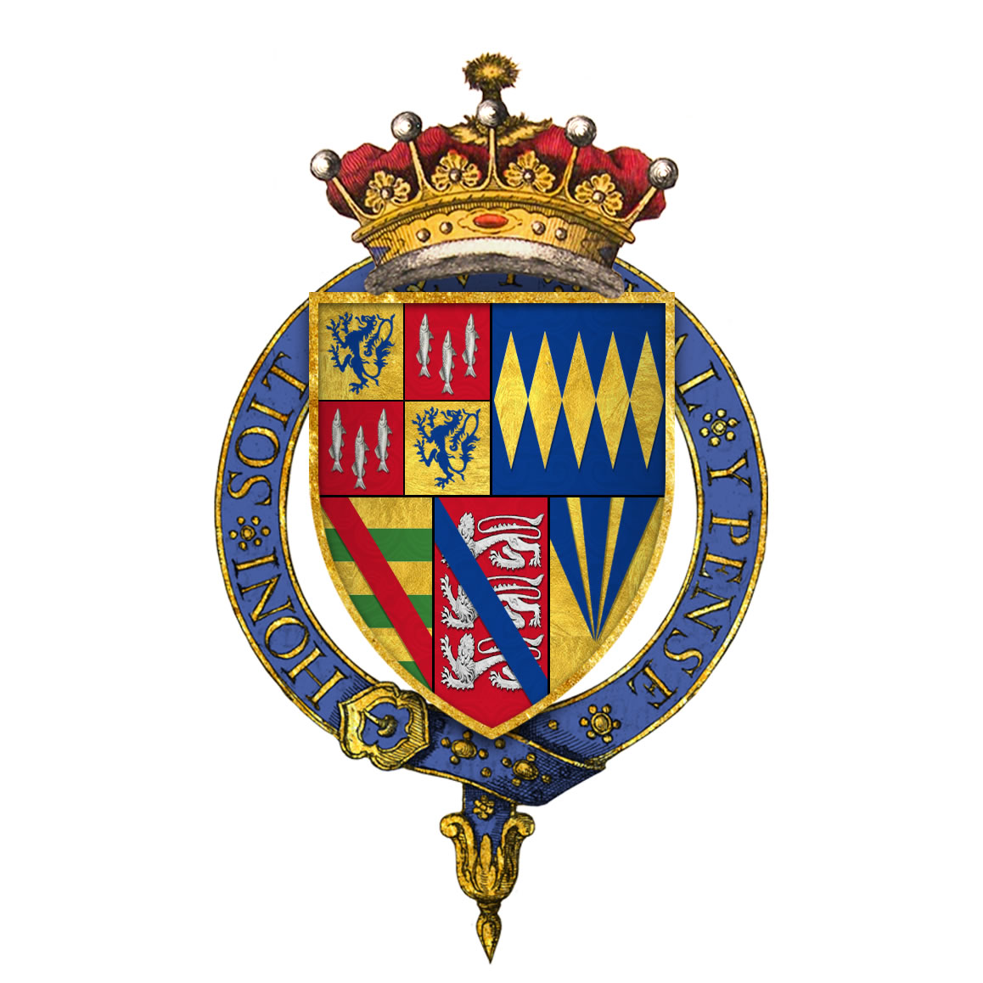
Coats of Arms
Long ago rich families would have a coat of arms made which they would paint on their shields or sew onto fabric and hang them in their castles.
This is the coat of arms for the Percy family who live in Alnwick Castle. Their Coat of Arms was designed many many years ago.

Slide 2
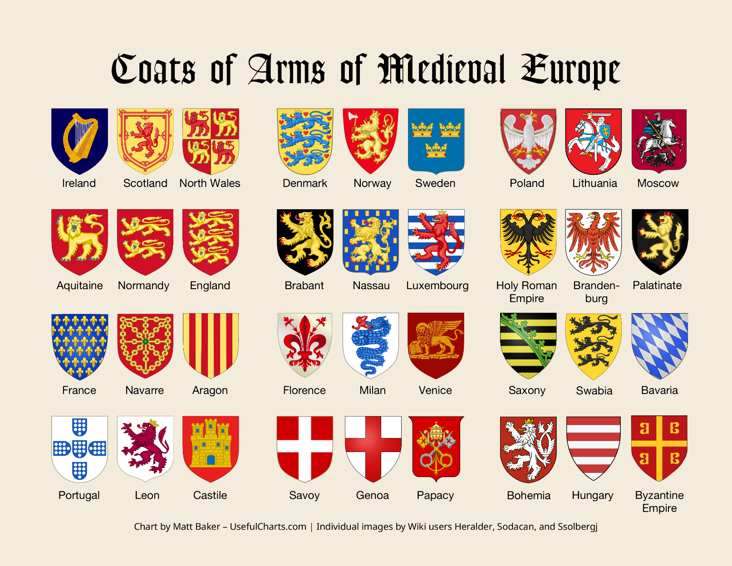
Here are some other famous Coats of Arms from different countries.

Slide 3
