Slide 2
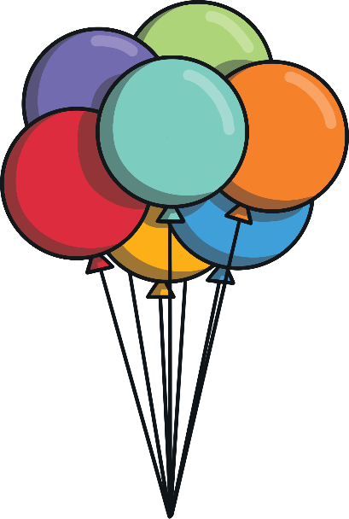
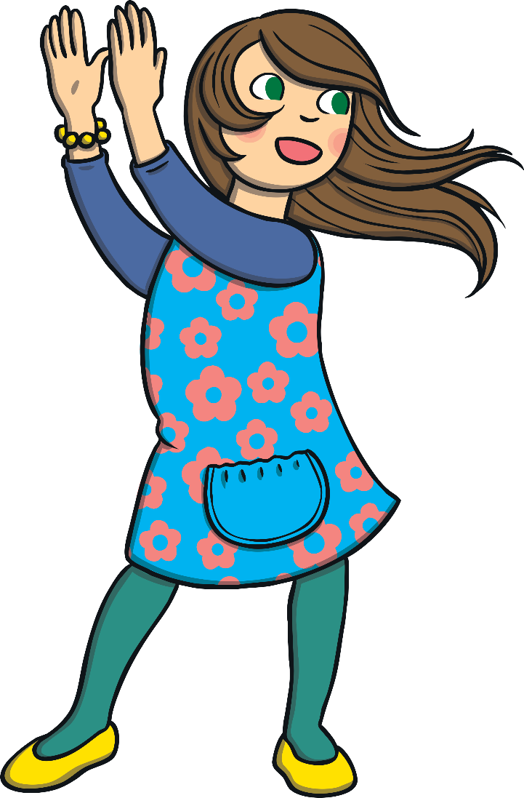
What are syllables?
Syllables are the beats or chunks that we hear in words.
Let’s clap out the syllables in the word syllables.
Sy - lla - bles = 3 claps
Now practise clapping your name.

Slide 3
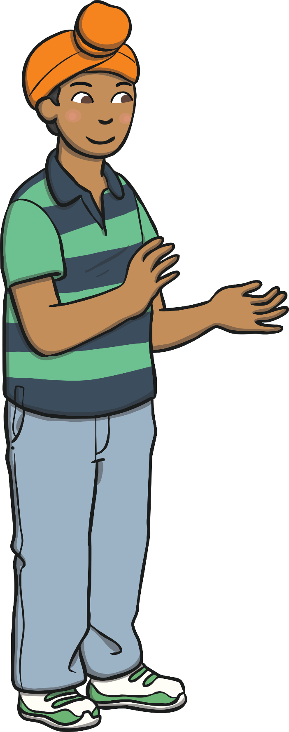
Clap Your Hands
Let’s clap out these family name syllables.
brother
sister
cousin
mum
dad
grandpa
grandma
friend

Slide 4
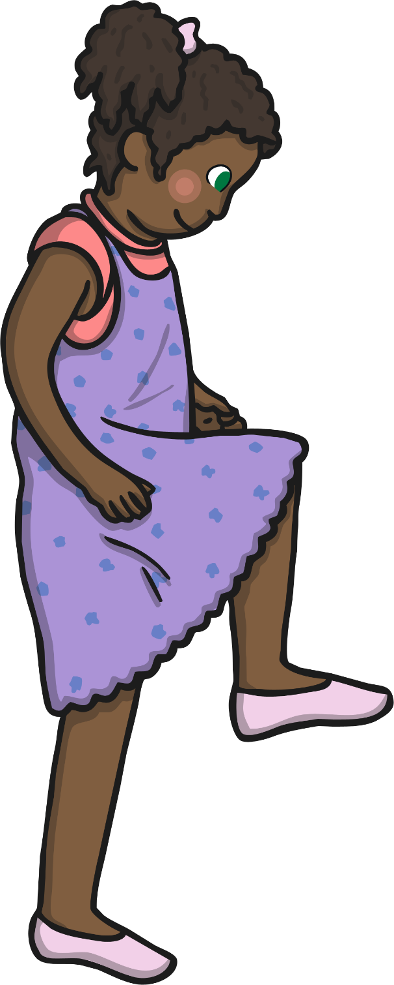
Stamp Your Feet
Let’s stamp out these animal name syllables.
crocodile
chimpanzee
hippopotamus
tiger
zebra
kangaroo
koala
horse

Slide 5
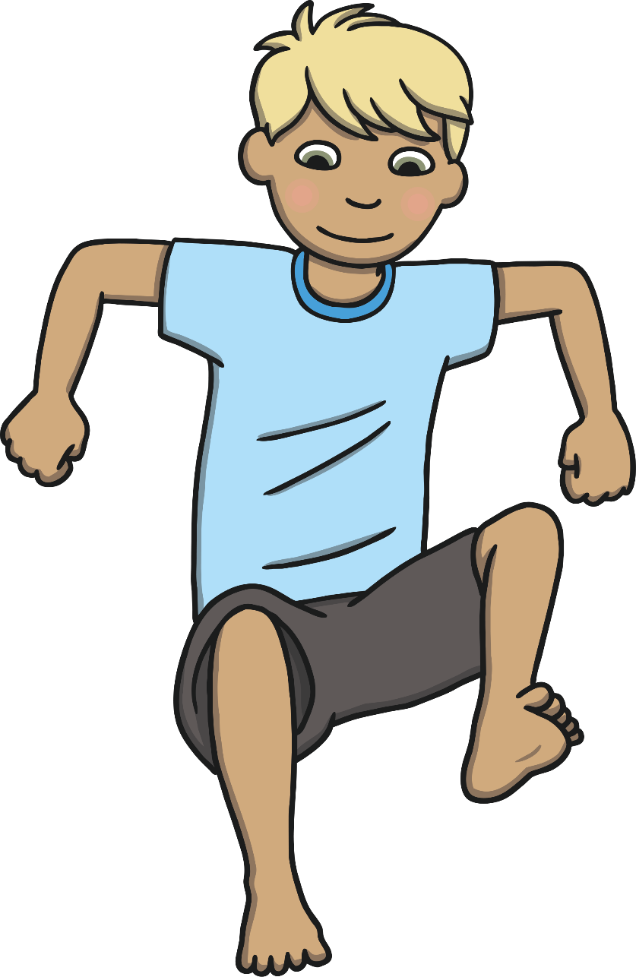
Jump Up and Down
Let’s jump out these food name syllables.
broccoli
carrot
cucumber
tomato
banana
apple
watermelon
celery

Slide 6
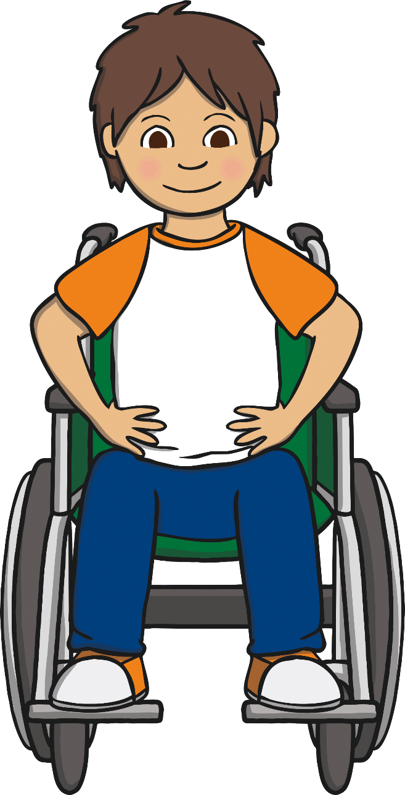
Sway from Side to Side
Let’s sway out these electronic name syllables
telephone
laptop
tablet
camera
microwave
refrigerator
computer
battery

Slide 7
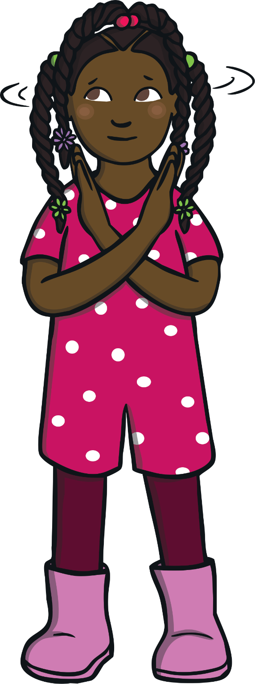
Shake Your Head from Side to Side
Let’s shake out these flower name syllables.
daffodil
rose
carnation
lily
daisy
sunflower
tulip

Slide 8
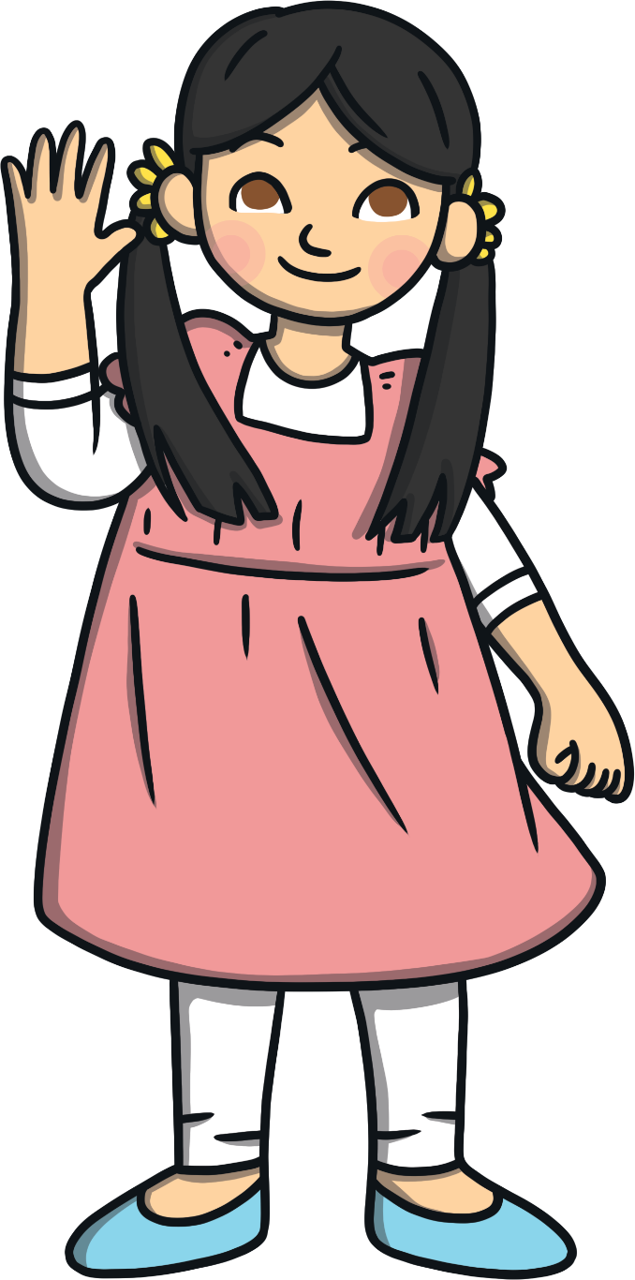
Wave Your Arms
Let’s wave out these clothing name syllables.
jumper
shirt
underwear
socks
trousers
beanie
gloves
raincoat

