Slide 1
Maths
Fractions
Year One
Maths | Year 5 | Fractions | Multiply Fractions | Lesson 2 of 2: Bubble Blast

Slide 2
Multiplying Mixed numbers
In this lesson you will:
understand that multiplication is the same as repeated addition.
use fraction diagrams to multiply fractions by whole numbers.
convert between improper fractions and mixed numbers.

Slide 3
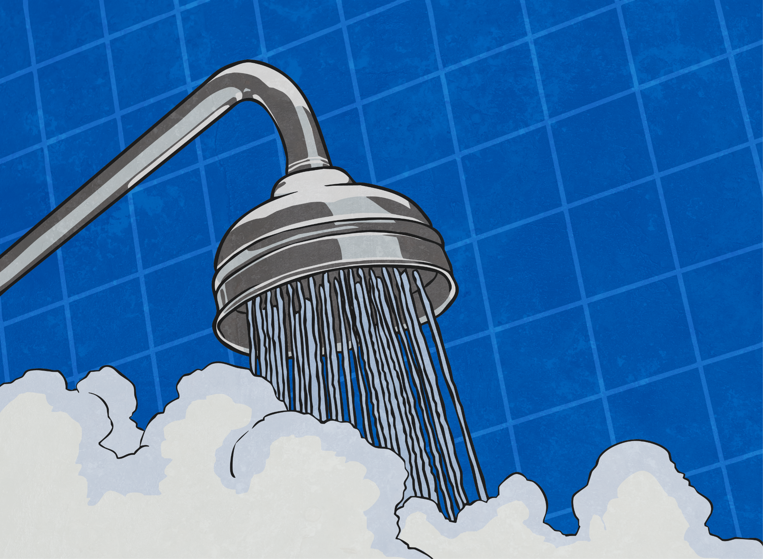
Fraction Bubble Burst
Pop the bubbles which are proper fractions.
$$\frac{\text{2}}{\text{3}}$$
$$\frac{\text{1}}{\text{4}}$$
$$\frac{\text{4}}{\text{9}}$$
5
$$\frac{\text{13}}{\text{4}}$$
$$\frac{\text{15}}{\text{8}}$$
$$\frac{\text{6}}{\text{7}}$$
2
$$\frac{\text{1}}{\text{4}}$$
8
$$\frac{\text{7}}{\text{3}}$$
$$\frac{\text{7}}{\text{8}}$$

Slide 4
Fraction Bubble Burst
Pop the bubbles which are improper fractions.
$$\frac{\text{1}}{\text{4}}$$
$$\frac{\text{2}}{\text{3}}$$
$$\frac{\text{1}}{\text{4}}$$
8
$$\frac{\text{13}}{\text{4}}$$
$$\frac{\text{15}}{\text{8}}$$
$$\frac{\text{6}}{\text{7}}$$
2
$$\frac{\text{4}}{\text{9}}$$
5
$$\frac{\text{7}}{\text{8}}$$
$$\frac{\text{7}}{\text{3}}$$

Slide 5
Fraction Bubble Burst
Pop the bubbles which are mixed numbers.
$$\frac{\text{13}}{\text{4}}$$
$$\frac{\text{4}}{\text{9}}$$
$$\frac{\text{7}}{\text{3}}$$
5
$$\frac{\text{15}}{\text{8}}$$
$$\frac{\text{7}}{\text{8}}$$
$$\frac{\text{6}}{\text{7}}$$
2
$$\frac{\text{1}}{\text{4}}$$
8
$$\frac{\text{1}}{\text{4}}$$
$$\frac{\text{2}}{\text{3}}$$

Slide 6
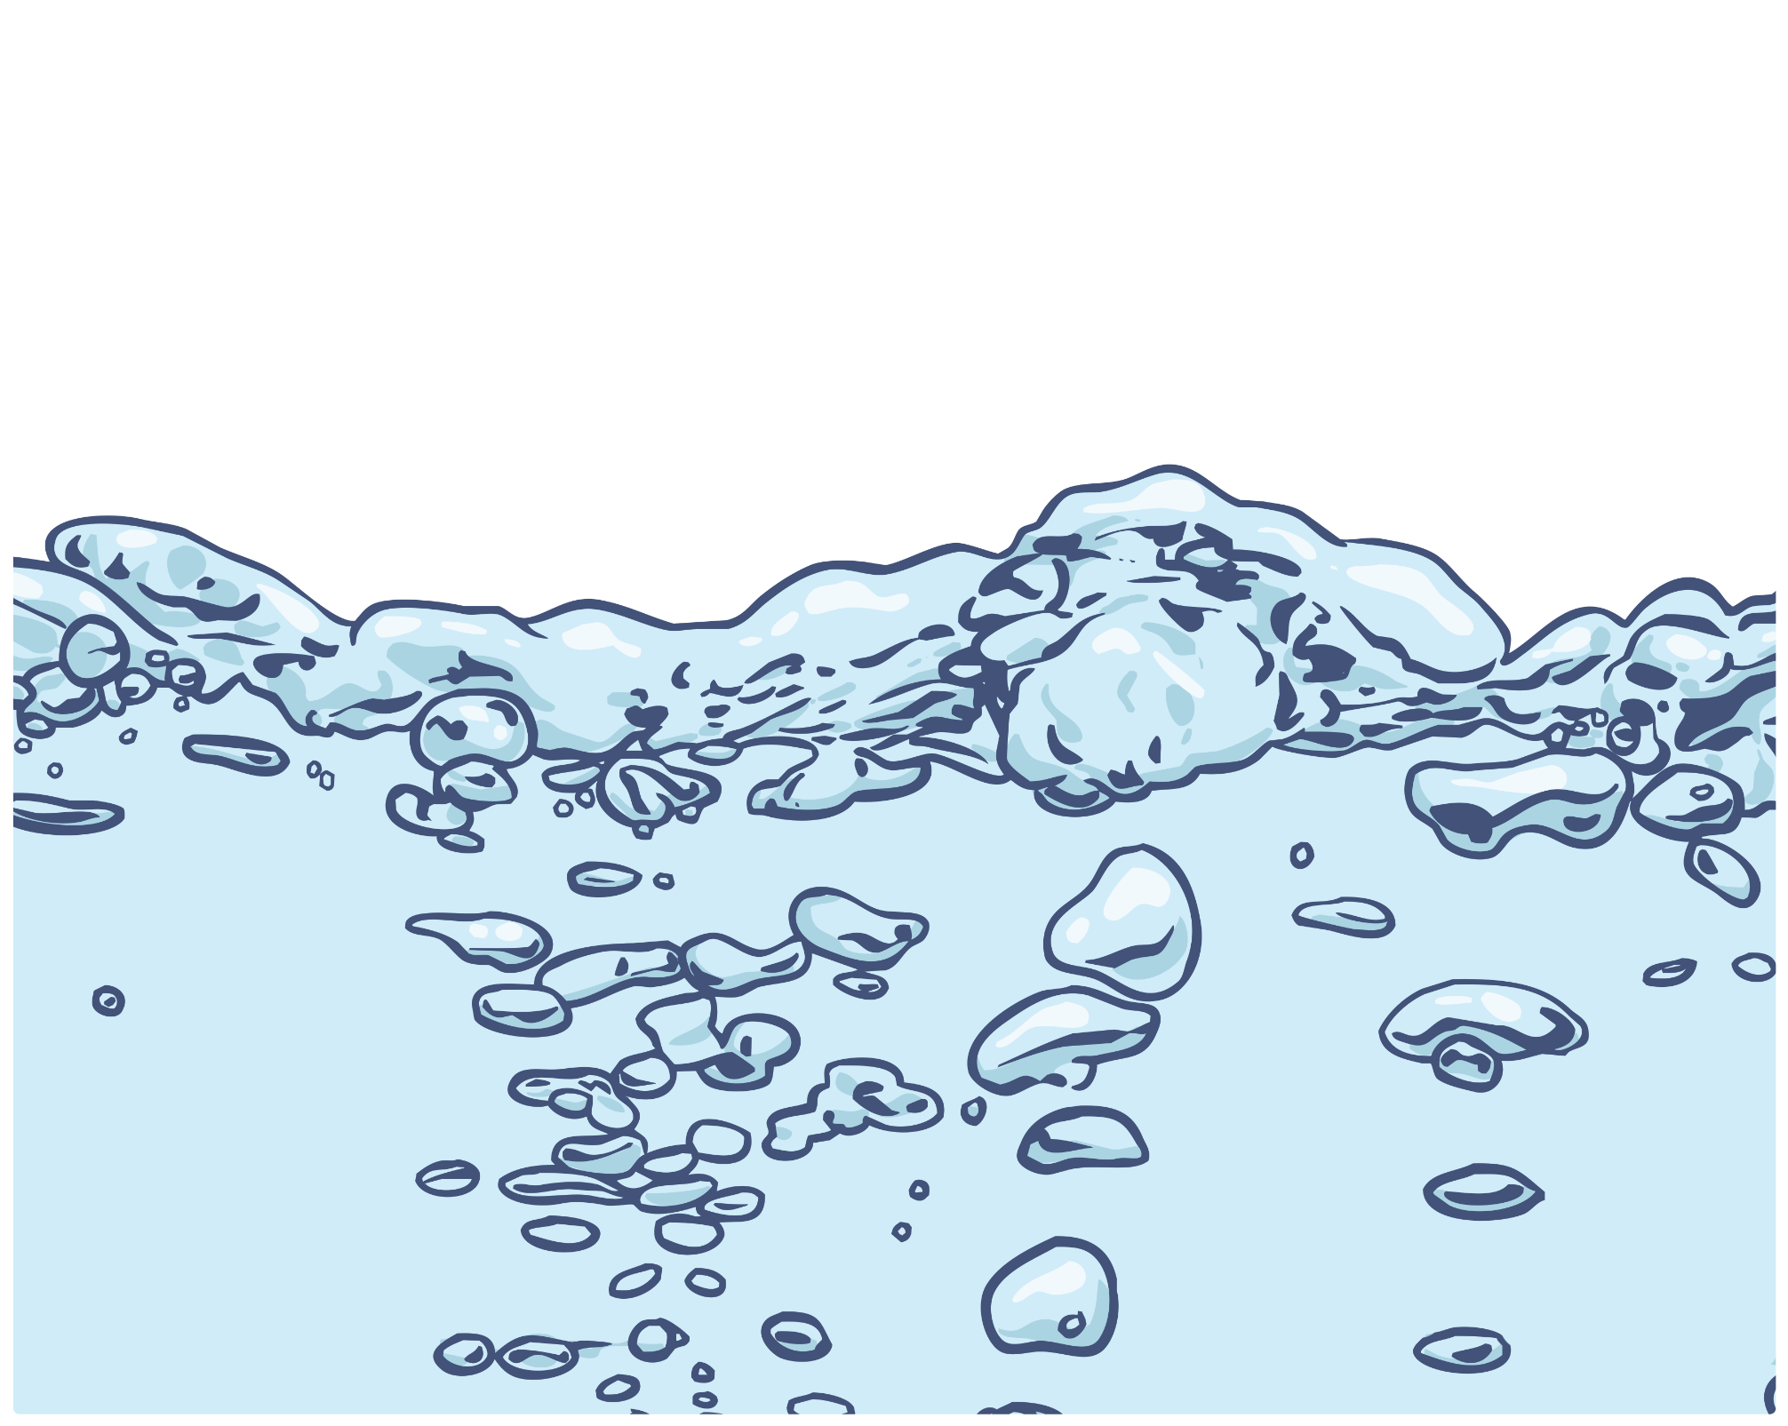
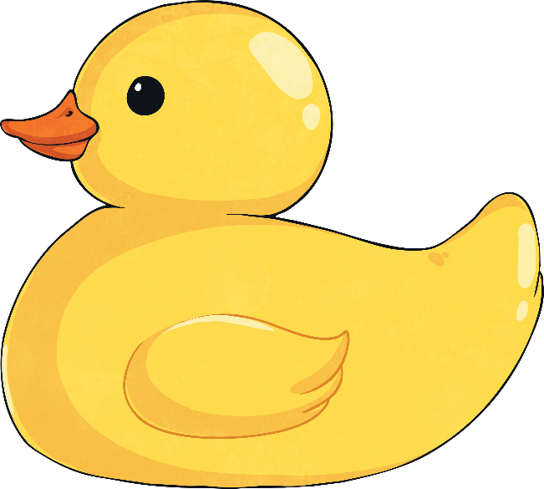
Multiplying Proper Fractions
Multiplying a fraction by a whole number is the same as repeated addition.
The numerator is multiplied by the whole number.
2 × 5 = 10
$$\frac{\text{2}}{\text{7}}$$
× 5
The denominator is multiplied by one.
7 × 1 = 7
$$\frac{\text{2}}{\text{7}}$$
$$\frac{\text{2}}{\text{7}}$$
$$\frac{\text{2}}{\text{7}}$$
$$\frac{\text{2}}{\text{7}}$$
$$\frac{\text{2}}{\text{7}}$$
$$\frac{\text{10}}{\text{7}}$$
+
+
+
+
=

Slide 7
Multiplying Proper Fractions
There are different strategies to multiply a mixed number by a whole number. One strategy is repeated addition.
The numerator is multiplied by the whole number.
2 × 2 = 4
1$\frac{\text{2}}{\text{7}}$
× 2
The whole is multiplied by the whole number.
1 × 2 = 2
The denominator is multiplied by one.
7 × 1 = 7
1$\frac{\text{2}}{\text{7}}$
1$\frac{\text{2}}{\text{7}}$
2$\frac{\text{4}}{\text{7}}$
+
=

Slide 8
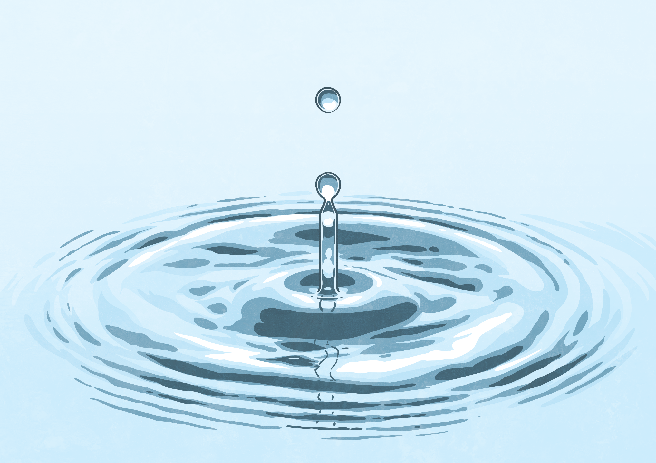
Multiplying Mixed Numbers
To multiply a mixed number by a whole number, you can also change the mixed number into an improper fraction.
In this mixed number, every whole is made of four parts.
(2 × 4) + 1 = 9
The numerator is multiplied by the whole number.
9 × 2 = 18
This answer is an improper fraction. We need to change it to a mixed number.
$$\frac{\text{1}}{\text{4}}$$
$$\frac{\text{9}}{\text{4}}$$
$$\frac{\text{18}}{\text{4}}$$
$$\frac{\text{2}}{\text{4}}$$
2
× 2
=
× 2
=
=
4
The denominator is multiplied by one.
4 × 1 = 4
18 ÷ 4 = 4 r 2

Slide 9
Multiplying Mixed Numbers
To multiply a mixed number by a whole number, you can also change the mixed number into an improper fraction.
In this mixed number, every whole is made of four parts.
(1 × 7) + 4 = 11
The numerator is multiplied by the whole number.
11 × 3 = 33
This answer is an improper fraction. We need to change it to a mixed number.
$$\frac{\text{4}}{\text{7}}$$
$$\frac{\text{11}}{\text{7}}$$
$$\frac{\text{33}}{\text{7}}$$
$$\frac{\text{5}}{\text{7}}$$
1
× 3
=
× 3
=
=
4
The denominator is multiplied by one.
7 × 1 = 7
33 ÷ 7 = 4 r 5

Slide 10
Multiplying Mixed Numbers
Another strategy to multiply a mixed number by a whole number is to partition the whole and the fraction.
Partition the mixed number into a whole and a fraction.
$$\frac{\text{5}}{\text{6}}$$
2
× 4
Multiply the whole and then multiply the fraction.
$$\frac{\text{5}}{\text{6}}$$
$$\frac{\text{20}}{\text{6}}$$
2
× 4 = 8
× 4 =
Add them back together to find the answer.
$$\frac{\text{20}}{\text{6}}$$
8 $\frac{\text{20}}{\text{6}}$
11 $\frac{\text{2}}{\text{6}}$
11 $\frac{\text{1}}{\text{3}}$
8
+
=
=
or

Slide 11
Lets have a go

Slide 12
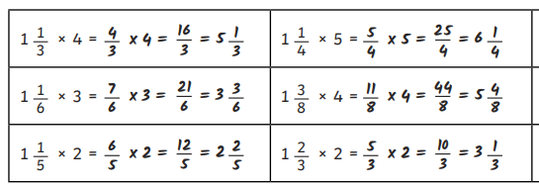
Were you correct?

Slide 13
Word Up
Four friends shared a takeaway.
Each person ate 1 $\frac{\text{2}}{\text{3}}$ pizzas each.
How much pizza was eaten in total?
$$\frac{\text{2}}{\text{3}}$$
$$\frac{\text{5}}{\text{3}}$$
$$\frac{\text{20}}{\text{3}}$$
$$\frac{\text{2}}{\text{3}}$$
1
× 4
=
× 4
=
=
6

Slide 14
Word Up
Six friends took part in a sponsored swim.
They each swam 1 $\frac{\text{5}}{\text{8}}$ km.
How many kilometres did they swim in total?
$$\frac{\text{5}}{\text{8}}$$
$$\frac{\text{13}}{\text{8}}$$
$$\frac{\text{78}}{\text{8}}$$
$\frac{\text{6}}{\text{8}}$km
1
× 6
=
× 6
=
=
9

