Slide 1
Lesson 2: Understanding percentages

Slide 2
Warm up
Match the decimals below to their expanded forms.
0.68 |  | 8 + 0.06
6.08 |  | 6 + 0.8
8.6 |  | 0.6 + 0.08
8.06 |  | 6 + 0.08
6.8 |  | 8 + 0.6
© Classroom Secrets Limited 2019

Slide 3
Were you correct?
Match the decimals below to their expanded forms.
0.68 |  | 8 + 0.06
6.08 |  | 6 + 0.8
8.6 |  | 0.6 + 0.08
8.06 |  | 6 + 0.08
6.8 |  | 8 + 0.6
© Classroom Secrets Limited 2019

Slide 4
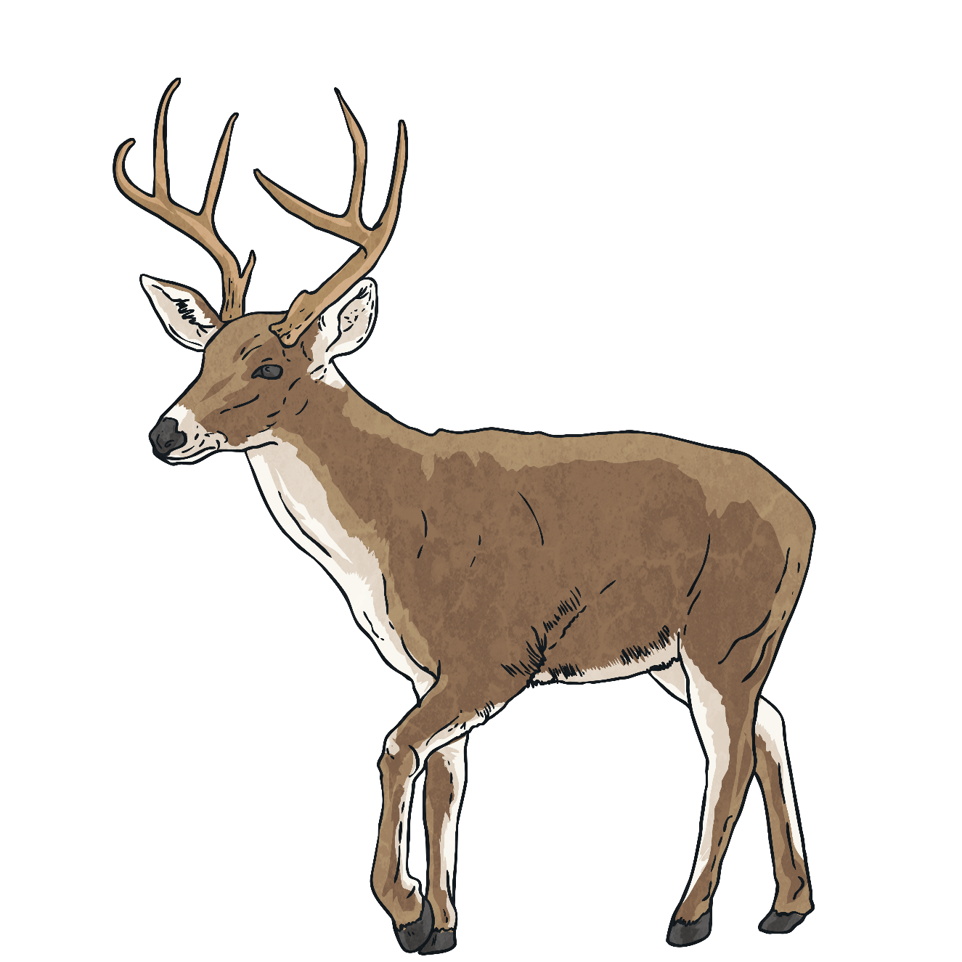
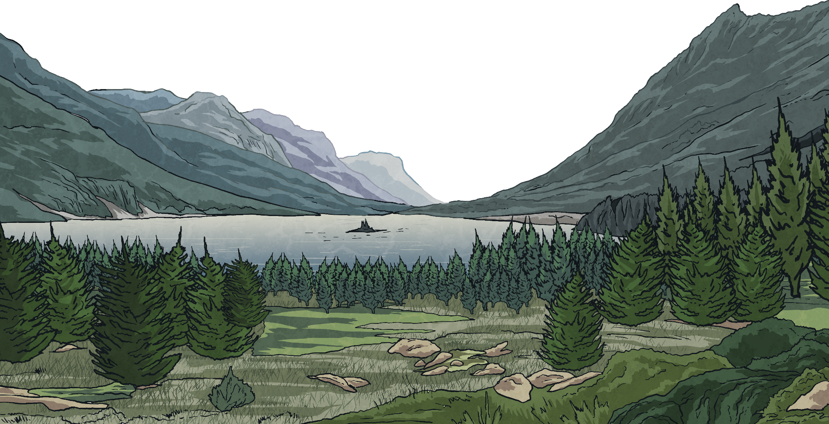
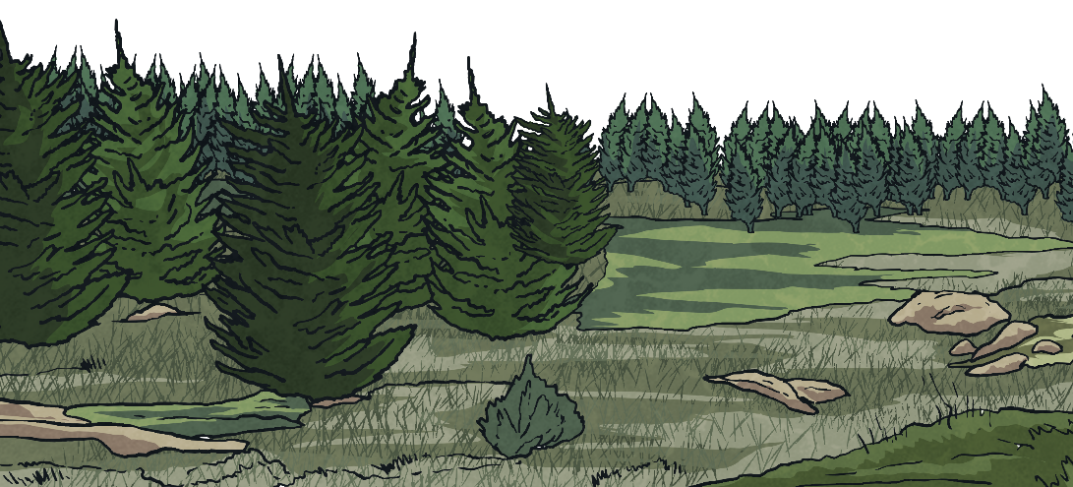
Tell Me
What can you tell me about this symbol?
‘Per cent’ relates to ‘number of parts per hundred’.
%

Slide 5
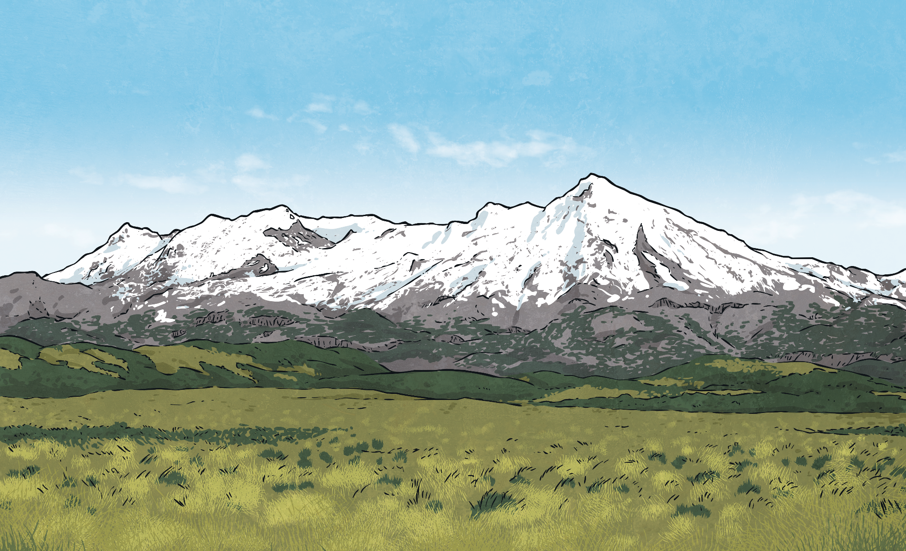
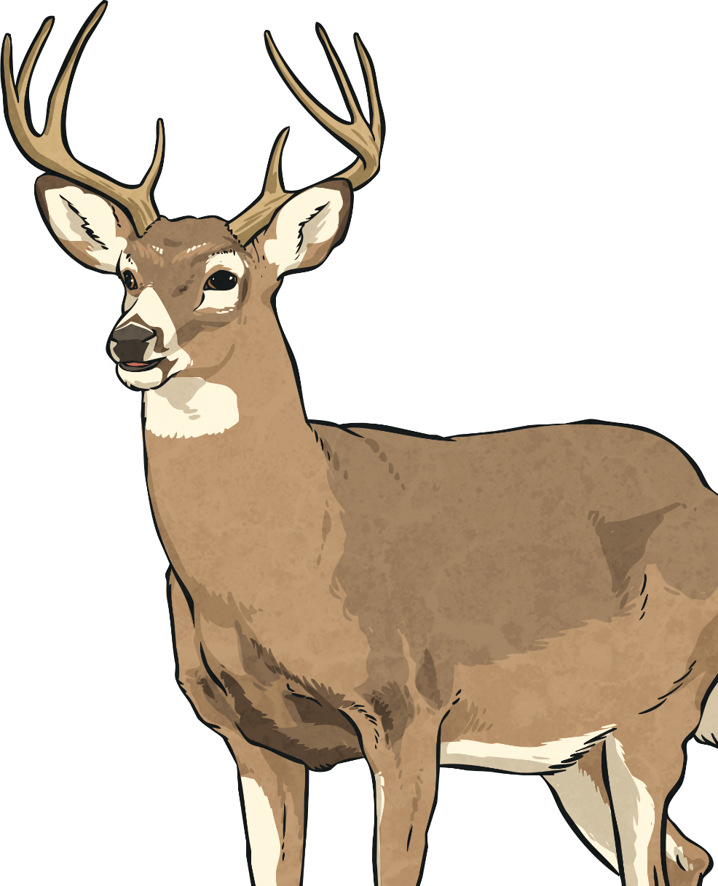
Percentage Diagrams
Here is a 10 by 10 grid made of 100 small, equal squares. What is the number of parts per hundred shaded? What percentage does each square represent?
1 part per hundred is shaded = 1%
90 parts per hundred is shaded = 90%
55 parts per hundred is shaded = 55%
74 parts per hundred is shaded = 74%
30 parts per hundred is shaded = 30%
20 parts per hundred is shaded = 20%

Slide 6
Percentage Diagrams
How many squares should be shaded in to show:
90%
3%
48%
17%

Slide 7
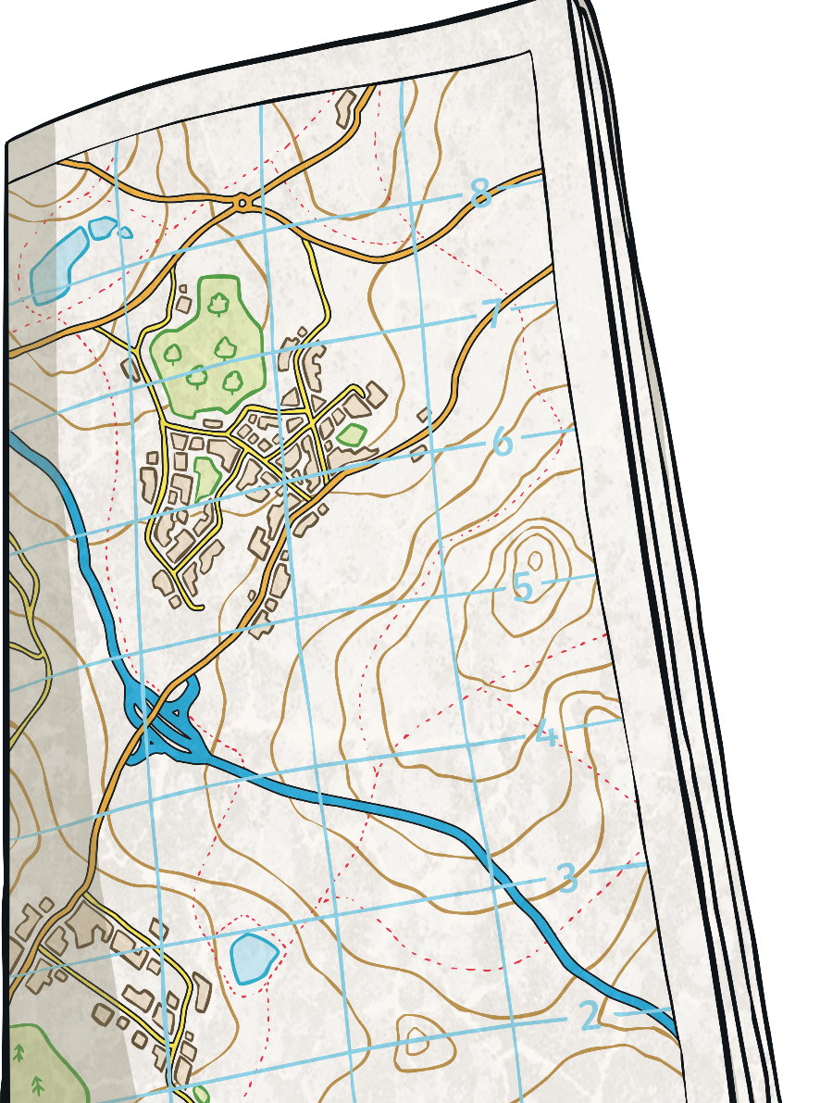
Percentage Diagrams
Here is a grid made of 10 equal rectangles.
What percentage of the grid does each rectangle represent?
Here is a grid made of two equal rectangles.
What percentage of the grid does each rectangle represent?
Here is a grid made of four equal squares.
What percentage of the grid does each square represent?
There are 10 parts per hundred shaded, which is equivalent to 10%
There are 25 parts per hundred shaded, which is equivalent to 25%
There are 50 parts per hundred shaded, which is equivalent to 50%
10%
50%
25%

Slide 8
What percentage is coloured in?
Lets use our fractions to help us.
We can see this represents $\frac{4}{5}$
To help us work out as out of a hundred. We use our finding fractions of amounts skill.
So we DIVIDE 100 by the DENOMINATOR= 100÷ 5= 20
Then MULITPLY the ANSWER by the NUMERATOR= 20 x 4= 80
So it equals 80 %

Slide 9
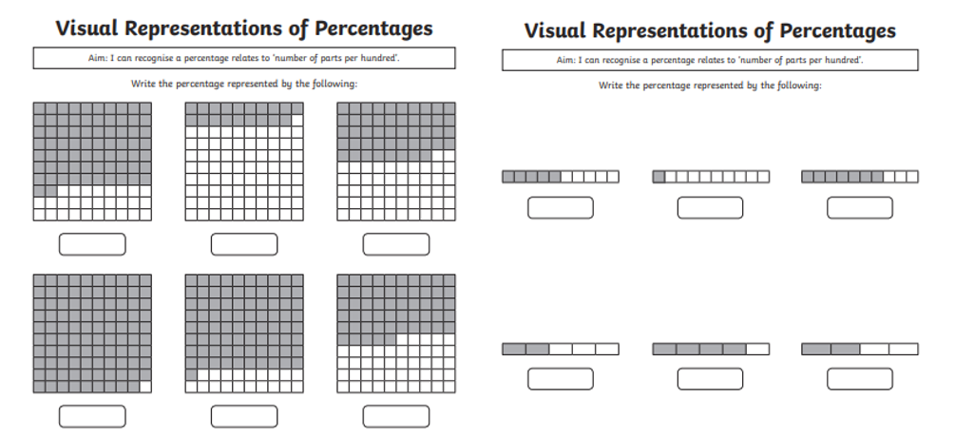
Your turn
Can you find what percentage of each shape is shaded?

