Slide 1
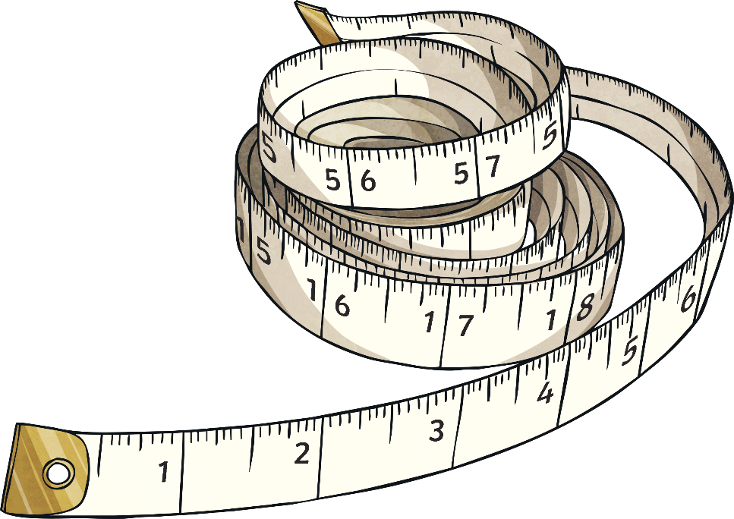
Warm up
Can you fill in the gaps using our knowledge from the last lesson?
mm | cm | m
 | 150cm
125mm
 |  | 2.78m
 | 56.5cm
mm | cm | m
 | 150cm
125mm
 |  | 2.78m
 | 56.5cm

Slide 2
How did you do?
Complete the table below
mm | cm | m
 | 150cm
125mm
 |  | 2.78m
 | 56.5cm
mm | cm | m
1500mm | 150cm | 1.5m
125mm | 12.5cm | 0.125m
2780mm | 278cm | 2.78m
565mm | 56.5cm | 0.565m
Hide Answers
Show Answers

Slide 3
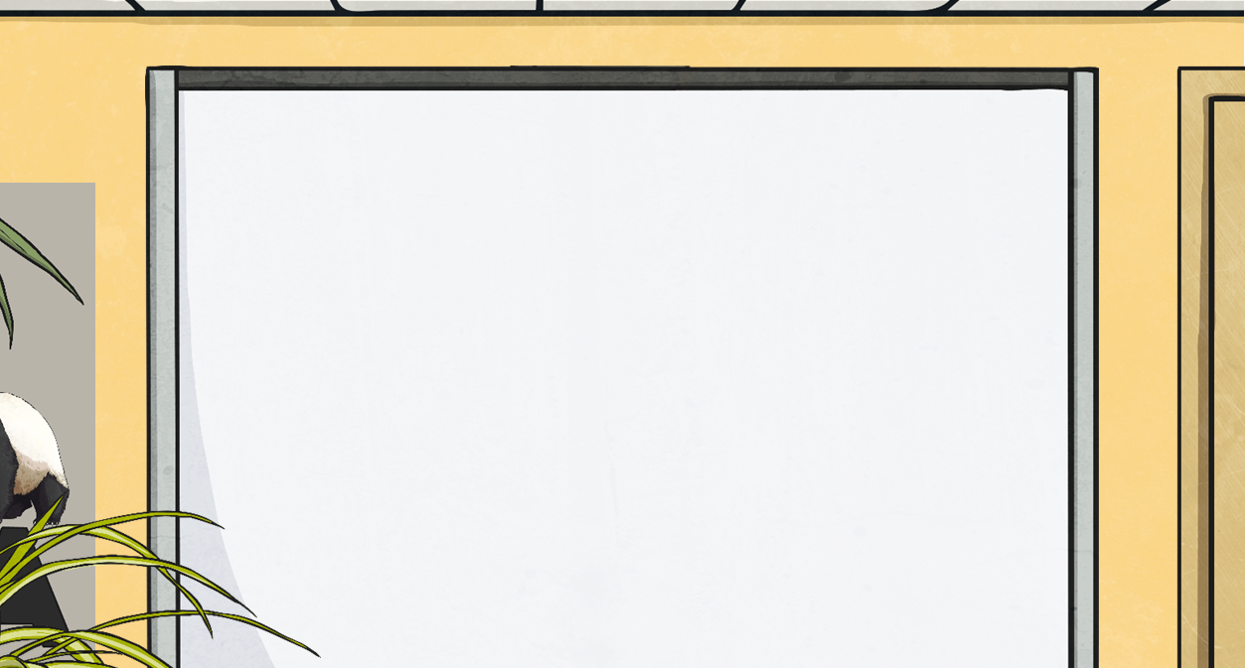
Multiplying and Dividing by 1000
5km = 5000m
What calculation did we do to convert from kilometres to metres?
5 × 1000 = 5000
We multiply by 1000 to convert kilometre measurements with decimal numbers in the same way.
To convert from kilometres to metres, we multiply by 1000. To multiply by 1000, each digit moves three places to the left:
2.74km =
3.653km =
4.5km =
4500m
2740m
3653m
thousands | hundreds | tens | ones | tenths | hundredths | thousandths
0
0
0
0
0
4
2
3
5
5
7
6
4
0
5
3

Slide 4
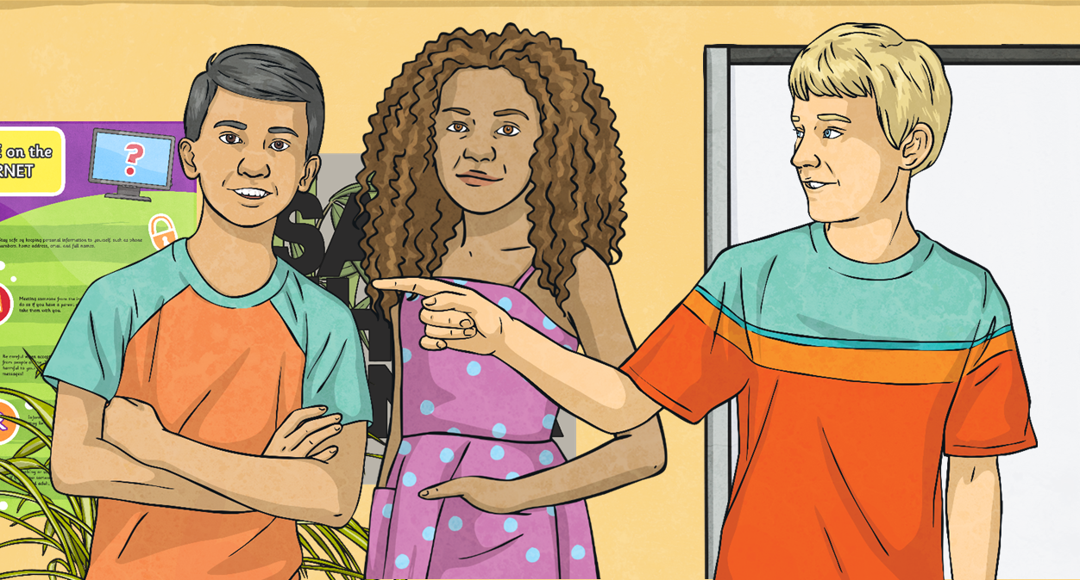
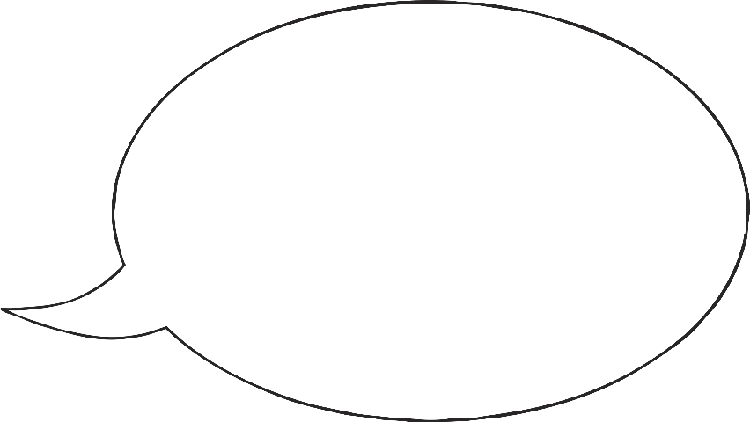
Multiplying and Dividing by 1000
Convert each measurement from kilometres to metres by multiplying the number by 1000.
Remember, before the decimal point, we must add zeros as a placeholder to fill the empty places.
Kilometres | Metres
2.852km
4.32km
8.9km
9.06km
2852m
4320m
8900m
9060m

Slide 5
Multiplying and Dividing by 1000
3000m = 3km
What calculation did we do to convert from metres to kilometres?
3000 ÷ 1000 = 3km
Sometimes dividing by 1000 gives us a decimal answer:
To convert from metres to kilometres, we divide by 1000. To divide by 1000, each digit moves three places to the right:
5.65km
3.8km
5650m =
8.943km
3800m =
8943m =
thousands | hundreds | tens | ones | tenths | hundredths | thousandths
8
3
5
3
0
9
6
8
0
0
4
5
0
0
0
3

Slide 6
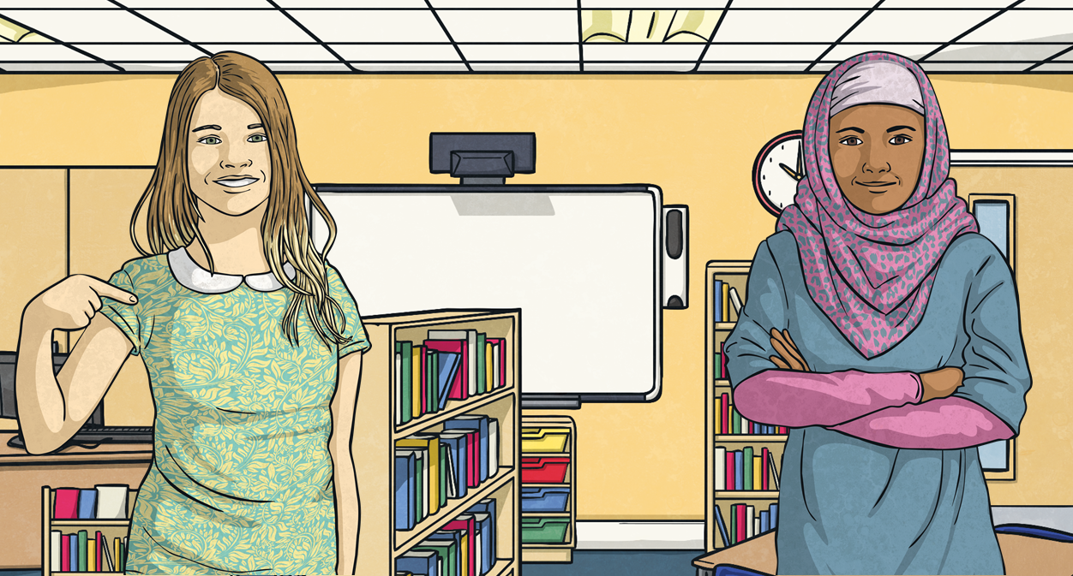
Multiplying and Dividing by 1000
Convert each measurement from metres to kilometres by dividing the number by 1000.
Remember, after the decimal place, any zeros after the last digit in the number have no value – so we do not need to write them.
Metres | Kilometres
3568m
4113m
6580m
8600m
7070m
3.568km
4.113km
6.58km
8.6km
7.07km

Slide 7
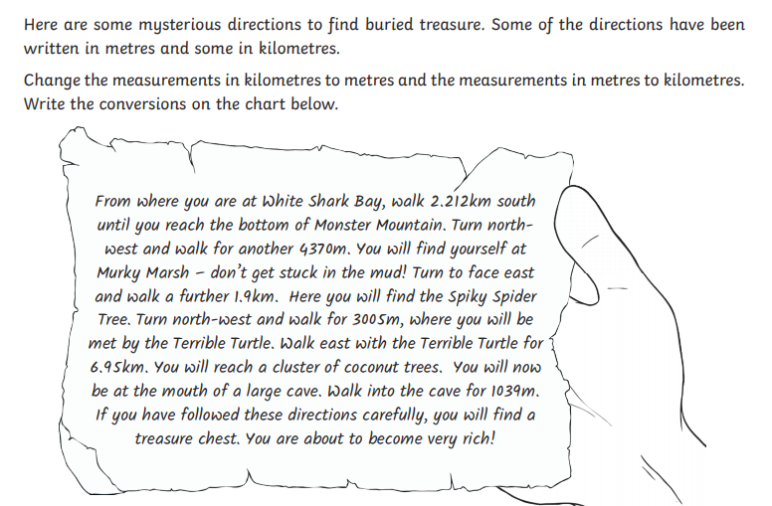
Can you change the measurements in this note
from kilometres to metres and the one in metres to kilometres?

Slide 8
Can you change the measurements in this note
from kilometres to metres and the one in metres to kilometres?
How did you do?
2.212 km = 2212m
4370 m = 4.370km
1.9km = 1900m
3005m = 3.005km
6.95 km = 6950 m
1039m = 1.039km

Slide 9
How do we tackle this question?
Start by converting each measurement, lets make them all metres:
3095m
3.9km = m
3km = m
3950m
390m
3.09km = m
Once you have done this order them from shortest to longest. Write them in their ORIGINAL FORM

Slide 10
How did you do?

Slide 11
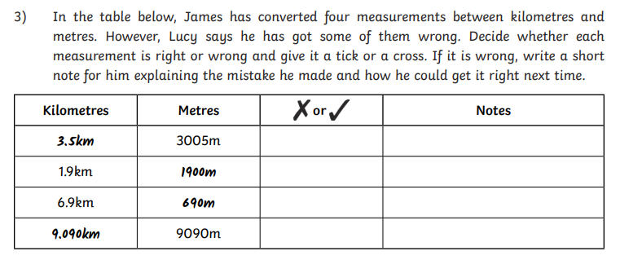
Time to become the teacher!
Check each of these answers. If they are correct great. If not write a short explanation to what their mistake was.

Slide 12
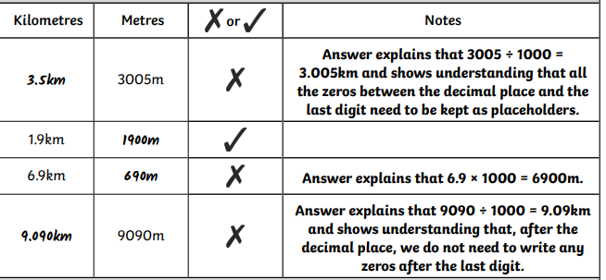
How did you do?

Slide 13
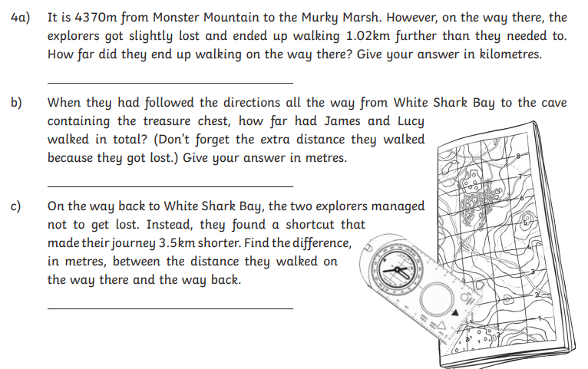
Now lets apply this skill to word questions.
Don’t forget:

Slide 14
How did you do?

