Slide 1
Lesson 3: Percentages, Fractions and Decimals

Slide 2
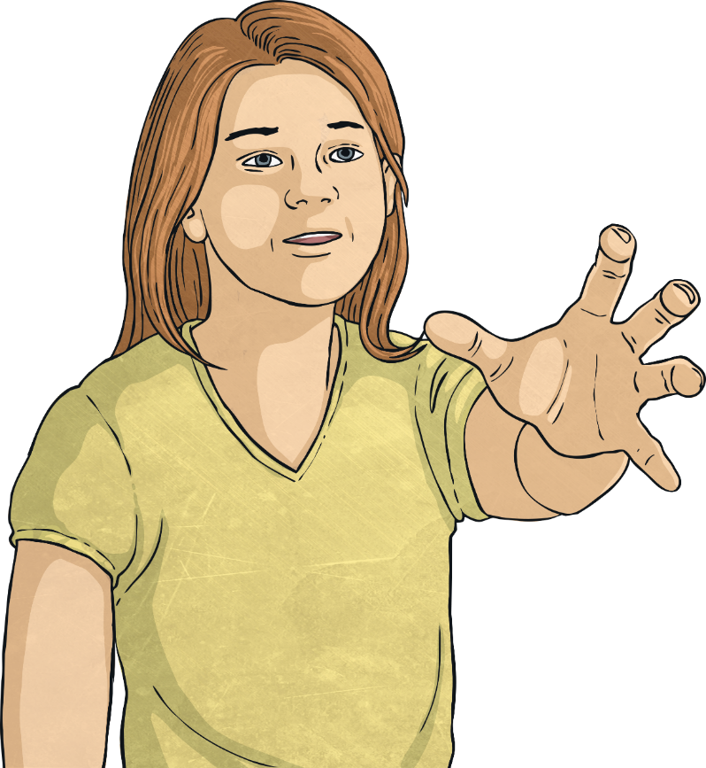
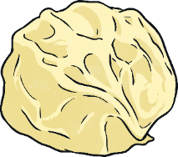
Percentages, Fractions and Decimals
Per cent means ‘out of every hundred’.
It tells us that something has been divided into 100 equal pieces. A percentage can always be written as an equivalent fraction with the denominator 100.
15
15% =
100
63
63% =
100

Slide 3
Percentages, Fractions and Decimals
Per cent means ‘out of every hundred’.
It tells us that something has been divided into 100 equal pieces. When a percentage is written as an equivalent decimal, we use tenths and hundredths.
15
63
= 0.15
15% =
= 0.63
63% =
100
100

Slide 4
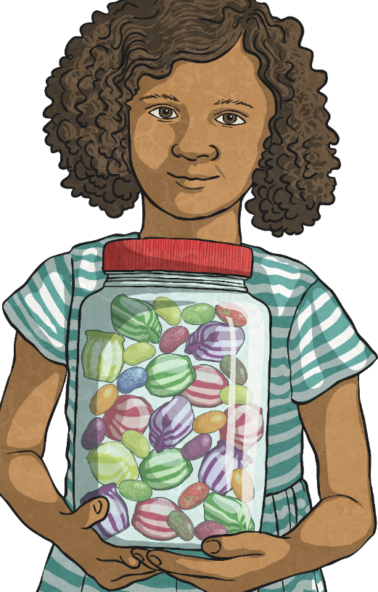
Would You Rather?
What proportion of this jar of sweets will give you the most sweets?
64
64
53%
0.49
100
100

Slide 5
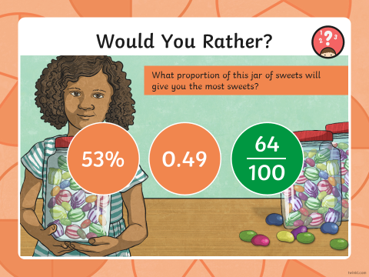
Can you choose now?
Try the same method on the next few slides.
The easiest way to work this out it to make them all the same.
Lets start by making them all a fraction.
We know percent is out of a 100 so 53%= $\frac{53}{100}$
We know that 0.49 = $\frac{49}{100}$
We already have $\frac{64}{100}$

Slide 6
Would You Rather?
What proportion of this jar of sweets will give you the most sweets?
30
0.5
40%
0.5
100

Slide 7
Would You Rather?
What proportion of this jar of sweets will give you the most sweets?
90
90
26%
0.09
100
100

Slide 8
Would You Rather?
What proportion of this jar of sweets will give you the most sweets?
1
7%
0.05
7%
100

Slide 9
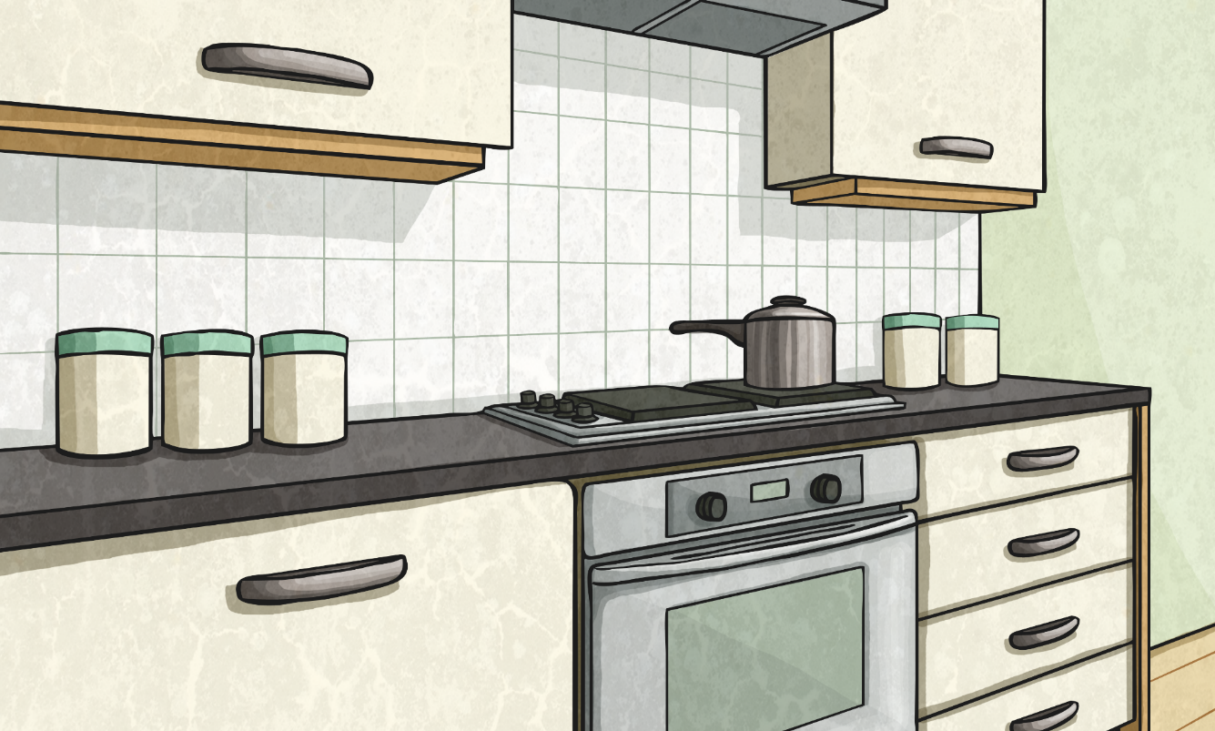
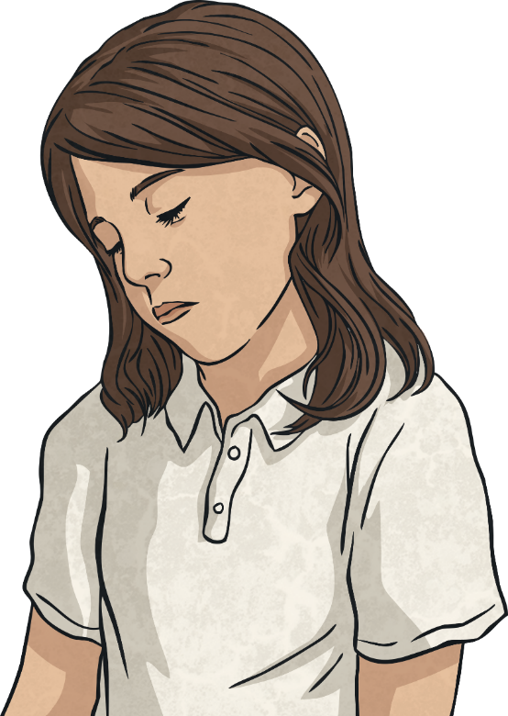
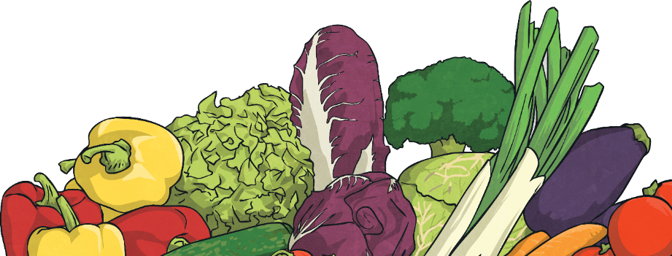
Percentage Equivalents
Percentage | Fraction | Decimal
11%
33%
70%
61%
10%
4%
1%
11
0.11
100
33
0.33
100
70
7
0.7
or
100
10
61
0.61
100
10
1
Can you work out the fraction and decimal equivalents of these percentages:
or
0.1
100
10
4
0.04
100
1
0.01
100

Slide 10
How can we tackle this question from your pack.
To find the fractions. We know there are 100 beads. This is your denominator.
The red shows you the numerator. Then convert to a percent and decimal.

Slide 11
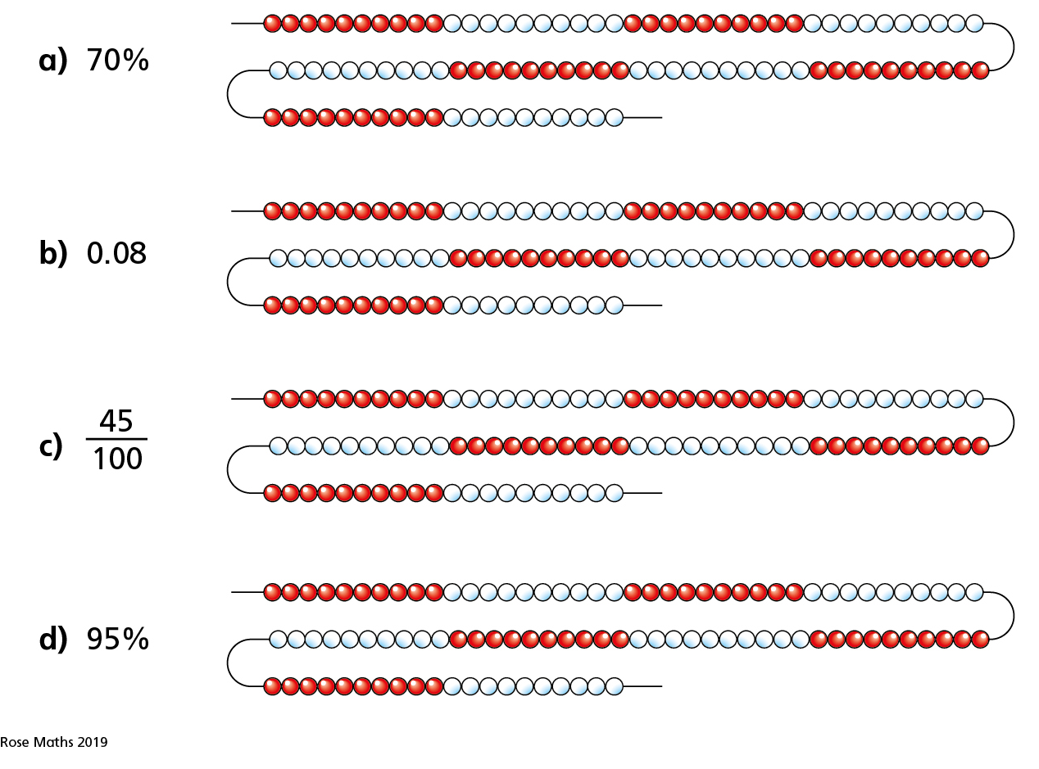
Now can you draw your own beads to match the fraction, decimal or percent.

