Slide 1
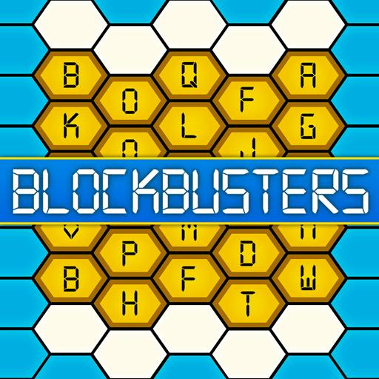
You have to get from one side of the Blockbusters PE grid to the other by clicking on the hyperlinks in the yellow hexagons You can go diagonally or right to left. Turn to the next slide to get started...

Slide 2
Circuits
Wacky Races (race a member of your family)
Just Dance - Eye of the Tiger
Yoga for Neck, Shoulders and Upper Back
Body Scan Meditation
Balloon Breathing Meditation
PE with Joe
Keepie Uppie Challenge
Create Your Own Assault Course (Fast Feet)
Yoga for the Classroom - Yoga with Adriene
Baby Shark Ab Challenge (watch the video first, then try it yourself)
Squat Walk
Yoga for the Classroom - Yoga with Adriene
Bicep Curls
Keepie Uppie Challenge
PE with Joe
Just Dance - The Weekend
Body Scan Meditation
Create Your Own Assault Course (Balance)
Just Dance - Rasputin
Circuits
Wacky Races (race a member of your family)

Slide 3
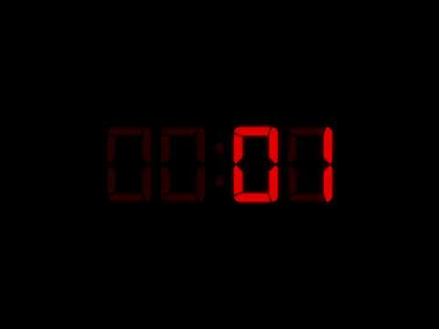
Circuits
For this exercise you have 5 different exercises to complete, performing each for 45 seconds & then rest for 15 seconds. Make sure you give it your all, it doesn’t last long. Repeat the 5 exercises twice.
Exercises to complete:
Star jumps- Jumping in an upward motion whilst waving your arms up and down.
Sit ups-Lie on your back, with your hand behind your head and use your stomach muscles to lift you up and down.
Sprinting on the spot- Run as fast as you can!
Mountain climbers- Start in a plank position, Pull your right knee into your chest., quickly switch and pull the left knee in. Continue to switch knees.
Burpees-No explanation needed!

Slide 4
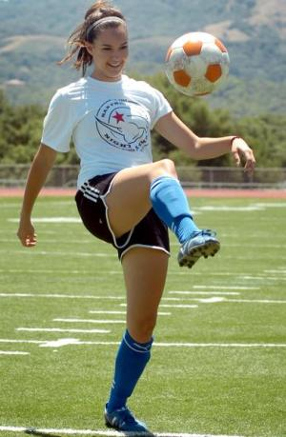
Keepie Uppie Challenge
Let’s work on our ball control, have a workout and have some fun at the same time!
Your Challenge is to see how long you can juggle a ball (or toilet roll even a pair of balled up socks) with your feet.

Slide 5
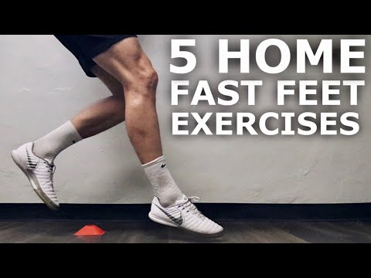
Create Your Own Assault Course!
This video shows you 5 different fast feet exercises. Can you create a (safe!) assault course around your room, your garden or your home based on these exercises?
If they are willing, see if you can get other members of your family to join in! Can they beat your PB?

Slide 6
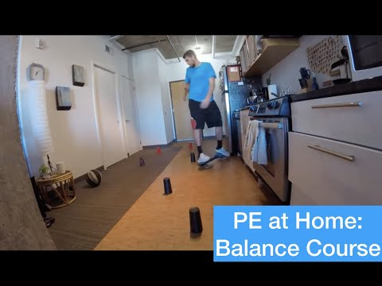
Create Your Own Assault Course!
Can you create an assault course around your home where you need to keep your balance? You don’t need any equipment to walk on, you could try hopping around on one foot (if you want to really challenge yourself, try that with your eyes closed… you’ll need someone to watch you to make sure you stay safe though).
This video shows what is possible using a scooter. You don’t need to do what he does though, it’s just an idea for what is possible.

Slide 7
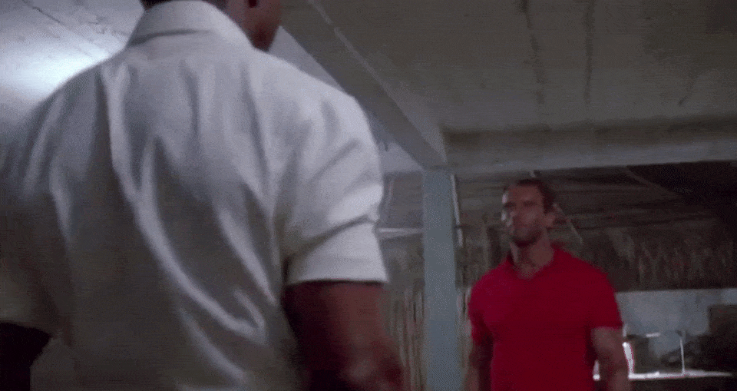
Bicep Curls
You don’t need dumbbells to exercise your muscles (although if you’ve got some suitable ones at home, great)! Anything you can hold, such as tins of food or water bottles, can be used for bicep workouts. Try 4-5 sets of for each arm, each of 8-12 curls. If it’s too easy, change the weight up!

Slide 8
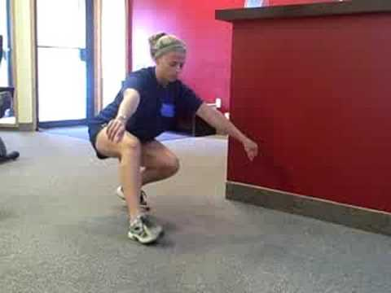
Squat Walk
How long can you walk around your home or garden doing the squat walk? Challenge other members of your family to see if they can beat your PB!
Remember, keep that butt low!

Slide 9
Wacky Races!
Use your imagination to challenge someone from your household to a race. You might choose to run in a funny way, wear funny clothes, have to tell jokes when you’re racing… the possibilities are endless and are up to you and your imagination!

