Slide 1
Victorians
Queen Victoria
By Jim and Conor

Slide 2

Who was Queen Victoria?
Queen for an age
People all over the world know the name of Queen Victoria. She is probably the most famous queen in history. She was Queen of a vast empire, as well as of Britain. A long period of history is named after her - the Victorian Age.

Slide 3
+
hat does 'Victorian' mean?
It means 'to do with Victoria'. It's an adjective used to describe people and things from her time. Victoria was Queen for over 60 years. Many things happened during her life. We talk about 'Victorian' buildings or 'Victorian' furniture. This doesn't mean that Queen Victoria made them herself! It usually means something dates from the 1800s.

Slide 4
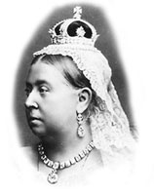
Queen Victoria was only 18 when she came to the throne and she had a lot to learn. Her reign had a rocky start. She thought that, as queen, she could do as she liked, and she quickly had to learn that she couldn't.

Slide 5
THIS IS THE END OF QUEEN VICTORIA

