Slide 2
WILMA:
I can group living things in a range of ways.
I can use a range of methods to sort living things.

Slide 3
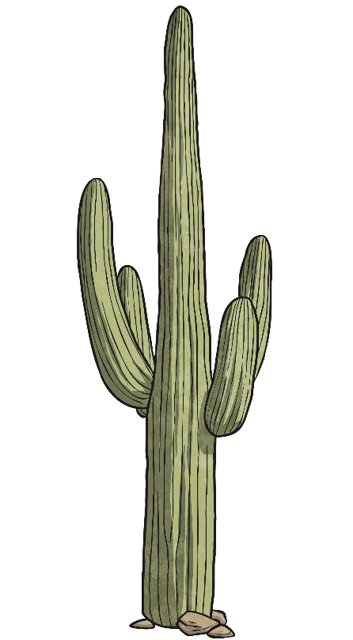
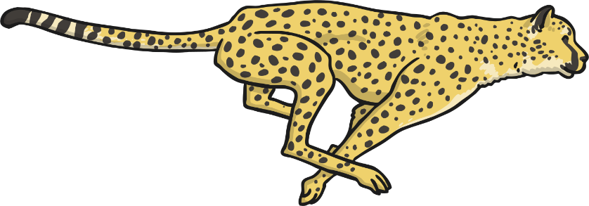
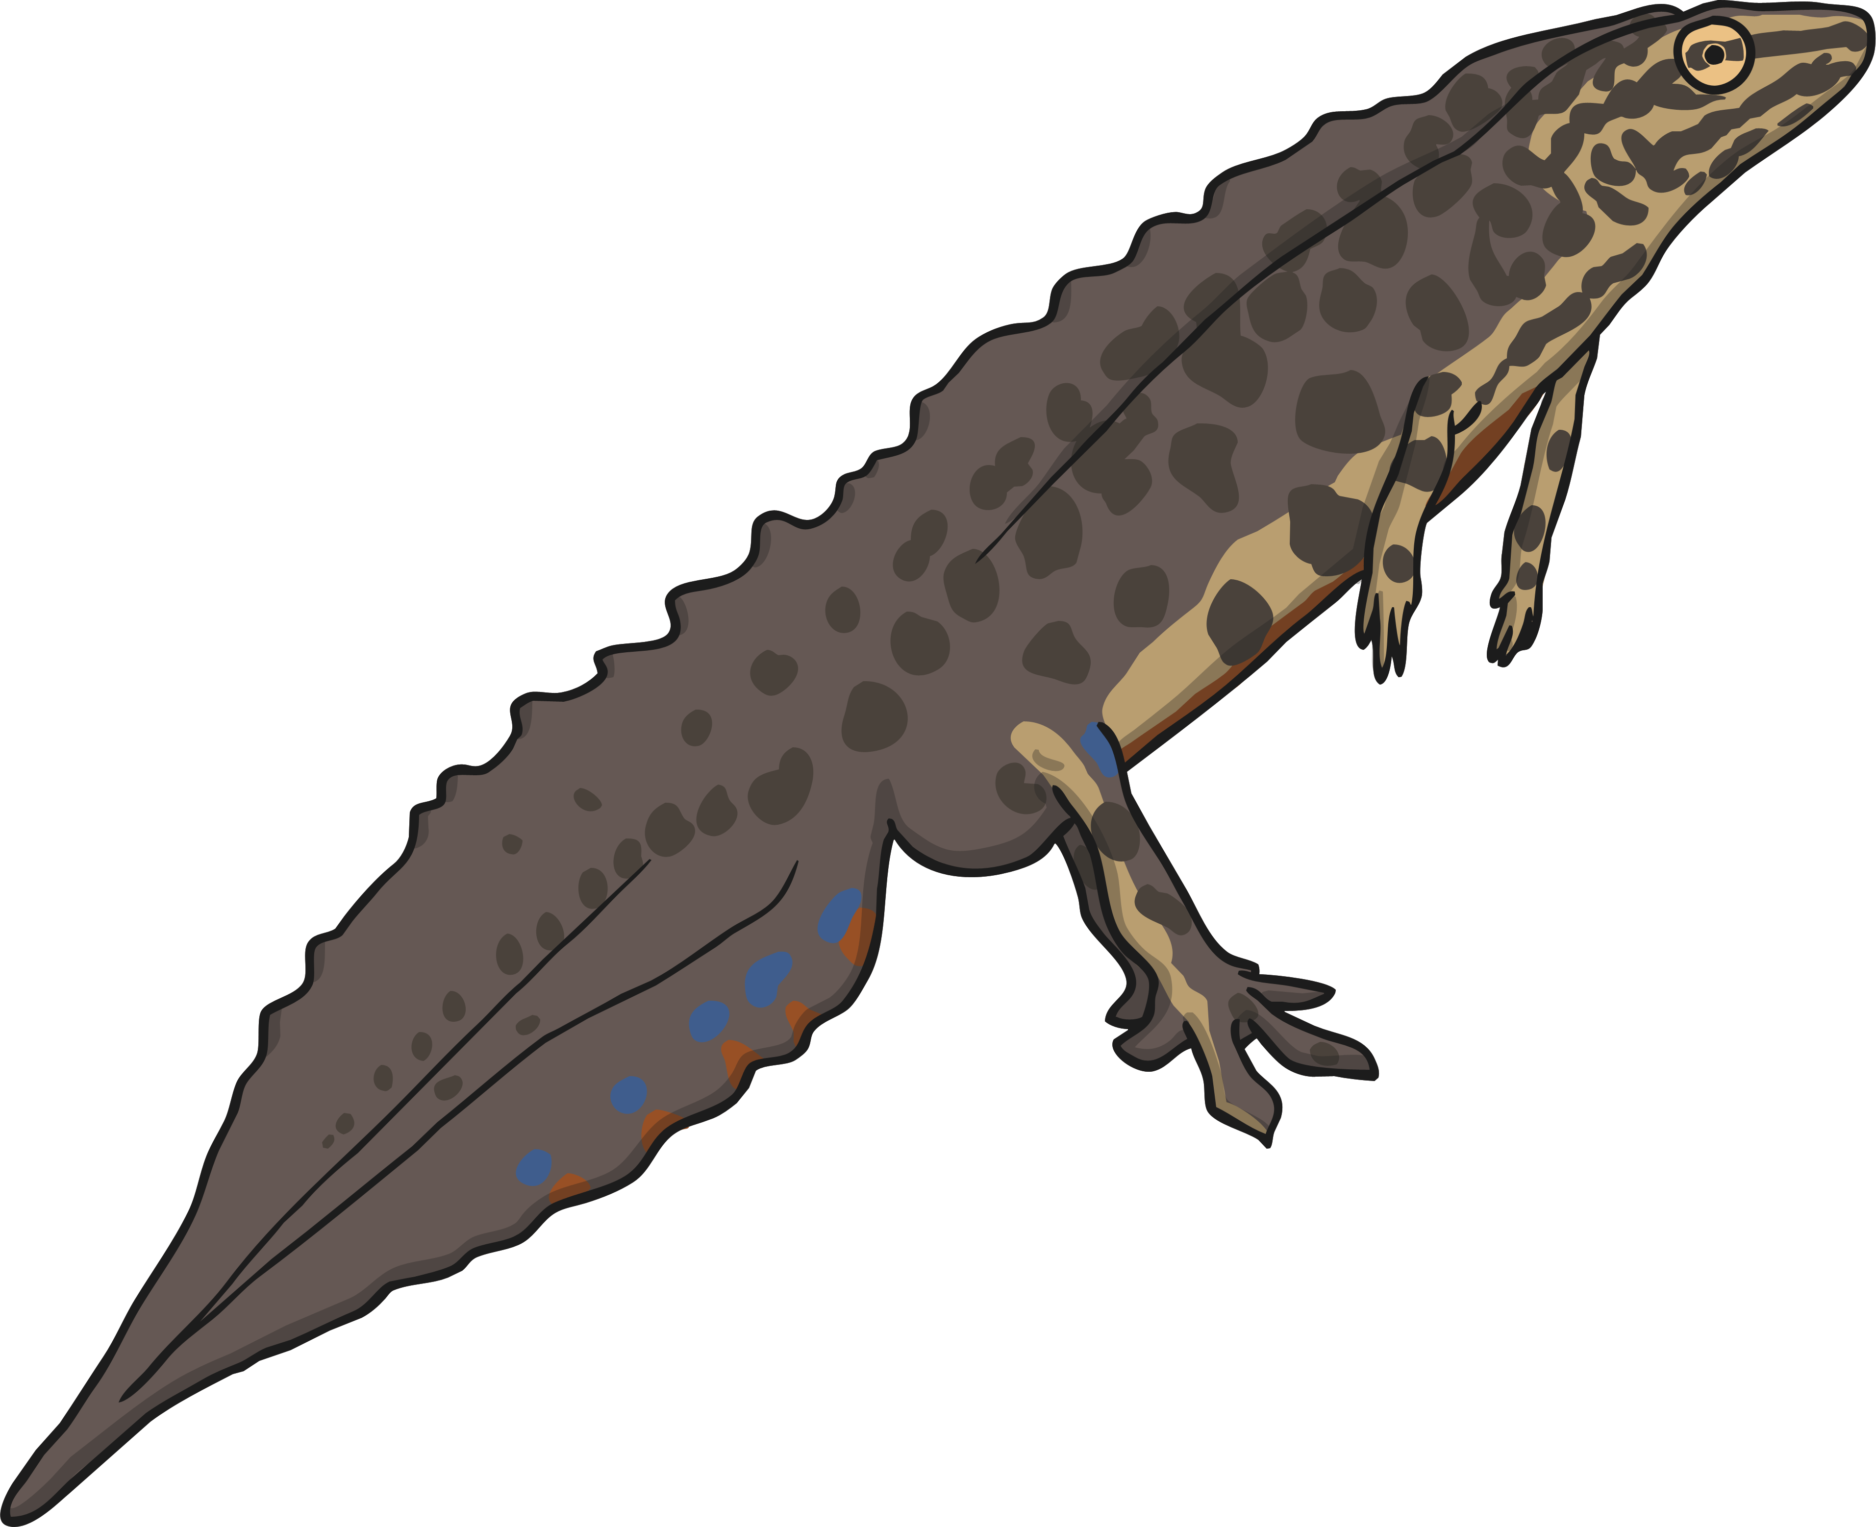
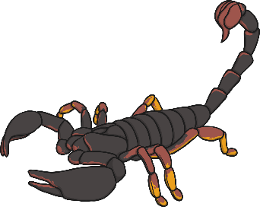
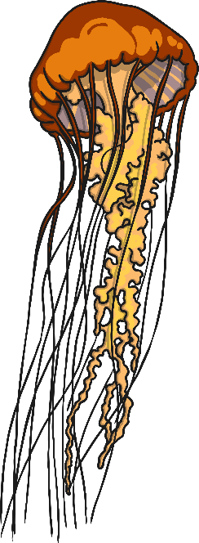
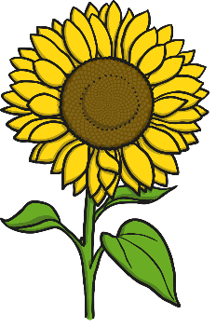
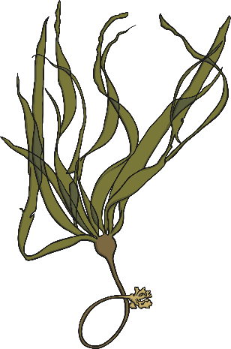
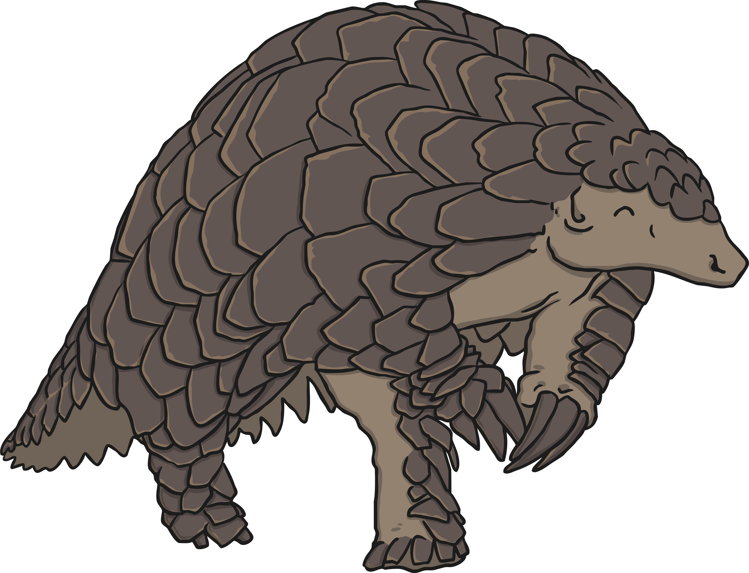
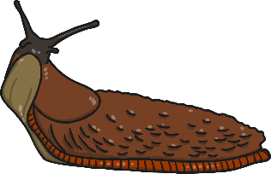
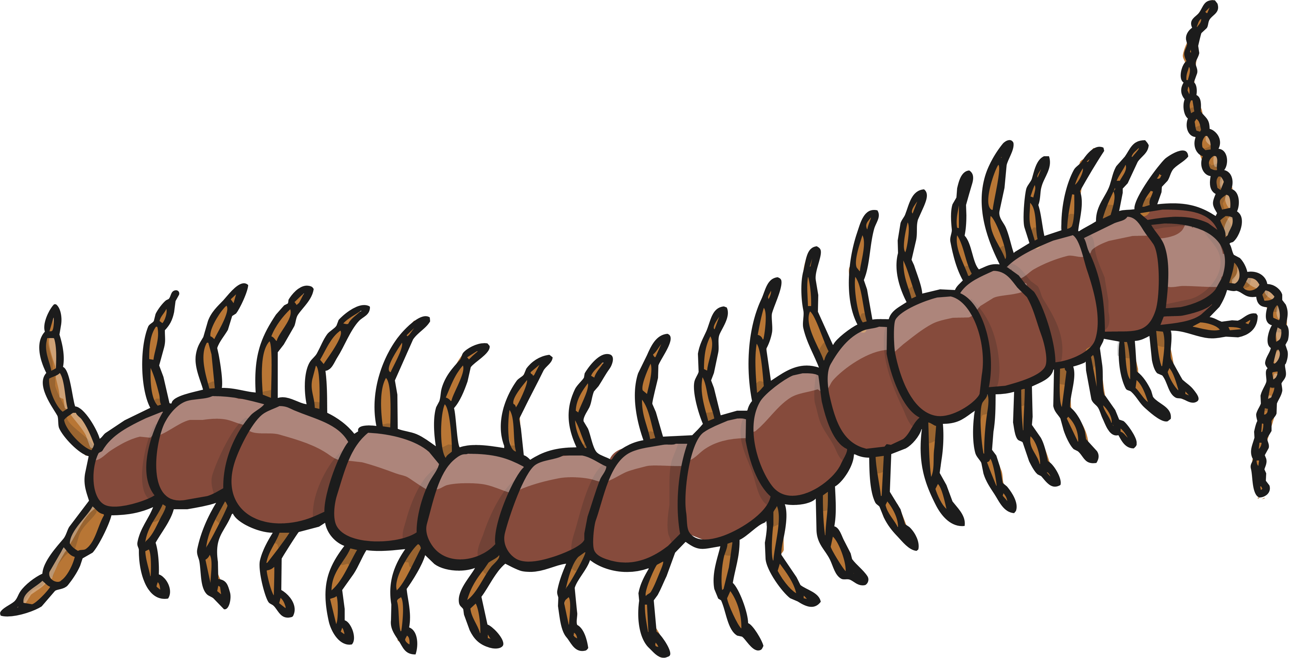
Life Processes
What do all these things have in common?

Slide 4
Life Processes
All of these images are of living things. Sometimes we call them ‘organisms’.
Even though they might be very different from each other, all of these organisms share certain characteristics. All living things do certain things to stay alive. These are called life processes.
All animals, including humans, do these things. Plants do too, although they do them in different ways.
We can remember life processes by thinking about Mrs Gren.

Slide 5
Life Processes
Movement
Respiration
Sensitivity
Growth
Reproduction
Excretion
Nutrition
MRS GREN

Slide 6
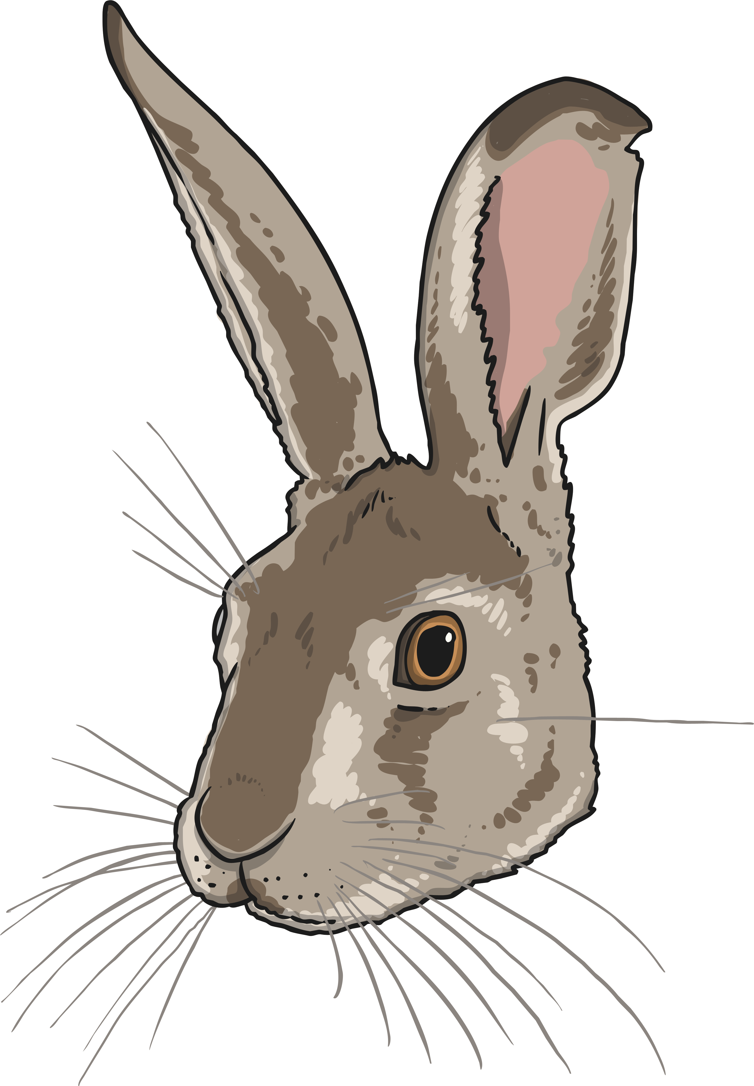
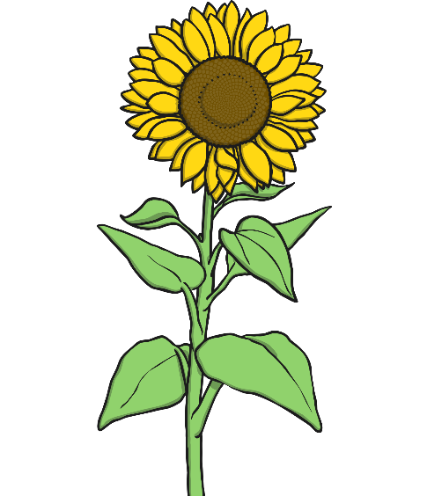
Life Processes
Movement
All living things move.
A hare runs to escape from danger.
Animals
move around
to get from
place to
place.
Plants grow and turn towards the light.
A sunflower moves to turn its face towards the sun.

Slide 7
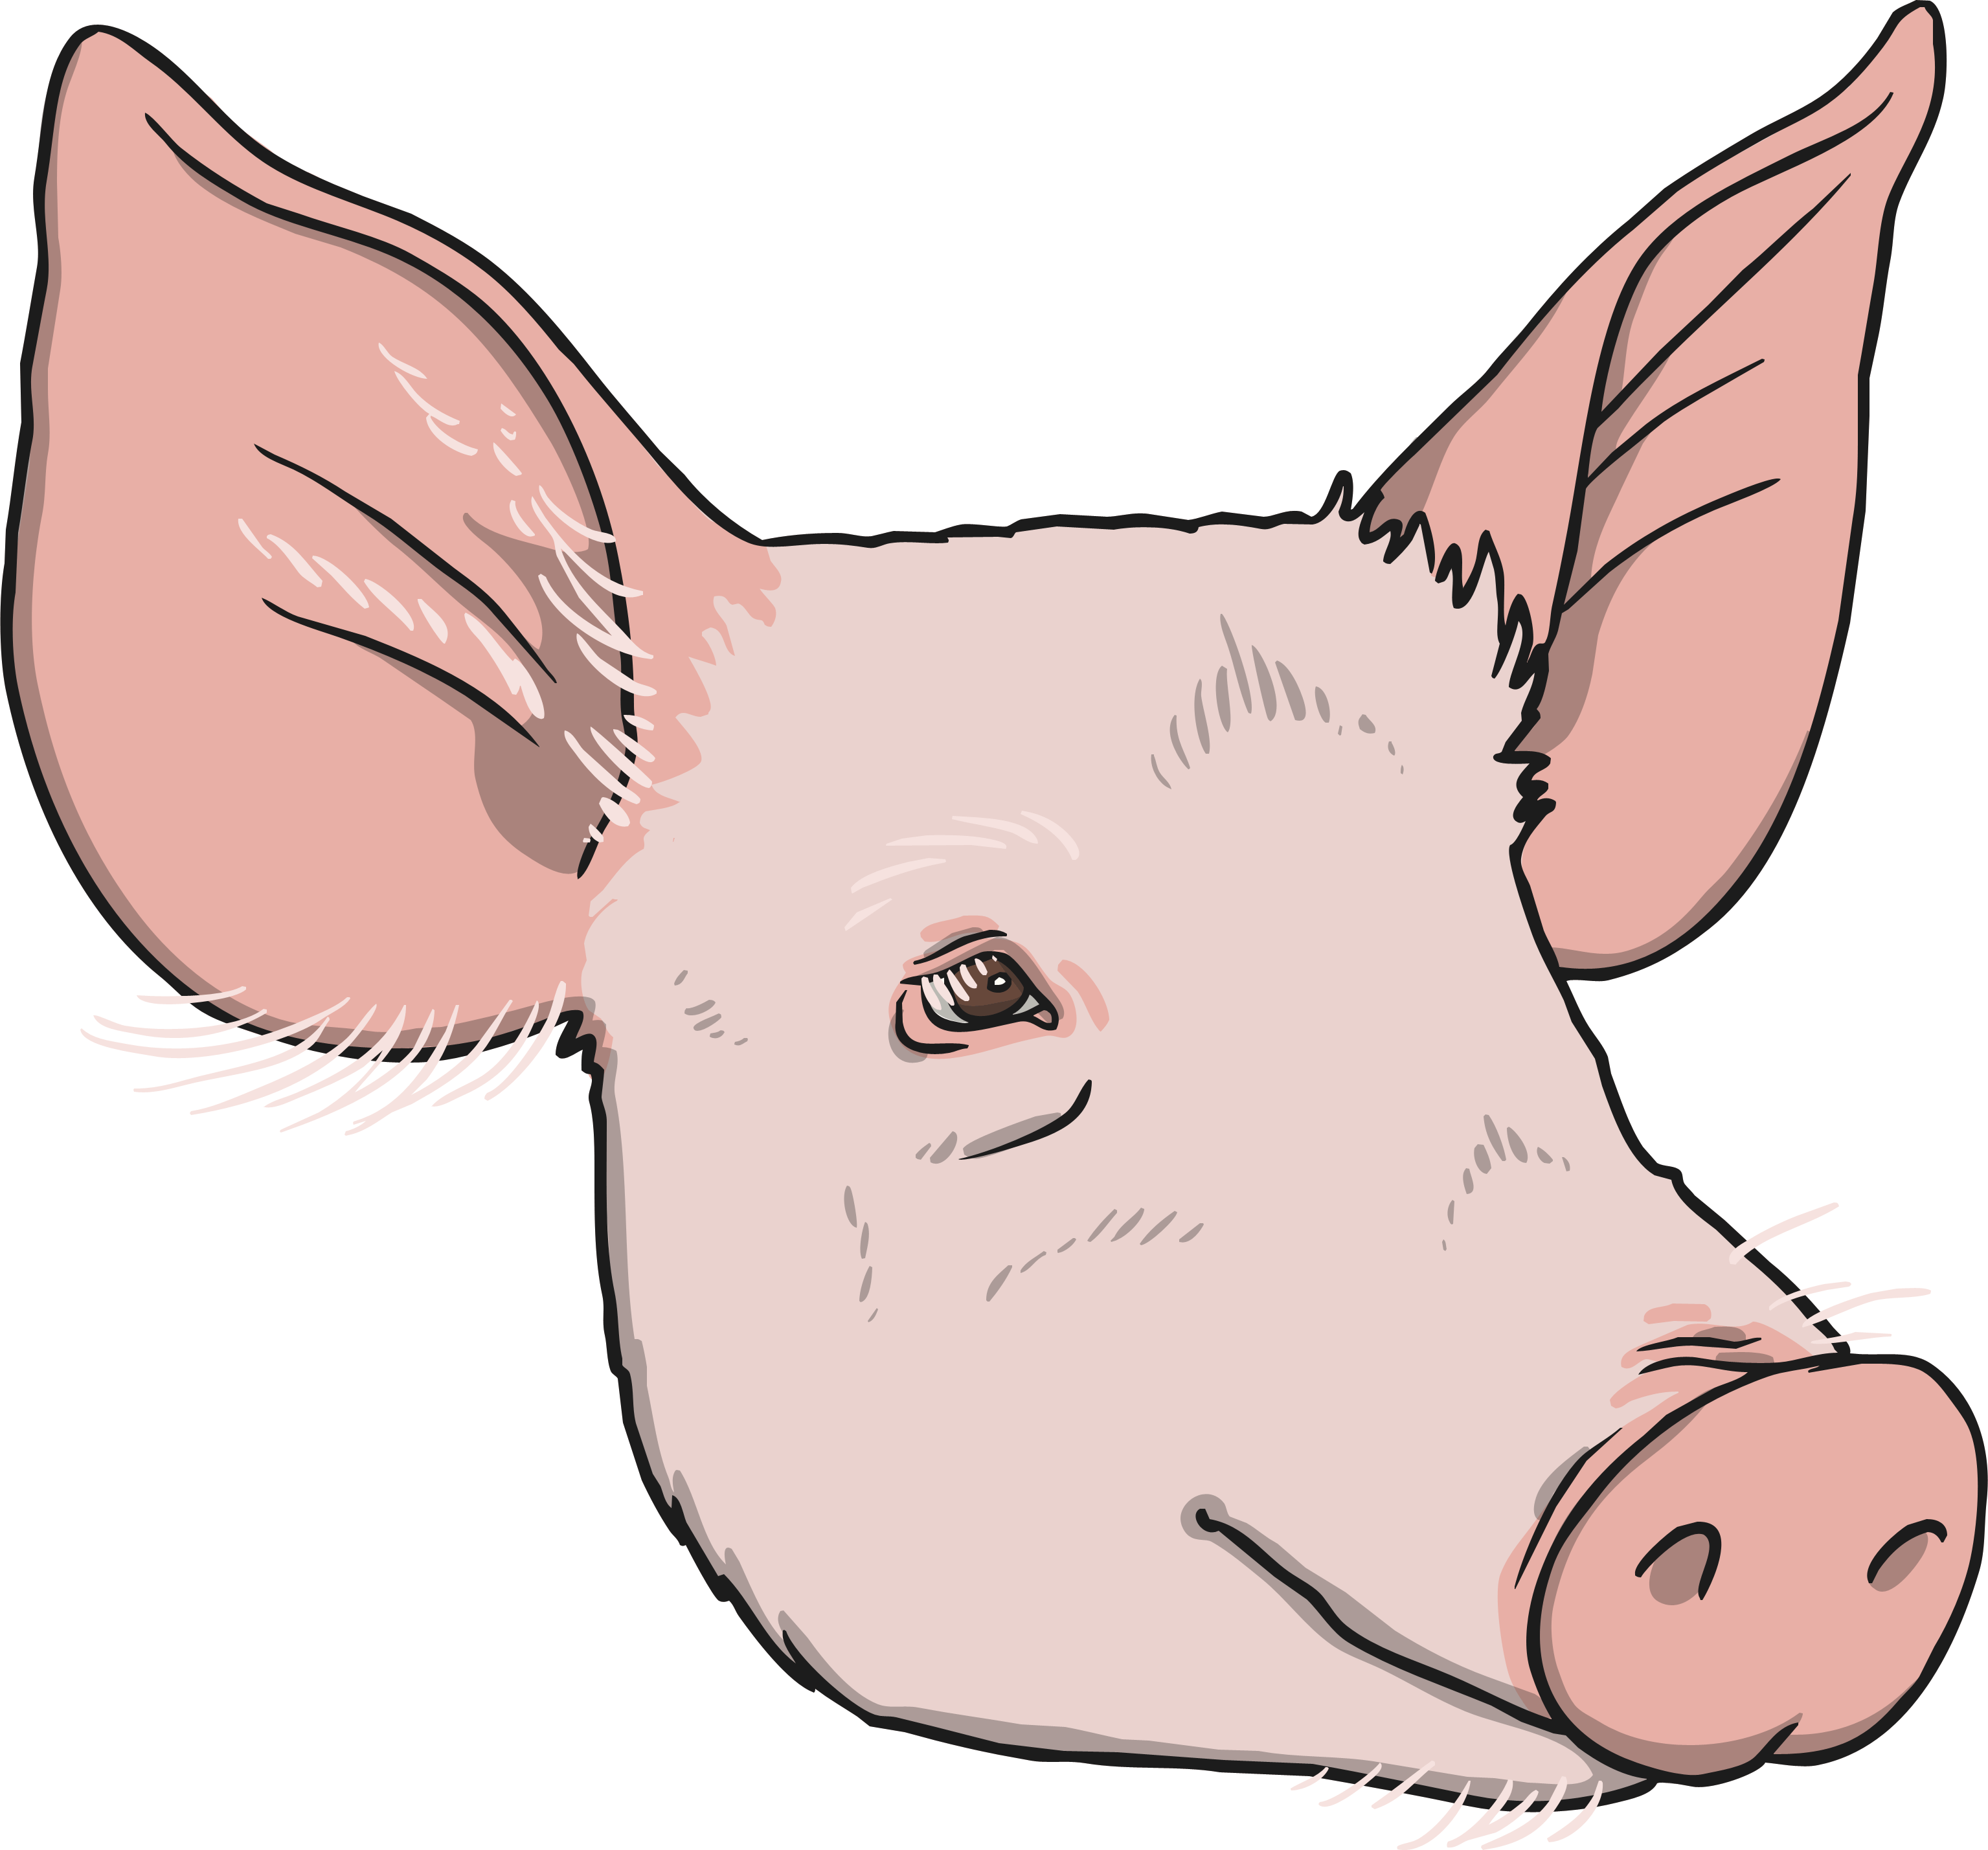
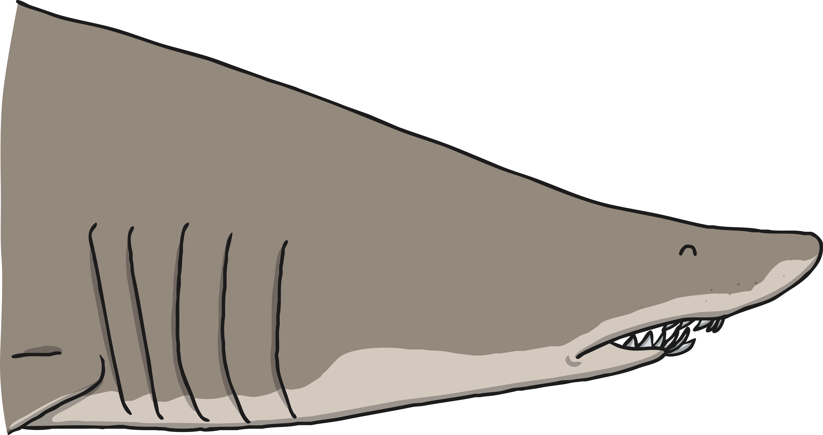
Life Processes
Respiration
Land animals breathe oxygen through their mouths or noses. Sea creatures breathe oxygen dissolved in the water through their gills. Both types of creature then use this oxygen in their
body for respiration.
All living things respire.
Plants and animals both use oxygen gas from the air to turn their food into energy. This is called respiration.
Plants both respire and photosynthesise. While photosynthesis happens when the plant is in light, plants respire by taking in oxygen and giving out carbon dioxide during darkness.

Slide 8
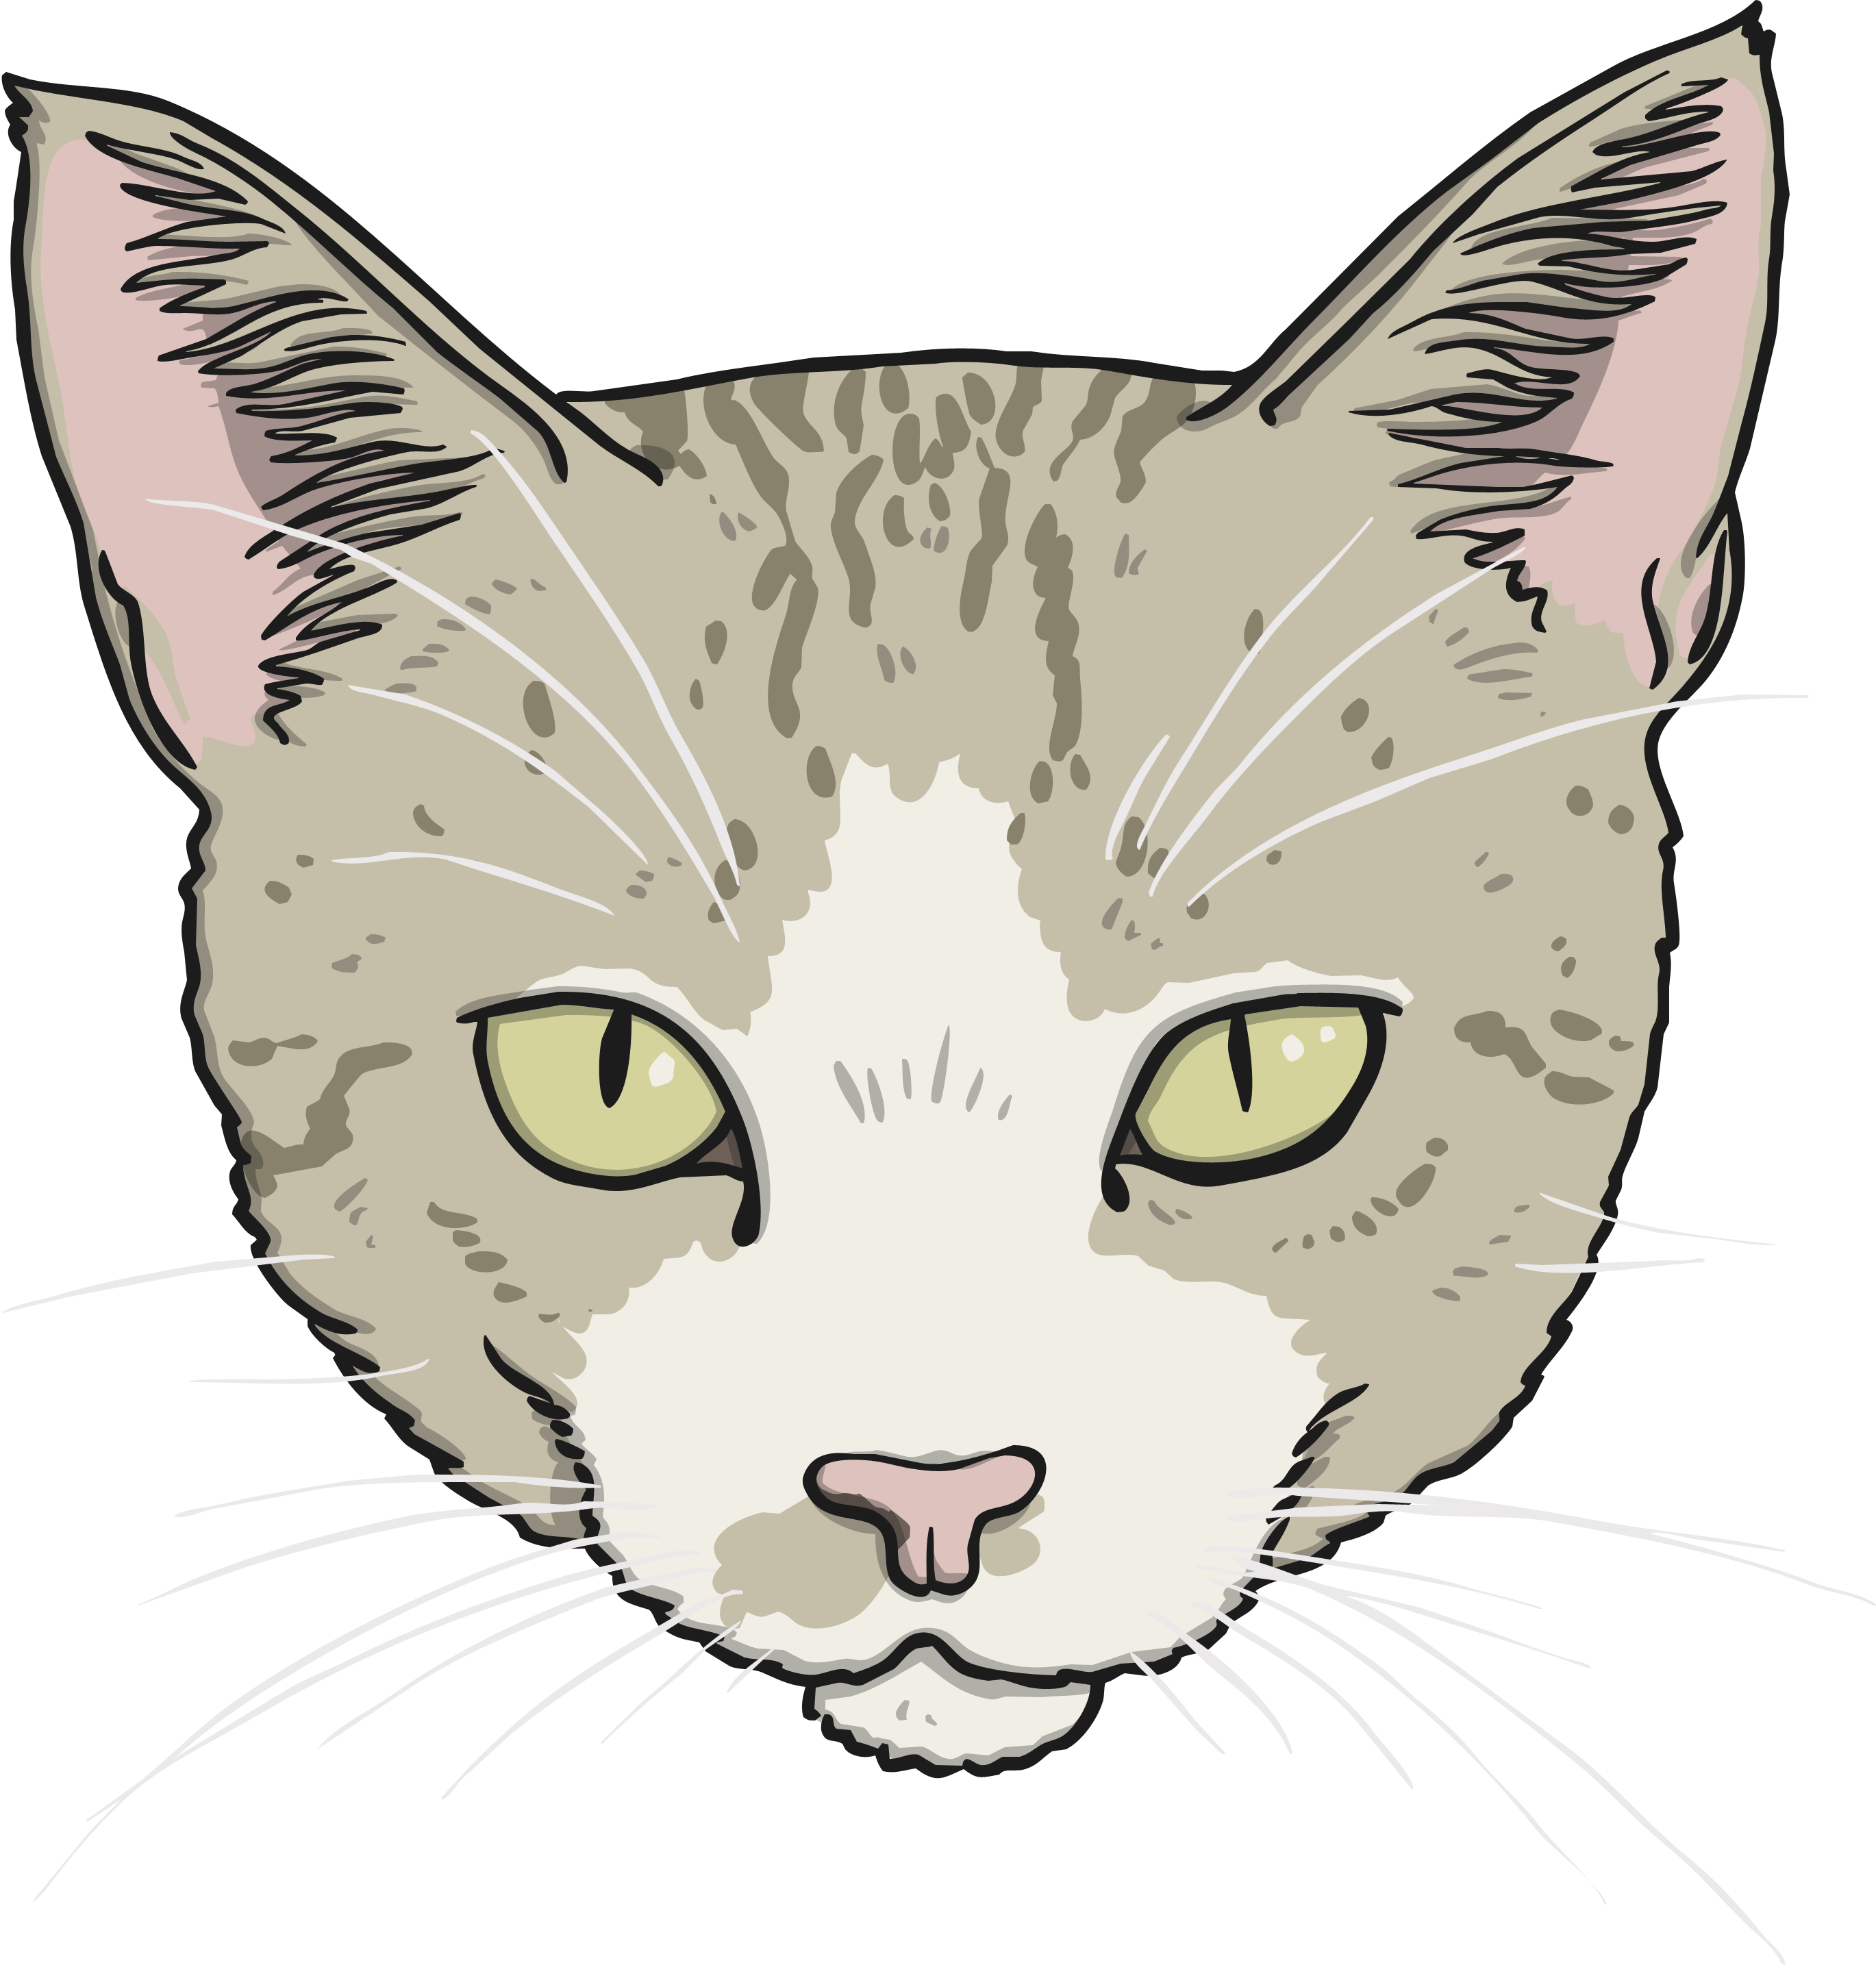
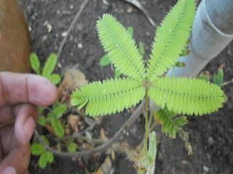
Life Processes
Sensitivity
Animals use their senses to see, hear, taste, touch and smell the world around them.
All living things are sensitive.
Every living thing can detect changes in their surroundings.
Plants can also detect changes in the environment. This mimosa plant curls up when you touch it!

Slide 9
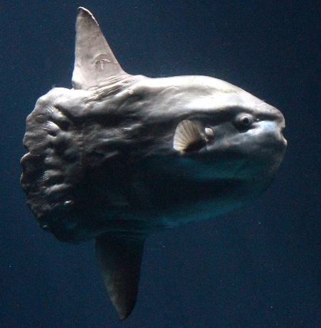
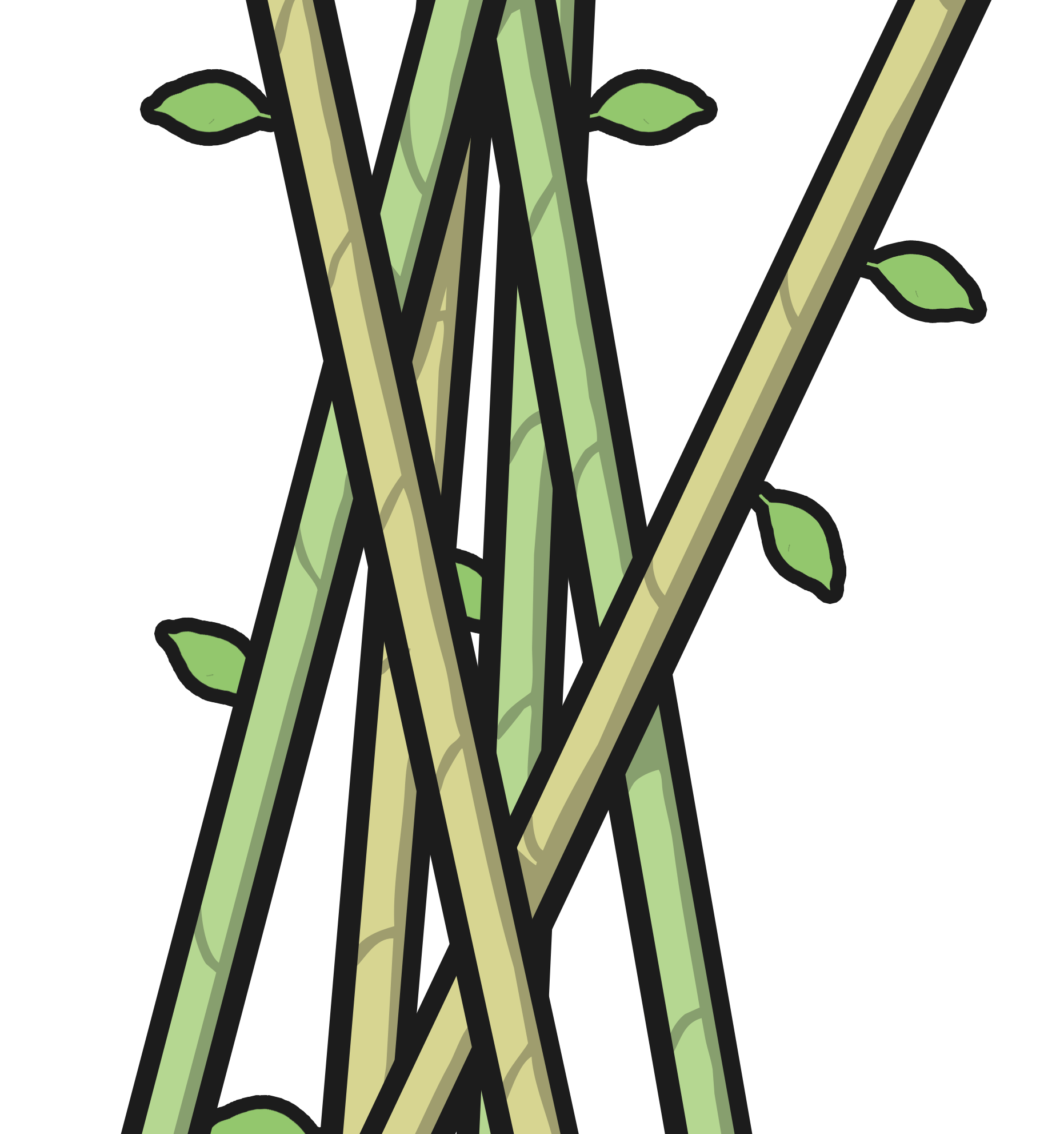
Life Processes
Growth
This ocean mola started life as an egg not much bigger than a full stop. It will grow to weigh about 1000 kg - this is the same size as a large bull!
All living things grow.
Animals grow from babies to adults.
Seeds grow into plants.
Bamboo can grow up to 3cm every hour.

Slide 10
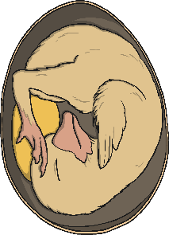
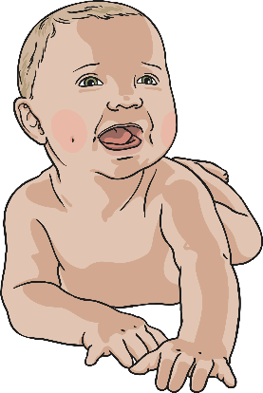
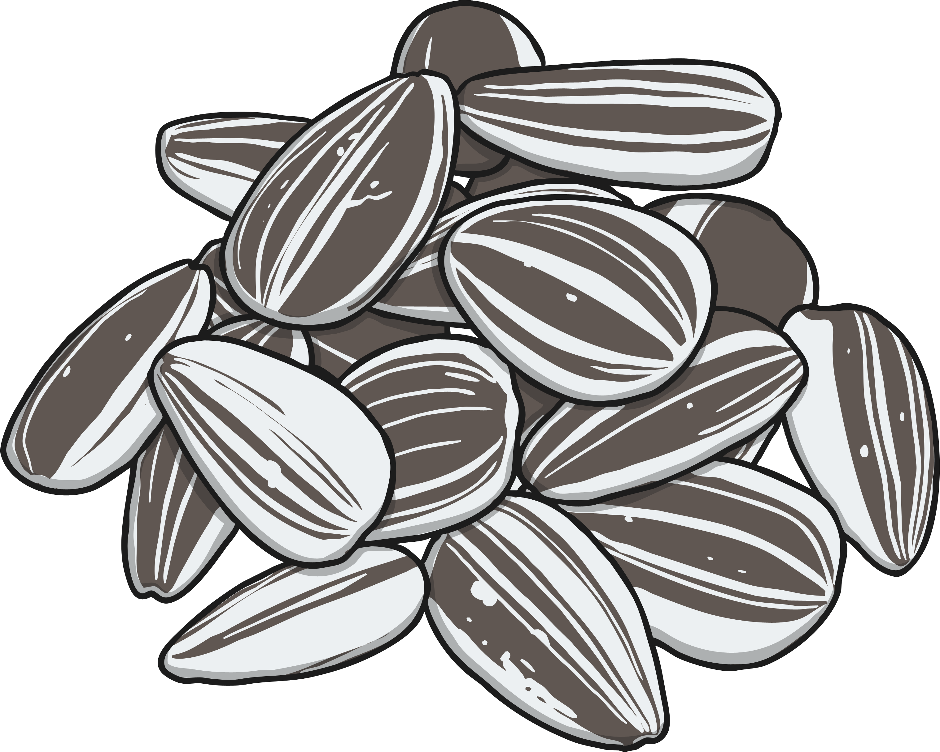
Life Processes
Reproduction
All living things reproduce.
Animals lay eggs or give birth to live young.
Animals have young.
Plants
produce seeds from which more plants grow.
Most plants reproduce by forming seeds.

Slide 11
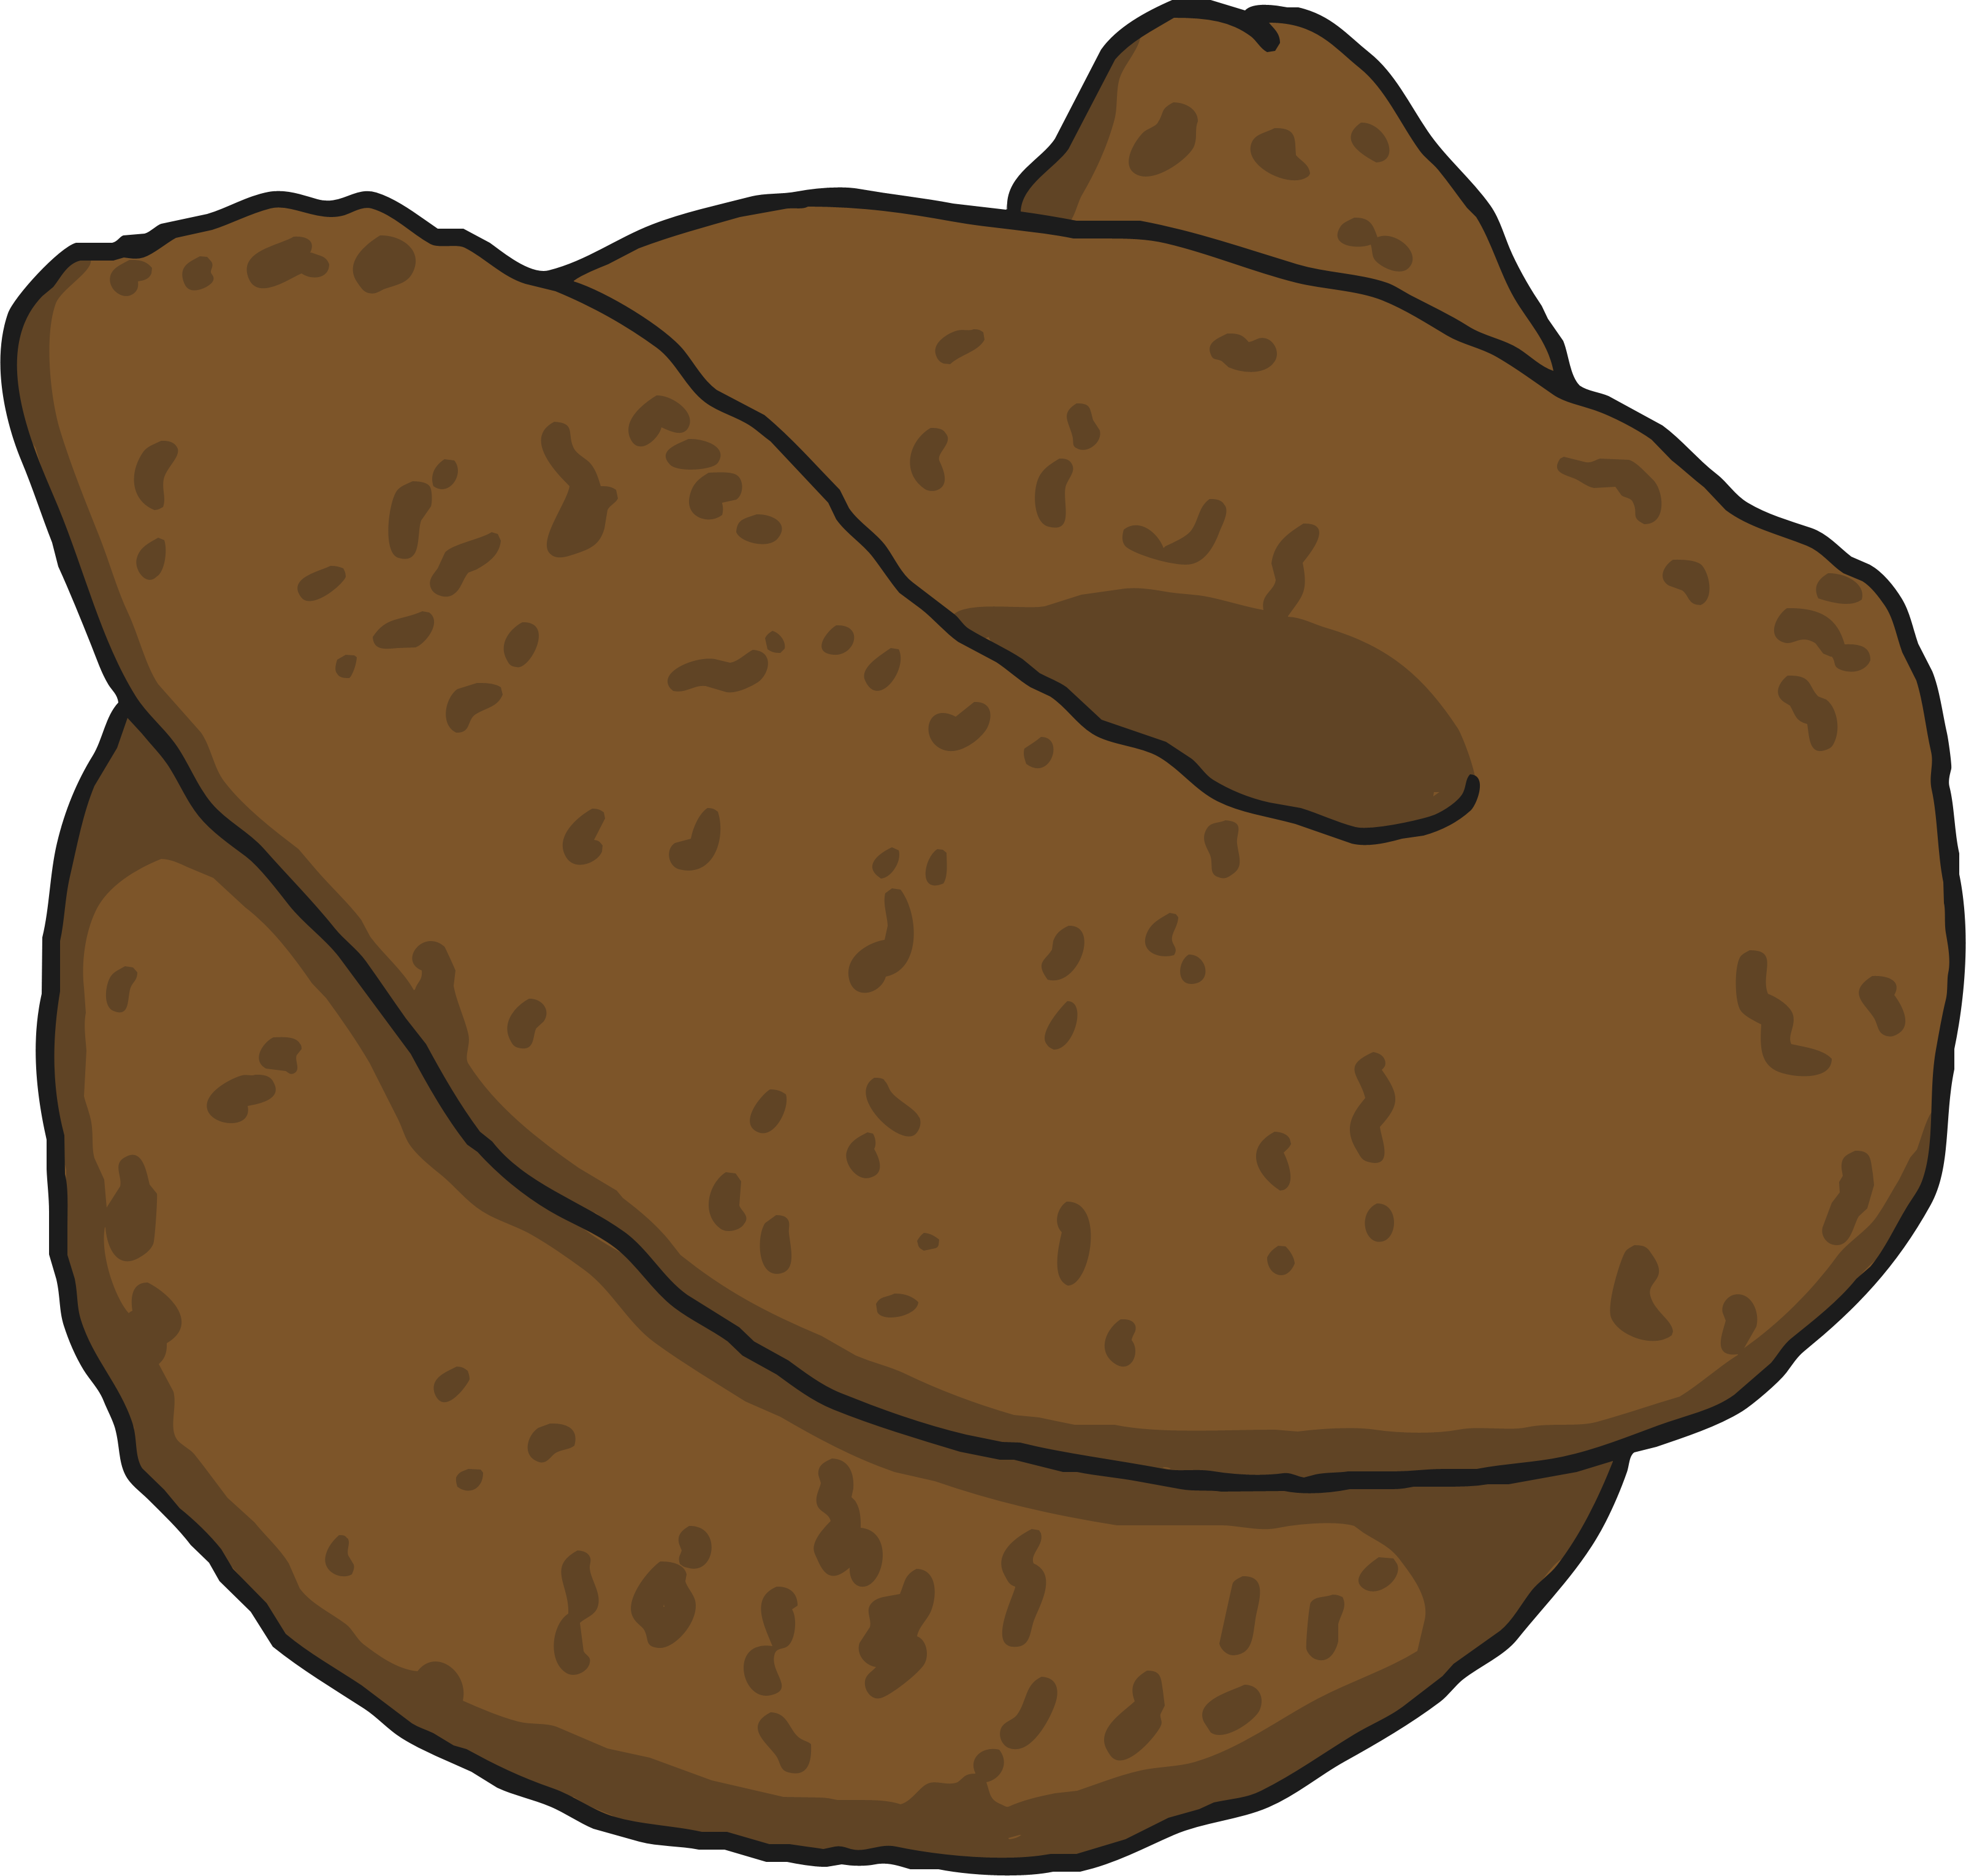
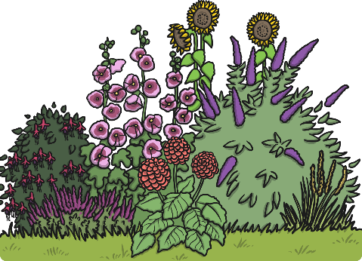
Life Processes
Excretion
All living things excrete.
Animals excrete waste through urine and faeces.
Waste products are removed from the body.
Both plants and animals have to get rid of excess gas and water.
Leftover gases and water leave plants from their leaves.

Slide 12
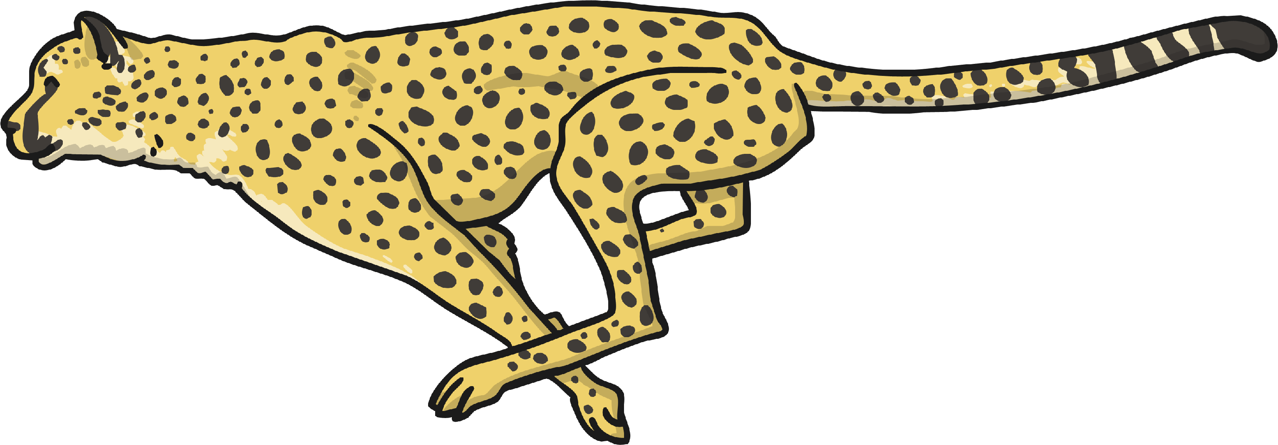
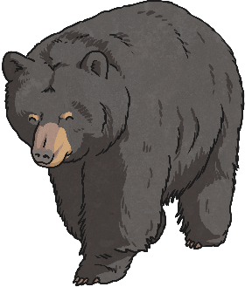
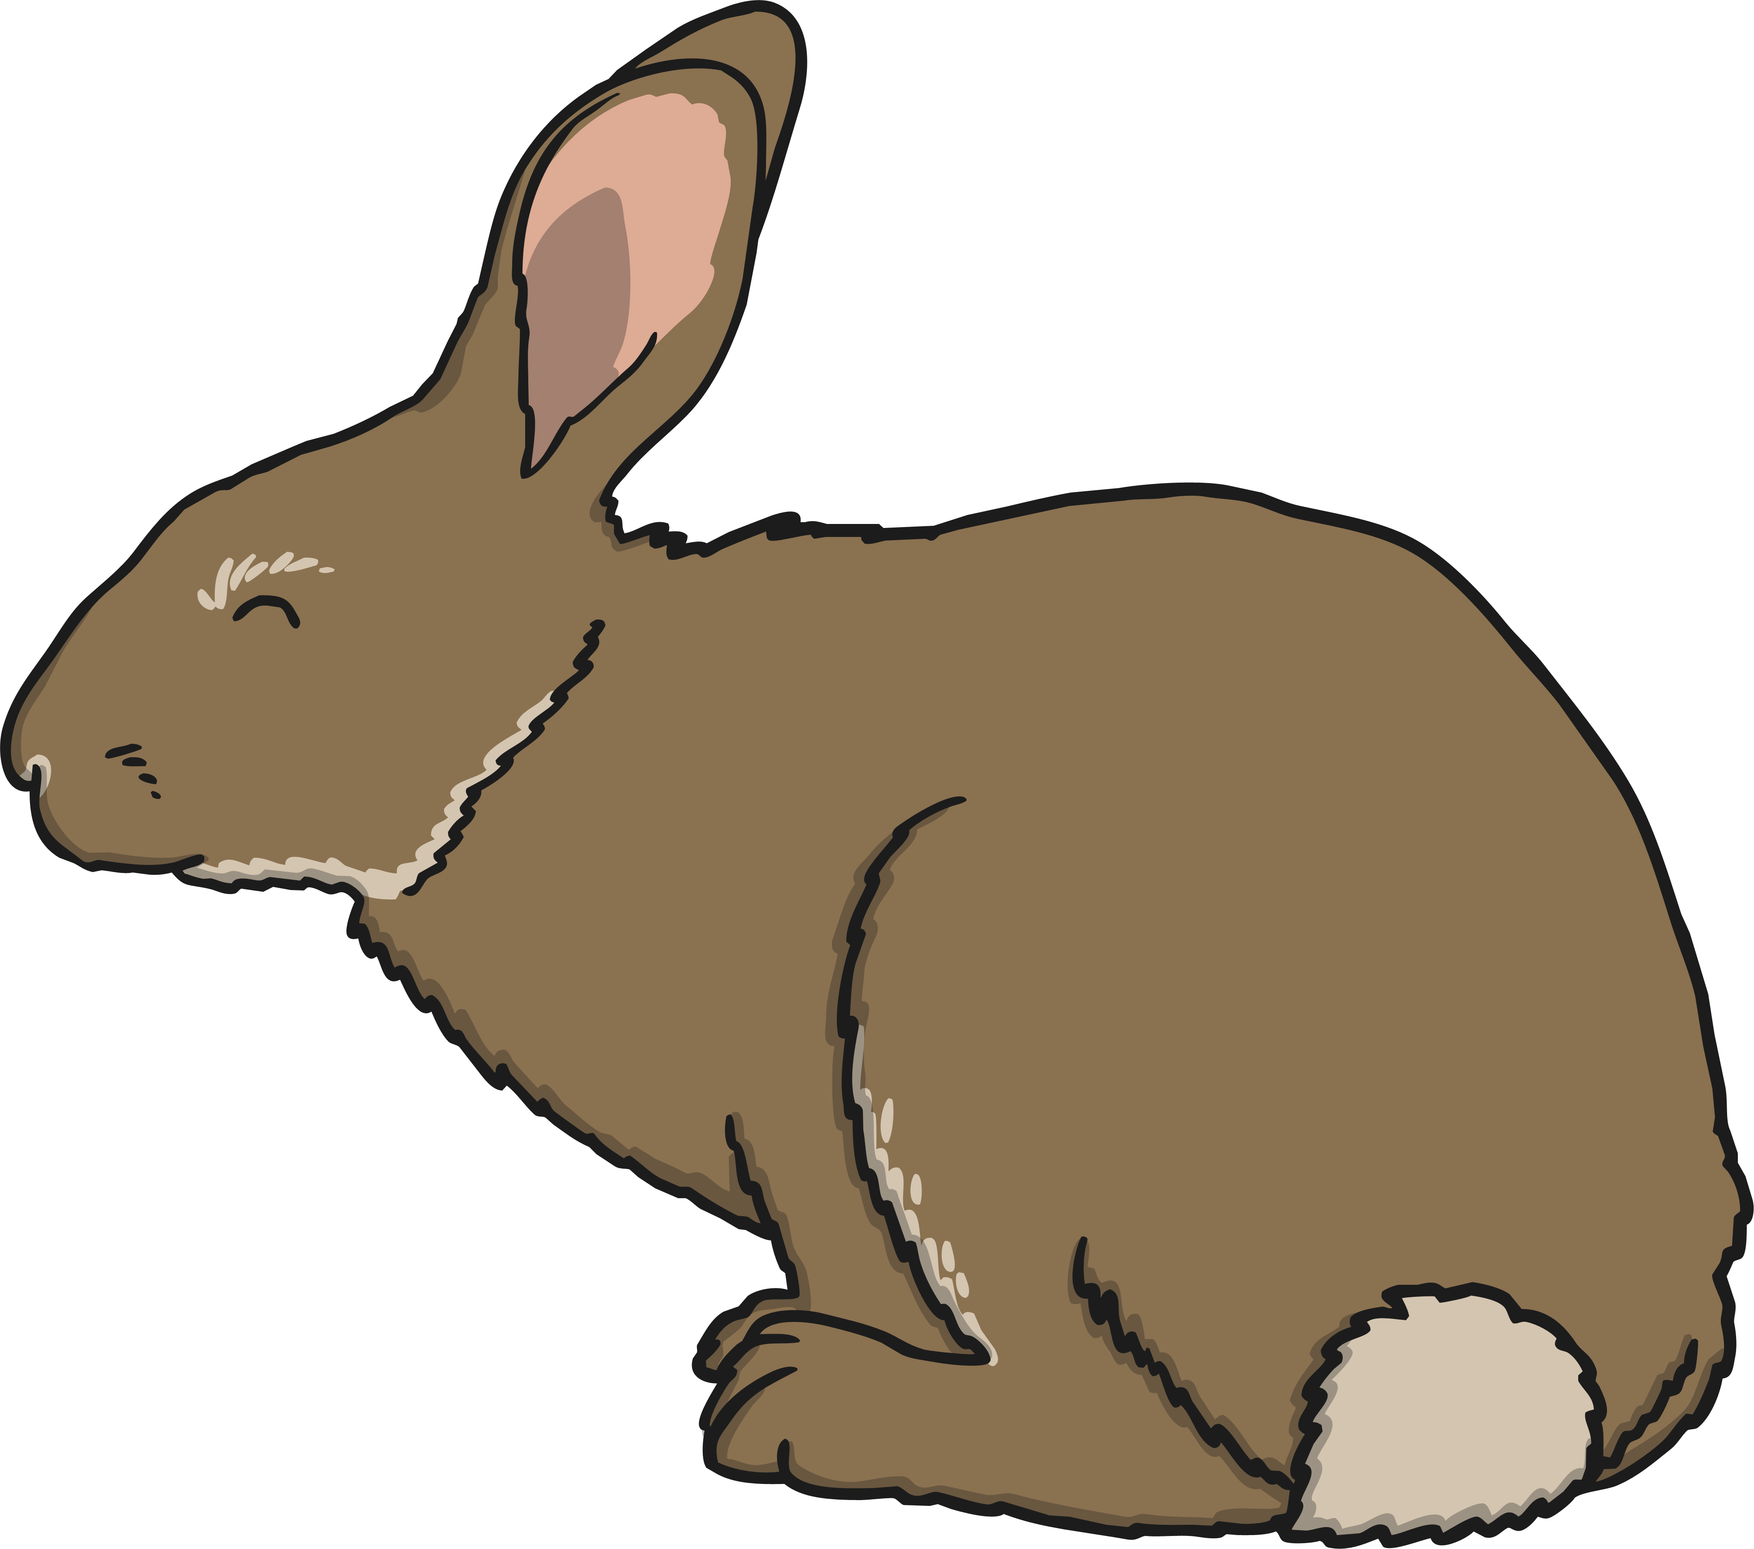
Life Processes
Nutrition
All living things need nutrition.
Animals may be carnivores, herbivores or omnivores.
Food is eaten to provide energy to live.
Green plants make their own food using sunlight.
Green plants make their own food using the energy from the sun.

Slide 13
Life Processes
All living organisms share these characteristics. This is how we know they are alive!
Living things have lots of other similarities, and many differences too. We can use these similarities and differences to sort the living things into groups.

Slide 14
Grouping Living Things
Can you think of a way we could sort these organisms into two groups?

Slide 15
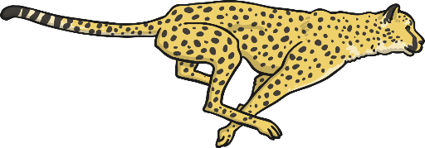
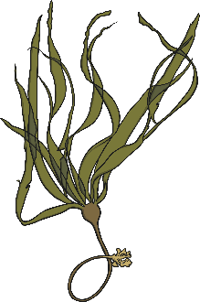
Grouping Living Things
Here the organisms have been sorted into two groups. We have used a diagram to represent these groups.
Can an organism be in both groups at the same time?
plants
animals

Slide 16
Grouping Living Things
Here, an organism cannot be both an animal and a plant, so it can not be in both groups at the same time.
plants
animals

Slide 17
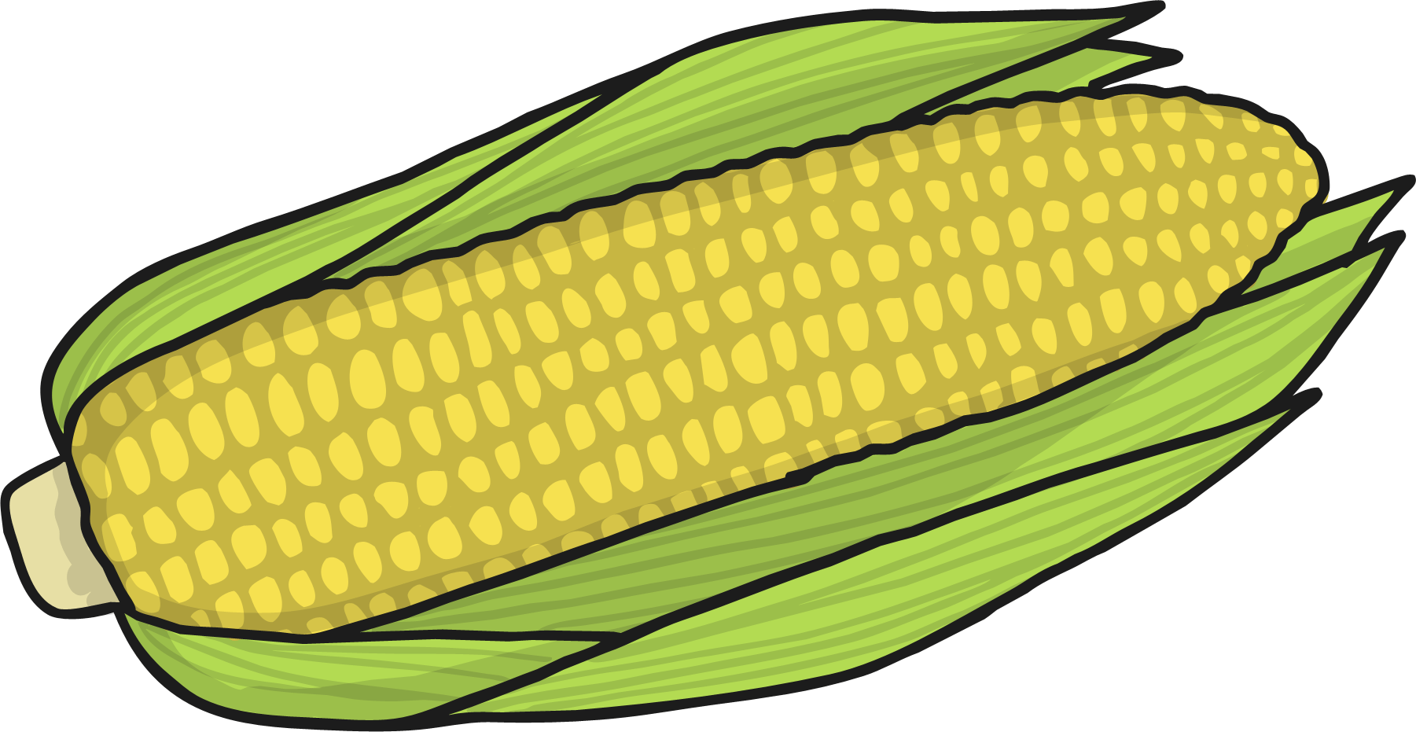
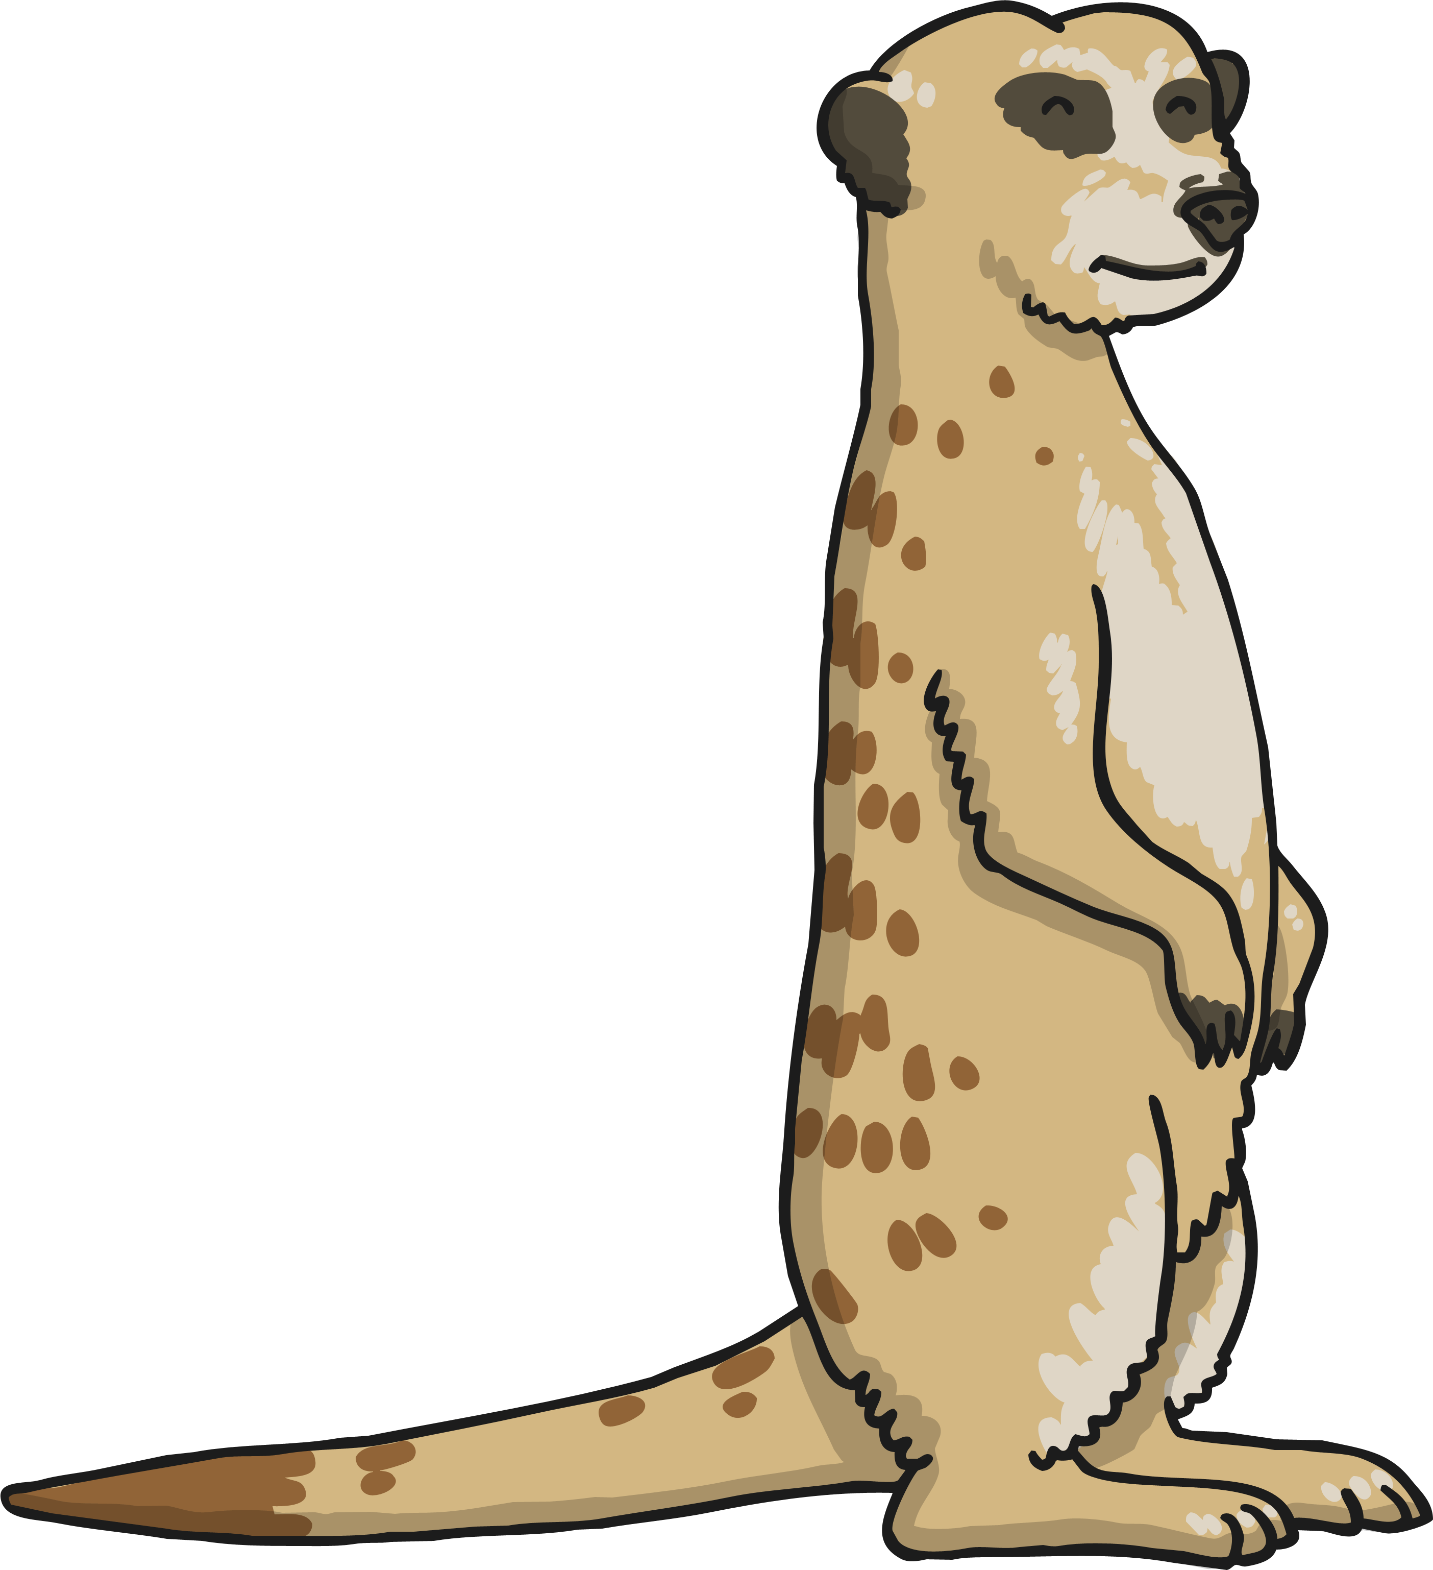
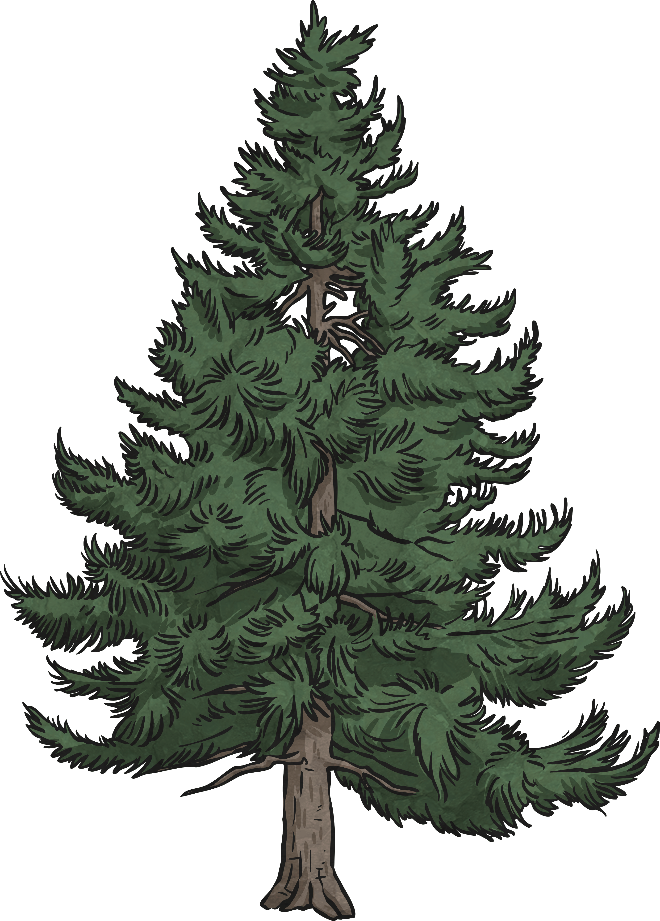
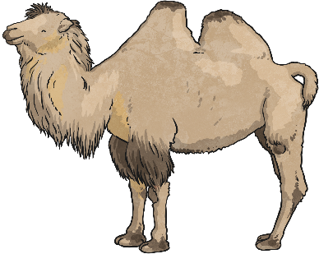
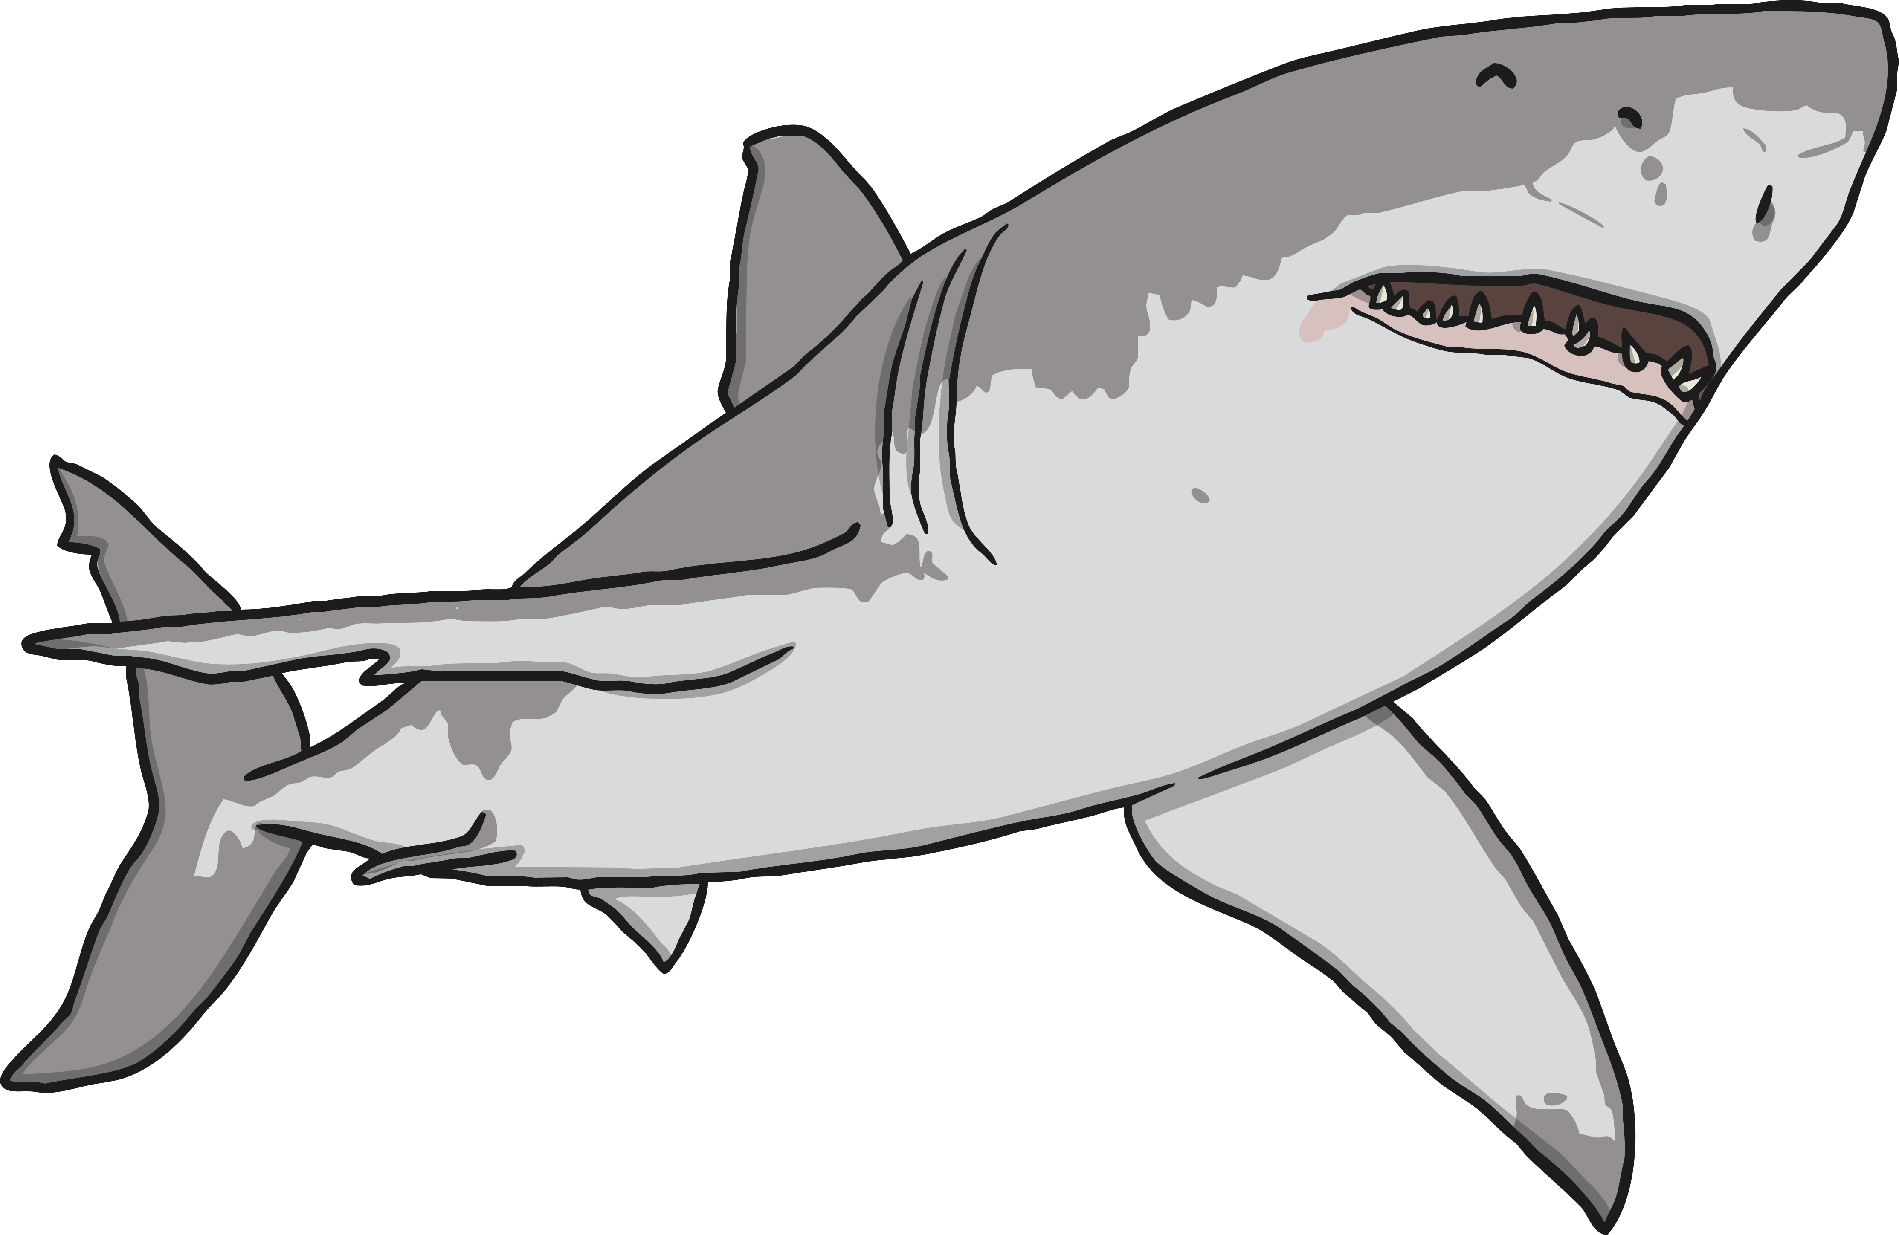
Grouping Living Things
This is called a Venn Diagram. Why is the shark on the outside of the diagram? Where does a cactus go in this diagram? How about a polar bear?
plants
lives in the desert
How is this diagram different to the previous diagram?

Slide 18
Grouping Animals Task
You are going to group animals using a Venn Diagram.
You need to choose the criteria (labels) for the different parts of the Venn Diagram. Then sort the animals from the animal picture sheet into the diagram, - you can draw them or write their names!

