Slide 1
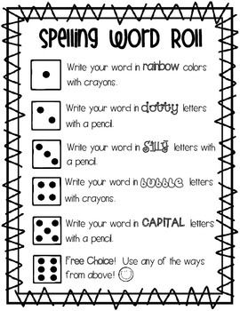
Spelling Game
Pick a word from your spelling list.
Roll a die.
Which number did it land on?
Look at the list on the left and write the word in this way.
Do this for all your spelling words.
Play this as many times as you can.

