Slide 1
Whitehouse Farm

Slide 2
Location
White house farm is located, south of Morpeth and is just one mile off the A1.

Slide 3
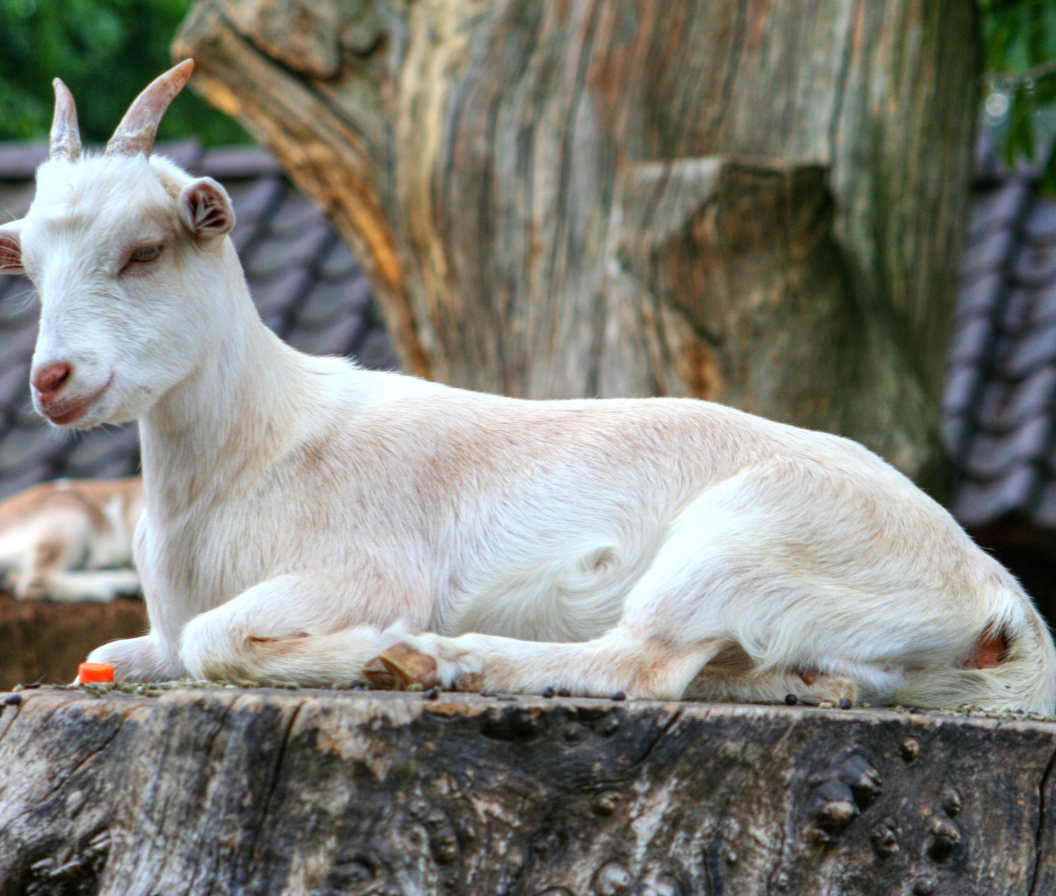
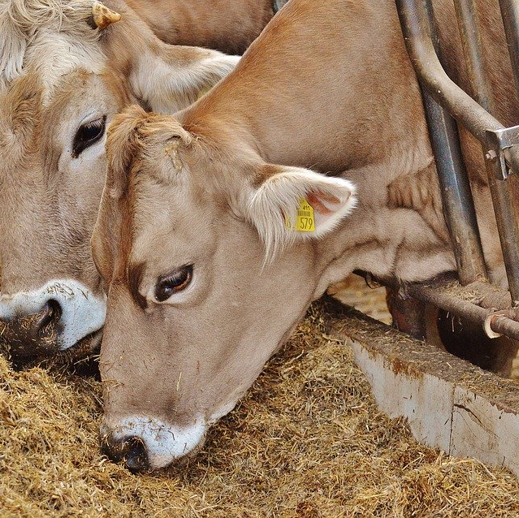
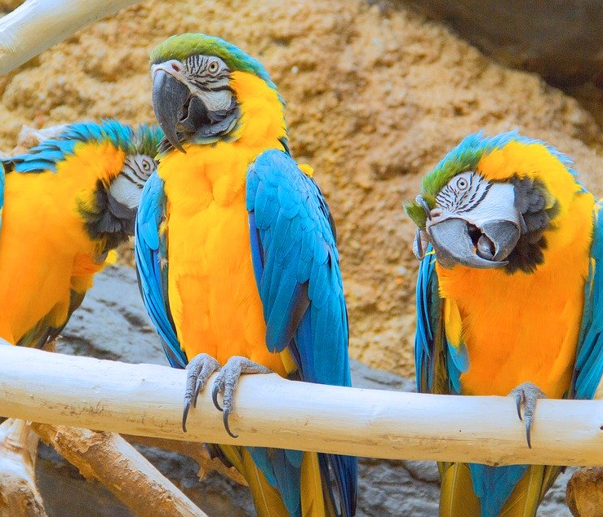
PRICE LIST
Adults £11.75
Children £10.50
Seniors £10.50
Students £10.50
Family ticket (4 people) £39.95
Bag of animal food 65p
This Photo by Unknown Author is licensed under CC BY-SA

Slide 4
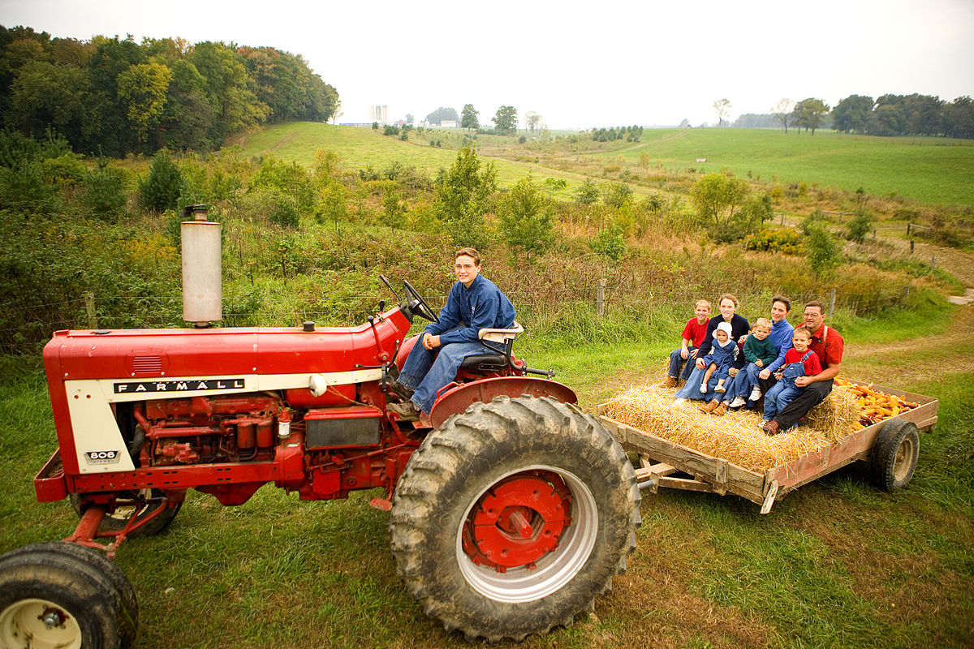
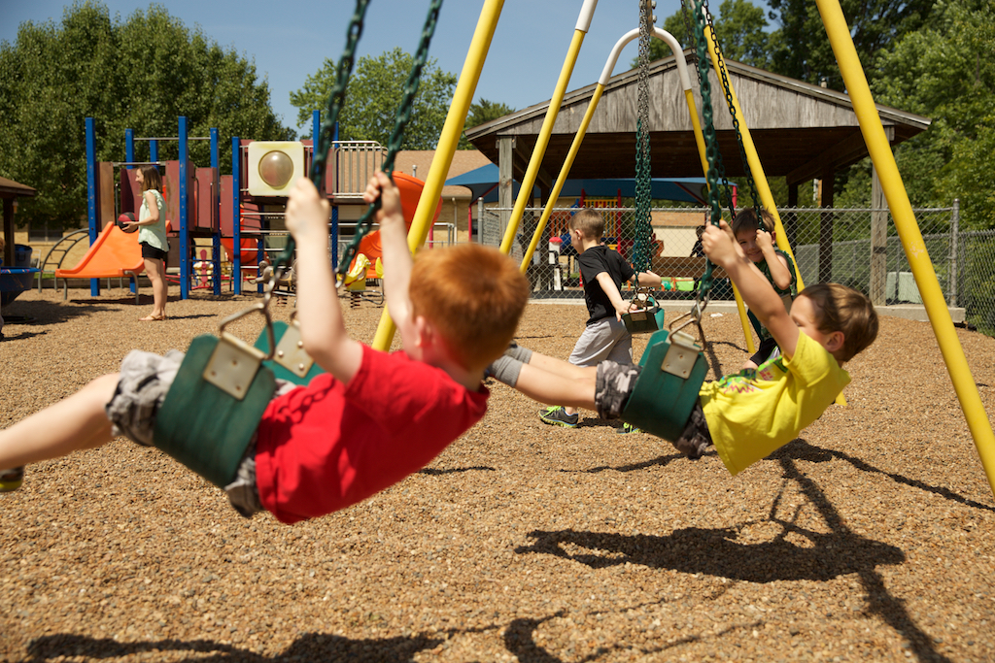
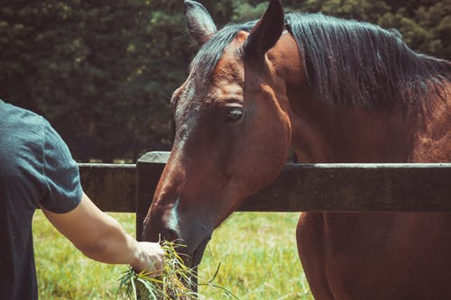
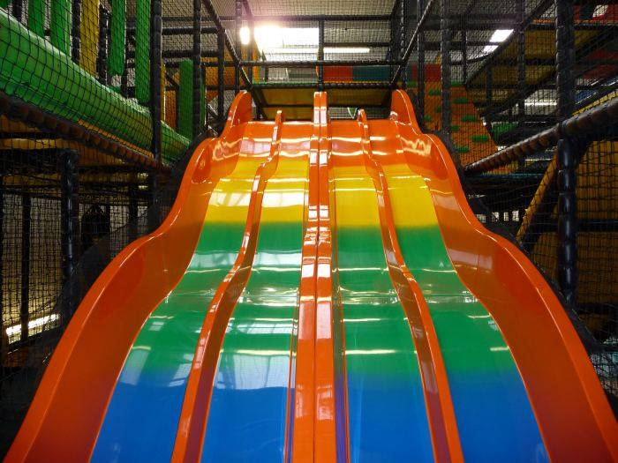
At white house farm there are lots of activates and there all my favorite. There is a long list of things to do; like feeding animals, tractor rides, the farmers den soft play, adventure playground, jumping pillows, indoor racing cars, outdoor play, the hungry pig café and the gift shop.

Slide 5
Why should you visit Whitehouse Farm?
People should visit white house farm because they can see lots of different animals. You will also get to hold some reptiles, rabbits, mice and even some baby chicks. There are lots of things to do, even if you do not like animals.

Slide 6
Educational
People will learn how to take care of animals, through exploring learning and play

