Slide 2
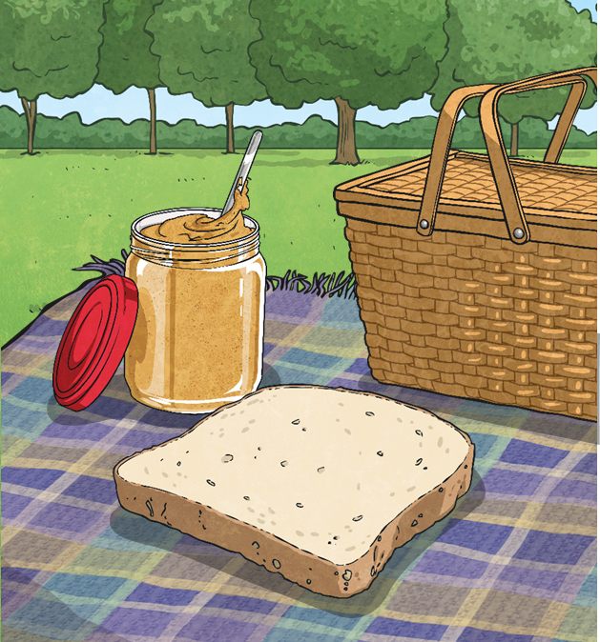
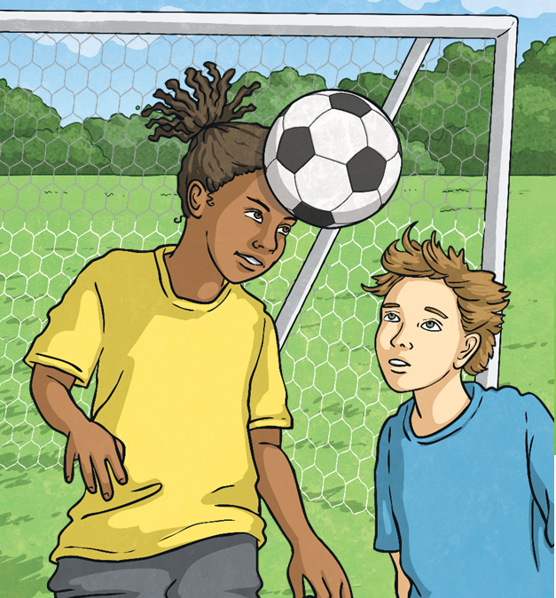
Imperial Units of Mass
The imperial system of measurement uses ounces and pounds to measure mass.
Ounces (oz) are the smaller unit of mass. One slice of bread has a mass of about one ounce. Ounces are often used in recipes to measure amounts of ingredients.
Pounds (lb) are the larger unit of mass – a football has a mass of about one pound. There are 16 ounces in one pound. We might use pounds to measure the mass of our bodies or larger amounts of ingredients.
Can you think of anything else that we use ounces or pounds to measure?

Slide 3
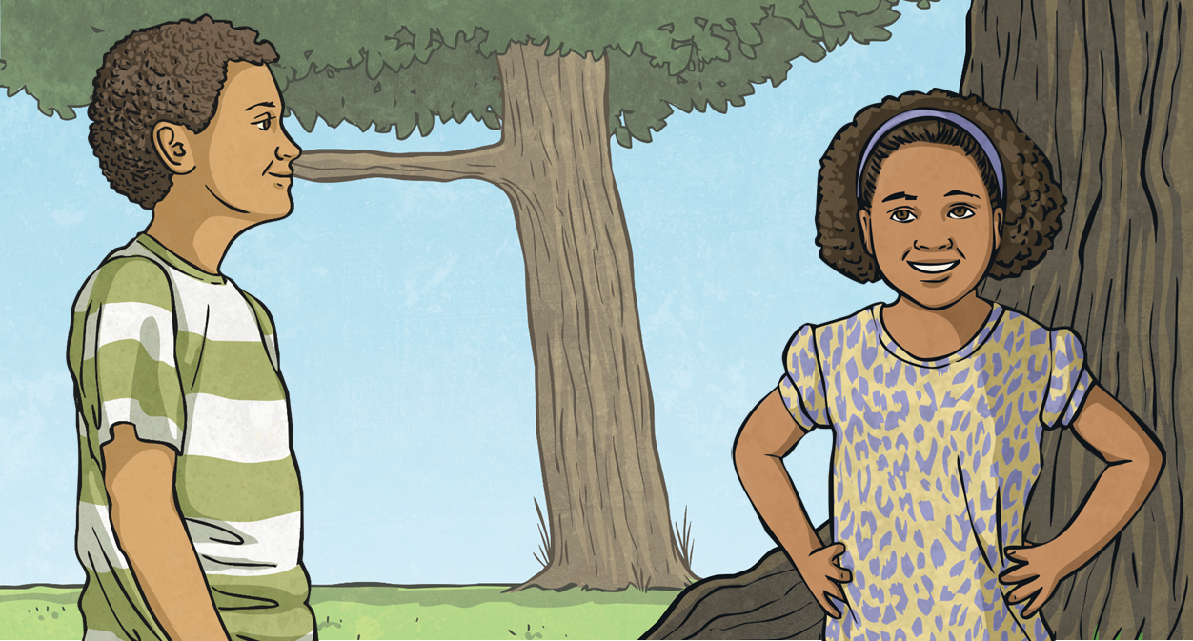
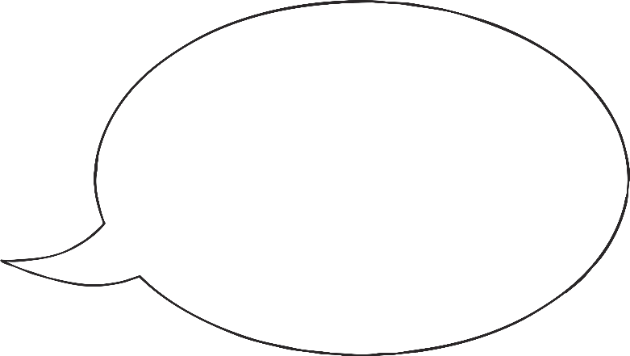
Ounces and Grams
1oz ≈ 28g
How could you work out how many grams are approximately equal to…
Remember that the ≈ sign means approximately equal to.
Ounces | Grams
2oz
5oz
6oz
56g
140g
168g
double
× 5
× 10 and find half
add
another method?

Slide 4
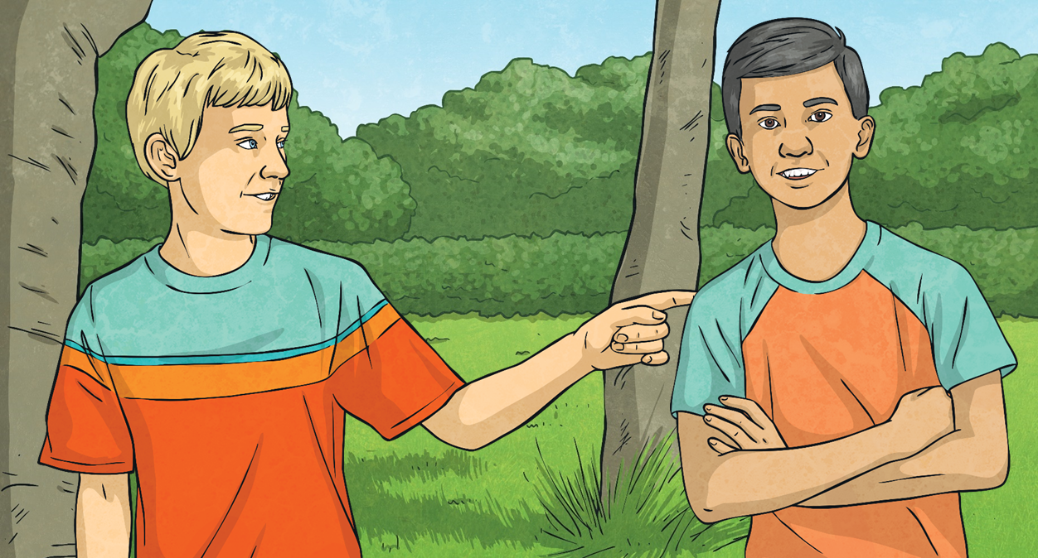
Ounces and Grams
1oz ≈ 28g
How could you work out how many grams are approximately equal to…
Remember that the ≈ sign means approximately equal to.
Can you think of another way to work this out?
Ounces | Grams
½ oz
2½ oz
28g × 2 = 56g
28g ÷ 2 = 14g
56g + 14g = 70g
14g
70g
double
halve
÷ 2
add
another method?

Slide 5
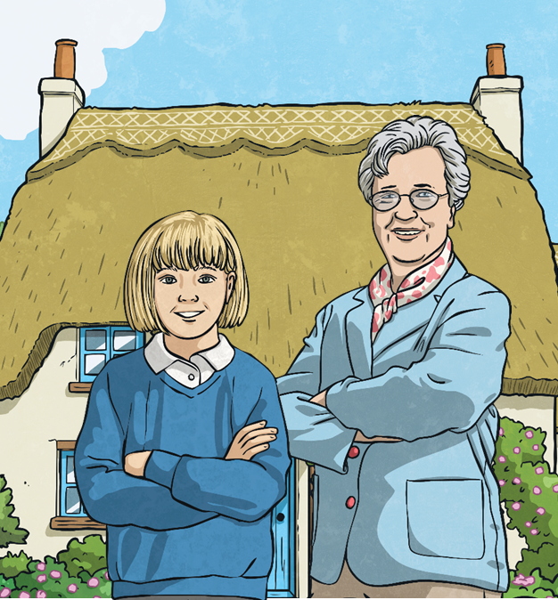
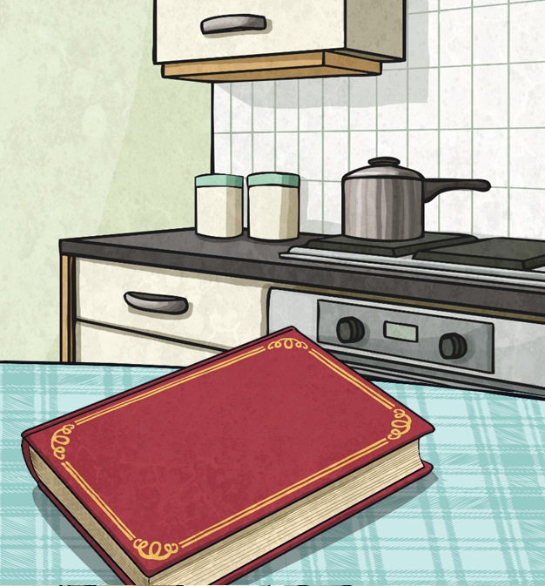
Recipes
Lucy’s grandma has given her an old book of cake recipes. The ingredients have been written in imperial measurements.
Lucy only has a set of scales that measure in metric units!
She wants to convert her grandma’s recipes from ounces to grams so that she can make them herself.

Slide 6
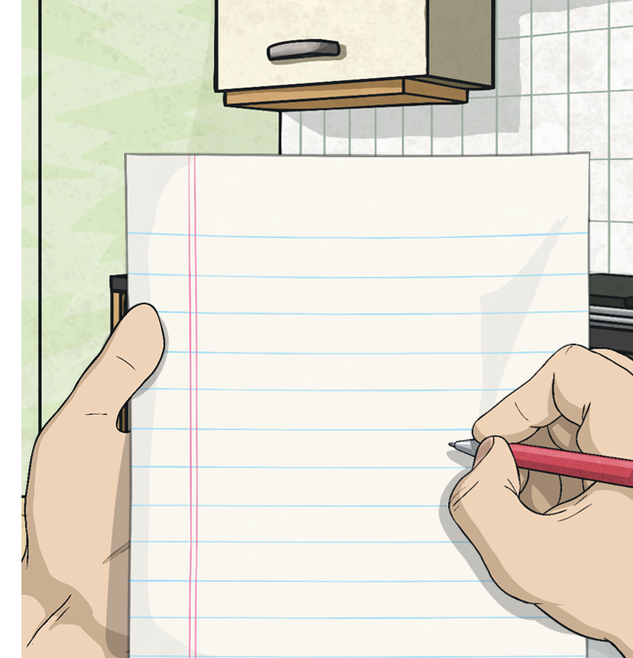
Recipes
1oz ≈ 28g
The first page in Lucy’s grandma’s book has a list of ingredients for making shortbread.
Shortbread Ingredients (oz)
makes 12
8oz butter
6oz sugar
10oz plain flour
Shortbread Ingredients (g)
makes 12
224g butter
168g sugar
280g plain flour
Convert the measurements given in ounces into grams:

Slide 7
Recipes
1oz ≈ 28g
Lucy found a recipe for chocolate cake. She wants to make 24 cakes so she can bring them in to share with her class.
Cake Ingredients (g)
makes 24
Cake Ingredients (oz)
makes 12
3oz caster sugar
4½oz butter
11oz plain flour
168g caster sugar
252g butter
616g plain flour
Write a list to show the ingredients in grams.

Slide 8
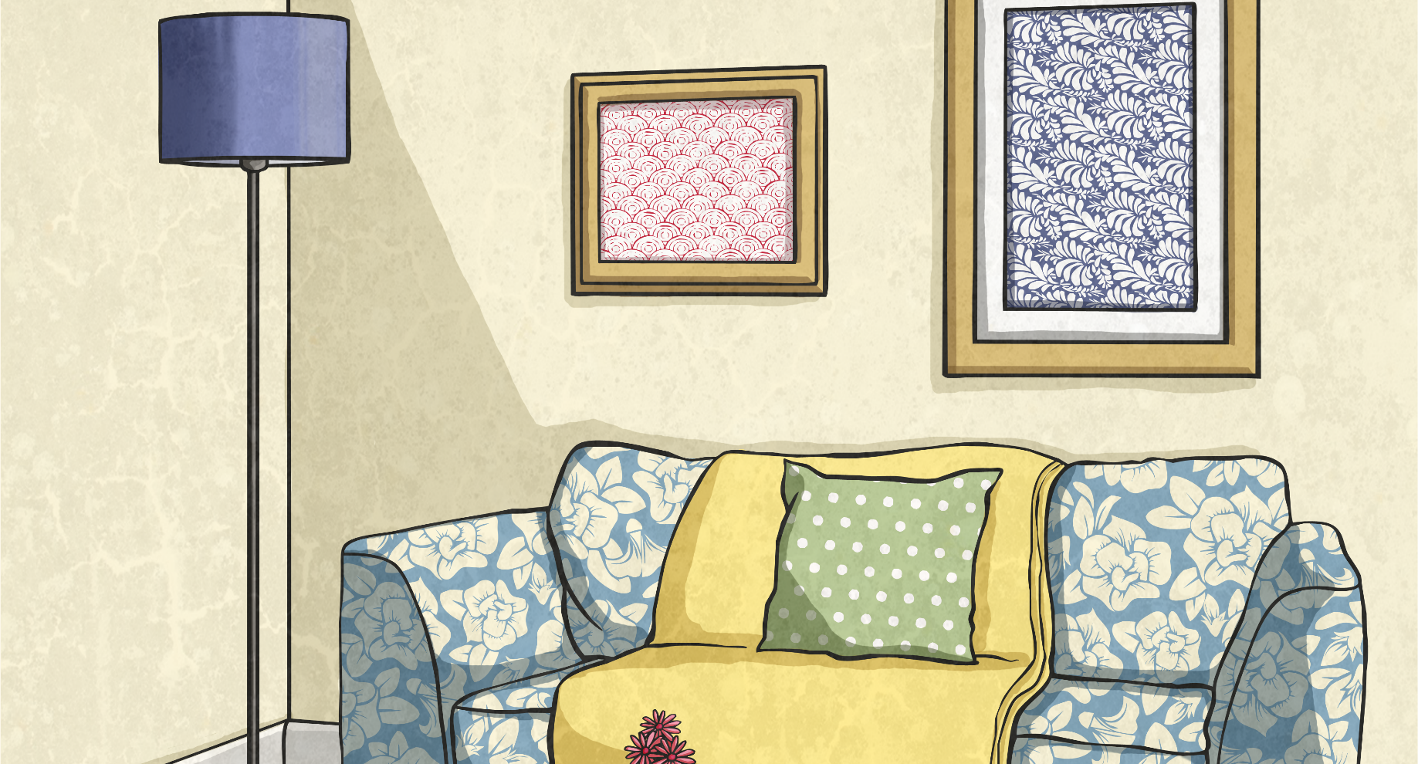
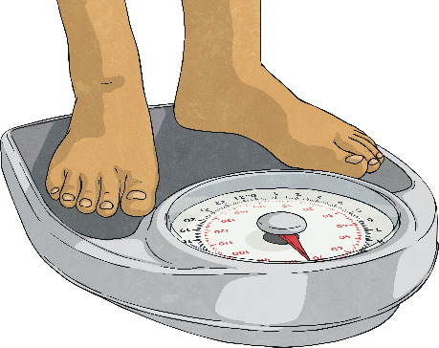
Pounds, Grams and Kilograms
We usually measure certain objects in either pounds or kilograms.
In shops, people find the mass of their fruit in grams and kilograms.
Can you think of any objects that we normally measure in pounds? How about kilograms?
A lot of people record their mass in either kilograms or pounds.
Can you think of any objects that we might use either unit to measure?
We weigh babies at birth and record their mass in pounds.

Slide 9
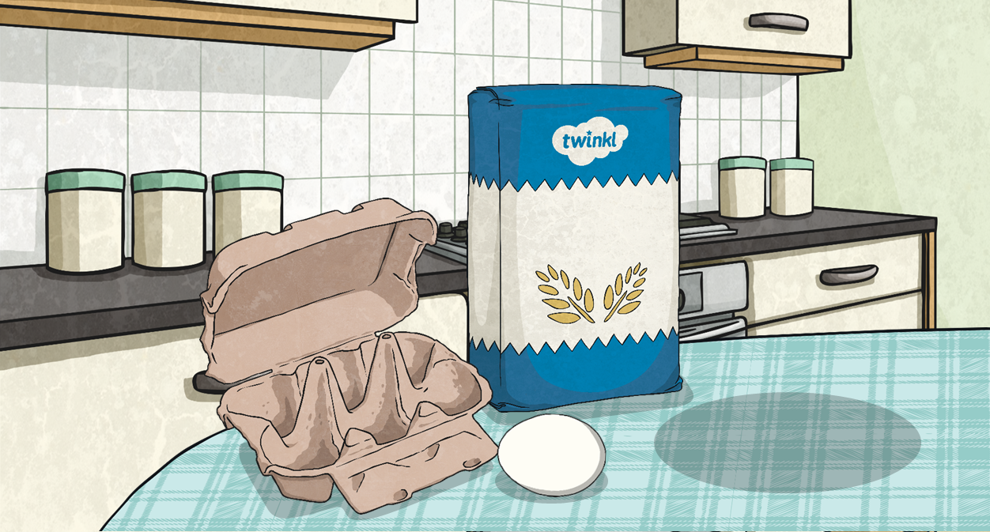
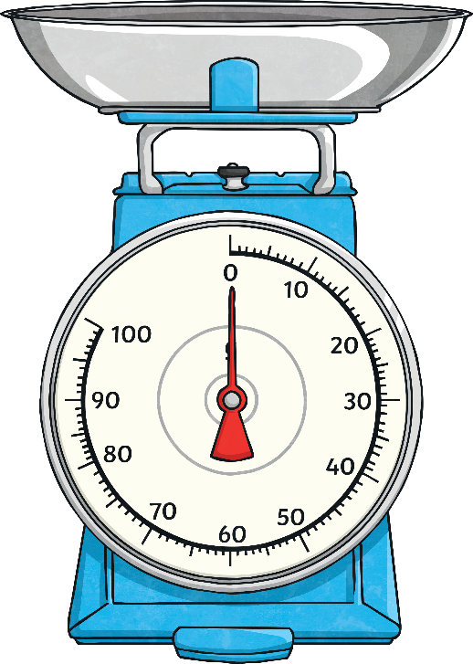
Pounds, Grams and Kilograms
1lb ≈ 450g
One of Lucy’s grandma’s recipes lists a pound of flour as one of the ingredients. Lucy needs to work out how much this is in grams so that she can measure the correct amount on her scale.
We could also write these measurements in kilograms.
1lb | 2lb | 5lb | 10lb | 15lb
450g
0.45kg
900g
2250g
4500g
6750g
0.9kg
2.25kg
4.5kg
6.75kg

Slide 10
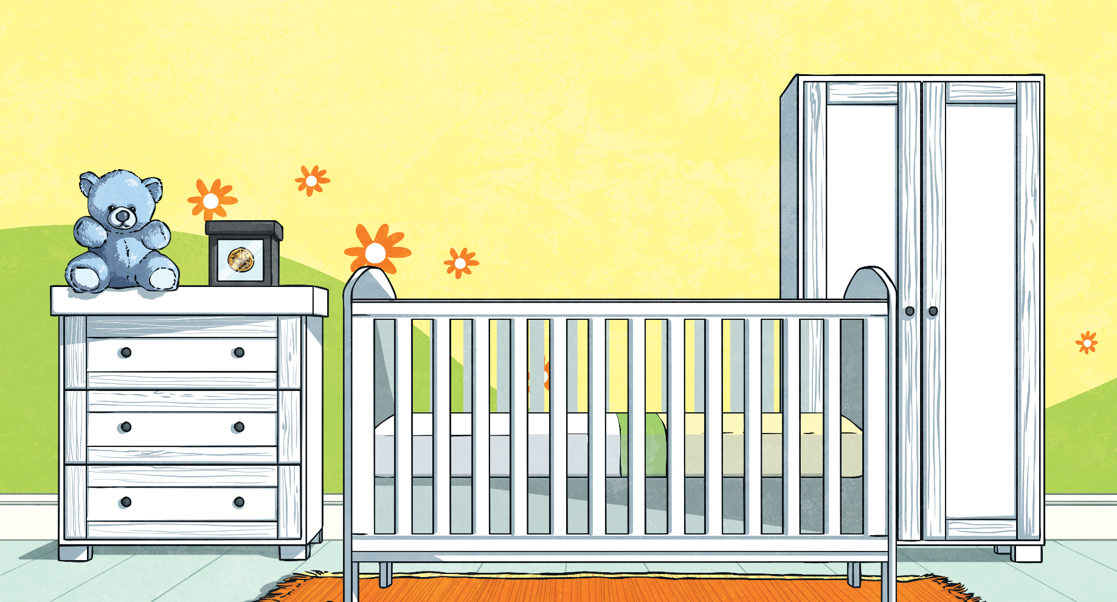
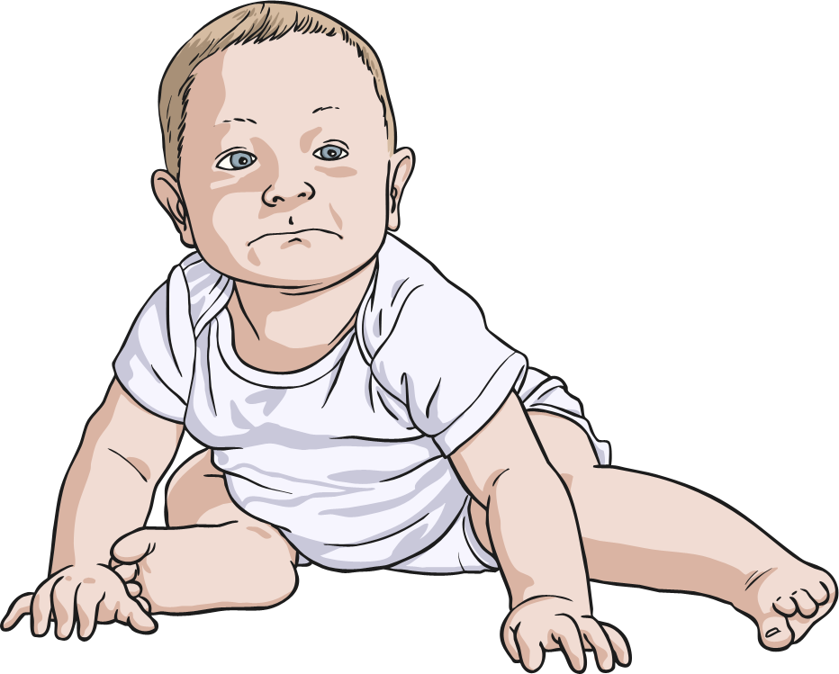
Pounds, Grams and Kilograms
1kg ≈ 2.2lb
?
Lucy’s baby sister had a mass of 6kg when she was three months old. Lucy’s grandma wanted to know what this was in pounds.
How could you work out what 6.6lb would be in kilograms?
There are three lots of 2.2 in 6.6, so 3kg = 6.6lb.
Convert these measurements from kilograms to pounds to help Lucy explain this to her grandma.
1kg | 2kg | 5kg | 10kg
2.2lb
4.4lb
11lb
22lb

Slide 11
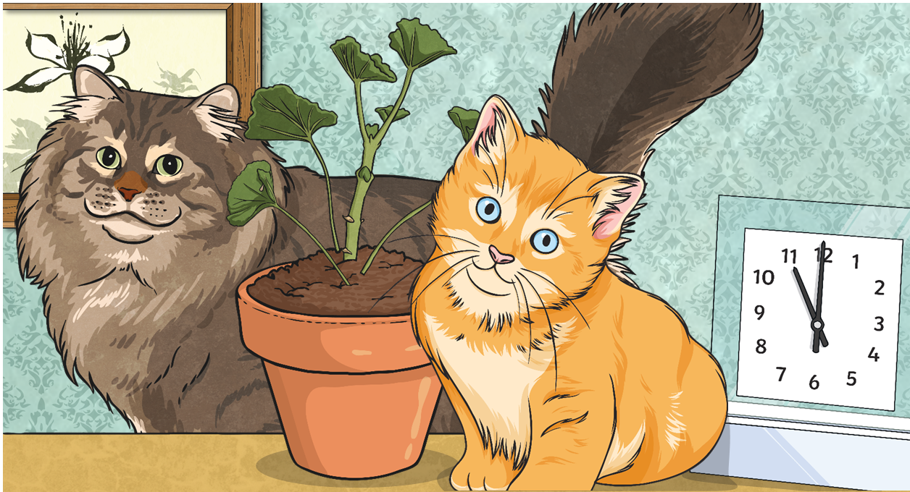
Mass Problems
1oz ≈ 28 grams 1lb ≈ 450g 1kg ≈ 2.2lb
Kitten:
1oz ≈ 28g × 20 ≈ 560g
Mother:
2kg = 2000g
2000g - 560g = 1440g
The mother is 1440g heavier
than her kitten.
Its mother has a mass of 2kg. How much heavier is the mother than her kitten? Give your answer in grams.
A kitten has a mass of 20oz.

Slide 12
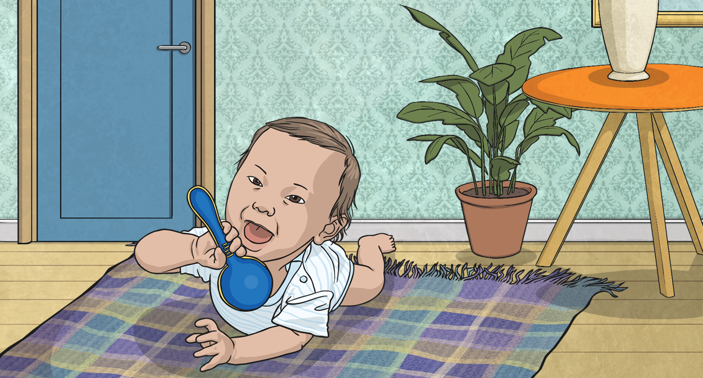
Mass Problems
1lb ≈ 450g × 6 = 2700g
2700g = 2.7kg
2.7kg + 2.5kg = 5.2kg
Aran’s mass now is 5.2kg.
1oz ≈ 28 grams 1lb ≈ 450g 1kg ≈ 2.2lb
He gained 2.5kg in three months. What is his mass now?
Give your answer in kilograms.
When Aran was born, his mass was 6lbs.

Slide 13
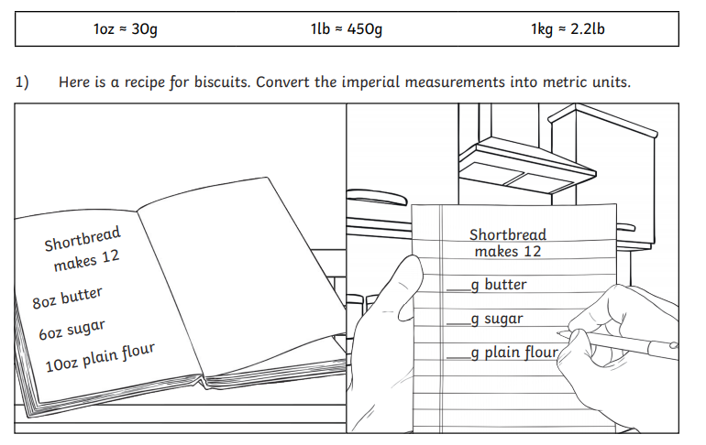
Units of Mass
Can you answer these questions

Slide 15
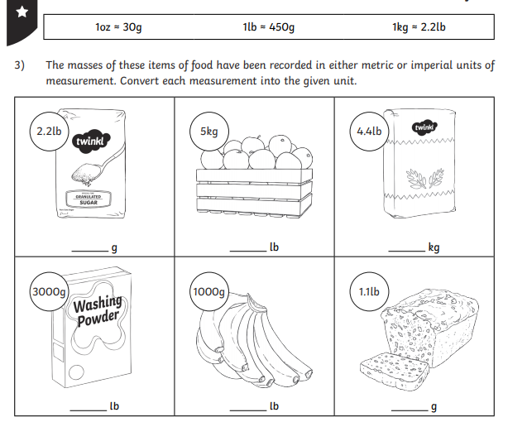
Make sure you look at which measurement you are converting to.

Slide 16
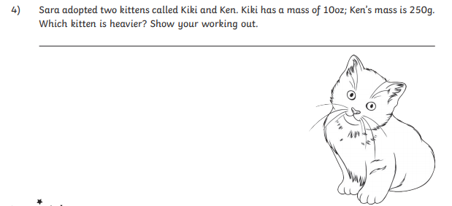

Slide 17
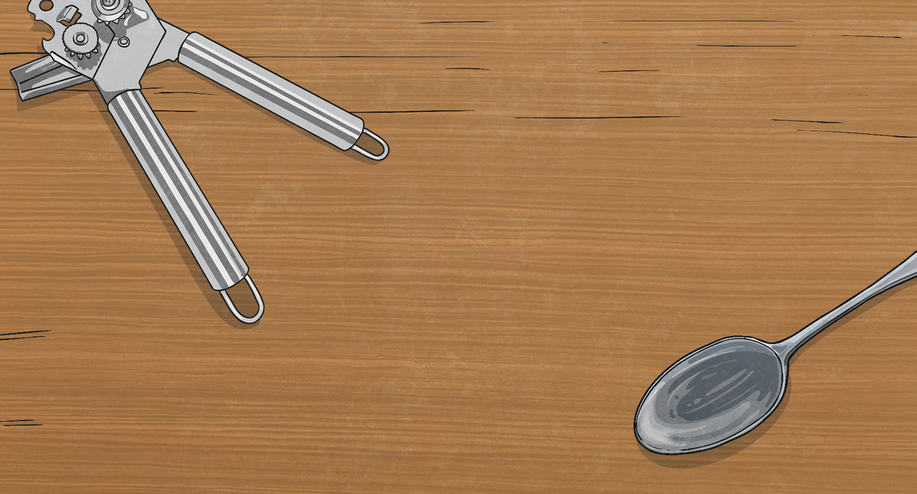
Comparing Measurements
Use <, > or ≈ to compare each set of measurements. For each set, decide which measurement it would be more sensible to convert.
1lb ≈ 450g 1kg ≈ 2.2lb
?
≈
<
>
?
?
2.5kg
4.4lb
4kg
6lb
3lb
3.1kg
2kg
4lb
5lb

