Slide 2
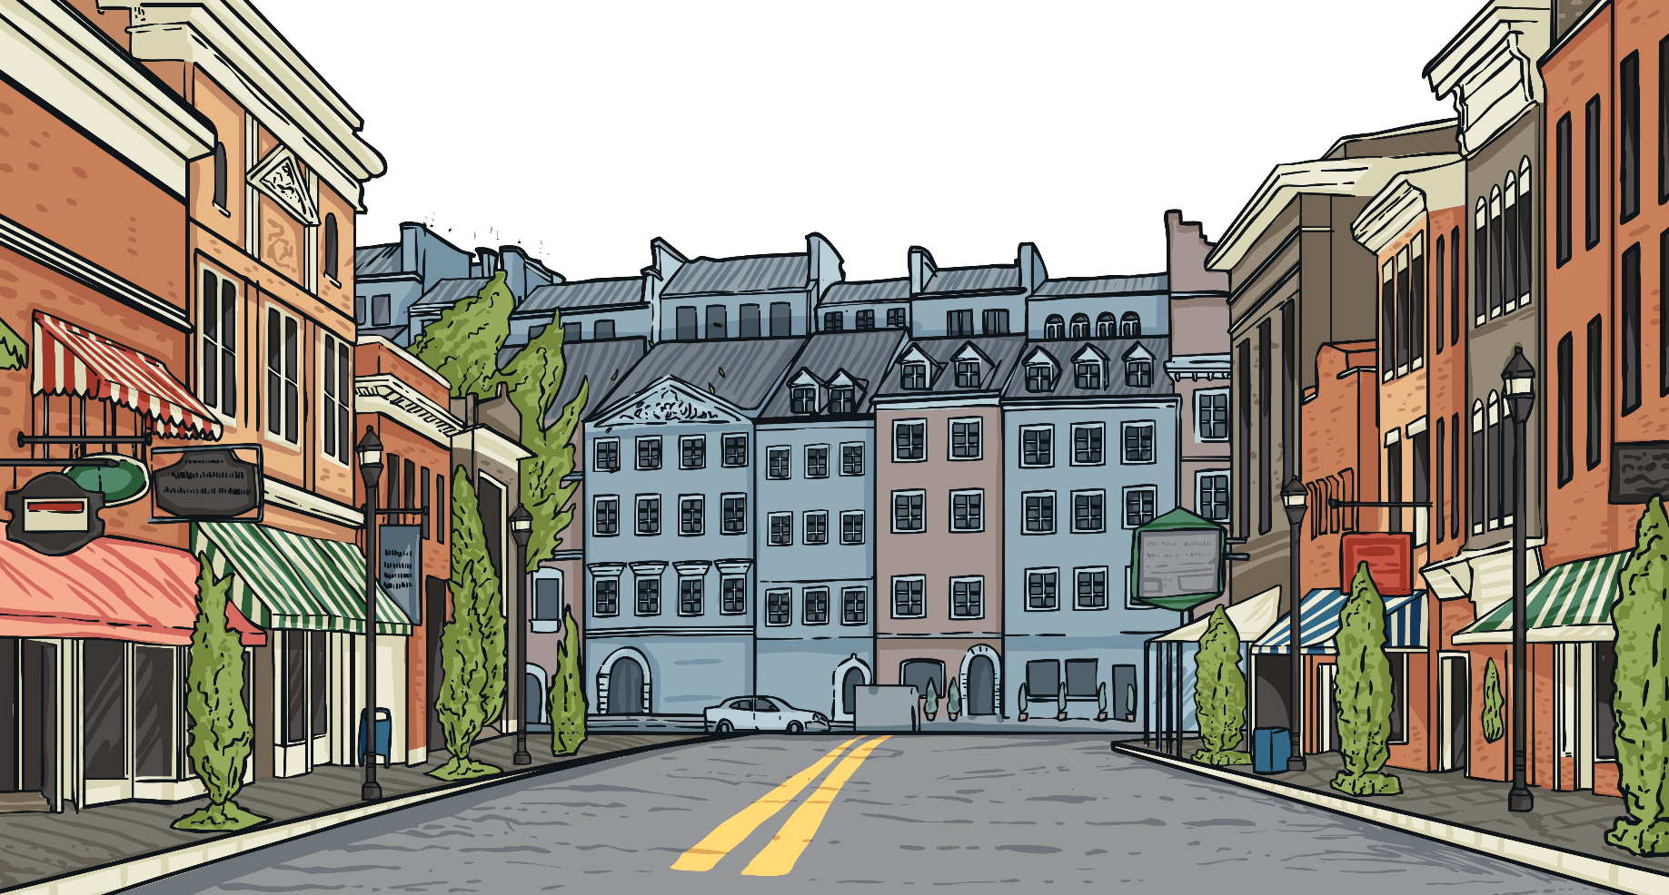
Measurements of Length
Here are some units of measurement.
Sort them into units that measure length and units that do not.
How do you think these units of length have been sorted?
Can you order the units of measurement from smallest to largest?
The units that have been shaded green are units of length.
The units shaded purple are metric units of measurement.
?
kilometre
ounce
litre
millimetre
Have you heard of the imperial system of measurement before?
gram
foot
pound
inch
mile
gallon
centimetre
kilogram
pint
stone
yard
metre
The units shaded orange are imperial units of measurement.
The units that have been shaded turquoise are units of mass, volume or capacity.

Slide 3
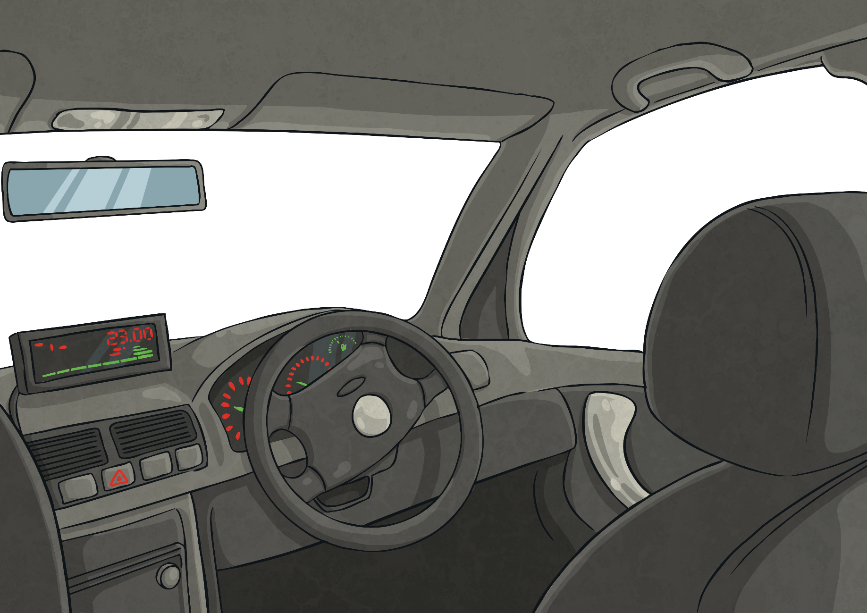
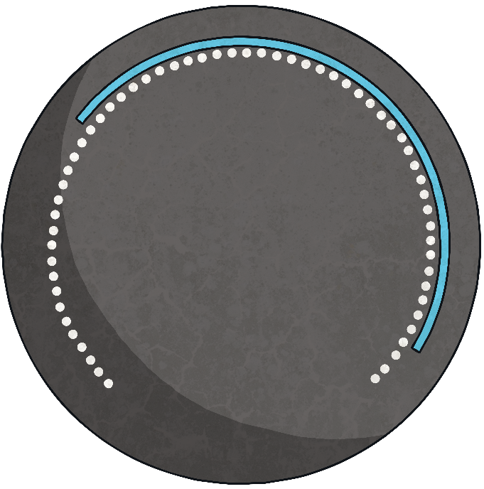
Introducing Imperial Measurements
There are two main systems of measurement in use – the metric system and the imperial system.
The UK uses a mixture of imperial and metric measurements. For example, we normally use miles to measure long distances.
Most countries in the world use the newer metric system of measurement. However, a few countries – such as the USA – still use the imperial system.
Although they both measure length, mass, volume and capacity, they use different units of measurement.
50
60
70
80
80
100
120
40
100
120
90
British cars have a speedometer that shows speed on the outside of the dial in miles and on the inside in kilometres.
In most of the rest of Europe, the speed is only shown in kilometres.
80
140
100
60
140
30
60
MPH
160
110
40
km/h
20
40
km/h
180
120
160
10
20
200
20
180
0
220
130
0
140
0
200

Slide 4
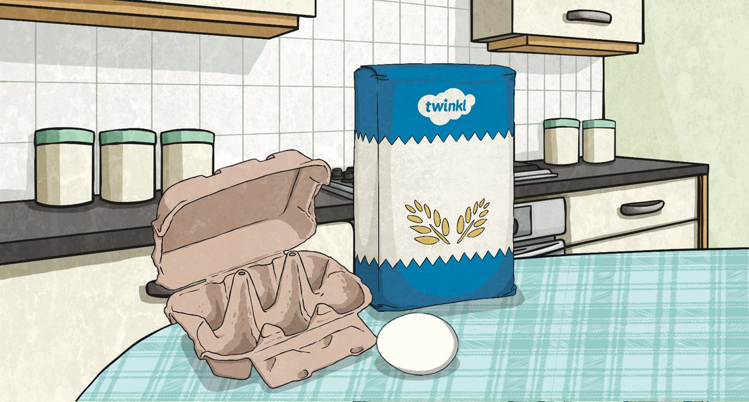
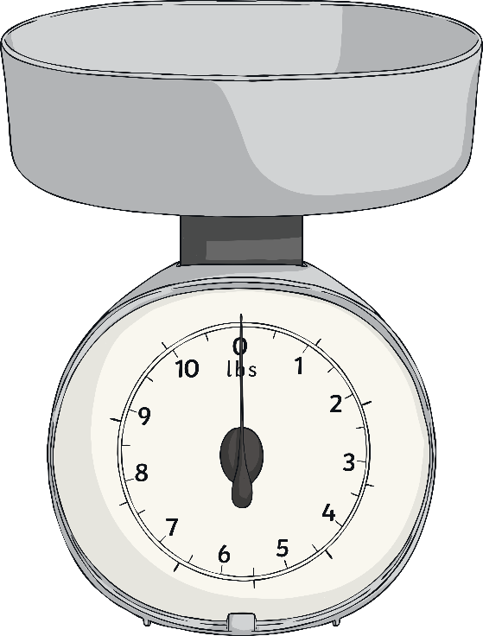
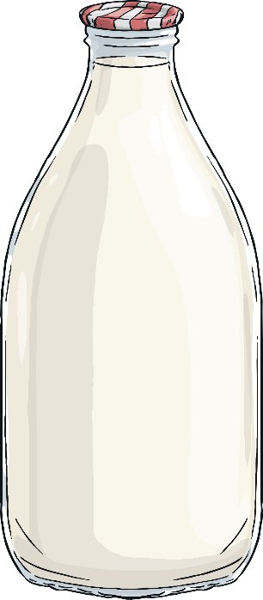
Introducing Imperial Measurements
Which are the most common metric units of mass?
Which are the most common metric units of capacity?
Grams and kilograms.
Millilitres and litres.
The most common imperial units of capacity are pints and gallons. We measure milk in pints and some builders use buckets which measure in gallons.
The most common imperial units of mass are ounces, pounds and stone.
Some people have weighing scales that measure in imperial units.

Slide 5
Introducing Imperial Measurements
Have you heard of any of these imperial units of length before?
inch
inch
yard
mile
foot
foot
pizza
TV
clothing
cricket pitch
or
rugby pitch
road signs for
shorter distances
height of a person
carpets
depth of a swimming pool
road sign for
long distances
speed limit
yard
mile
Can you name any
objects that we might
measure the length of
using imperial units?

Slide 6
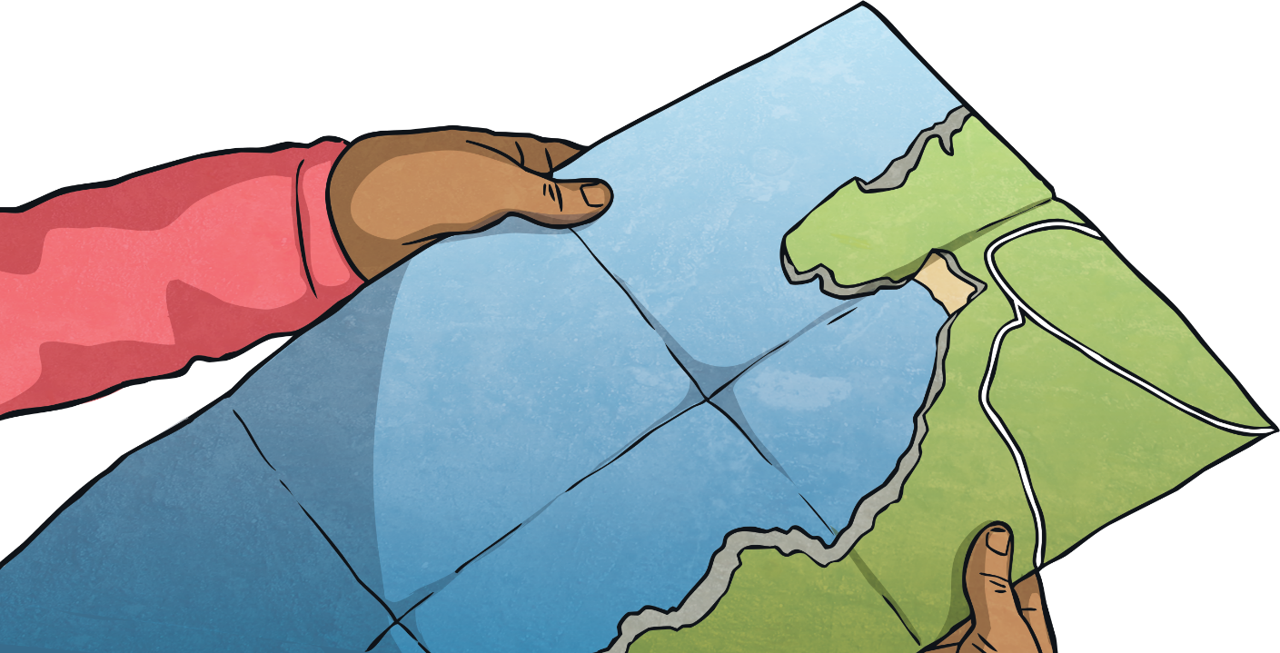
Miles and Kilometres
Sometimes we need to convert between imperial and metric units.
5 miles ≈ 8km
For example, we might want to use a map from another country.
10 miles ≈ 16km
How did you calculate this approximate equivalence?
!
How many kilometres are approximately equal to 10 miles?
≈ This sign means ‘approximately equal to’.
5 miles ≈ 8km

Slide 7
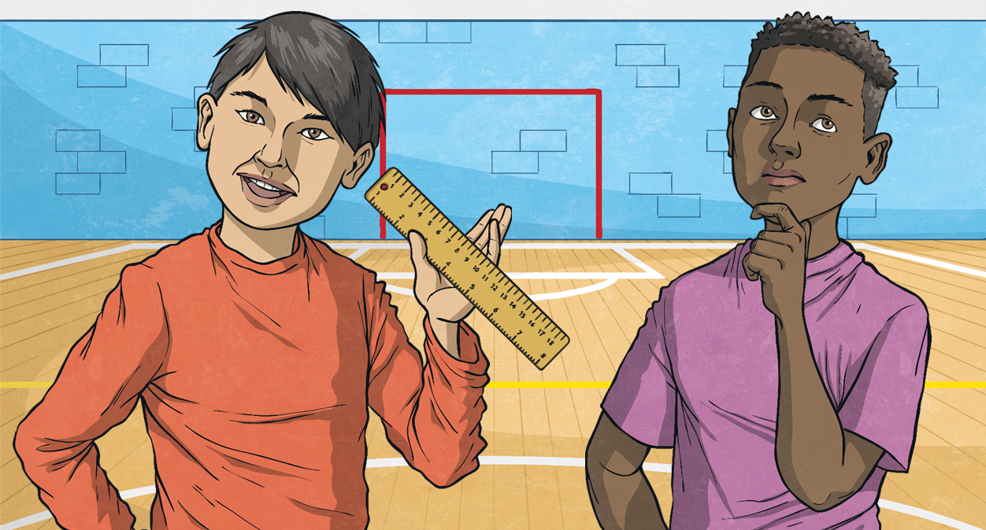
Inches and Centimetres
Many rulers show measurements in both centimetres and inches.
Are you sure that’s the right unit to use?
My teacher has asked me to measure the length of the hall. I’m going to measure it in inches!

Slide 8
Inches and Centimetres
Look at your ruler. How many centimetres are approximately equal to one inch?
When you measure the same object using two different units of measurement, you should see that the measurement recorded in cm is two and a half times larger than the measurement written in inches.
Measure each of the
following classroom objects.
First, measure the object in
centimetres. Then, measure
it in inches to the nearest
half-inch.
pencil book
rubber table
2½ centimetres (or 2.5cm) are approximately equal to one inch.
Can you prove that an inch
is two and a half times
larger than a centimetre?

Slide 9
Converting between Inches and Centimetres
1 inch ≈ 2.5cm
Which of these conversions could you use to find the last answer?
How could you calculate the other measurements?
Can you think of any other methods of working this out?
50cm + 12.5cm = 62.5cm
Double 2.5cm = 5cm
2.5cm × 10 = 25cm
Half of 25cm = 12.5cm
25cm × 2 = 50cm
10 inches ≈ ? cm
5 inches ≈ ? cm
20 inches ≈ ? cm
25 inches ≈ ? cm
2 inches ≈ ? cm
1 inch | 2 inches | 5 inches | 10 inches | 20 inches | 25 inches
2.5cm
5cm
12.5cm
25cm
50cm
62.5cm

Slide 10
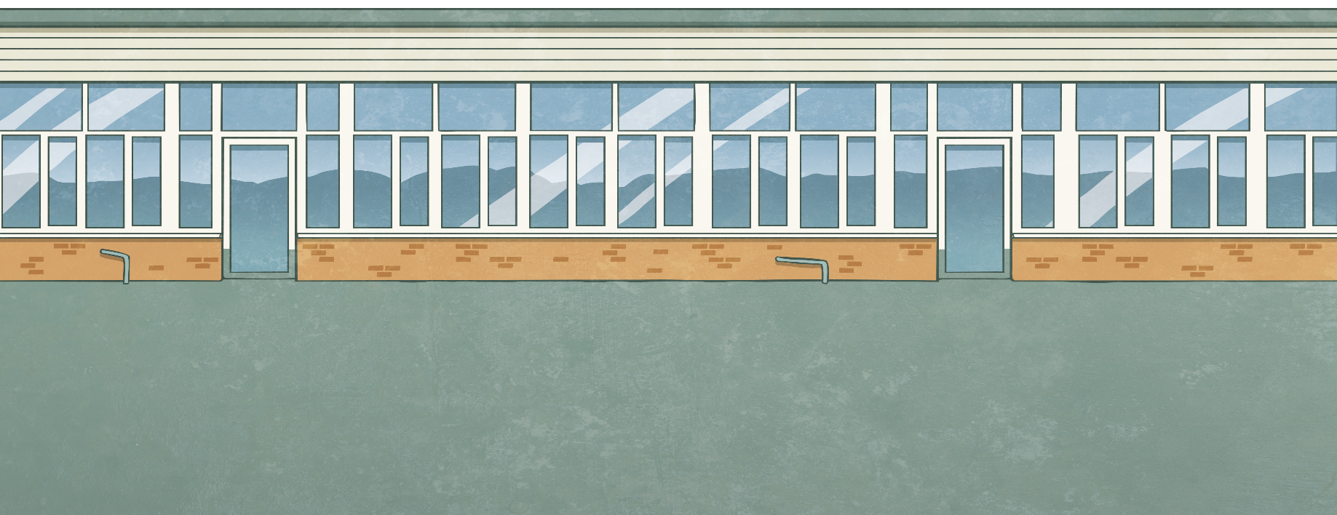
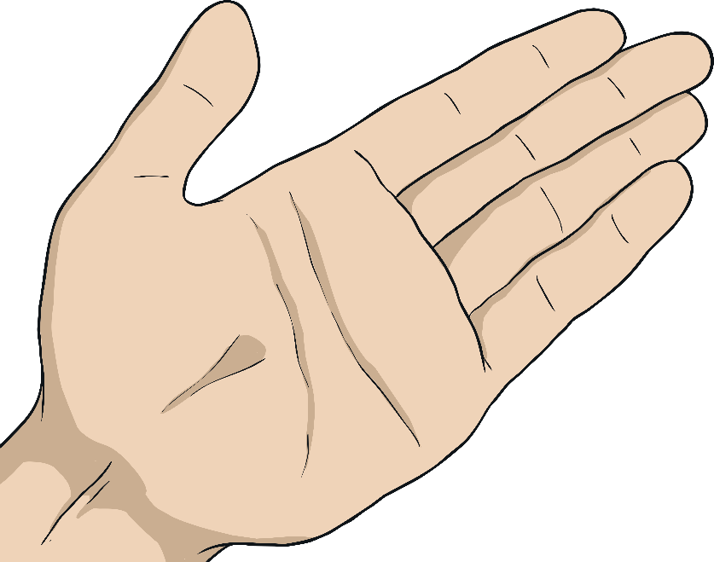
Converting between Inches and Centimetres
Convert from centimetres to inches to complete this table.
Click each box in the table to reveal the answer underneath.
1cm | 2cm | 4cm | 5cm
0.4 inches
10cm | 12cm | 20cm | 31cm
0.8 inches
1.6 inches
2 inches
4 inches
4.8 inches
8 inches
12.4 inches

Slide 11
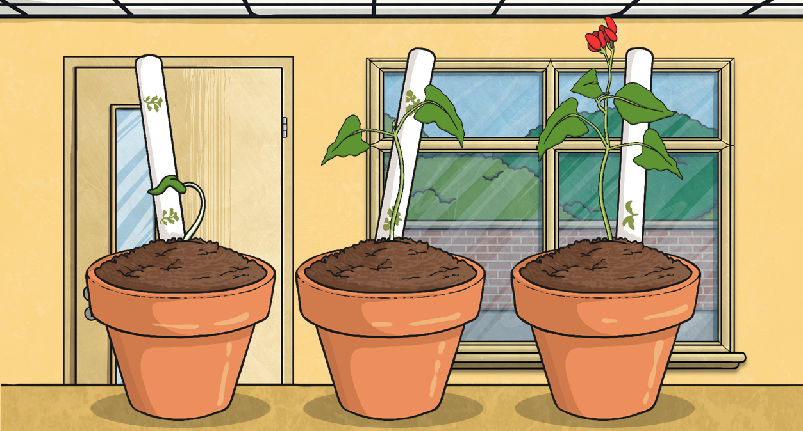
Solving Seedling Problems
First, convert the measurements to the same unit.
Class 5B grew seedlings as part of their science topic. 1 inch ≈ 2.5cm 1cm ≈ 0.4 inches
Halfway through the term, Mr Leonard asked half the class to measure the height of their seedlings in inches and half the class to measure theirs in centimetres.
Now you can put the original measurements in order.
He challenged the class to order the measurements of some of the seedlings from shortest to tallest.
Shortest |  | Tallest
3.2 inches
2 inches
7cm
2.8 inches

Slide 12
Solving Seedling Problems
At the end of the term, the seedlings had grown taller. Mr Leonard challenged the class to order the measurements of four more seedlings.
1 inch ≈ 2.5cm
1cm ≈ 0.4 inches
Which measurements will you convert?
Shortest |  |  | Tallest
10cm
2 inches
17.5cm
6 inches
4 inches
5cm
7 inches
15cm

Slide 13
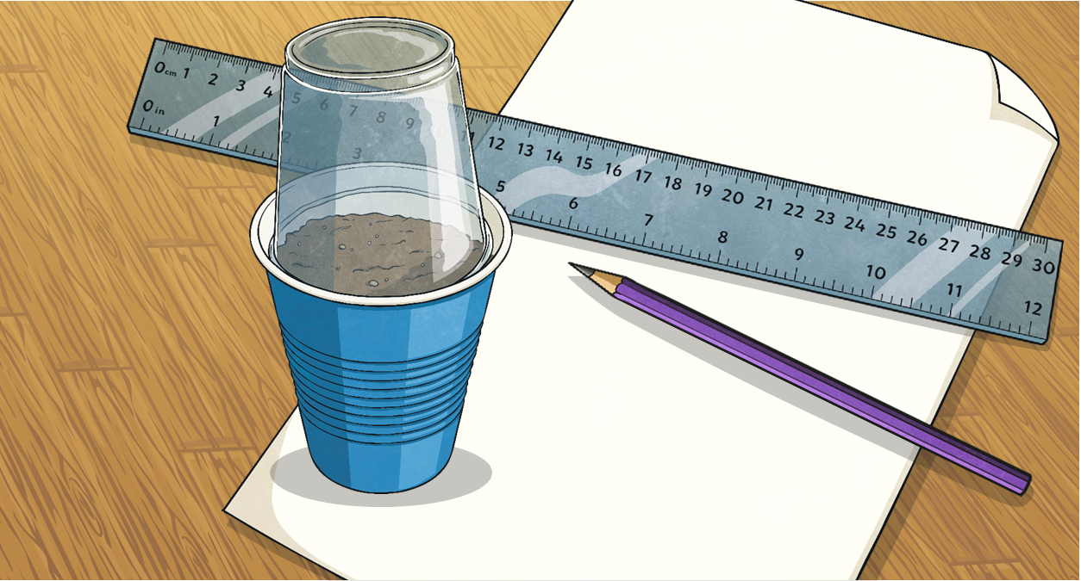
Solving Seedling Problems
As part of their science topic, Class 5B measured how much their seedlings grew throughout the term.
Sophia’s seedling grew from
3cm to 12cm tall.
Haydar’s seedling grew from
2 inches to 6 inches tall.
Haydar thinks that his
seedling grew more than
Sophia’s.
Is he right?
1 inch ≈ 2.5cm
1cm ≈ 0.4 inches
Find out how much
each child’s seedling grew:
Sophia: 12cm - 3cm = 9cm
Haydar: 6 inches - 2 inches
= 4 inches
Convert the
measurements so they
are all in the same units.
4 inches ≈ 10cm
Haydar is right.
His seedling grew the most.

Slide 14
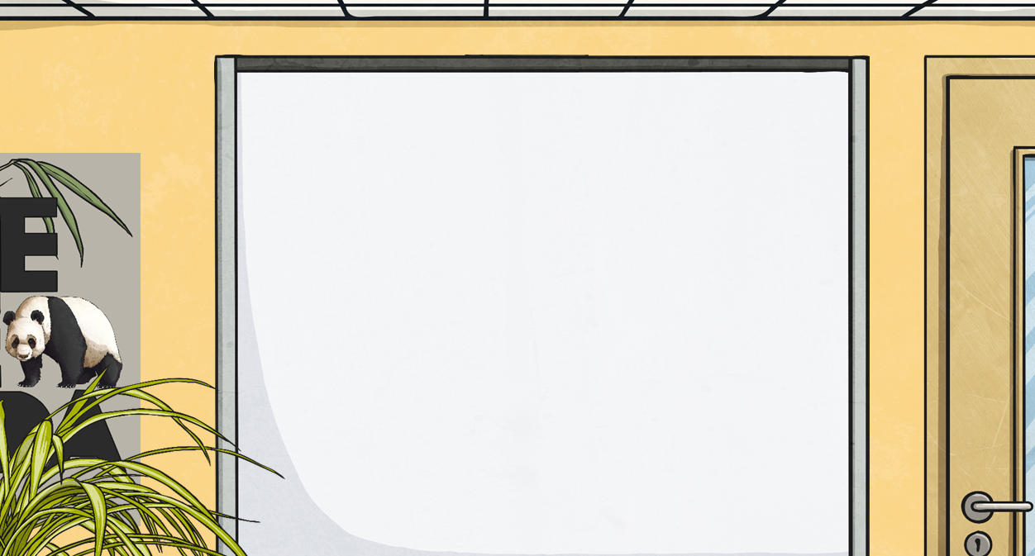
Centimetres, Feet and Inches
Mr Leonard’s seedling grew to be 1 foot tall. How tall is this in cm?
1 foot = 12 inches
1 inch ≈ 2.5cm
1cm ≈ 0.4 inches
1 foot ≈ 30cm
Convert inches to centimetres
12 inches = 10 inches + 2 inches
25cm + 2.5cm + 2.5cm = 30cm
Convert feet to inches:
1 foot = 12 inches

Slide 15
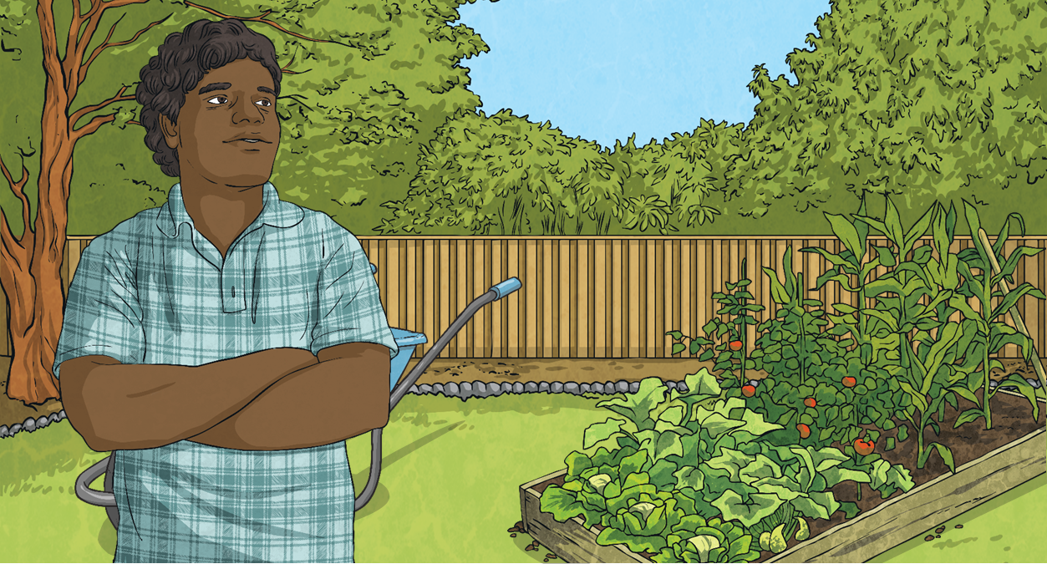
Centimetres, Feet and Inches
Mr Leonard’s husband grew a plant that was 2 feet and 5 inches tall! How tall wa the plant in cm?.
1 foot = 12 inches
1 inch ≈ 2.5cm
1cm ≈ 0.4 inches
Did you use a different method to find the answer?
29 inches is one less than 30 inches. We will find 30 inches in cm and then subtract 2.5cm.
10 inches ≈ 25cm
25cm × 3 = 75cm
75cm - 2.5cm = 72.5cm
Convert feet to inches:
2 feet = 24 inches
24 inches + 5 inches = 29 inches

Slide 16
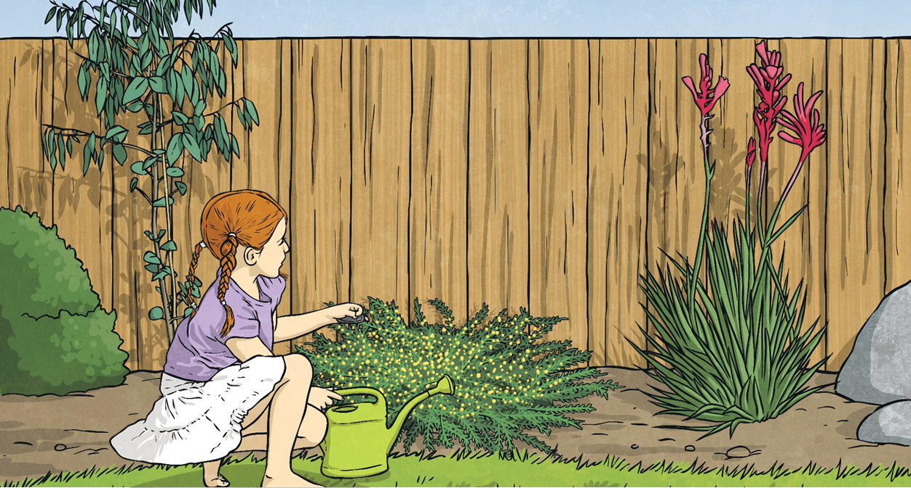
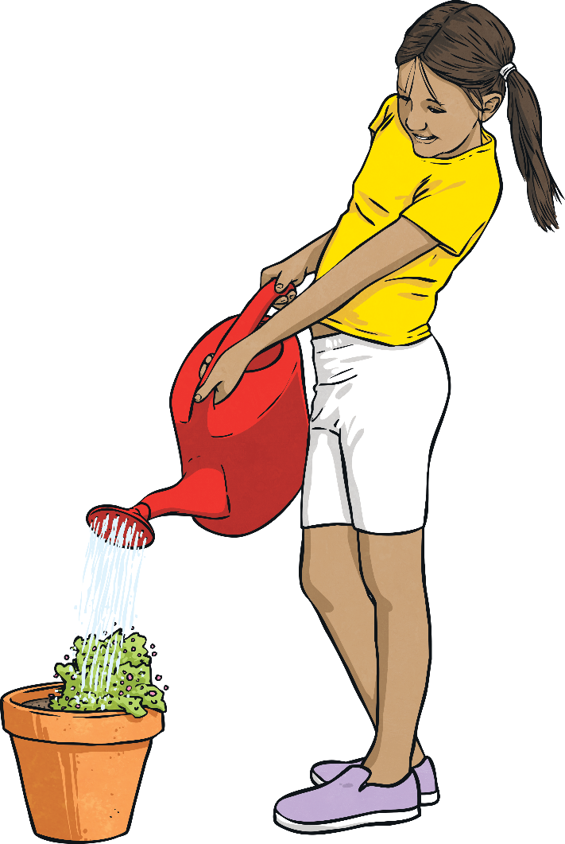
Centimetres, Feet and Inches
Haydar’s younger sister grew a plant that was 45cm tall. How tall was it in feet and inches?
1 foot = 12 inches
1 inch ≈ 2.5cm
1cm ≈ 0.4 inches
Did you use a different method to find the answer?
Convert centimetres to inches:
45cm = 20cm + 20cm + 5cm
8 inches + 8 inches + 2 inches = 18 inches
How many whole feet and how many inches left over?
1 foot and 6 inches
45cm ≈ 1 foot 6 inches

Slide 17
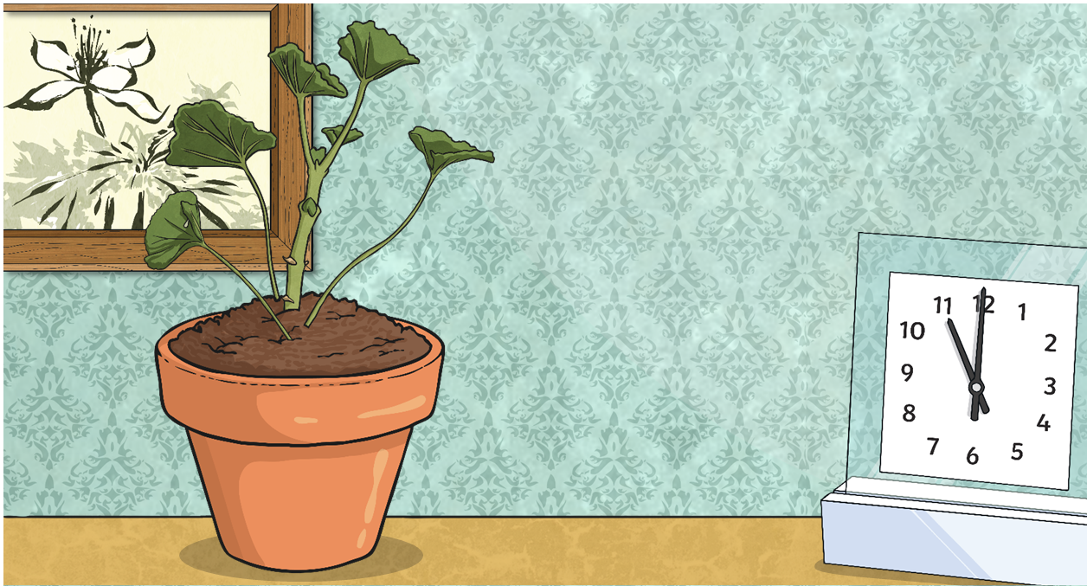
Centimetres, Feet and Inches
By December, Haydar’s sister’s plant had grown to 65cm. What was the plant’s height in feet and inches?
1 foot = 12 inches
1 inch ≈ 2.5cm
1cm ≈ 0.4 inches
Convert
centimetres to inches:
65cm = 60cm + 5cm
10cm ≈ 4 inches, so
60cm ≈ 24 inches
5cm ≈ 2 inches
24 inches + 2 inches
= 26 inches
How many whole feet and
how many inches left over?
2 feet and 2 inches
65cm ≈ 2 feet 2 inches

Slide 18
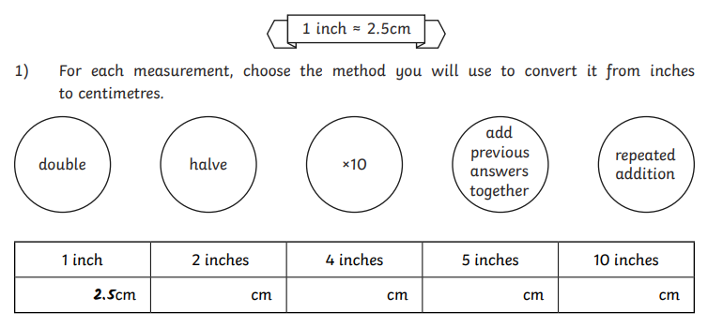
Your turn- Write the answers on a piece of paper.

Slide 19
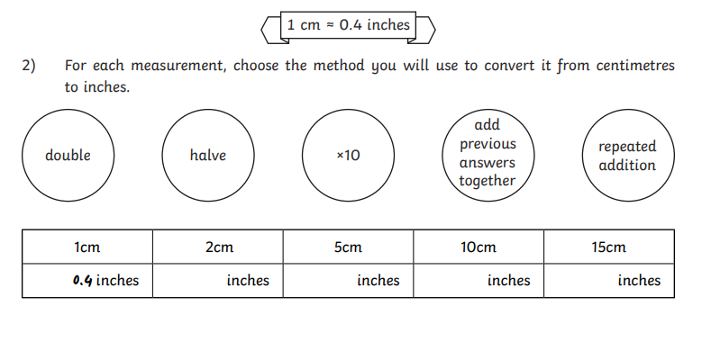

Slide 20
