Slide 1
Solids, Liquids and GasES
By tommy phelan

Slide 2
SOLIDS
LIQUIDS
GAS
Ice lollies
Rocks
Sands
Pebbles
Glass
Cardboard
Metal
Fabric
Magnet
Wool
Ice
Coffee
Cream
Lemonade
Tea
Rain
Juice
Water
Milk
Cola
Soup
Steam
Hot air
Oxygen
Clouds
The particles in liquids are spread out a bit more but are still attached and move together.
The particles in gases are spread out a lot, move fast and do not stick together.
Solids have particles that are squashed together like this, they do not move very much.

Slide 3
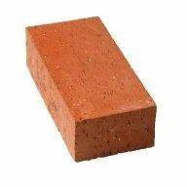
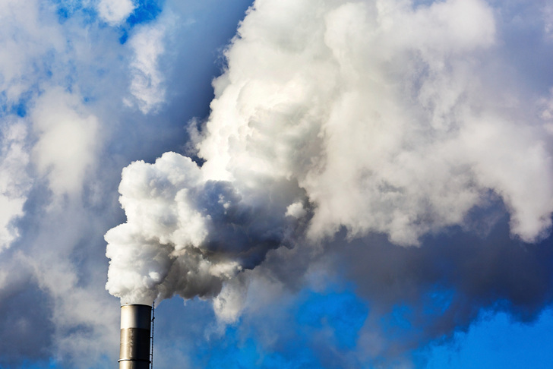
Describing the properties of materials
Solids can be soft or hard, squashy or rigid and can be reshaped. Their volume does not change.
Gases can look fluffy but you can not really feel them and they do not keep their shape.
Liquids are sloppy and wet, they take the shape of their container. Their volume does not change but they can change shape.

Slide 4
States of matter
Some matter can change it’s state, for example:
H²O (water) can be a solid, liquid and gas
Glass is a solid but you can melt it and it turns in to a liquid
Ice Water Steam
By Tommy Phelan

