Slide 2
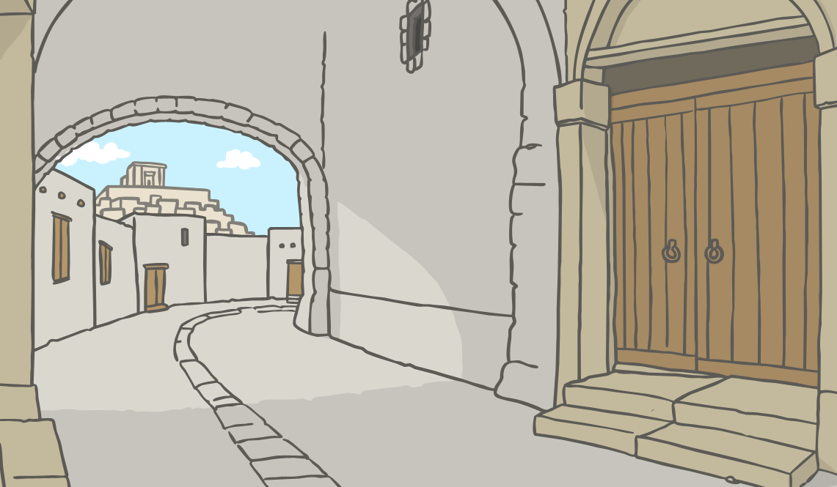
Jesus Heals a Blind Man
One day, as Jesus walked along, he saw a man who was begging at the roadside.
The man had been born blind.

Slide 3
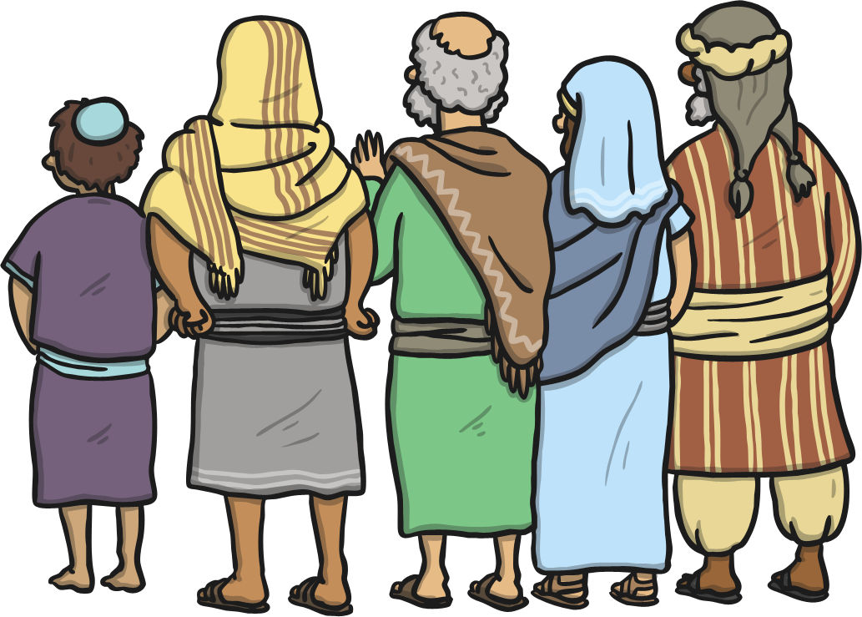
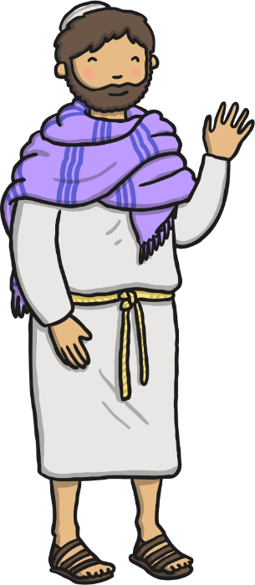
Jesus Heals a Blind Man
The disciples thought that the man must have done something bad to be blind.
But Jesus said,
This man has not done anything bad. He is blind so that God’s work can be carried out.

Slide 4
Jesus Heals a Blind Man
Jesus said,
While I am in the world, I am the light of the world.
Then Jesus spat on the dusty ground, mixed it into some mud, and gently rubbed the mud on the man’s eyes.

Slide 5
Jesus Heals a Blind Man
Then Jesus said to the man,
Now go and wash your face in the pool of Siloam.

Slide 6
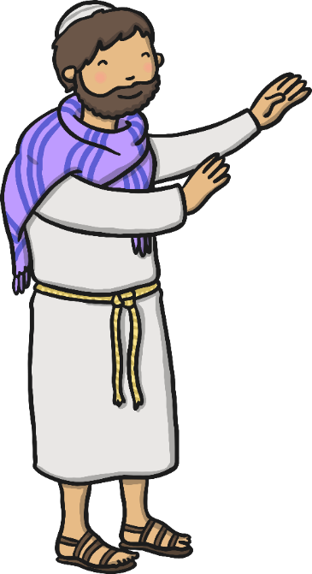
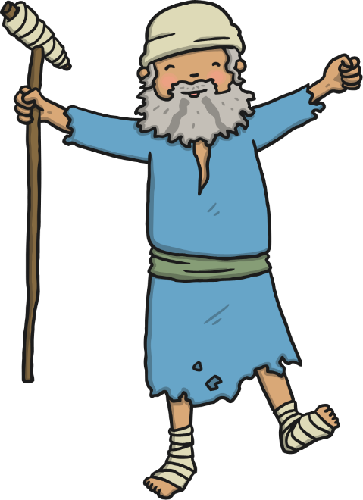
Jesus Heals a Blind Man
The man returned, overjoyed that he could now see!

Slide 7
Jesus Heals a Blind Man
The man’s neighbours had seen him begging, and said, “Are you the same man who was begging?”
Others said, “No! That’s not him. He was blind!”
But the man said, “It is me! I was blind but now I can see!”

Slide 8
Jesus Heals a Blind Man
The man explained, “The man called Jesus came along. He made some mud and rubbed it on my eyes. Then he told me to wash in the pool of Siloam. When I did, I could see!”
The people said, “But where is Jesus now?”
The man replied, “I don’t know.”

