Slide 1
Geography
Extreme Earth
Year One
Geography | Year 3 | Extreme Earth | Under Our Feet | Lesson 1

Slide 3
Aim
To describe what you find underground.
Success Criteria
I can recognise that there is rock under all surfaces.
I can list the layers that make up the Earth.
I can create and label a cross-section of the Earth.
I can compare the Earth’s structure to a familiar object.

Slide 4
What Would You Find?
Imagine you are digging this hole.
What is at the bottom of the hole?
What different things might you find as you are digging?
Where would you end up?
Photo courtesy of Crazy Craven @flickr.com) - granted under creative commons licence – attribution

Slide 5
Welcome on board the
Underground Explorer!
Photo courtesy of Kecko @flickr.com) - granted under creative commons licence – attribution

Slide 6
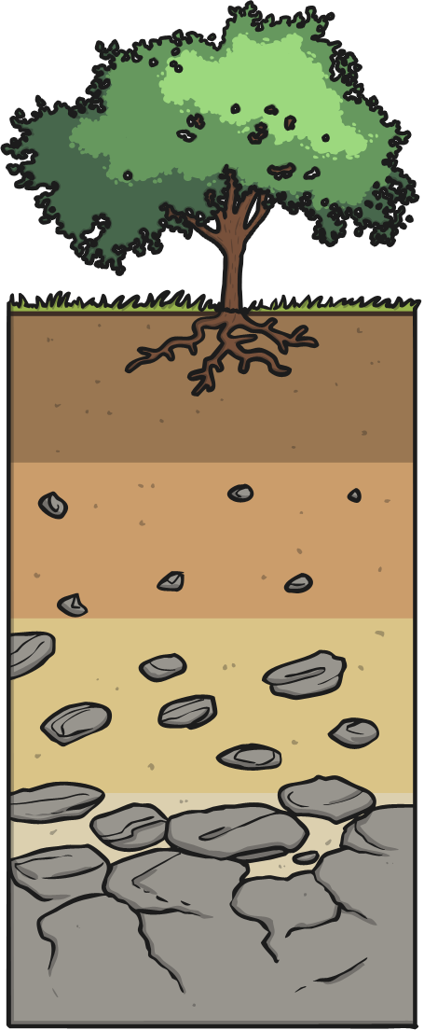
Layers of Soil
Humus
The very top layer of soil, made up of rotting dead leaves and animals.
Topsoil
Where plants grow their roots. Very few rocks.
Subsoil
More rocks and stones in clay. This soil is full of nutrients. Tree roots may reach into this soil. You might find fossils here.
Bedrock
A mass of rock such as granite, basalt, quartzite, limestone or sandstone. You might find fossils here.

Slide 7
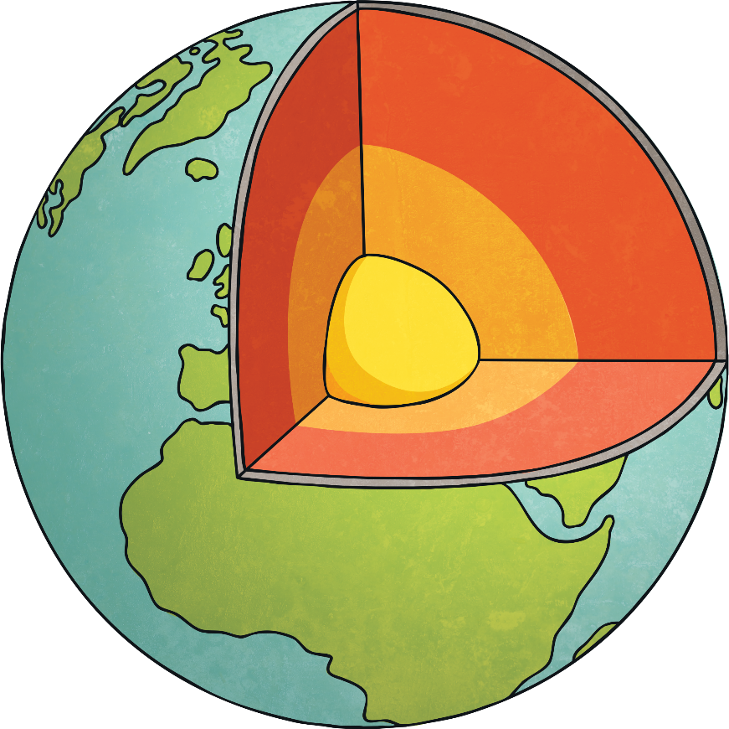
Layers of the Earth
The crust is the thin outer layer of cold, hard rock that covers the Earth. It is 10km-90km thick.
The mantle (extremely hot rock that often flows like treacle) is 3000km thick.
The outer core is mostly made up of iron, with some nickel. It is over 4000˚C. it is mostly liquid with some rocky parts. The outer core moves around the inner core, creating the Earth’s magnetism.
The inner core, which is made of iron and nickel, is the hottest layer of the Earth at over 5000˚C. It melts the metals in the outer core to form magma.

Slide 8
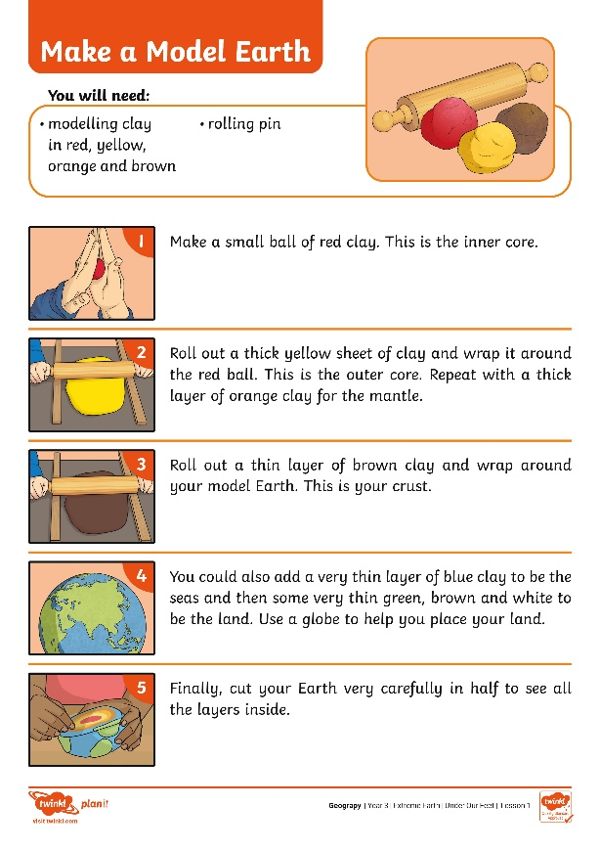
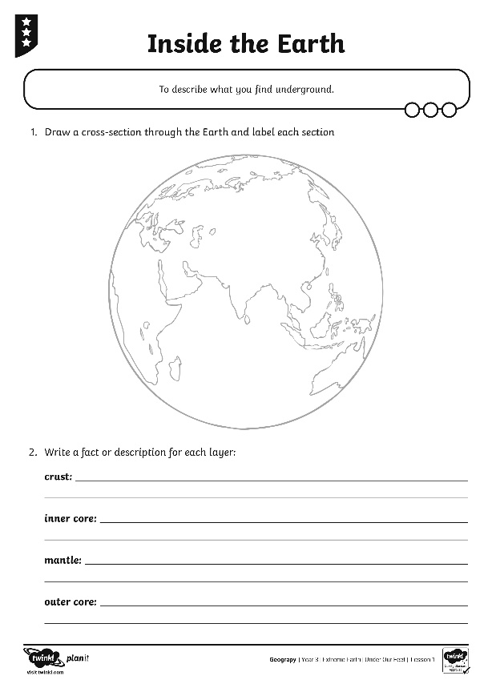
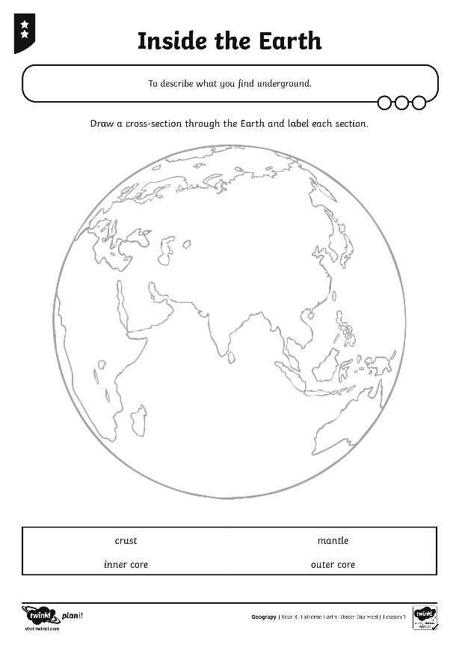
What Is Under Your Feet?
Use the equipment on your table to show the different layers that make up Earth.
Try to think about the size of each different layer! The crust is thin, but the mantle is very thick.

Slide 9
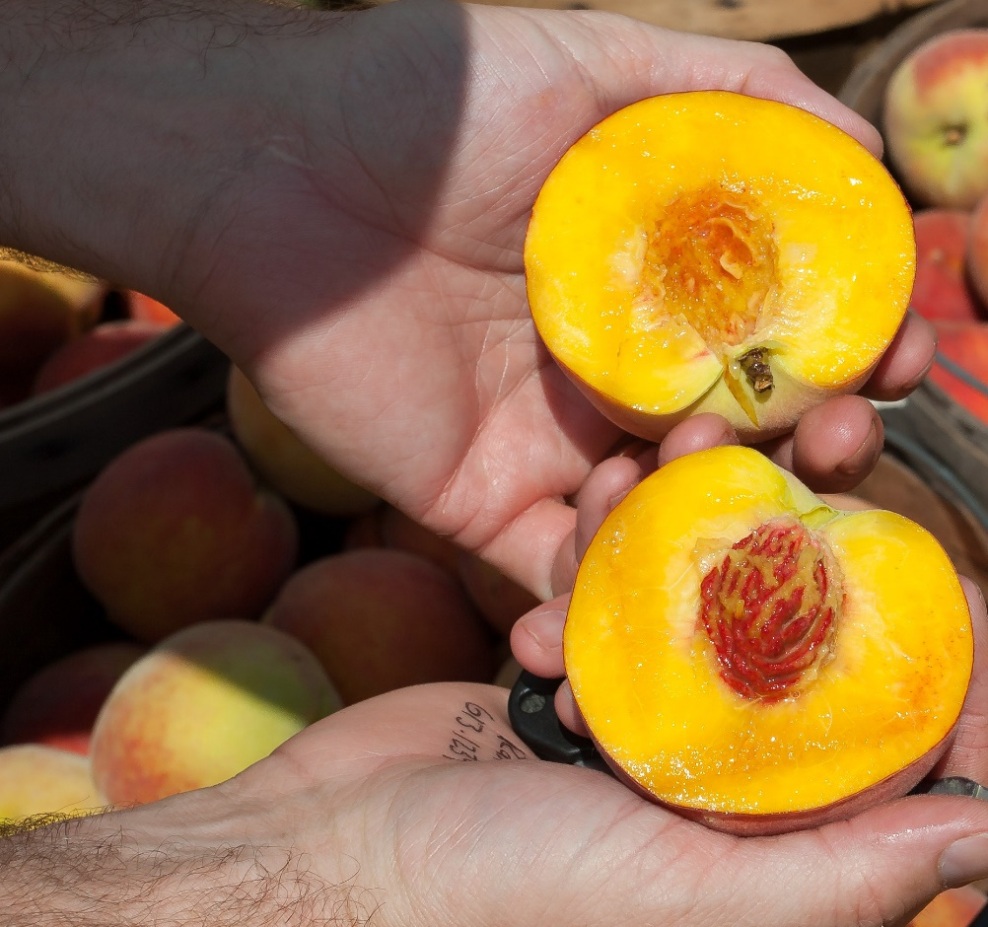
What’s That Like?
Watch this video comparing the Earth’s structure to a peach.
How is the comparison accurate?
How is the structure of the Earth different to that of a peach?
Notes:
Please check that the content in this link, including any comments, is suitable for your educational environment before showing. Please do not let the next video automatically play at the end of the clip. Twinkl accepts no responsibility for the content of third party websites.

Slide 10
Aim
To describe what you find underground.
Success Criteria
I can recognise that there is rock under all surfaces.
I can list the layers that make up the Earth.
I can create and label a cross-section of the Earth.
I can compare the Earth’s structure to a familiar object.

