Slide 1
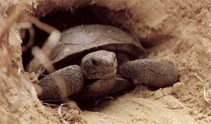
Canyon animals
Desert gopher tortoise
The gopher tortoise digs burrows that provide shelter for at least 360 other speices that live in the canyon.Gopher tortoises are herbivors their diet contains over 300 species of plants.The gopher tortoise is representative to gopherus which contains the only tortoises native to America.

Slide 2
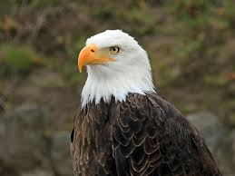
Canyon animals
Bald Eagle
The Bald Eagle is both a national bird and national animal of the united states of America. 66% of the year Bald Eagle eat different type of fish. They eat 14% of smaller mammals.The Bald Eagle are not actually bald; the name comes from an older word meaning, white headed.

Slide 3
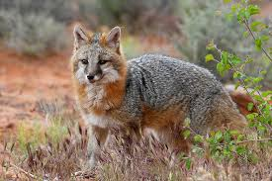
Canyon animals
Grey Fox
A Grey Fox is a conivorous mammal of the family conidae . They are wide spreaded thoughout Northen and Central America. The Pacific states still have the Grey Fox as a dominate.The Grey Fox is also known as a tree fox and is a nocturnal mammal what makes them unique from the dog family is that this fox is the only type to climb trees.

Slide 4
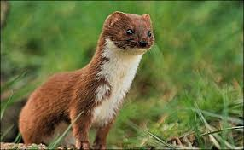
Canyon animals
Weasle
A Weasel is a mammal from the genus mustela of the family Mustelidae. They include polecats,minks ,stoats, ferrets and least weasels. These are highly active preditors and they are all very small and skinny .There lenth would be from 173 to 217mm and all the females are smaller than the males and usally have red or brown upper coats and white bellies .There food to eat is big rodents such as mice and rats.

