Slide 2
Aim
To tell the exact time with minutes to the hour.
Success Criteria
Know that time is read as ‘past the hour’ and ‘to the hour’.
Know that clocks are marked at 5 minute intervals.
Know ‘quarter past’, ‘half past’ and ‘quarter to’.
Know that addition and subtraction can help tell you the exact time.

Slide 3
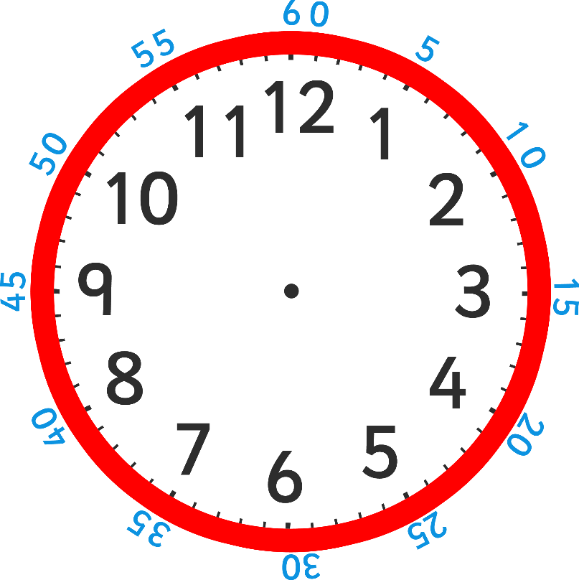
What is the exact time?

Slide 4
After half past the hour we read the time as ‘minutes to’. This is because it sounds better to say ‘13 minutes to 11’, rather than 47 minutes past 10’.

Slide 5
Reading the time to the hour needs a little more concentration than with minutes past the hour. A simple method is to count the blocks of 5 minutes to the hour from ‘0’ at the top, then any more minutes there may be. This show 5 lots of 5 minutes and 1 more minute. What is the exact time?

Slide 6
The exact time is 26 minutes to 10.

Slide 7
You can look at this as 6 lots of 5 minutes and then take away 4 or 5 lots of 5 and add 1.
+5
+5
+5
+5
+5
-4
+5

Slide 8
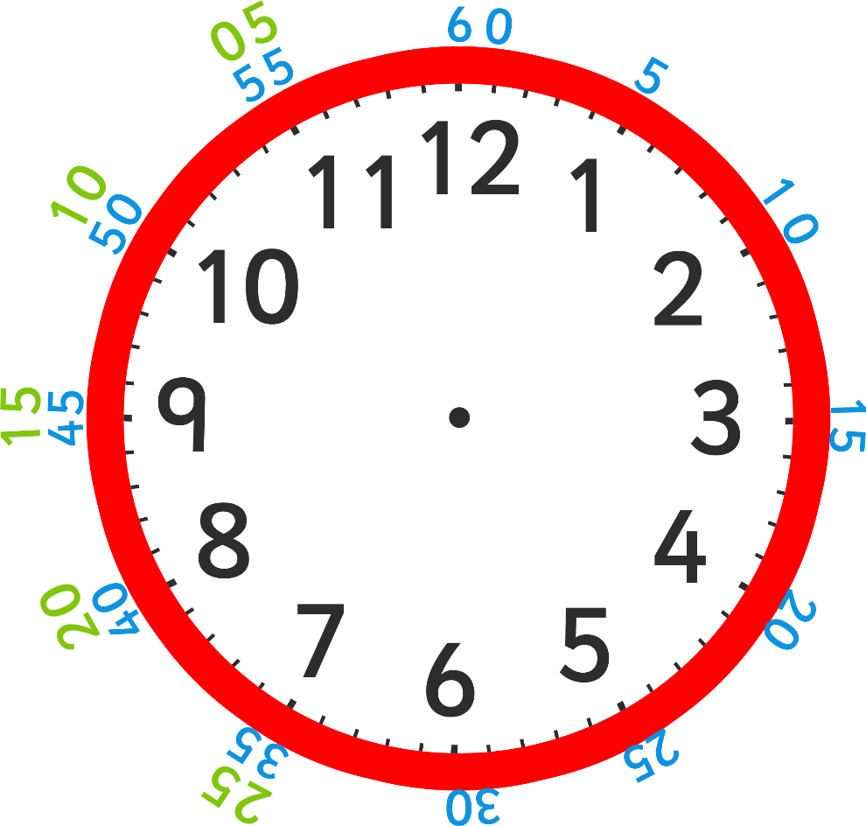
The numbers in green on this clock show the minutes to the hour. These green numbers just make it easier to read the minutes to the hour (normal clocks don’t look like this)

Slide 9
What is the exact time here? (Hint – it is the green number to the black number.)

Slide 10
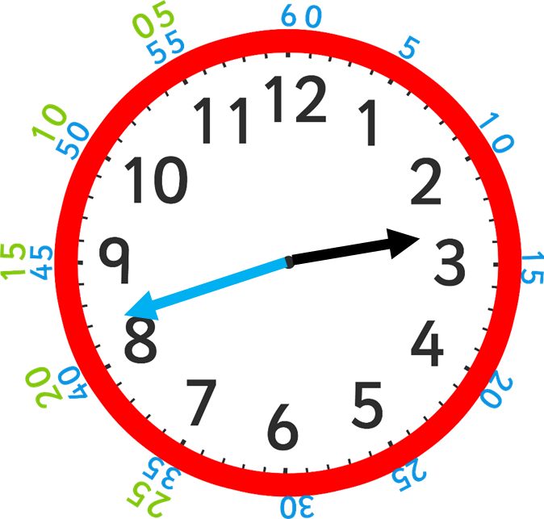
The exact time is 18 minutes to 3.

Slide 11
Plenary What is the exact time here?

