Slide 2
Welcome to our new way to practise spellings
Make sure you have your username and password handy!!!

Slide 3
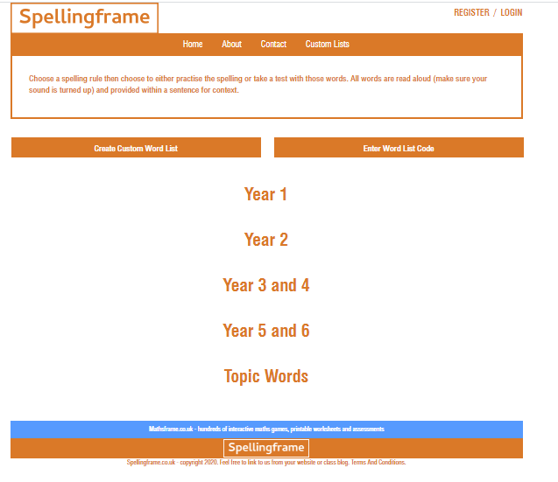
Logging in
Step 1: Type in www.spellingframe.co.uk into your address bar.
Step 2: You should see this page come up. Click on Login in on the top right corner.

Slide 4
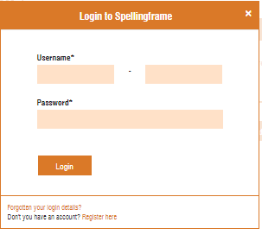
Step 3: You will then see this box pop up. Please type in your username and password.

Slide 5
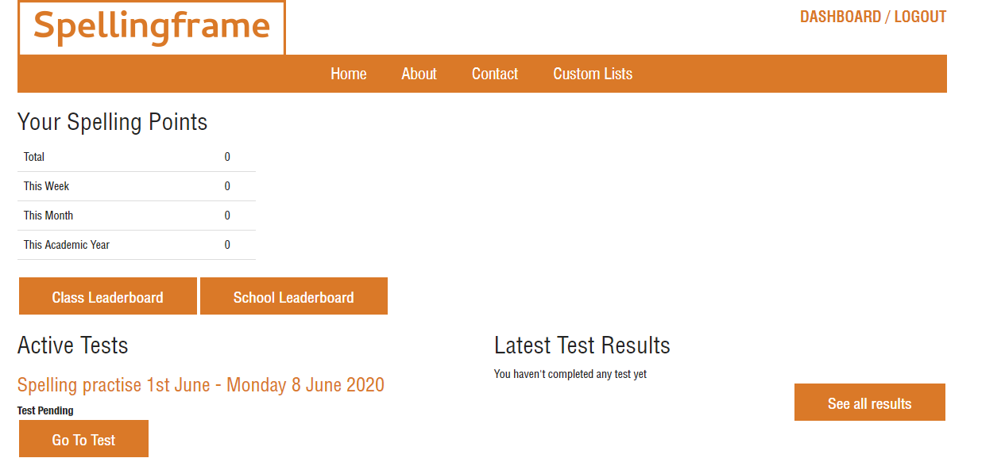
Step 4: You will now see your home page. As you can see you can earn Spelling points. The more you practise, play games and complete tests the more points you will receive and can become top of the YEAR 5 Leaderboard.
Step 5: Click onto Go to test to take you to your personalised spellings.

Slide 6
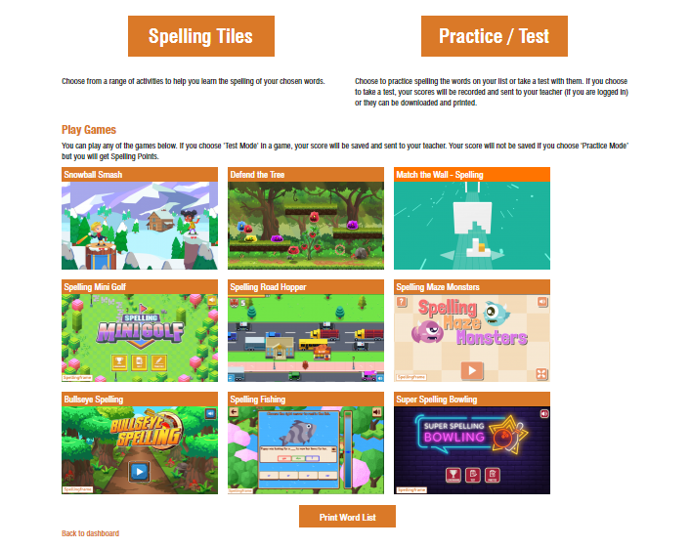
Step 6: You can now choose Spelling Tiles or Practise/Test. Start by clicking Practice/Test

Slide 7
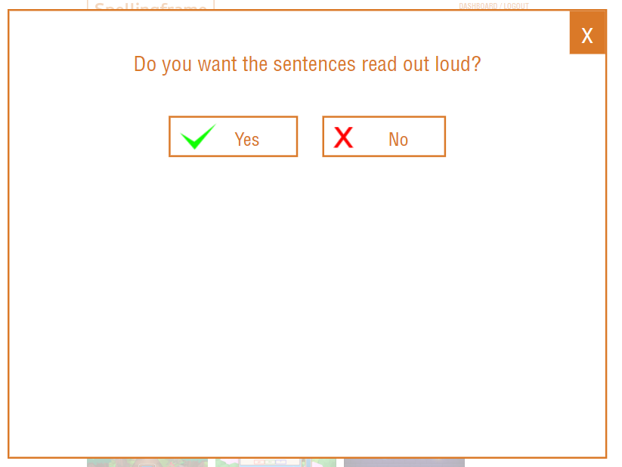
Step 7: It will then give you the option if you want the sentences read out loud. I do recommend this option!

Slide 8
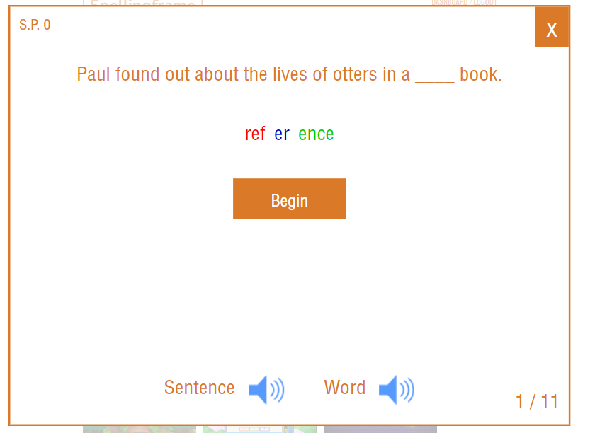
Step 8: As you can see all your spelling words are read aloud within a sentence.

Slide 9
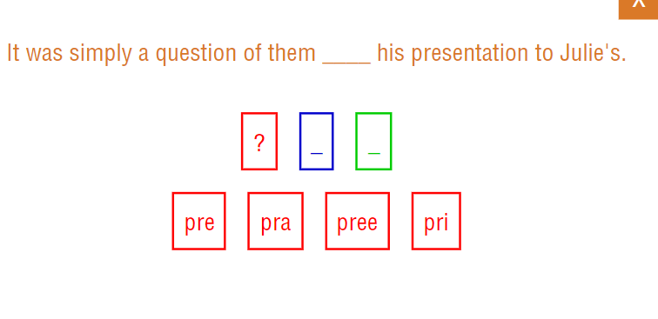
Step 9: You then work through by selecting the correct syllable.

Slide 10
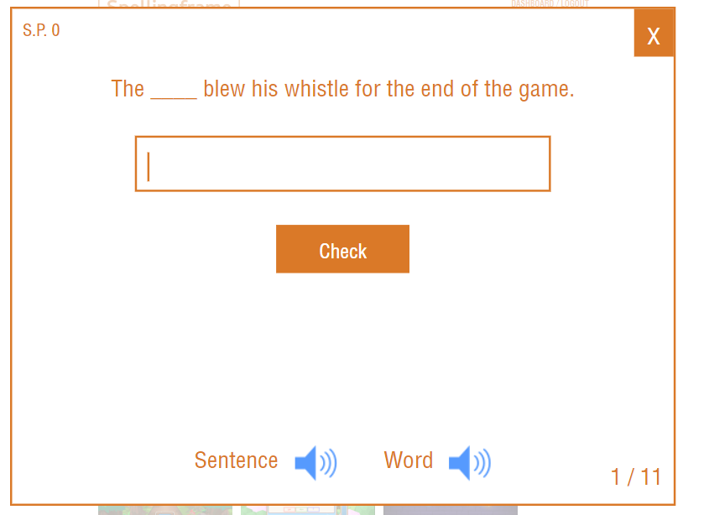
Step 10: Then it is time to try typing your spelling words.
Once you have practised all the words you can move onto Spelling tiles or Games.

Slide 11
In the Spelling Tiles option you can complete these activities to help you learn your spellings.

Slide 12
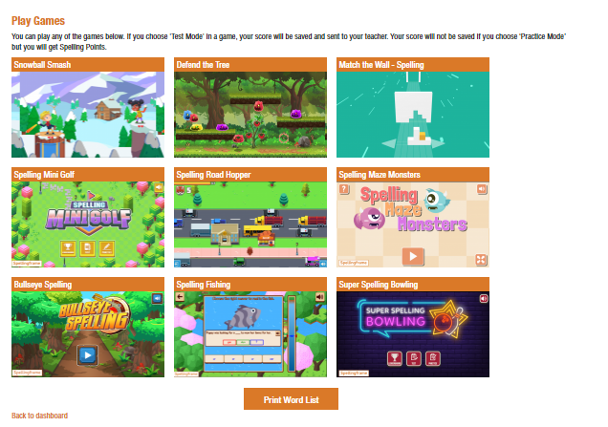
Games:
There are also 9 different games to help you practise your spellings.

