Slide 2
Learning Outcomes
LO: To tell the exact time in minutes past the hour.
Know that time is told as ‘past the hour’ and ‘to the hour’.
Know that clocks are marked at 5 minute intervals.
Know ‘quarter past’, ‘half past’ and ‘quarter to’.
Know that addition and subtraction can help tell you the exact time.
Next

Slide 3
Recap Quiz
How many seconds are there in a minute?
There are 60 seconds in a minute.
Show Answer
How many minutes are there in an hour?
There are 60 minutes in an hour.
Show Answer
How many days are there in a month?
There are between 28 and 31 days in a month.
Show Answer
Next

Slide 4
Recap Quiz
How many days are there in a year?
There are 365 days in a year.
Show Answer
Bonus Question
How many days are there in a leap year?
There are 366 days in a leap year.
Show Answer
Next

Slide 5
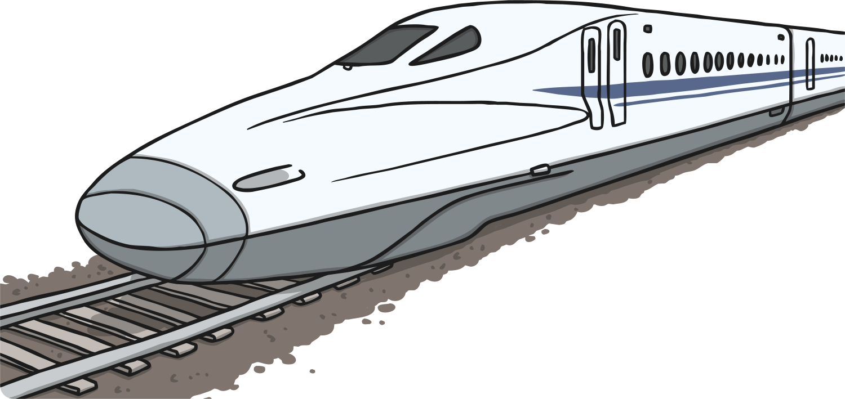
Telling the Exact Time
Knowing how to tell the exact time can be very useful.
Japanese Shinkansen trains (bullet trains) are incredibly precise with their timing and are very rarely late.
Next
It is important that they know what time it is, down to the last minute.
Next

Slide 6
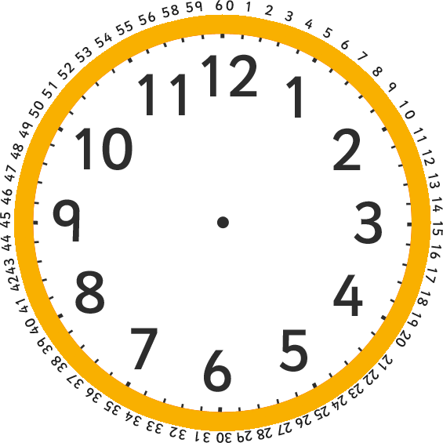
Telling the Exact Time
Each clock has 4 lines between the numbers. These show the minutes.
Minutes
Minutes
What number is the blue hand pointing to?
Show Answer
The blue hand is pointing to 8. That means that the exact time shown is 8 minutes past 12.
Next
Next

Slide 7
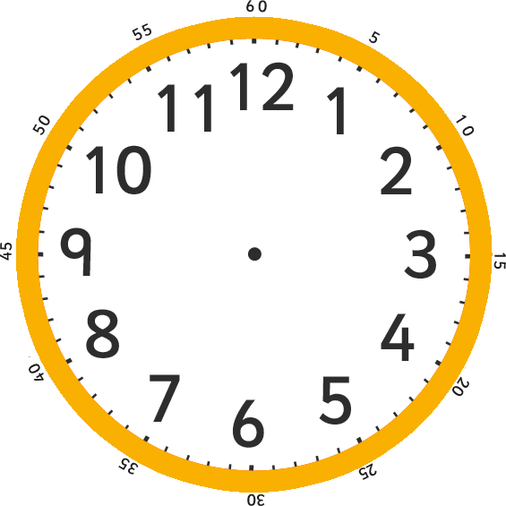
Telling the Exact Time
Now, let’s try that out in this question.
How many minutes past the hour is the blue hand showing?
The blue hand is showing 13 minutes past 12.
Show Answer
Next

Slide 8
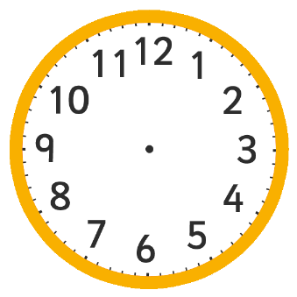
Count On and Count Back
When telling the exact time, it helps to look for points around the clock you are familiar with.
quarter past (15 minutes past)
quarter to (45 minutes past)
half past (30 minutes past)
five minute intervals
Then either count on or count back to find the exact time.
In other words, do a simple addition or subtraction to find the correct time.
Next
Next

Slide 9
Count On and Count Back
Now, let’s try that out in this question, together.
What exact time is it?
The exact time here is 19 minutes past 1.
Next Step
Here the minute hand is 1 minute away from 20 past.
You can easily work this out in your head as:
Let’s try another question, using this method.
20 – 1 = 19
Show Answer
Next

Slide 10
Count On and Count Back
Let’s try out this method again.
What exact time is it?
The exact time here is 27 minutes past 1.
Next Step
The blue hand is pointing at 2 minutes after 25 minutes past. In other words:
Great work! Try this next one without my help.
25 + 2 = ?
Show Answer
Next

Slide 11
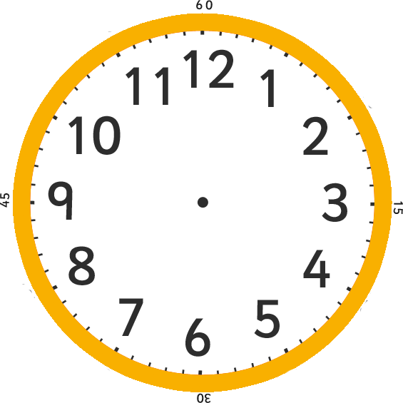
Count On and Count Back
Use the count on and count back method to tell the exact time.
What exact time is it?
The exact time here is 23 minutes past 12.
Show Answer
Nice work! Try and solve this final one.
Next

Slide 12
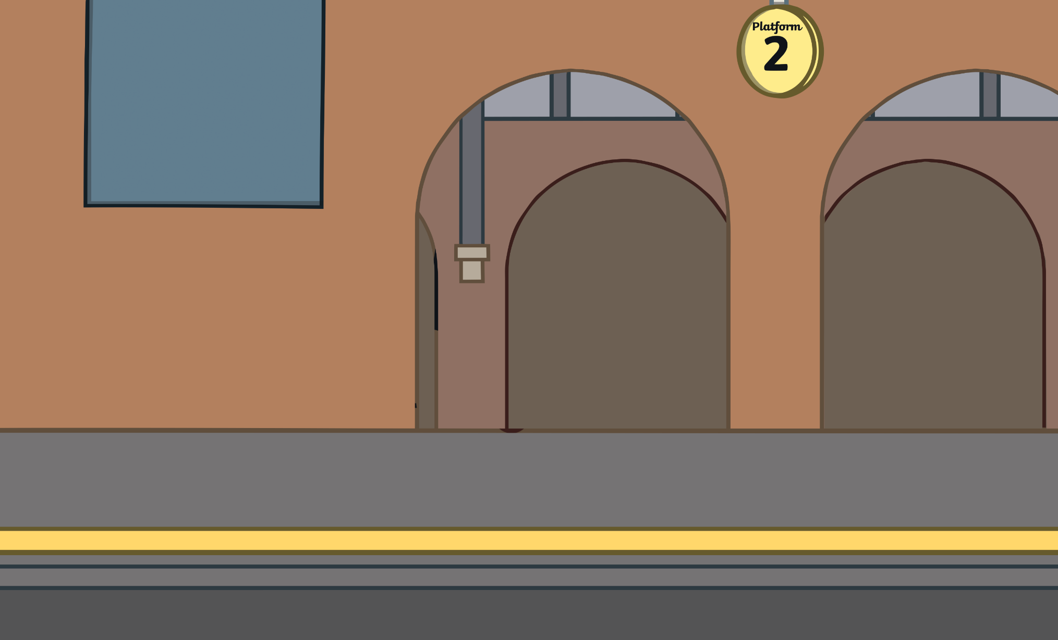
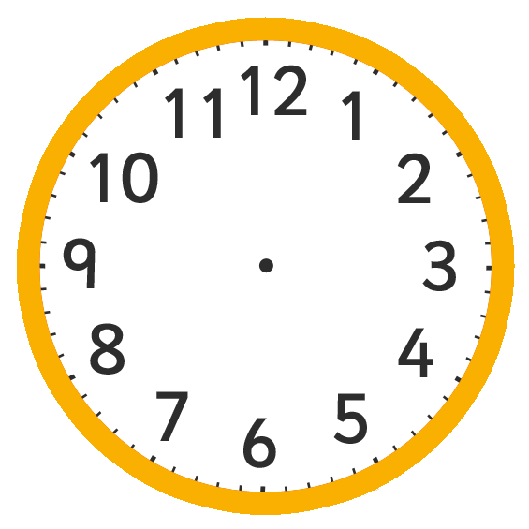
Plenary
Use the count on and count back method to answer this question.
What exact time will the train arrive?
The train will arrive at 27 minutes past 2.
Show Answer
Next

Slide 13
Plenary
Use the count on and count back method to answer this question.
Finish

