Slide 2
Wake-Up Time on Bumble Farm
Read the book ‘Wake-Up Time on Bumble Farm’ and look at the illustrations.
To see a question about the story, click this button:
?

Slide 3
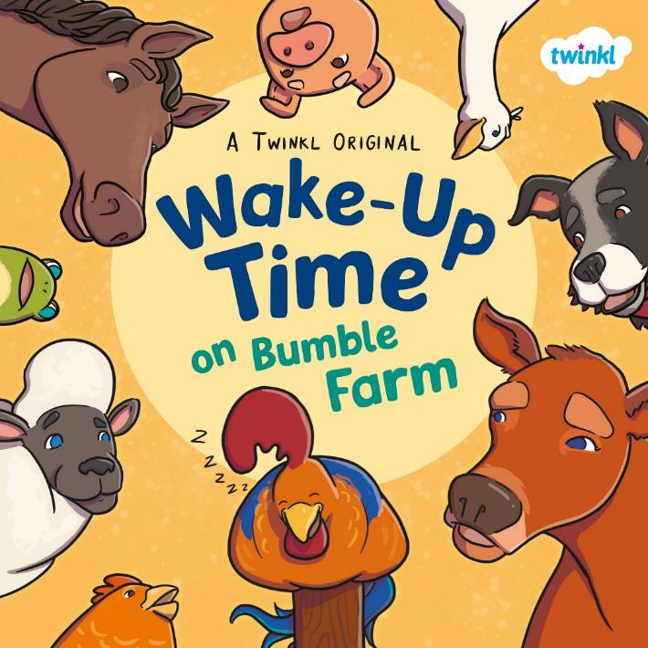
?
What do you think this book is going to be about?
?
Do you think it is fiction or non-fiction?
?
What job does a rooster usually do?

Slide 4
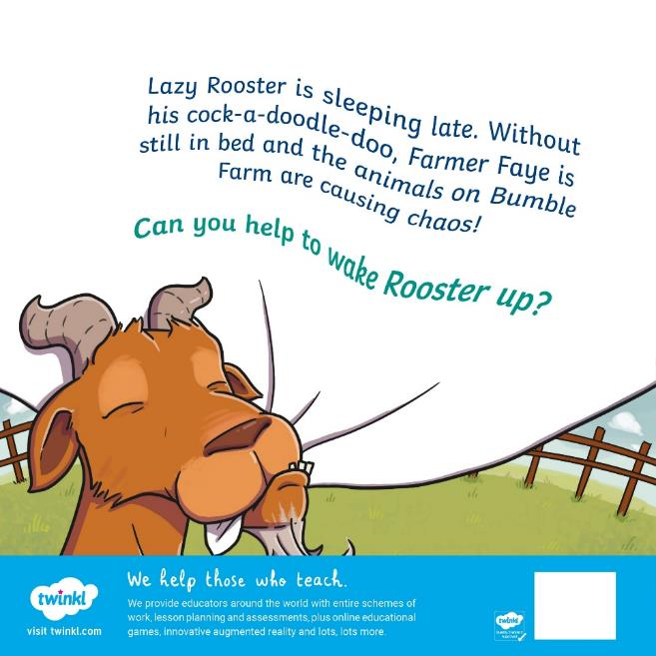
?
Do you think this will be a sad story? A funny story? An adventure story?
?
Have you ever been to a farm before? Do you know what happens on a farm?

Slide 5
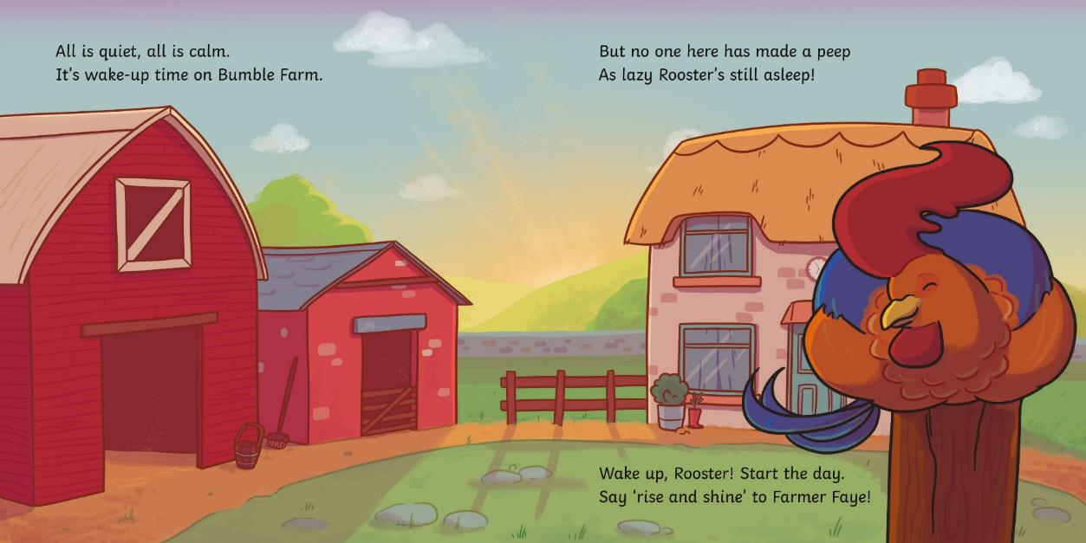
?
The story says that no one has ‘made a peep’. What does this mean?

Slide 6
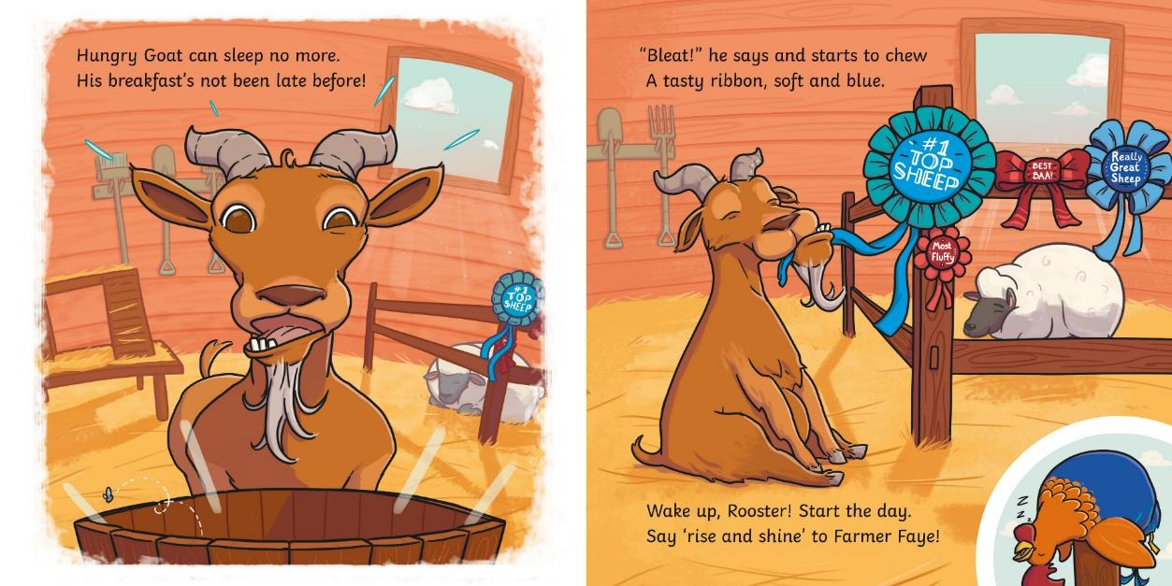
?
Why does Goat start eating Sheep’s ribbon?

Slide 7
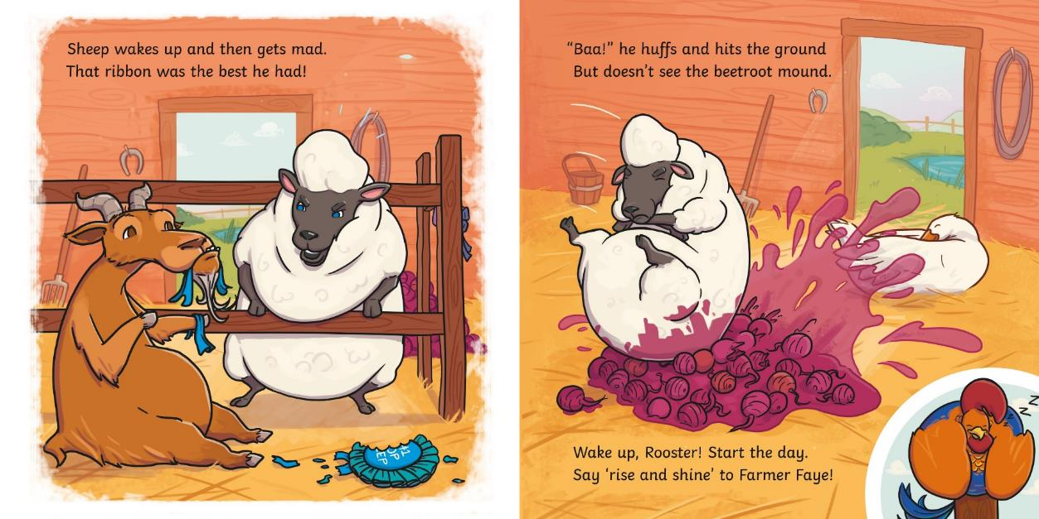
?
Who do you think will wake up next?

Slide 8
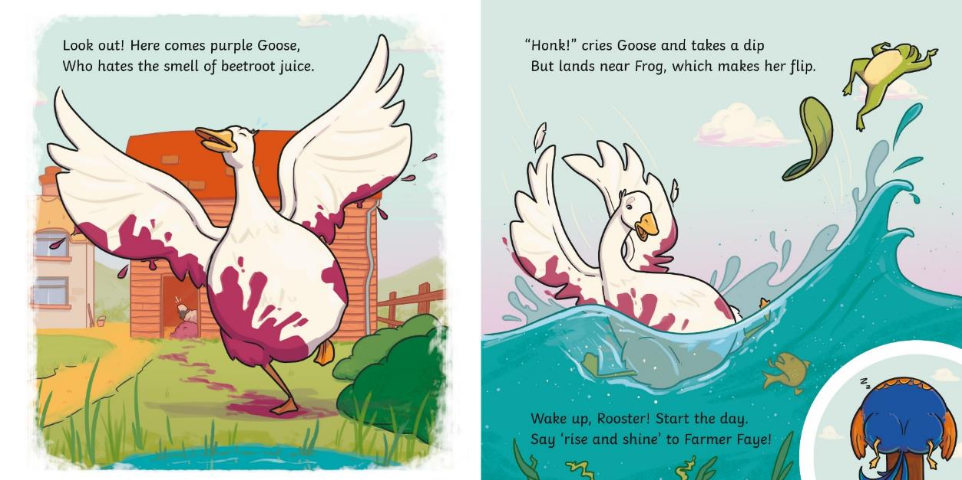
?
What has happened to Goose? Why is she purple?

Slide 9
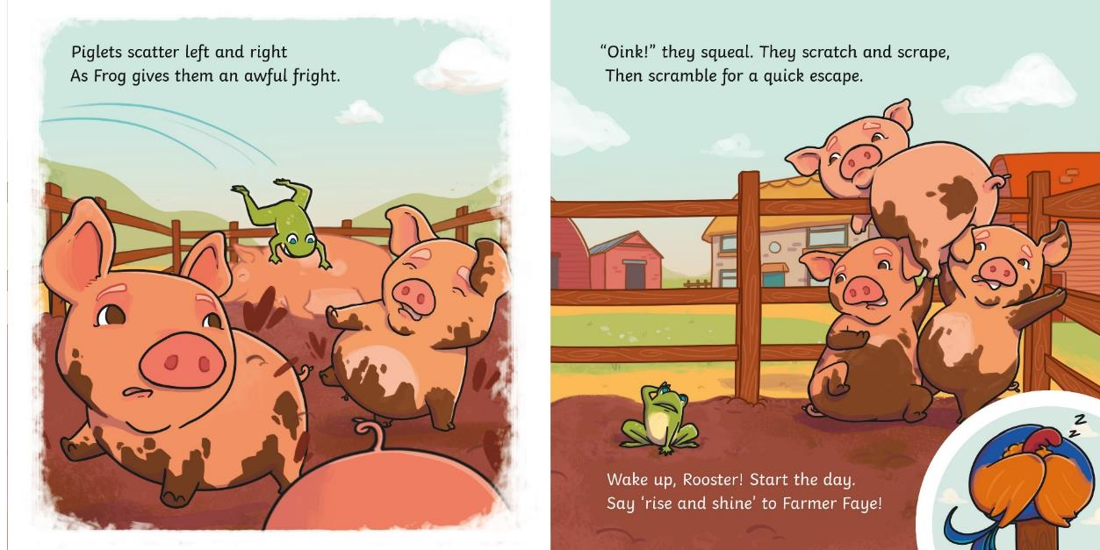
?
How are the piglets feeling?

Slide 10
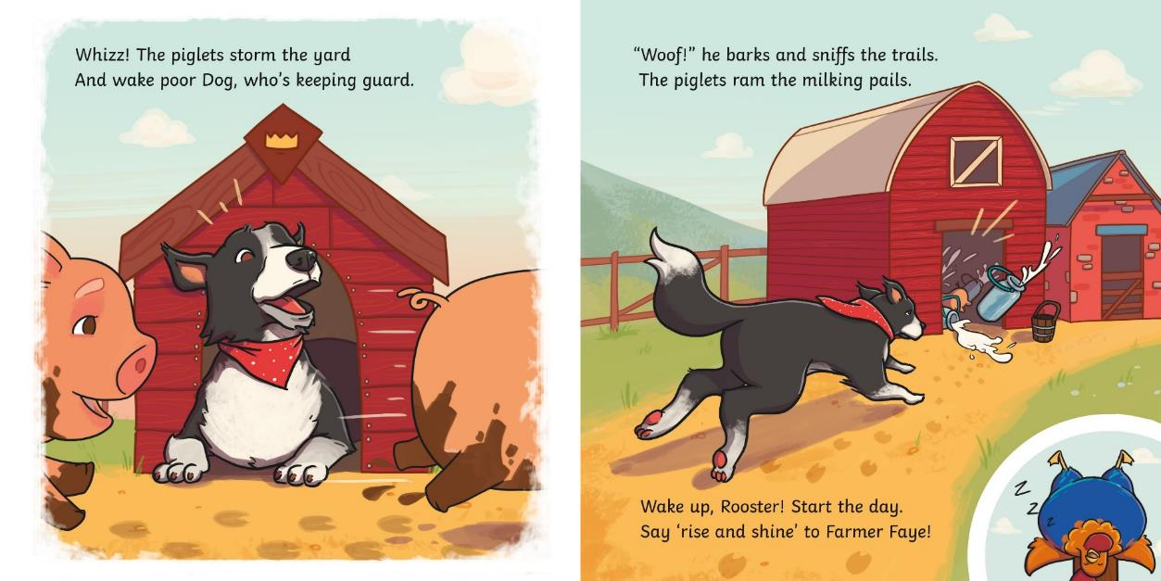
?
Who is still asleep?

Slide 11
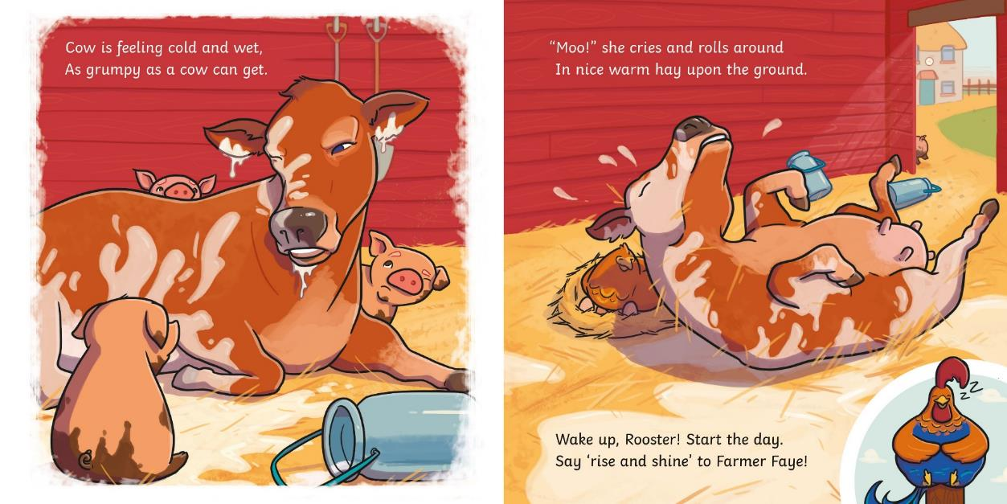
?
How did Cow get ‘cold and wet’?

Slide 12
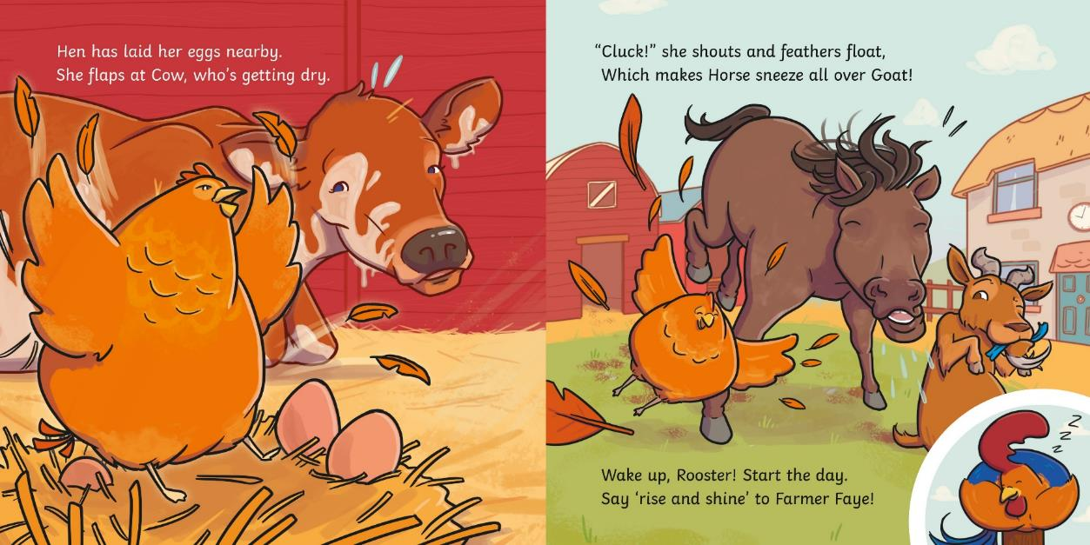
?
What do you think might happen next?

Slide 13
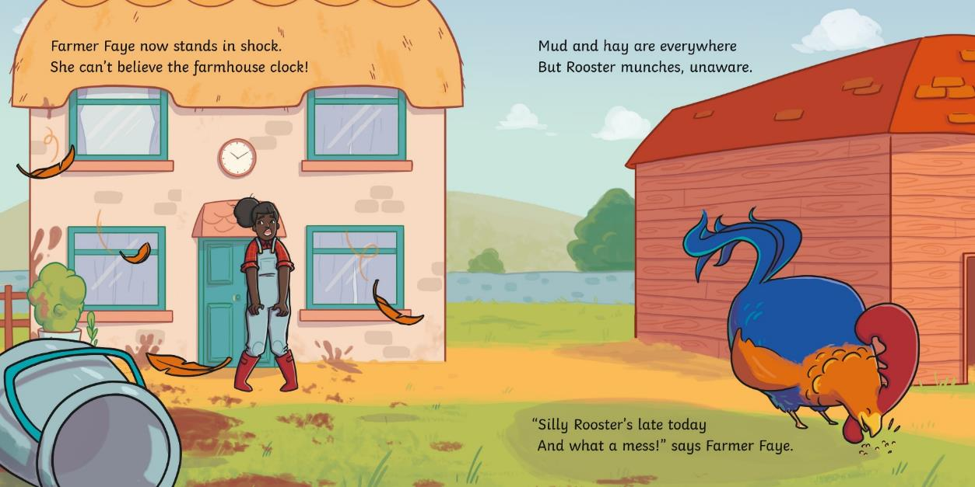
?
What can Farmer Faye see? Why is she shocked?

Slide 14
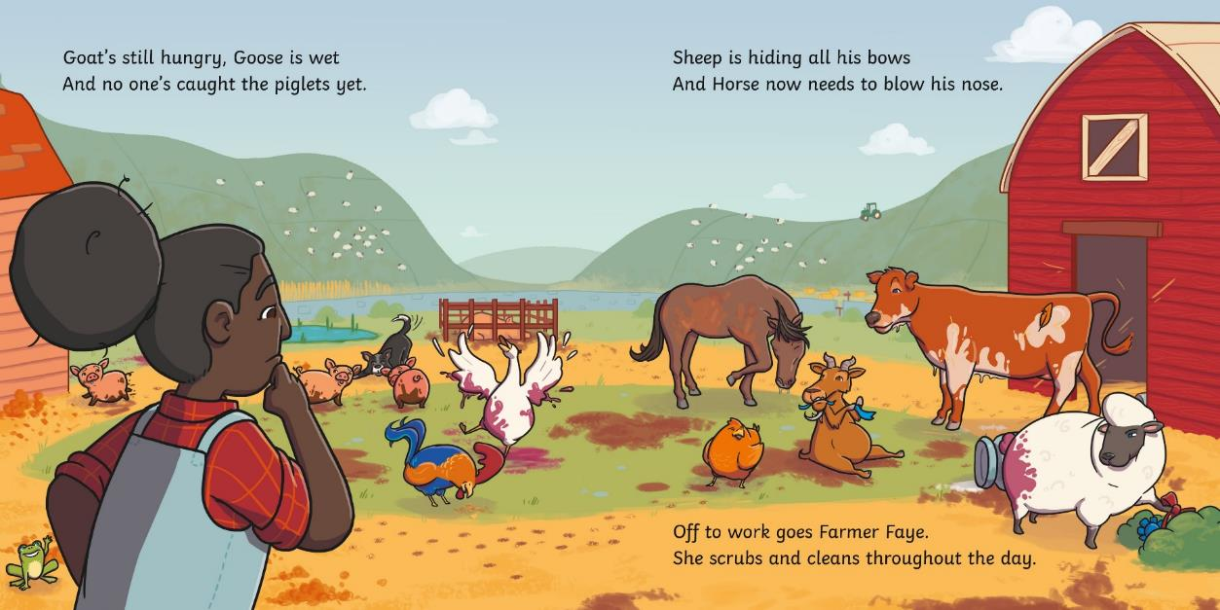
?
Do you think the problem will get solved? Do you think this story will have a happy ending?

Slide 15
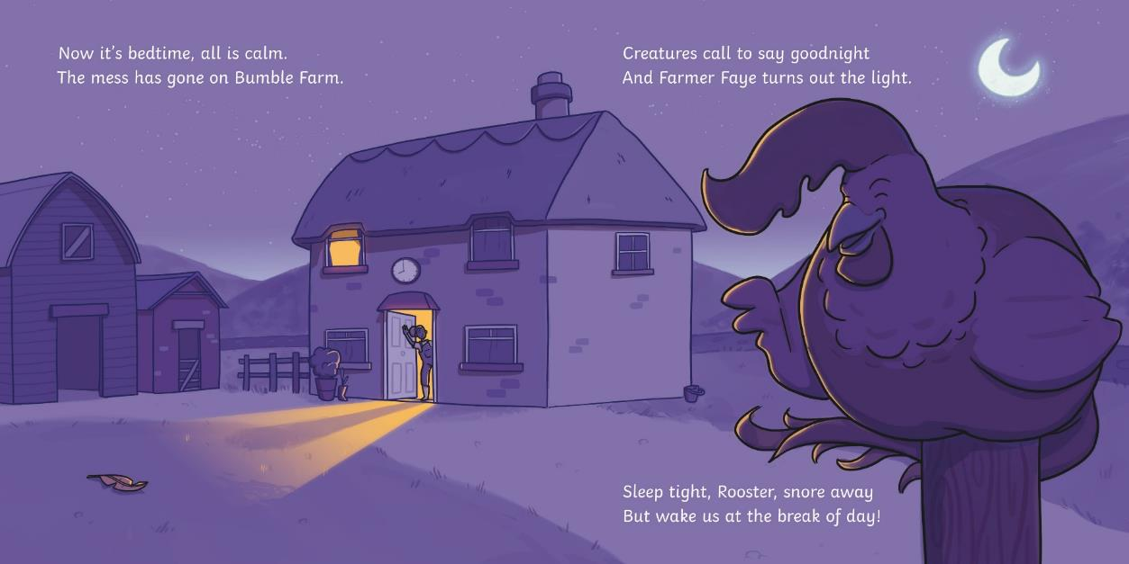
?
Do you think Rooster will wake everyone up on time tomorrow?

Slide 16
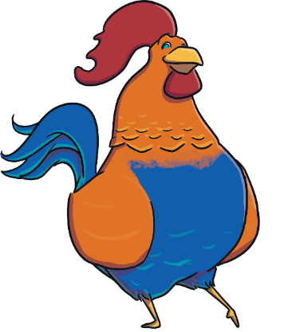
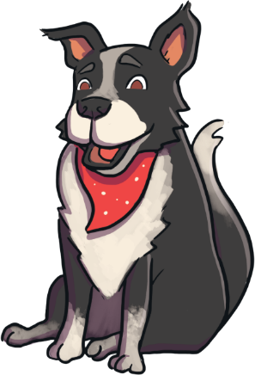
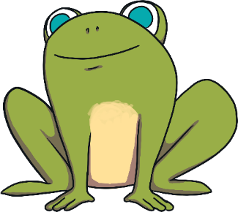
?
Who is the main character in this story?
Rooster
Frog
Dog

Slide 17
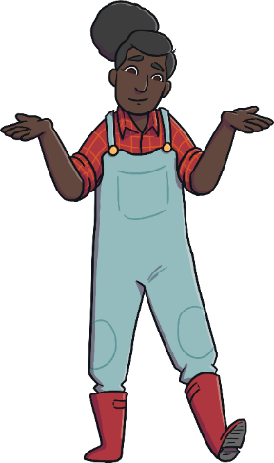
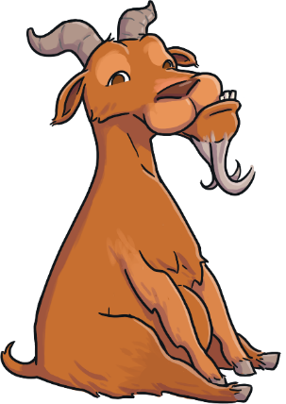
?
Who wakes up first?
Farmer Faye
Rooster
Goat

Slide 18
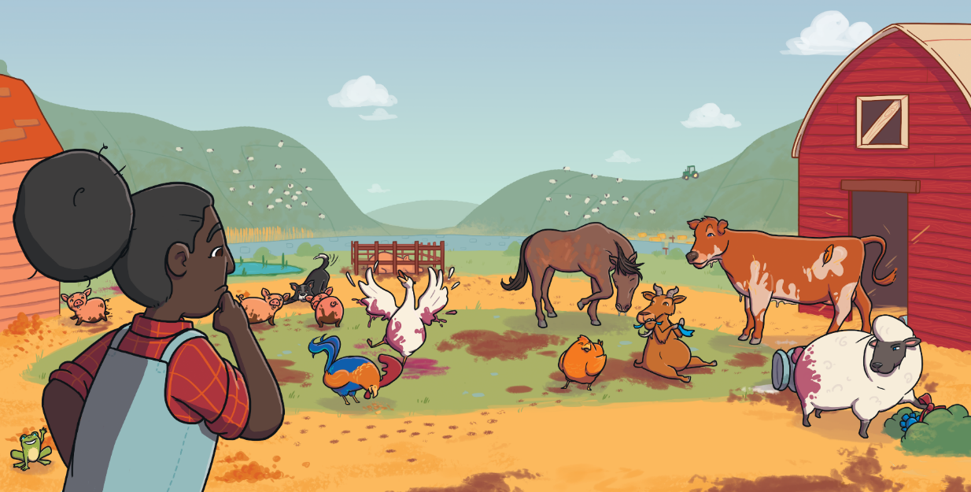
?
Why do all of the animals get into such a mess?

Slide 19
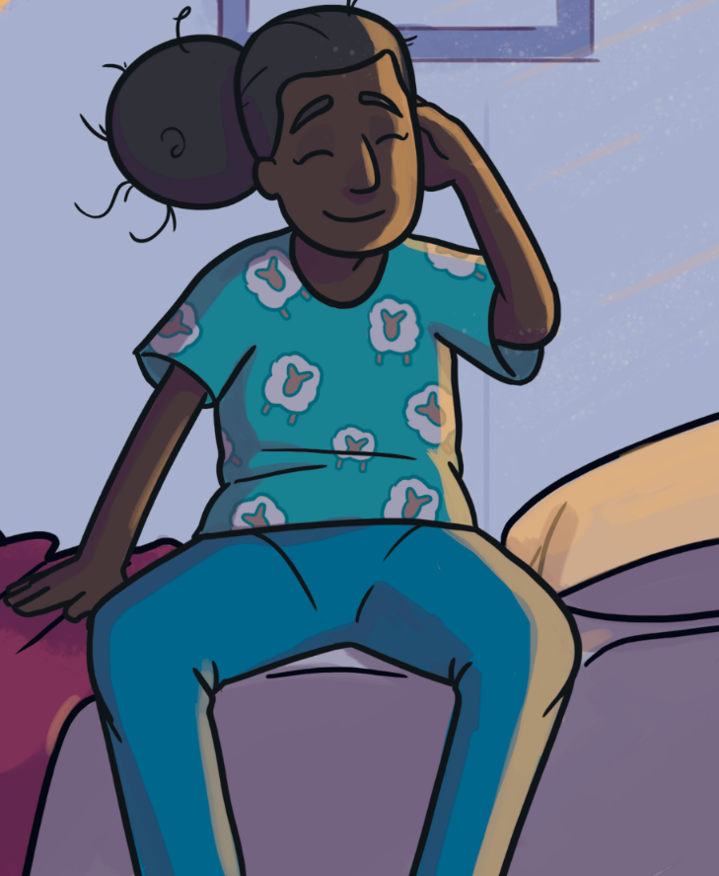
?
Have you ever overslept before? What happened?
?
Have you got any good ideas for waking up on time?

Slide 20
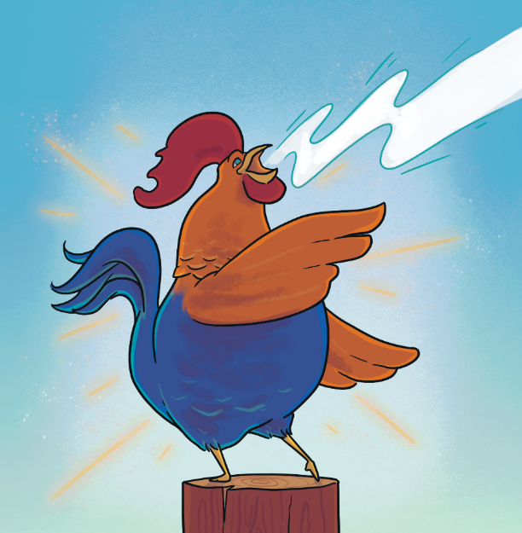
?
Do you think Rooster overslept on purpose? Why do you think that?

Slide 21
?
Choose three adjectives that best describe this book:
scary
sad
serious
funny
colourful
silly
confusing
exciting
interesting
boring
hilarious
enjoyable
magical
entertaining
mysterious
realistic
romantic
?
Why did you choose those words?

