Slide 2
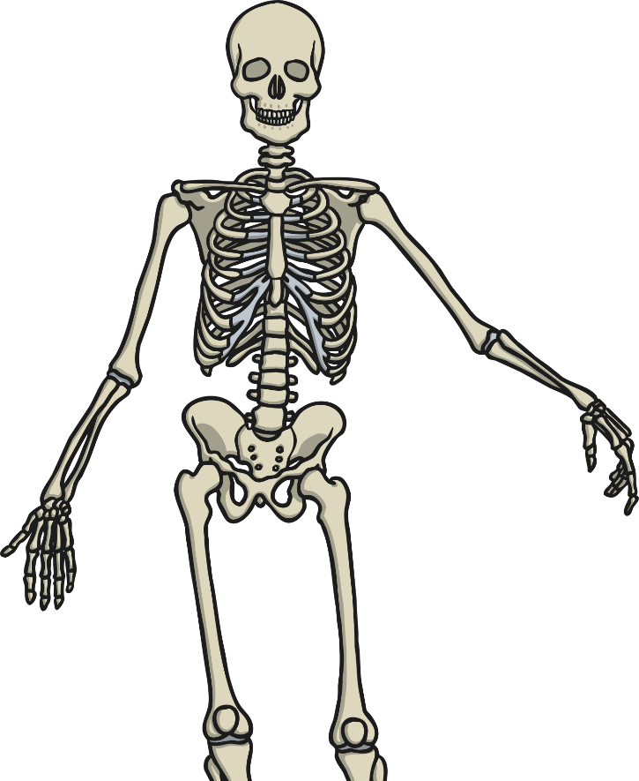
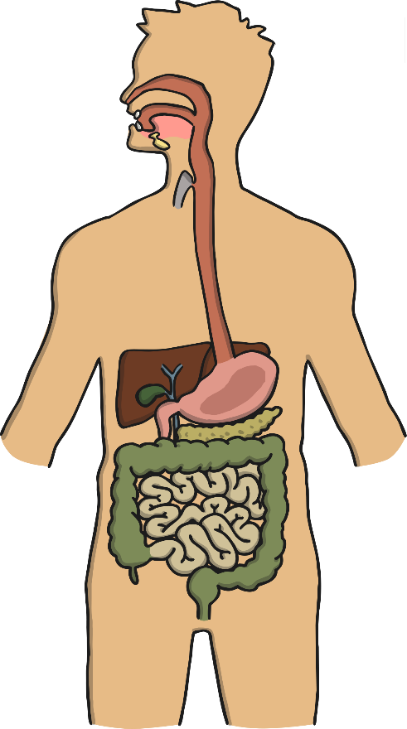
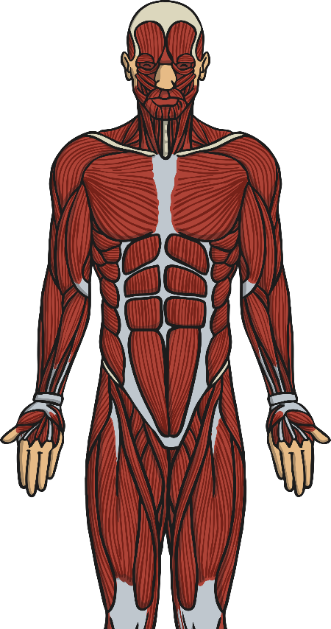
Systems in the Body: a Reminder
In Years 3 and 4, you may have learnt about a number of different systems in the body. We’re going to begin by seeing how much you remember!
On a piece of paper brain storm the systems you remember.

Slide 3
Did you remember these 3?
digestive
skeletal
muscular

Slide 4
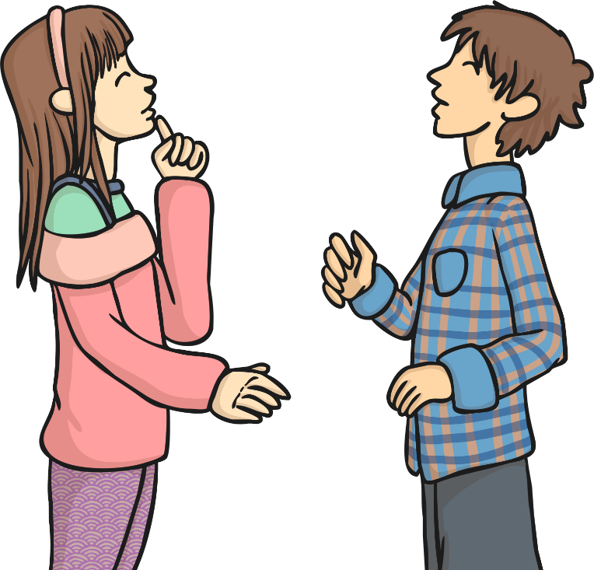
Systems in Your Body
We have just reminded ourselves about the skeletal, muscular and digestive systems in the body.
Do you know any other systems in the body?

Slide 5
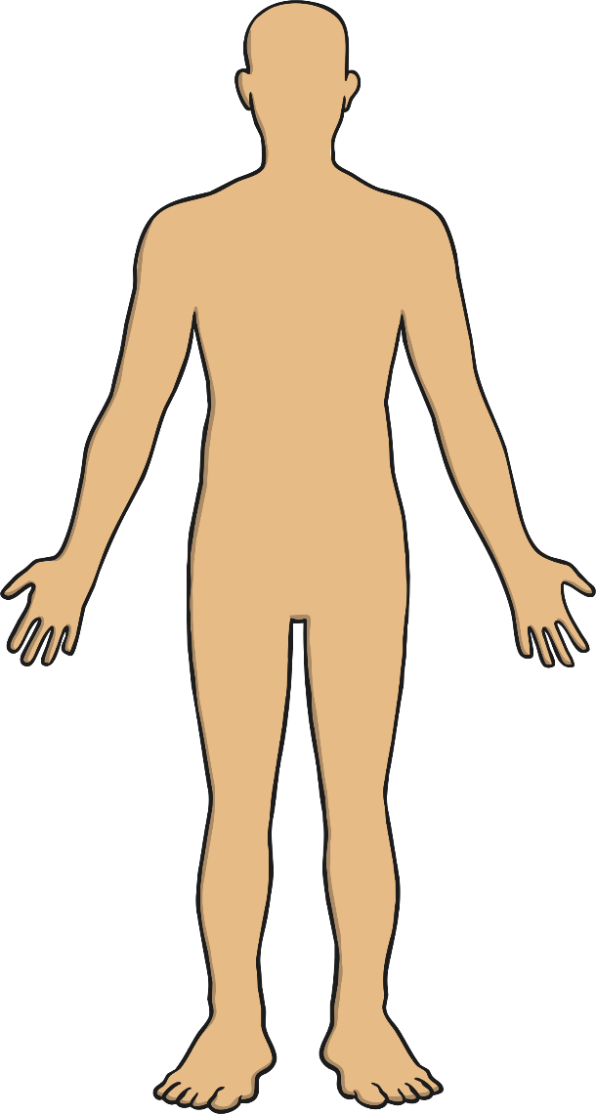
Systems in Your Body
The system we will look at for the rest of this lesson is called the:
‘Circulatory System’.
The word circulation means ‘the movement to, fro or around something’.
Have a little think:
What does the system do?
What are the parts of the system?

Slide 6
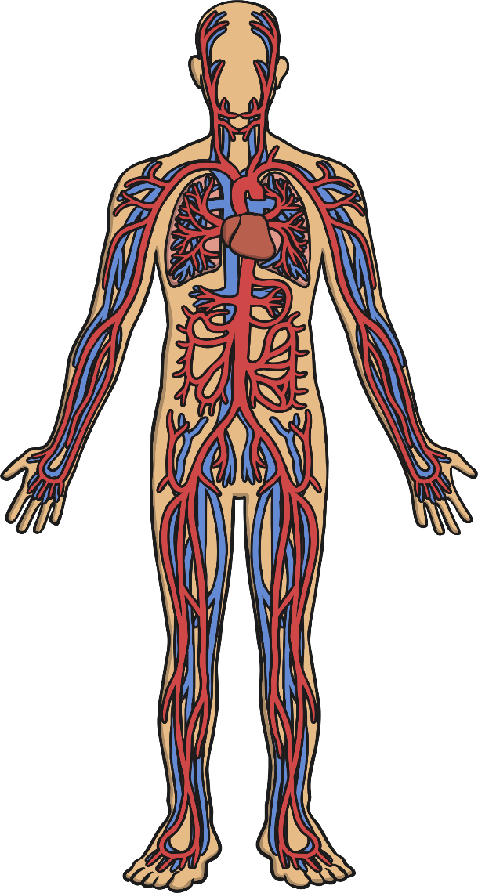
The Circulatory System
What can you see?
Is this what you expected?
Are there parts you did not expect to be in the circulatory system?

Slide 7
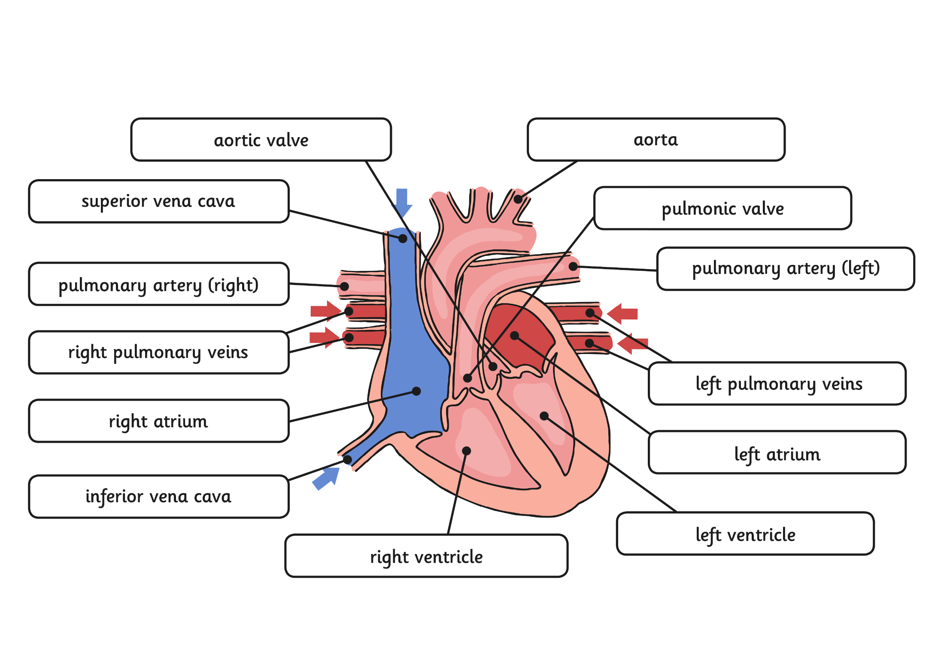
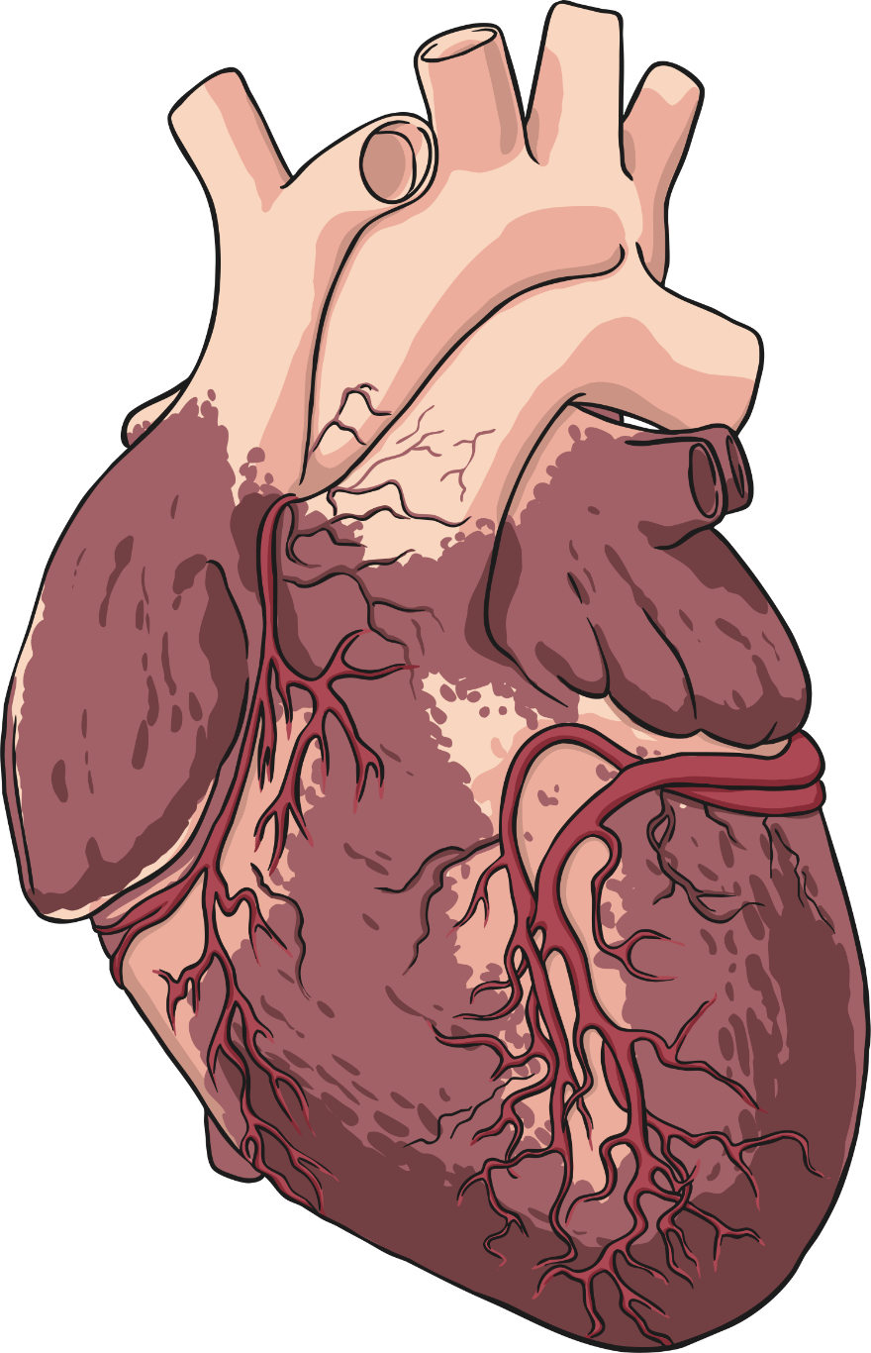
Parts of the Circulatory System: Heart
The heart is a powerful organ that is situated between your lungs and protected by the ribcage.
The heart pumps blood to the lungs to get oxygen.
The heart then pumps this oxygenated blood around the body.
The heart is split between the left and right side.
As you can see, it consists of many parts!
Click me for a larger version!
Click anywhere to hide.
Click me for a larger version!
Click anywhere to hide.

Slide 8
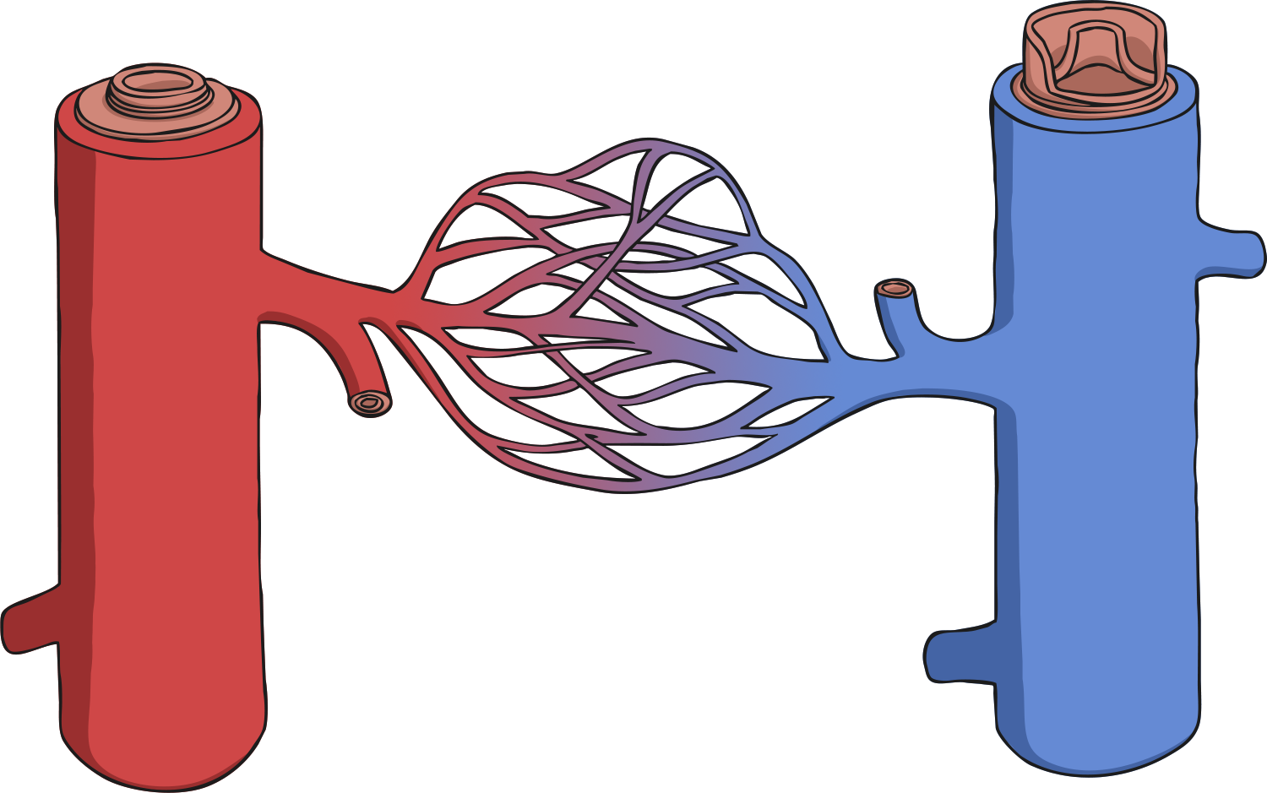
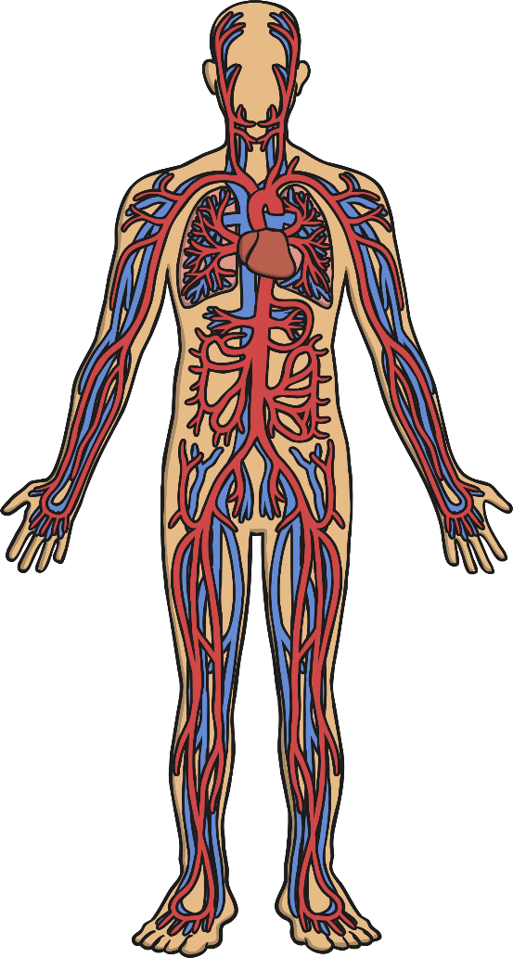
Parts of the Circulatory System: Blood Vessels
vein
artery
capillaries
Blood vessels can be split into three types:
Arterial blood vessels - arteries:
Arteries are blood vessels that carry blood away from the heart.
Venous blood vessels - veins:
Veins are blood vessels that carry blood to the heart.
Capillaries:
These are the smallest blood vessels. Capillaries connect the arteries and the veins and are the place where water and chemicals exchange in the blood.
Click anywhere to hide.
Click here for a diagram that shows how the three blood vessels are linked.

Slide 9
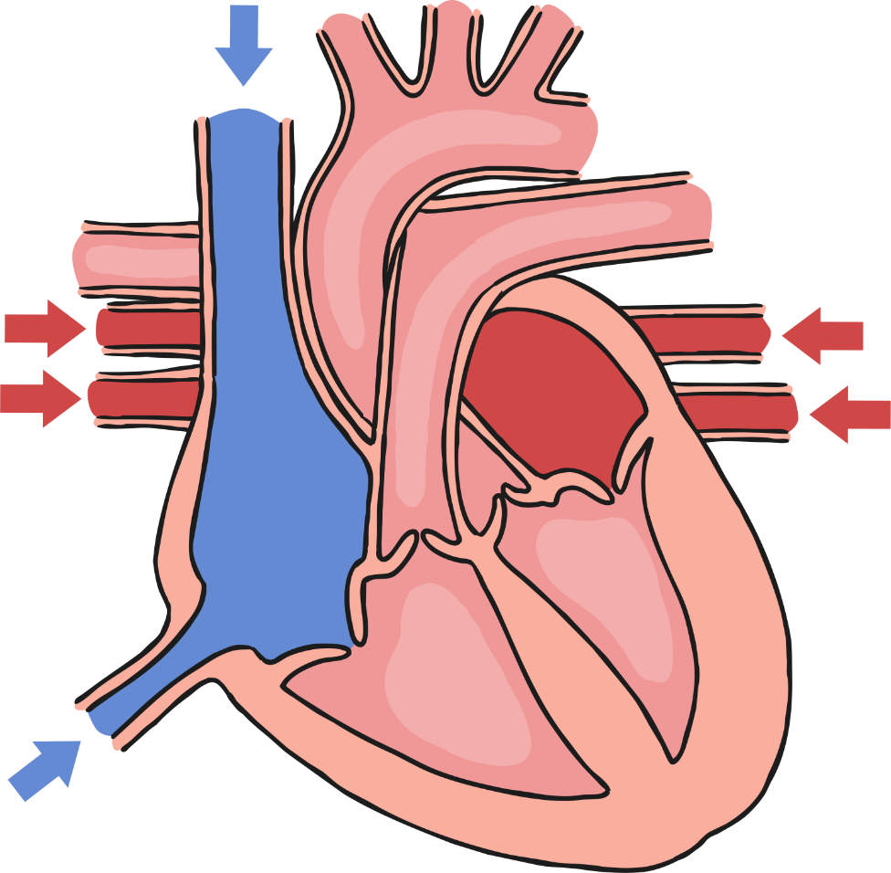
The Circulatory System: Heart
1
2
3
4
5
6
7
8
9
10
11
12
13
Superior vena cava
Inferior vena cava
Left ventricle
Right ventricle
Pulmonic valve
Pulmonary artery (right)
Pulmonary artery (left)
Right atrium
Left atrium
Aortic valve
Aorta
Right pulmonary veins
Left pulmonary veins
11
1
10
7
6
12
13
9
5
8
3
2
4

Slide 10
Parts of the Circulatory System
Can you label the different parts of the heart?

Slide 11
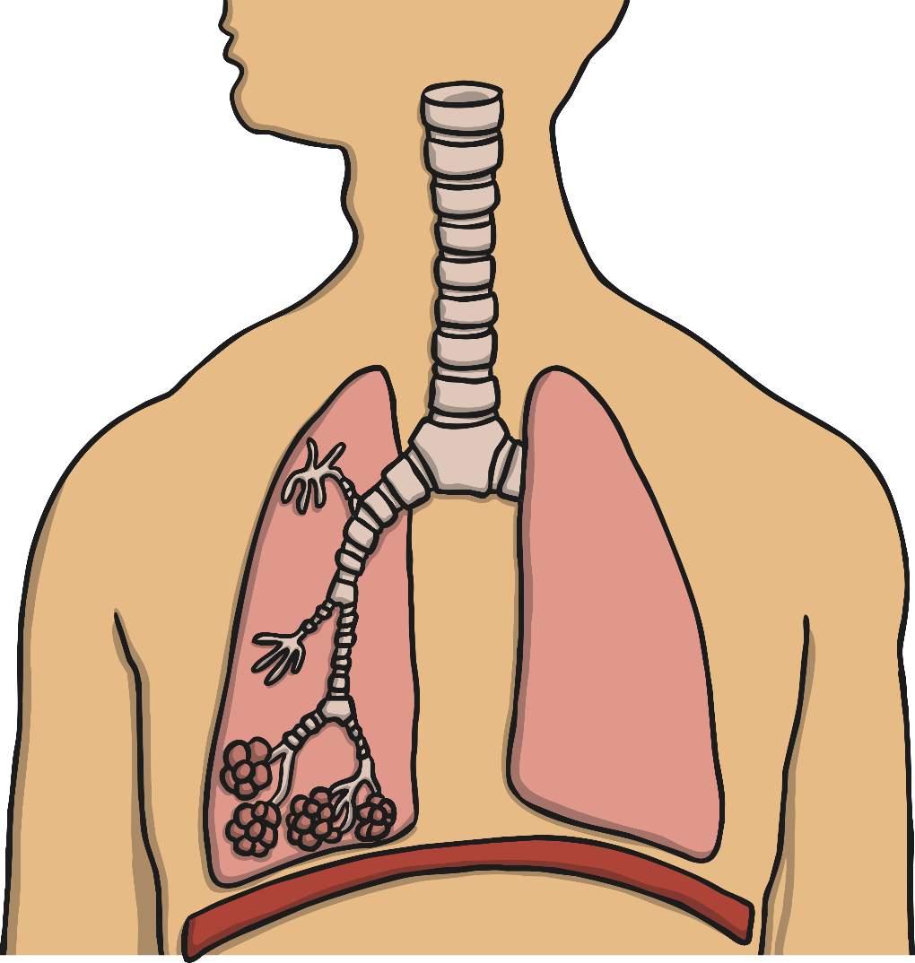
The Circulatory System: Lungs
Diaphragm
Trachea
Bronchus
Air sacs (alveoli)
Bronchiole
Trachea
Bronchiole
Bronchus
Air sacs
(alveoli)
Diaphragm

Slide 12
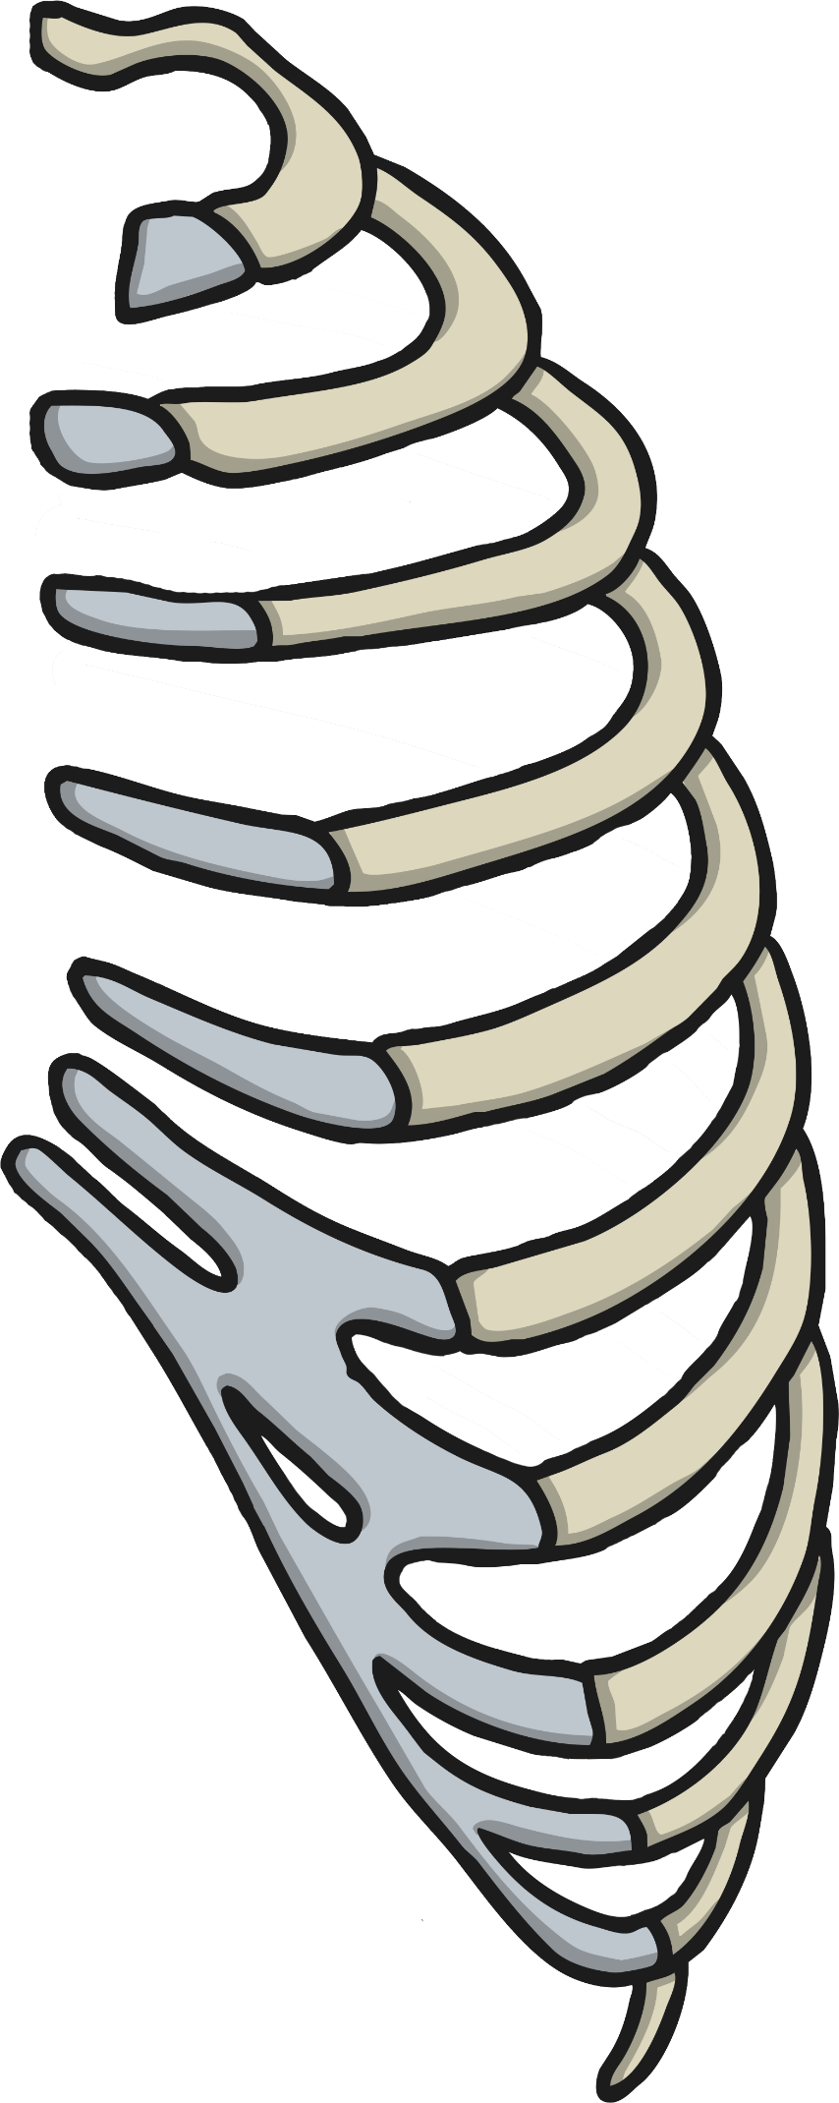
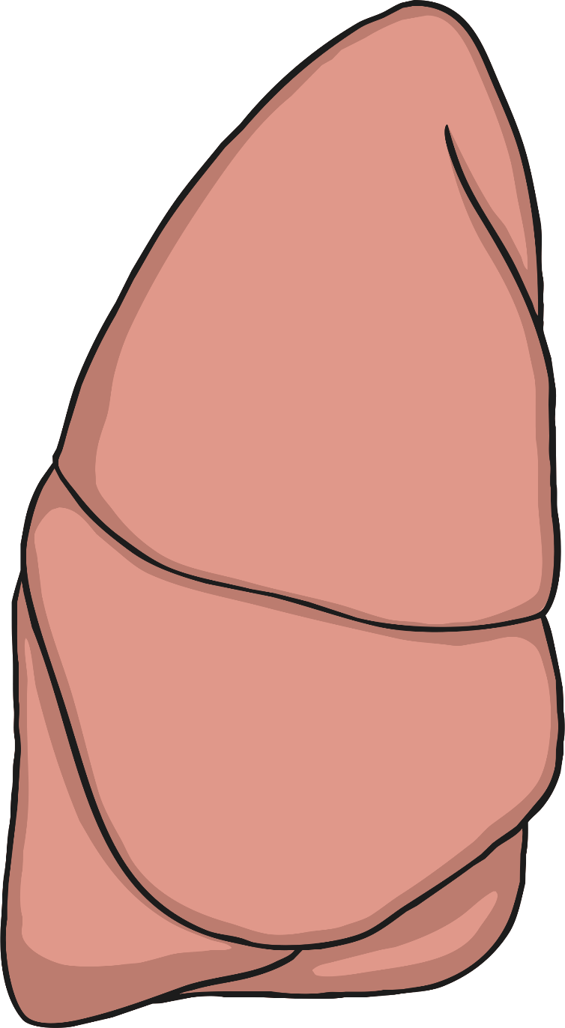
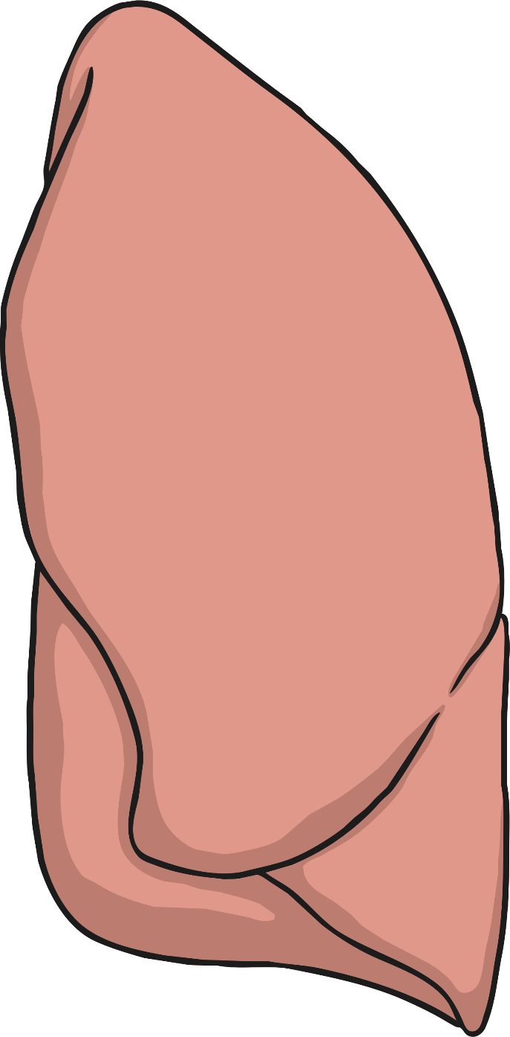

Slide 13
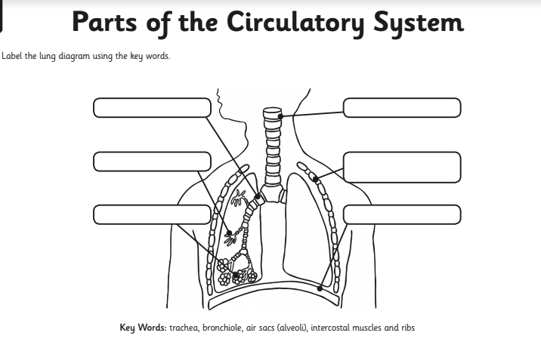
Parts of the Circulatory System
Can you label the different parts of the lungs?

